Slide 1


Cosmic Ray Vocabulary
Nathan Unterman
University of New Mexico 26.July.2022

Slide 2
Question | Team
1, 2 | Brie and Jeff
3, 4 | Tim and Sarah
5, 6, 11 | Ken and Bill
7, 8 | Philip and Carlos
9, 10, 14 | Connie and Turtle
12, 13 | Lexi and Tom

Slide 3
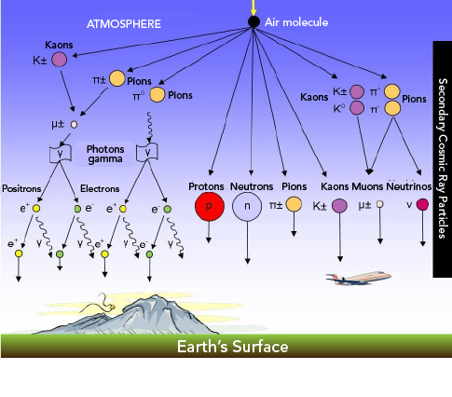
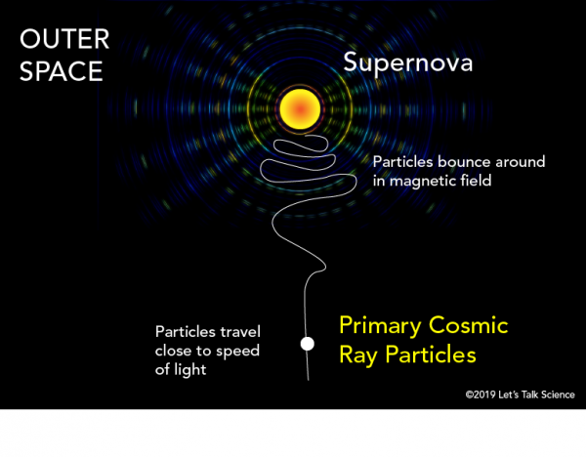

Slide 4
flux
Flux describes the number of muons that pass or travel through a surface (area) per unit time.

Slide 5
Relativity
Mass
Time
Length

Slide 6
Half-life VERSUS Lifetime
Half-life is the time required for a quantity to reduce to half of its initial value. The term is commonly used in nuclear physics to describe how quickly unstable atoms undergo radioactive decay or how long stable atoms survive.
Lifetime is the amount of time a particle takes to decay in the process of one unstable subatomic particle transforming into multiple other particles.

Slide 7
Coincidence and trigger
Recording an event when at least two counters have indicated a hit within a gate.
  Importance is to reduce the number of stray events.
Trigger rate is the rate of events.

Slide 8
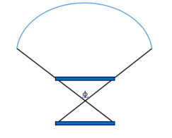
Angle of Acceptance

Slide 9
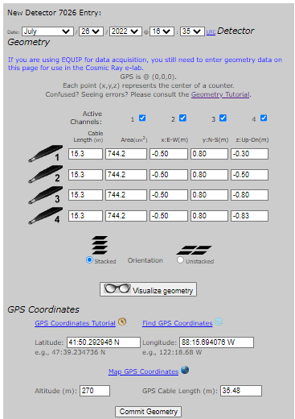

Slide 10
Stack Array

Slide 11
Gate Width

Slide 12
A nanosecond (ns or nsec) is one billionth (10⁻⁹) of a second.
0.000000001 seconds.
Notes:
Light goes about 34 cm in a nanosecond. Talk about speed of light.

Slide 13
Muon speed
Time of Flight tool
  Need geometry
  Plot on graph paper.
Time of flight can be used for counts, angle of acceptance, . . .

Slide 14
Blessing Data
How is the detector doing
  Individual rates
  Trigger rates
  Satellites
  Voltage
  Temperature
  Pressure

Slide 15
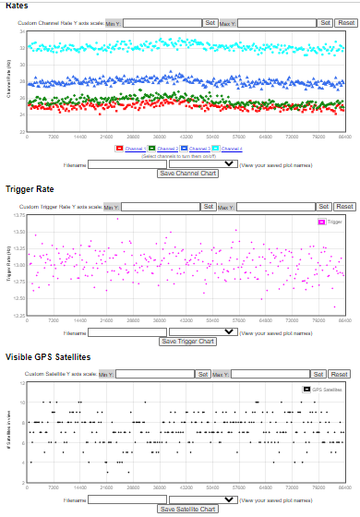

Slide 16
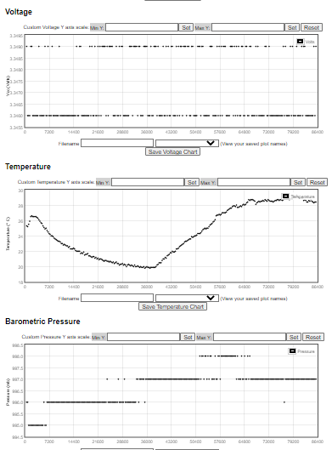

Slide 17
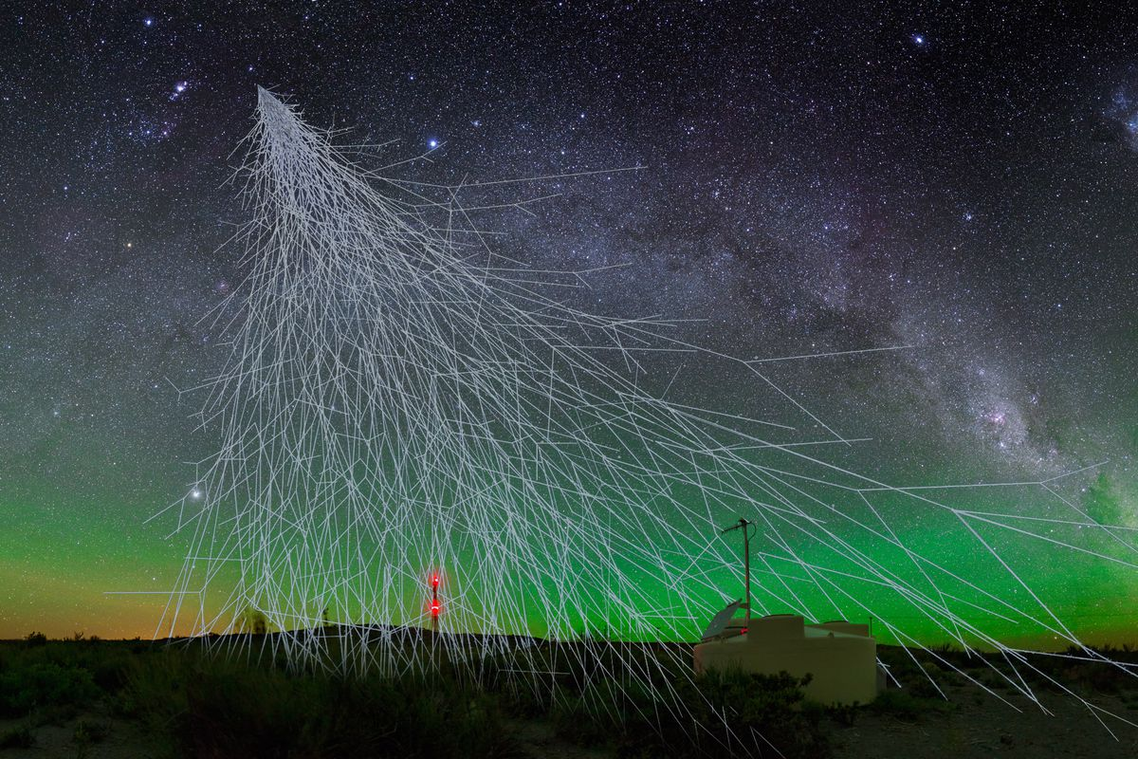

Slide 19
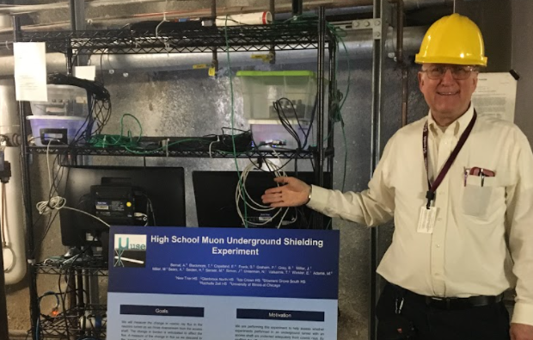
Contact
Nathan Unterman
nunterman@gmail.com
773 758-0464

