Slide 1


CRMD Counting Studies Without eLab
Nathan Unterman
university of new mexico July 2022

Slide 2
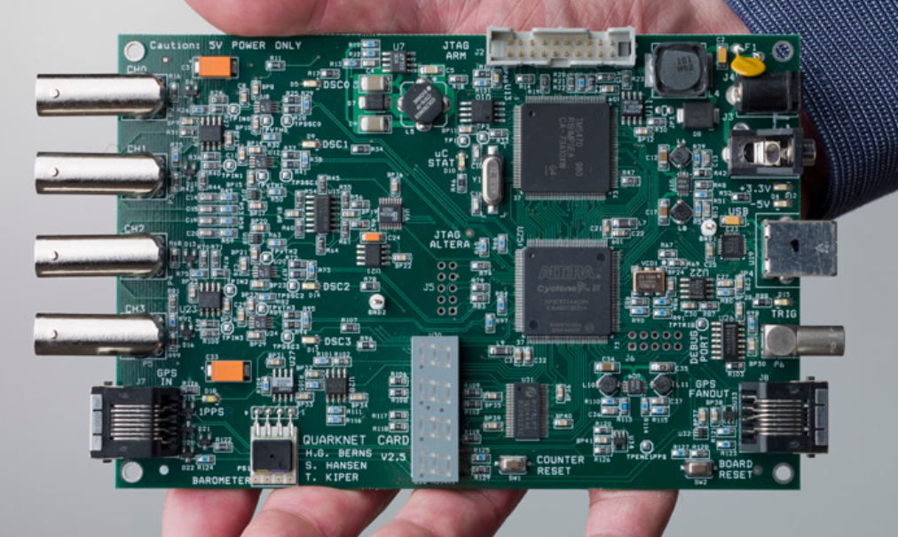
Stopwatch and DAQ Counter
Notes:
Use phone app for stopwatch.

Slide 3
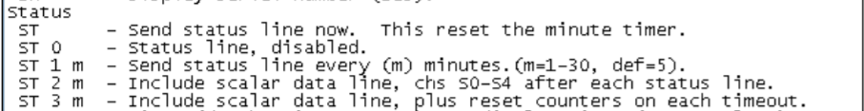
Change Status Line in EQUIP
From H2 on command line in EQUIP (Help Menu 2)

Slide 4
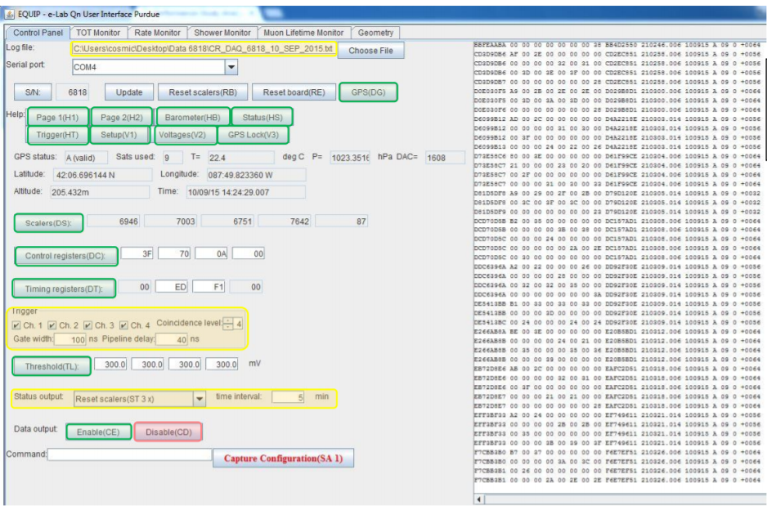

Slide 5
EQUIP Settings
Coincidence Level should be the number of counters you are using. This is a specific parameter for counting studies without eLab.
Gate Width: 300 ns Pipeline Delay 100 ns (should be regular settings)
Status Output: ST 2 n (Local counting studies. Regular use: ST 3 5)
  n is the interval in minutes for report.

Slide 6
CAUTION: Roll Over
4 minute run sample
  Estimate 24 hour count. Does it exceed counter limits?
Notes:
Consider the Status Line report as a possible help.

Slide 7
Types of Studies
Triangle Shower
Angle Acceptance
Shielding (can be tricky)
Zenith Angle (cos²θ)
E-W N-S

Slide 8
Triangle Shower Study
Notes:
Equilateral triangle. Problems with using squares. You may need to consider a stretch of 30 minutes as a common count interval.

Slide 9
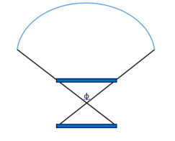
Angle of Acceptance

Slide 10
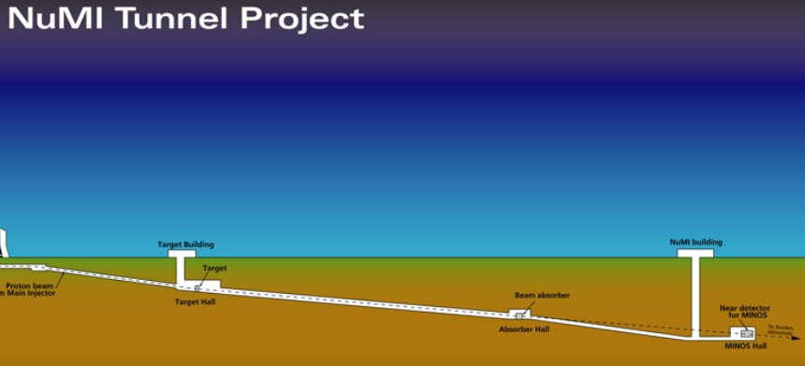
Shielding
Depth in building
  Careful of walls!
Copper or steel (lead, uranium) plates
Tunnels

Slide 11
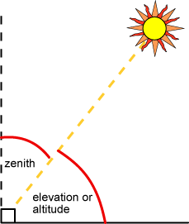
Directional Studies
Angle from Zenith
North – South versus East – West
Notes:
Latitude studies can be done with other Quarknet Groups.

Slide 12
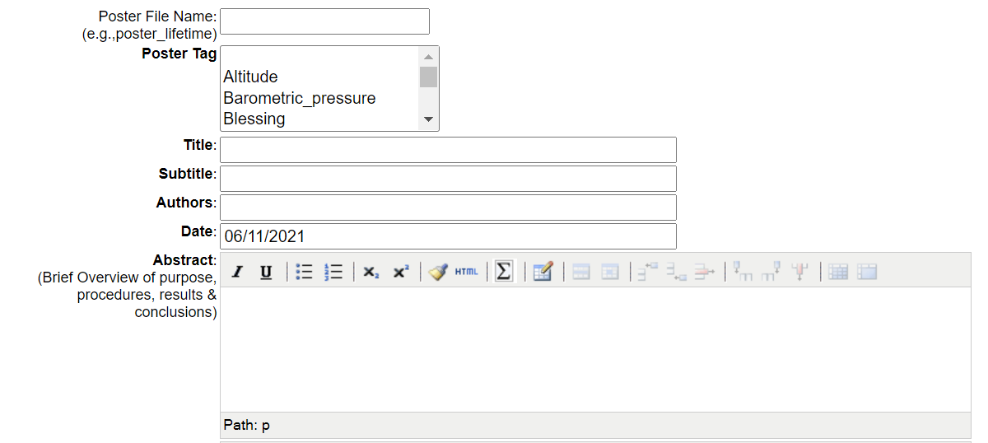
Poster

Slide 13
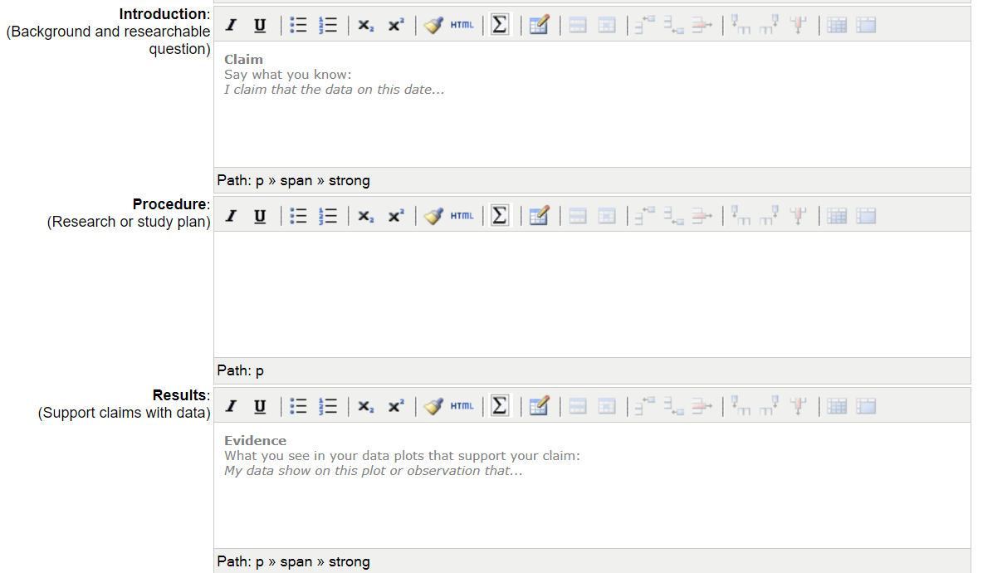

Slide 14
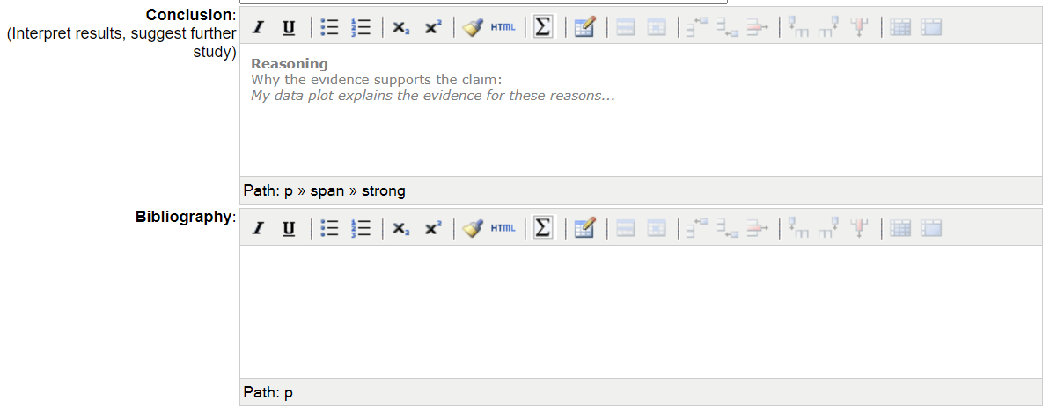

Slide 15
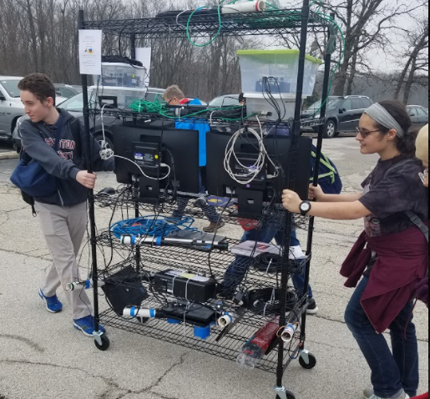
Questions?

Slide 16
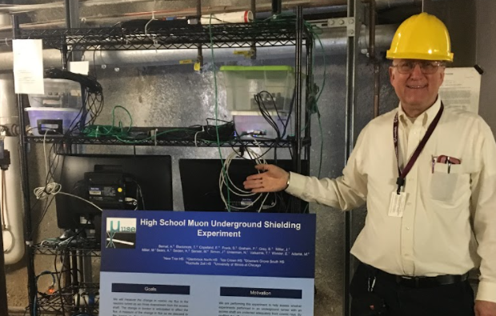
Contact
Nathan Unterman
nunterman@gmail.com
773 758-0464

