Slide 1
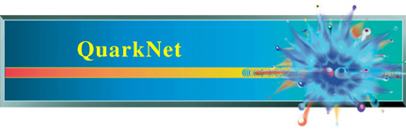

Using eLab Without a Detector
Nathan Unterman
University of New Mexico JULY 2022

Slide 2
Golden Files
How to find
  Correct Tools
  Geometry
  Blessing Charts
Classroom Strategies
Differentiated learning

Slide 3
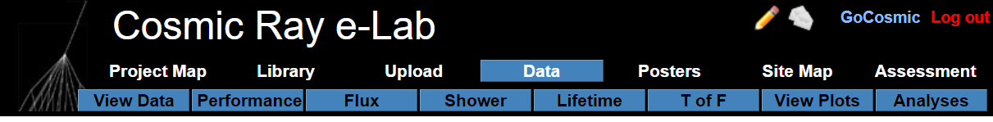
Tools
Geometry
Note: If you cannot directly get the geometry of a specific file, it can be seen from the Blessing Chart for that file.

Slide 4
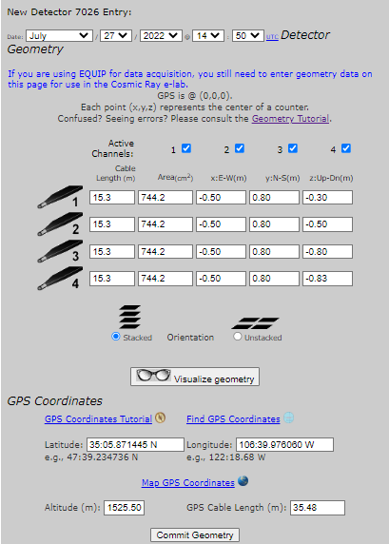

Slide 5
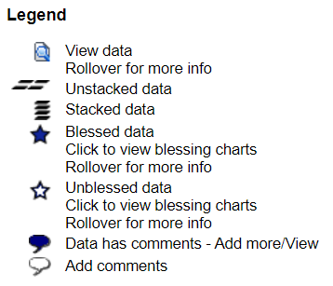
Blessing Files and Path to Geometry

Slide 6
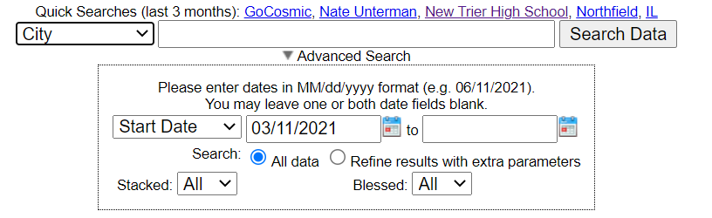
File Search
The Drop Down menu has selections for DAQ and Date

Slide 7
Available Files
Time of Flight
Angle of Acceptance
Shower Triangle Study
Lifetime
Shower Study 3.8 km Separation
Speed of Muon
Long Range Studies
Barometric Pressure Studies

Slide 8
Time of Flight and Angle of Acceptance
Experiment | Experiment | DAQ | Date | Geometry | Position Channel 1 (m) | Position Channel 2 (m) | Position Channel 3 (m) | Position Channel 4 (m) | Coincidence | Gate (ns) | Pipeline (ns) | Comment
Time of Flight | Angle of Acceptance | 6200 | 12.September.2019 -3 | Stacked | 0.04 | -0.87 | -1.64 | -1.67 | 2 | 300 | 100 | Barometer not reliable
Time of Flight | Angle of Acceptance | 6200 | 13.September.2019 | Stacked | 0.04 | -0.87 | -1.64 | -1.67 | 2 | 300 | 100 | Barometer not reliable
Time of Flight | Angle of Acceptance | 6200 | 14.September.2019 | Stacked | 0.04 | -0.87 | -1.64 | -1.67 | 2 | 300 | 100 | Barometer not reliable
Time of Flight | Angle of Acceptance | 6200 | 15.September.2019 | Stacked | 0.04 | -0.87 | -1.64 | -1.67 | 2 | 300 | 100 | Barometer not reliable
Time of Flight | Angle of Acceptance | 6200 | 16.September.2019 -0 | Stacked | 0.04 | -0.87 | -1.64 | -1.67 | 2 | 300 | 100 | Barometer not reliable
Time of Flight | Angle of Acceptance | 6200 | 16.September.2019 -1 | Stacked | 0.04 | -0.87 | -1.64 | -1.67 | 2 | 300 | 100 | Barometer not reliable

Slide 9
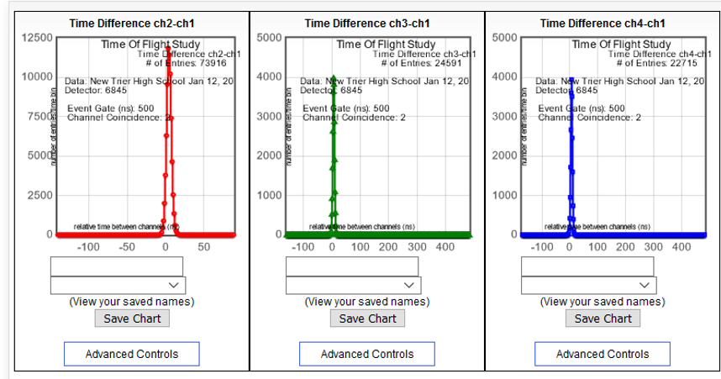

Slide 10
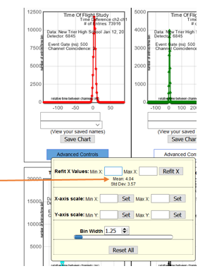

Slide 11
Angle of Acceptance Analysis
24-hour files only |  | angle acceptance = tan⁻¹((side/2)/(channel separation/2))*2
NOT corrected for pressure |  | angle acceptance = tan⁻¹((0.26/2)/(channel separation/2))*2
 | Channel pair | 1-2 | 1-3 | 1-4 | 2-3 | 2-4 | 3-4 | 1-2-3-4
 | Separation (meters) | 0.824 | 1.68 | 1.71 | 0.856 | 0.859 | 0.03 | 1.71
 |  | Number of Events for (Counter Pair) Angle of Acceptance
Date | DAQ | (1-2) 35.0⁰ | (1-3) 17.6⁰ | (1-4) 17.3⁰ | (2-3) 33.8⁰ | (2-4) 33.7⁰ | (3-4) 166.8⁰ | 17.3⁰ |  | Column E - I
13.Sept.2019 | 6200 | 58231 | 19049 | 17552 | 80896 | 71747 | 835224 | 15189 |  | 2363
14.Sept.2019 | 6200 | 57692 | 19070 | 17526 | 80208 | 71162 | 834085 | 15246 |  | 2280
15.Sept.2020 | 6200 | 58237 | 19271 | 17744 | 81205 | 71745 | 837186 | 15451 |  | 2293
17.Sept.2019 | 6200 | 57898 | 19144 | 17575 | 80434 | 71168 | 834965 | 15298 |  | 2277
18.Sept.2019 | 6200 | 57688 | 19077 | 17561 | 81210 | 71542 | 834466 | 15201 |  | 2360
20.Sept.2019 | 6200 | 55889 | 18888 | 17360 | 80395 | 71322 | 835586 | 15123 |  | 2237
21.Sept.2019 | 6200 | 55655 | 18701 | 17276 | 80445 | 71582 | 835501 | 15059 |  | 2217

Slide 12
Angle of Acceptance

Slide 13
Speed of Muon
20.Sept.2019 |  | DAQ 6200
Counter Pair | Time (s) | Spacing (m)
1 – 2 | 3.52E-09 | 0.91 |  |  |  |  |  |  | v | 2.78E+08
1 - 3 | 6.07E-09 | 1.68
1 - 4 | 6.02E-09 | 1.71
2 - 3 | 2.77E-09 | 0.77
2 - 4 | 2.75E-09 | 0.8
3 - 4 | 2.00E-11 | 0.03

Slide 15
Shower Triangle Study
Indoor Study |  |  |  |  |  |  |  | All need to normalize by duration
Experiment | DAQ | Date | Time Duration | Geometry | Side Length (m) | Events | Coincidence | Comment
Shower Triangle | 6690 | 06.September.2015 | 14:34 | Stack | 0.00 | 38988 | 3
Shower Triangle | 6690 | 04.November.2015 | 0:56 | Array | 0.50 | 442 | 3
Shower Triangle | 6690 | 04.November.2015 | 12:58 | Array | 1.00 | 108 | 3
Shower Triangle | 6690 | 04.November.2015 | 17:00 | Array | 1.50 | 99 | 3
Shower Triangle | 6690 | 04.November.2015 - 05.November.2015 | 22:29 | Array | 2.00 | 37+ 274 | 3 | Crosses midnight UTC

Slide 16
Muon Lifetime
DAQ | Date | Configuration | Position Channel 1 (m) | Position Channel 2 (m) | Position Channel 3 (m) | Position Channel 4 (m) | Coincidence | Gate Width (seconds) | Bins | Lifetime (μS) | Comments
6234 | 21.December.2017 | Stacked | 0.12 | 0.1 | x | 0 | 1 | 1.00E-05 | 40 | 2.1 | Run under OLD program
6234 | 22.December.2017 | Stacked | 0.12 | 0.1 | x | 0 | 1 | 1.00E-05 | 40 | 2.25 | Run under OLD program
6234 | 23.December.2017 | Stacked | 0.12 | 0.1 | x | 0 | 1 | 1.00E-05 | 40 | 2.24 | Run under OLD program
6234 | 24.December.2017 | Stacked | 0.12 | 0.1 | x | 0 | 1 | 1.00E-05 | 40 | 1.99 | Run under OLD program
6234 | 25.December.2017 | Stacked | 0.12 | 0.1 | x | 0 | 1 | 1.00E-05 | 40 | 2.36 | Run under OLD program
6234 | 26.December.2017 | Stacked | 0.12 | 0.1 | x | 0 | 1 | 1.00E-05 | 40 | 2.06 | Run under OLD program
6234 | 27.December.2017 | Stacked | 0.12 | 0.1 | x | 0 | 1 | 1.00E-05 | 40 | 2.29 | Run under OLD program

Slide 18
Shower Study 3.8 km Separation
DAQ | Date | Configuration | DAQ | Date | Configuration
6200 | 07.February.2020 | Stacked | 6845 | 07.February.2020 | Stacked
6200 | 08.February.2020 | Stacked | 6845 | 08.February.2020 | Stacked
6200 | 09.February.2020 | Stacked | 6845 | 09.February.2020 | Stacked
6200 | 10.February.2020 -0 | Stacked | 6845 | 10.February.2020 -0 | Stacked
6200 | 10.February.2020 -1 | Stacked | 6845 | 10.February.2020 -1 | Stacked
6200 | 11.February.2020 | Stacked | 6845 | 11.February.2020 | Stacked

Slide 19
Barometric Studies
Any stacked file lends itself to barometric studies
Days may be concatenated together under Flux study. Barometer tool will show concatenated Blessing Charts.

Slide 20
Classroom Strategies
In most studies, enough files for individualized assignment
Simple studies, such as speed of muons, taking averages
  More complex with histograms
  Outlier error analysis
  Differentiated Instruction possibilities
Multiple sections of course can build analysis cooperatively
Poster writing
Reflection and metacognition of process
More difficult problems, such as shower study at 3.8 km available for enrichment
What else can be asked of the data set?

Slide 21
Other Studies
Might Lunar Shadow be buried within the data set?
Severe weather
. . . Only limited by imagination

Slide 22
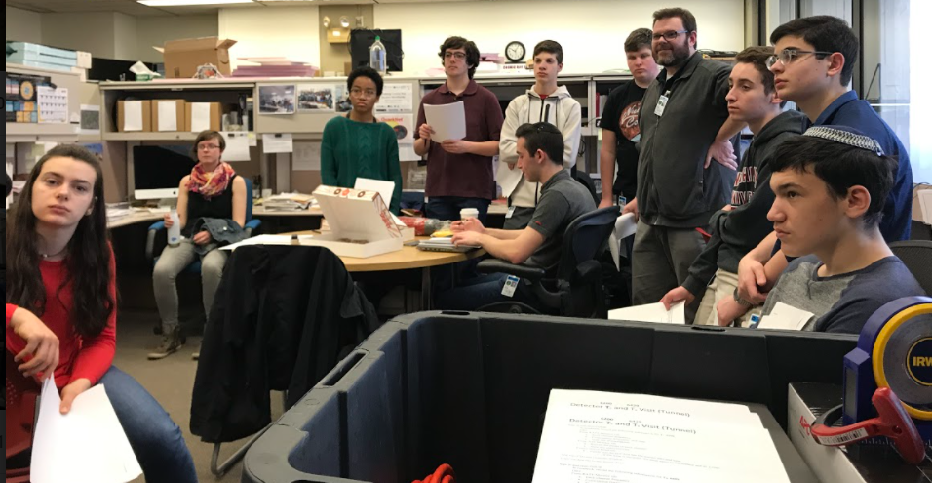
Questions?

Slide 23
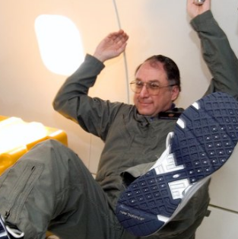
Contact
Nathan Unterman
nunterman@gmail.com
773 758-0464

