Slide 1


Introduction to eLab
Nathan Unterman
University of New Mexico 27.JULY.2022

Slide 2
Upload
Upload
  If you are uploading a data file. Select detector, file, and place any comments.
Geometry
  This is where you can create, update, and view YOUR geometry

Slide 3
Data -- Flux
If your birthDAY is an odd number:
  School New Trier High School
  Select 8-14 June 2022 DAQ 6906
  Run flux study, channel 2 Make bin width 30 minutes. Rerun, but start graph at a flux (y-axis) of 2500.
  Rerun, but for a bin size of 10 minutes.
If your birthDAY is an even number:
  School New Trier High School
  Select the first 7 (seven) days of May, DAQ 6906
  Run flux study, channel 3 with a bin width of 60 minutes. Comment on 3.May.2022
  Rerun, but start graph at a flux (y-axis) of 8000.
Notes:
30.Feb birthday: even 25.Tevet birthday: odd
Did you check the blessing charts?
Show advanced like concatenated blessing and barometer study.

Slide 4
Triangle Shower
What do we want to know?
Notes:
Events versus side length

Slide 5
∆ Shower Experiment Design
How will we analyze the data?
What do we need to look for?
Notes:
Events per unit time.

Slide 6
∆ Shower DAQ 6690 2015
6.Sep (1)
4.Nov (2)
4.Nov (3)
4.Nov (4)
4.Nov (5) + 5.Nov (1)
5.Nov (2)
5.Nov (3)
6.Nov (3)
Notes:
Parentheticals – the order of file number on that day.

Slide 7
Report Out
Graph

Slide 8
TOF and Angle Acceptance
Open QNet files for Clean Analysis
Select TOF and Angle Acceptance 6845 tab
Odd Line Numbers: find speed of muon
Even Line Numbers: find relationship with Angle Acceptance

Slide 9
Report Out
Speed Muon
Events versus Angle of Acceptance

Slide 10
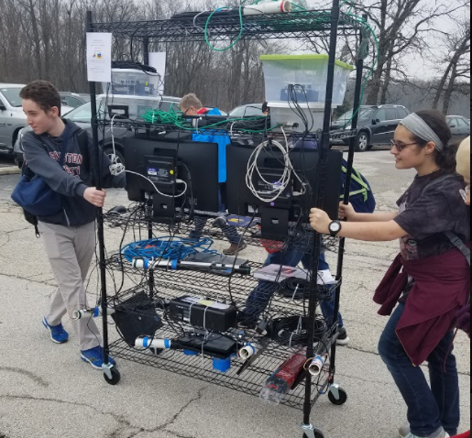
Questions?

Slide 11
Signin
Teacher
  Top: Registration
    Update your research groups >Show Group Info
      Upload: YES In survey: NO
      You can change password here
      Update Group Information
    Register student research groups
      Placeholder name like Place Holder >Make New Group
        Put in group name, like GoSchoolMascot
        Check upload box Uncheck pencil box > I’m Done
    Update Detector ID
      Show Group Info >enter daq number
Log out

Slide 12
Signin Student Username/Password
Landing Page
  Bottom: Milestones
  Top: Tab navigation
    Explore Library, Site Map, and Assessment on your own

Slide 13
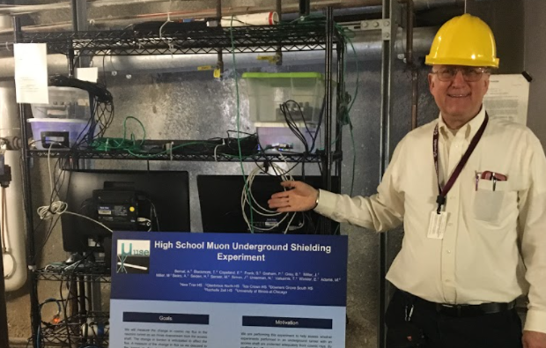
Contact
Nathan Unterman
nunterman@gmail.com
773 758-0464

