Slide 1


Moon Shadow, g-2, and Shielding
Nathan Unterman
University of Minnesota June 2022

Slide 2
Reports of Lunar Shadow
Reports of shadow range from 35 degrees to 120 degrees
Possible two shadows (muons, anti muons)

Slide 3
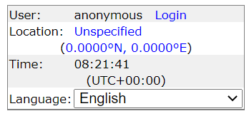
Heavens Above
https://www.heavens-above.com/

Slide 4
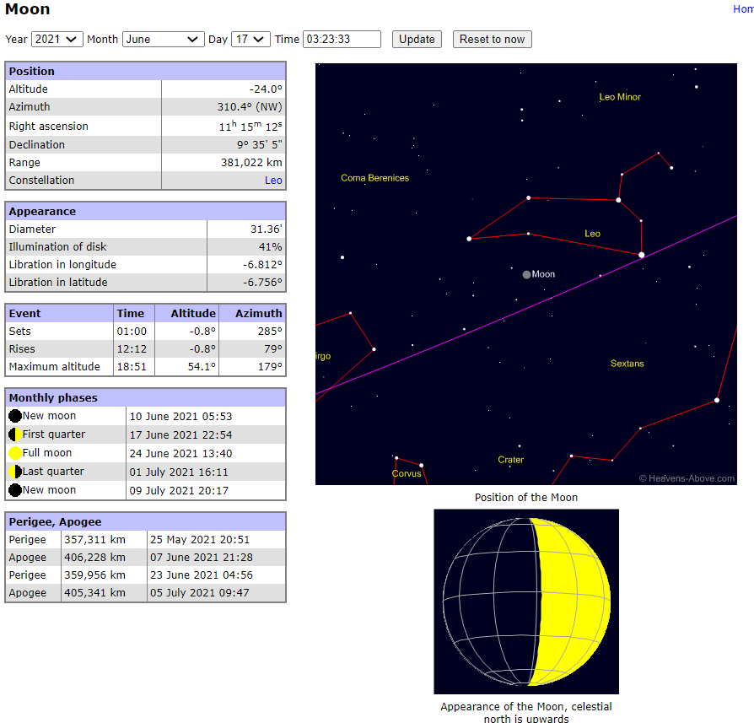

Slide 5
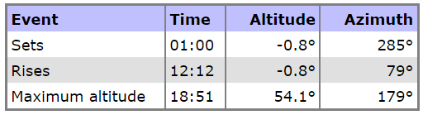

Slide 6
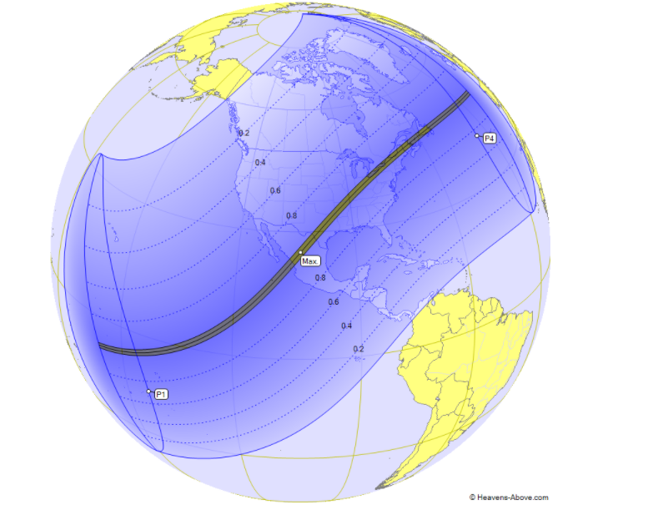
08.April.2024

Slide 7
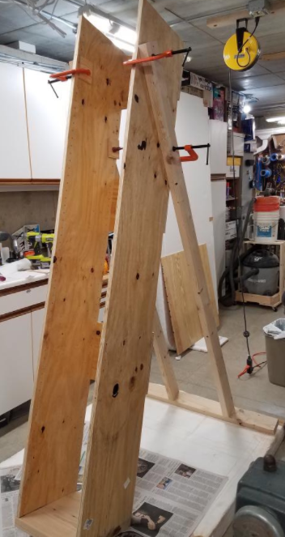
Aiming Device I
Robust
Slightly less expensive
Heavy
Not easy to transport

Slide 8
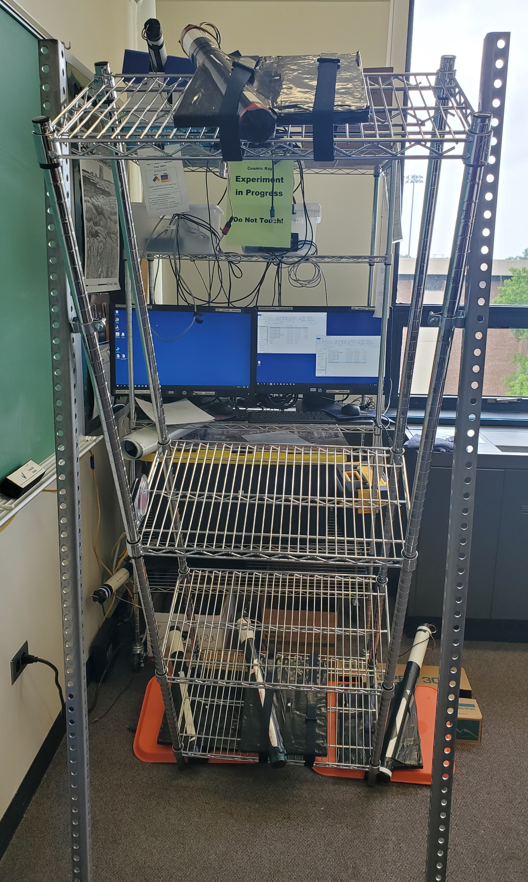
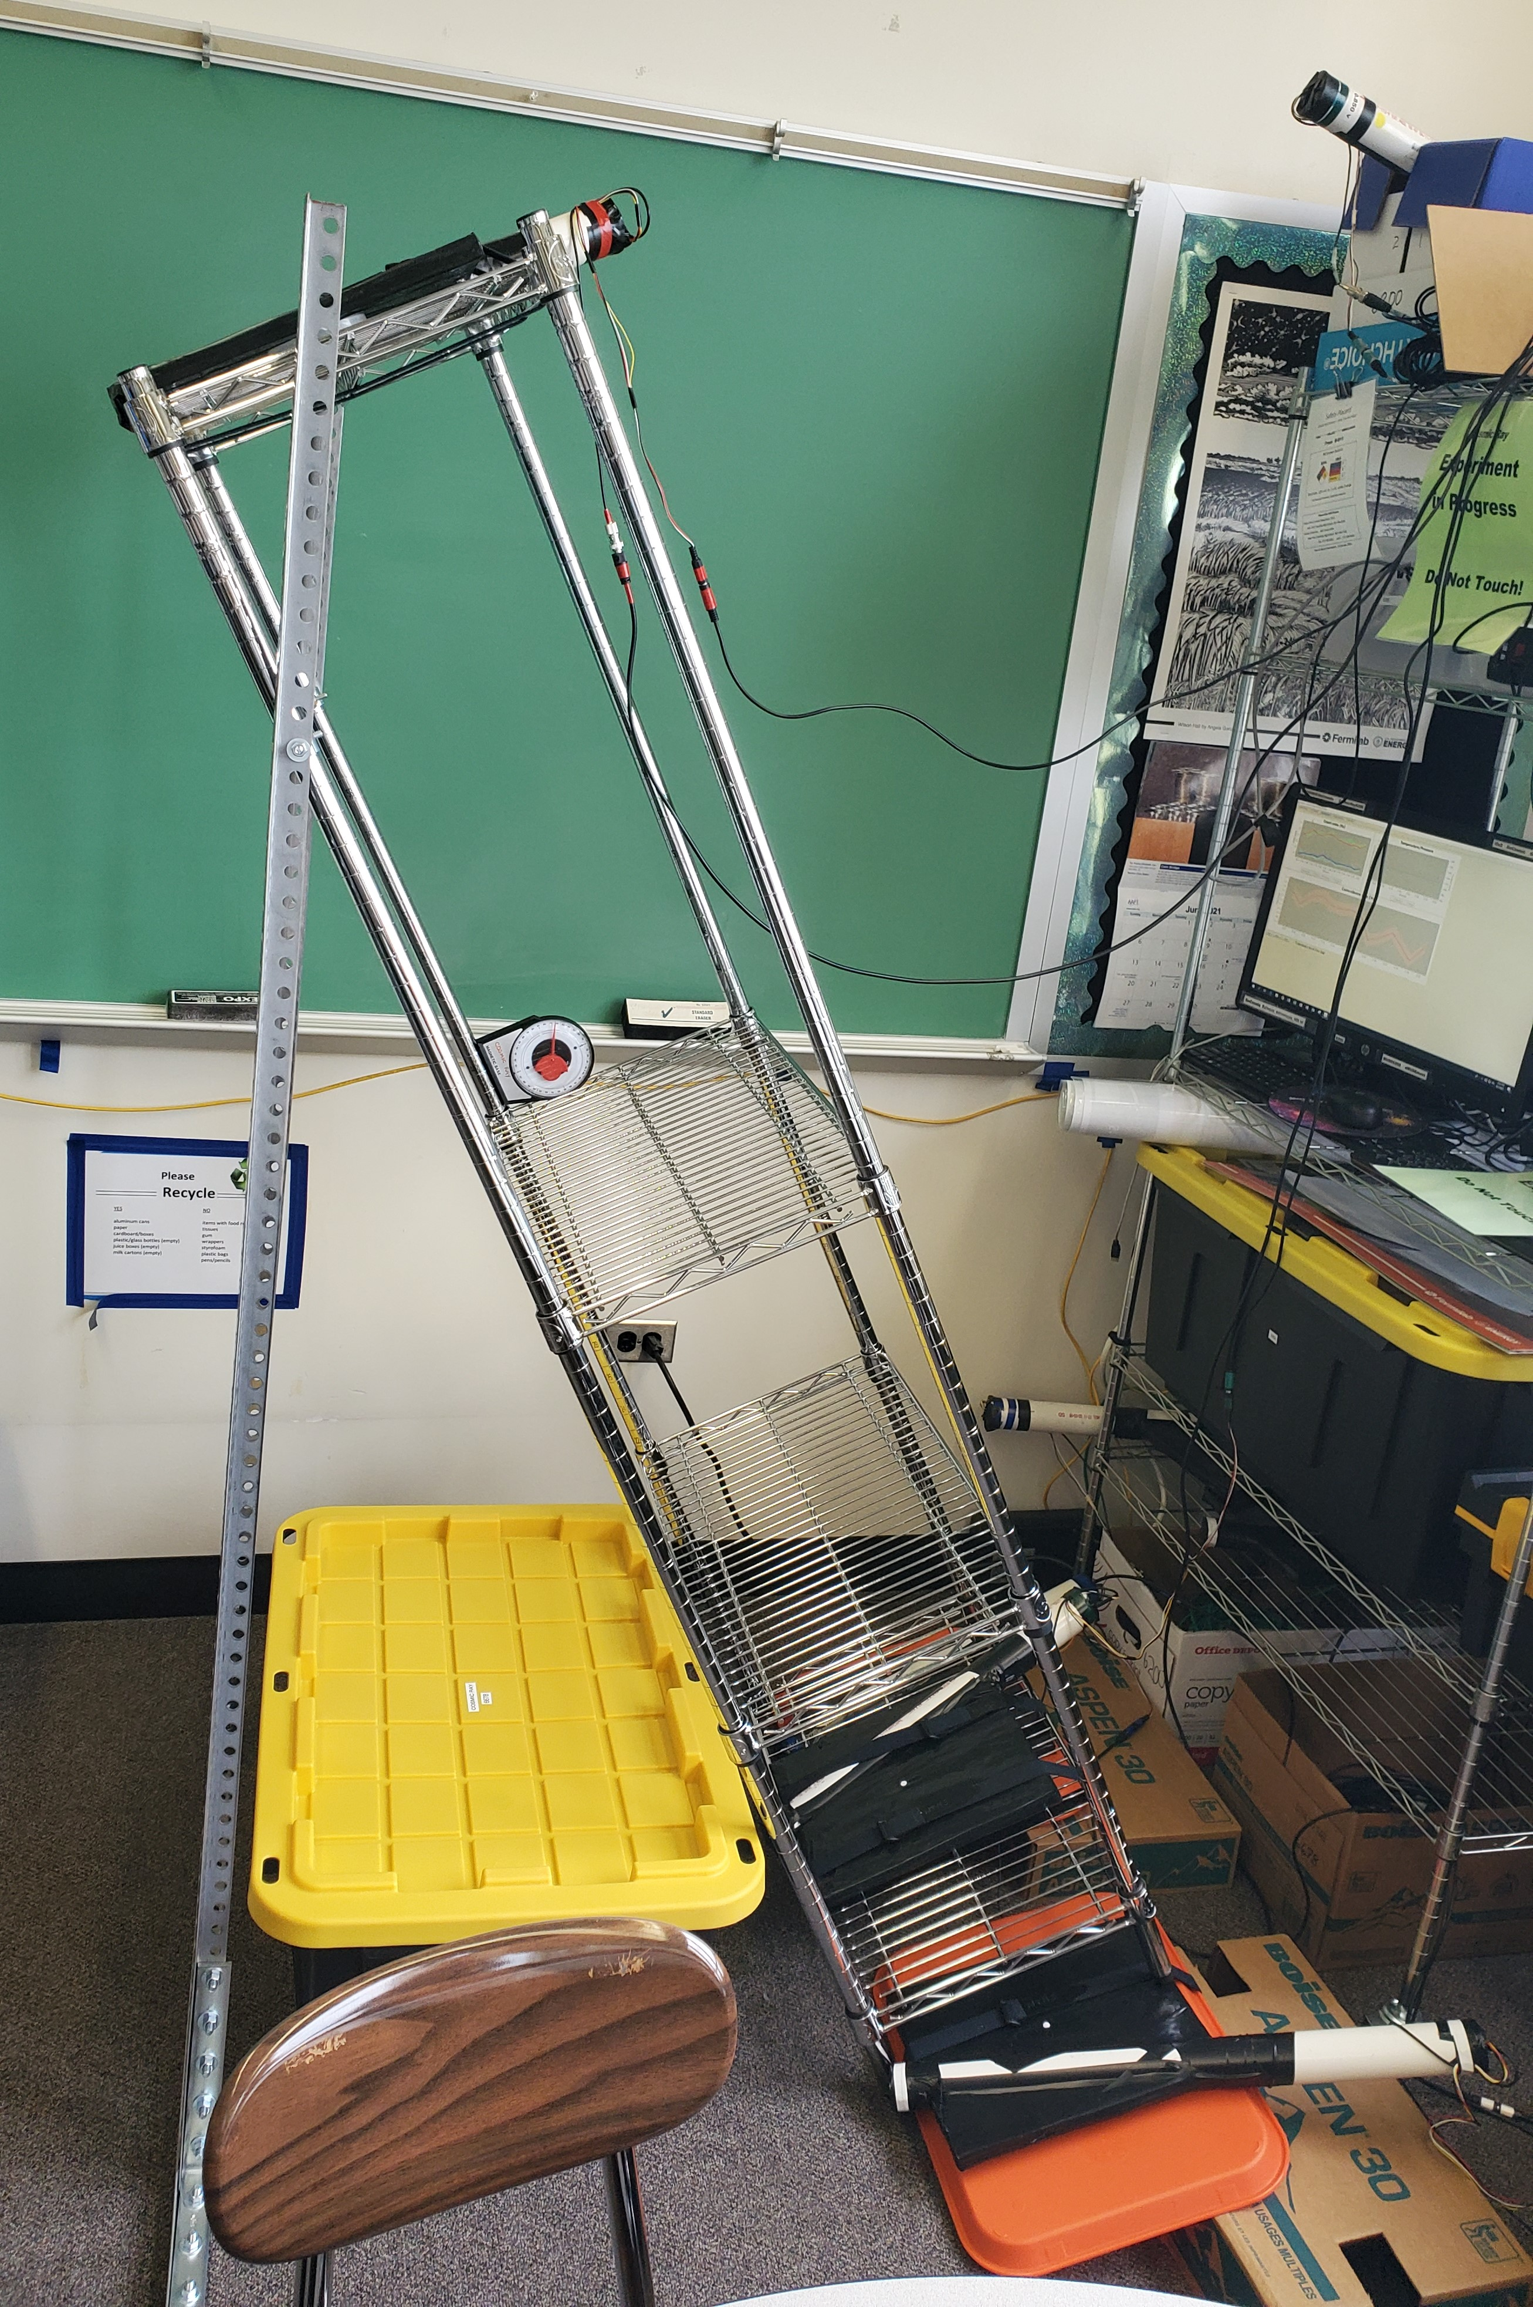
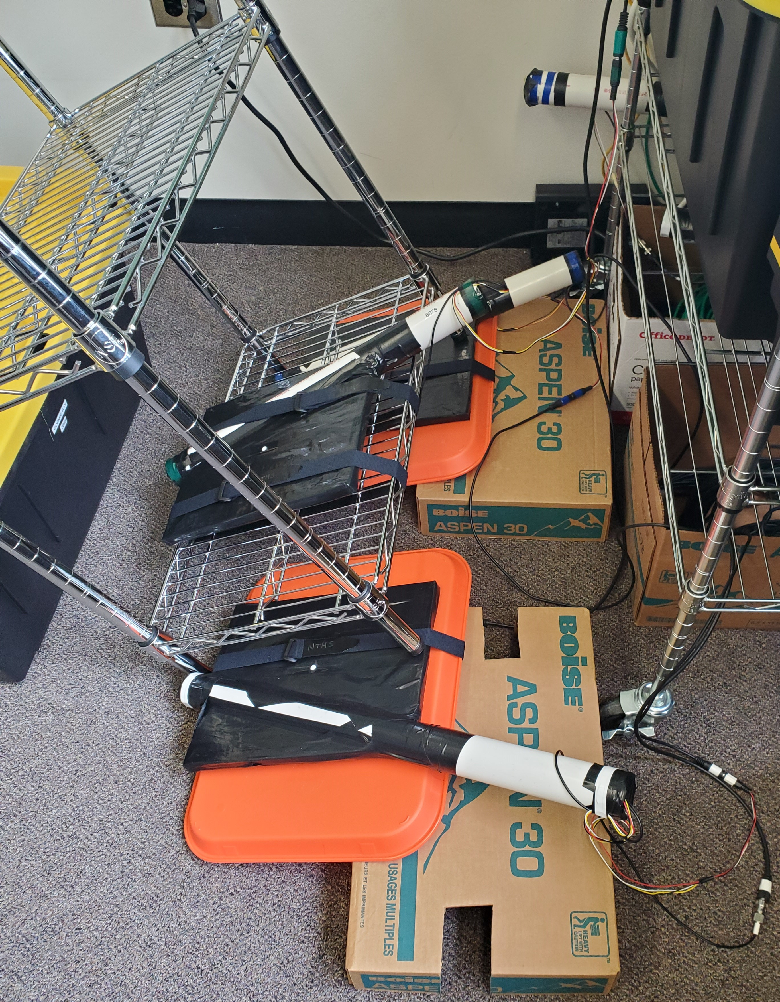
Aiming Device 2

Slide 9
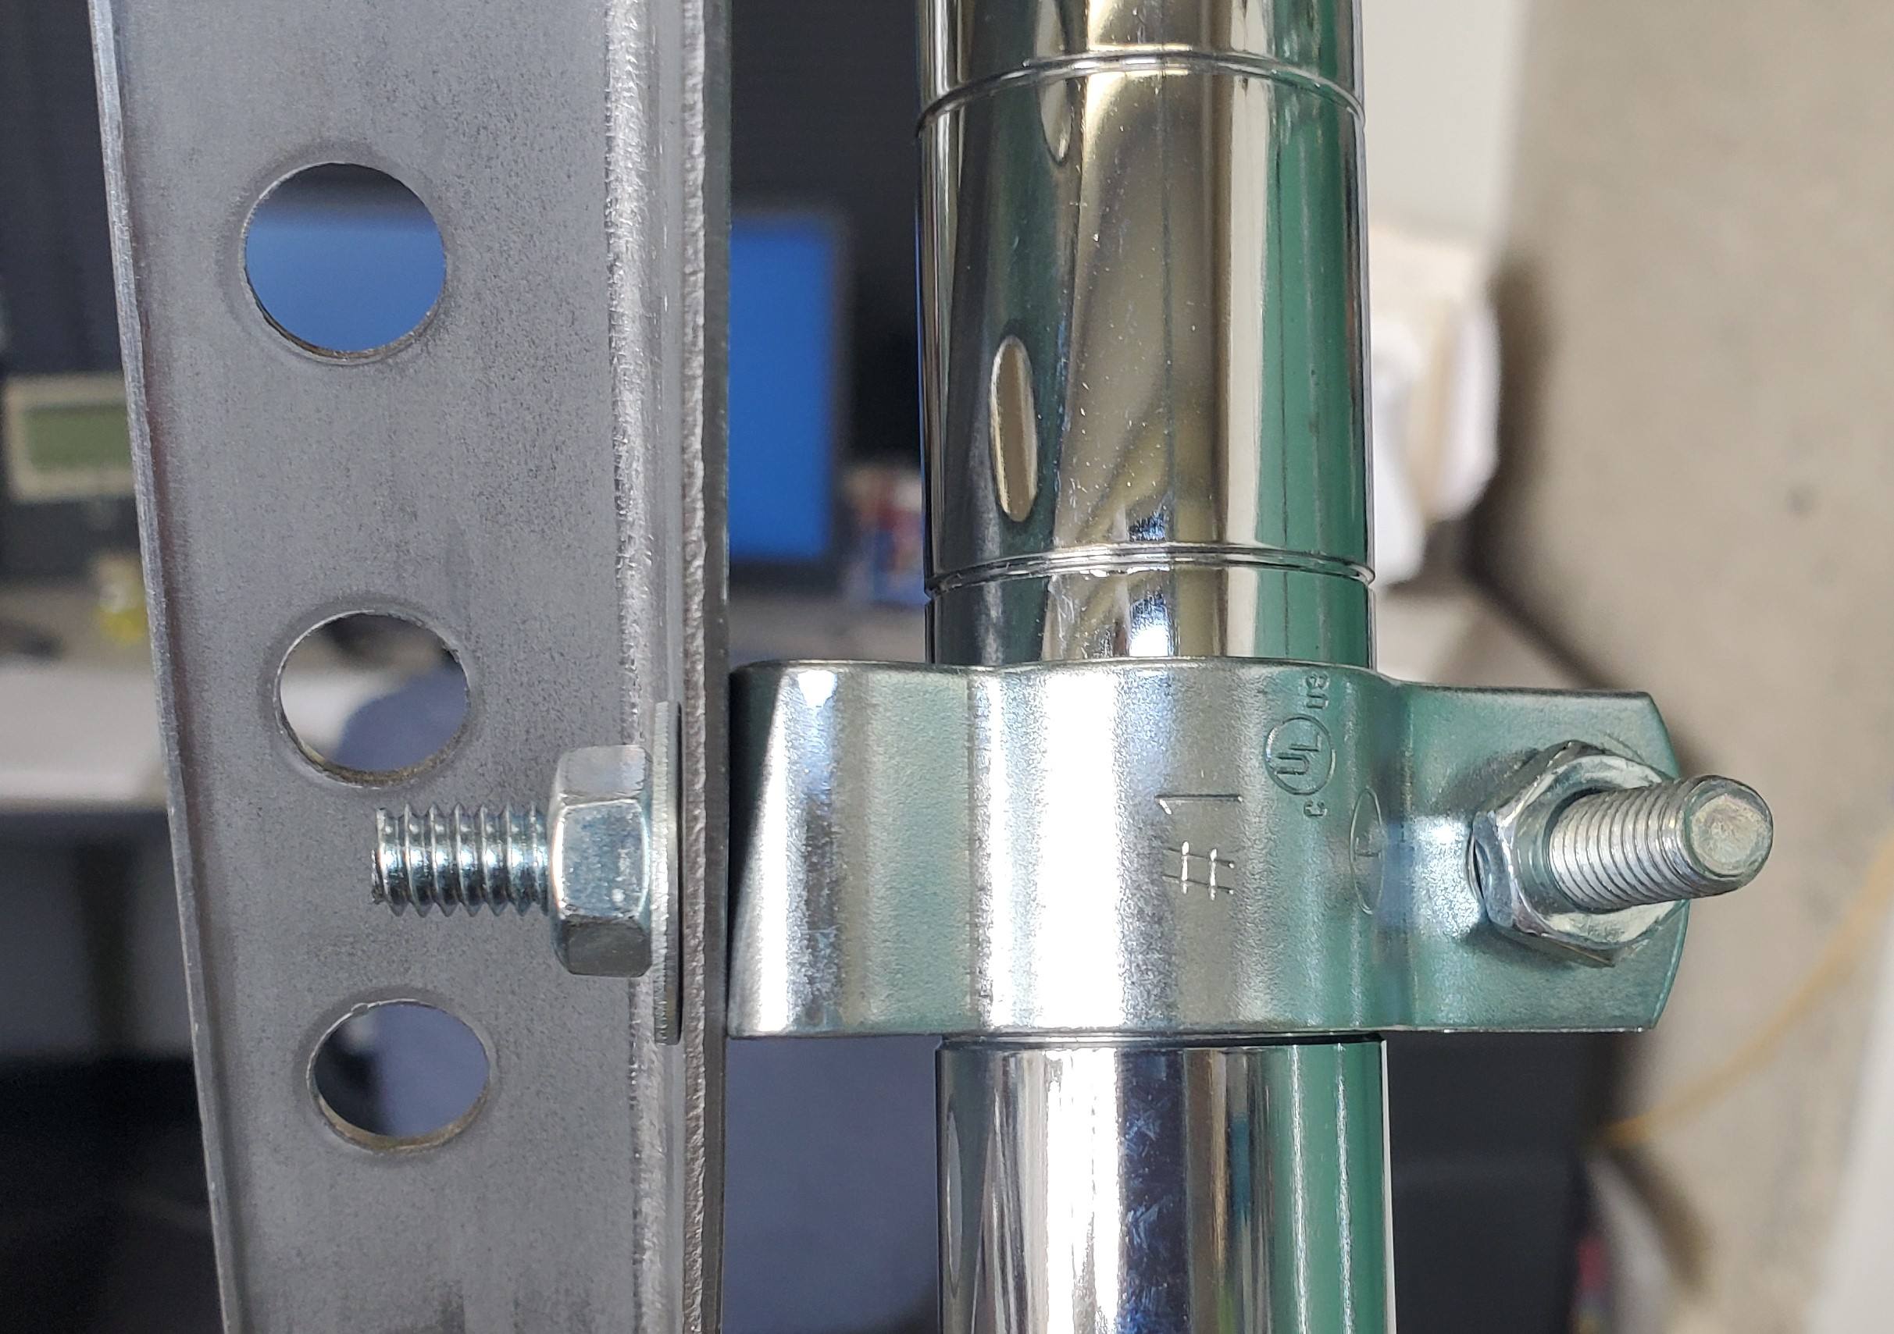
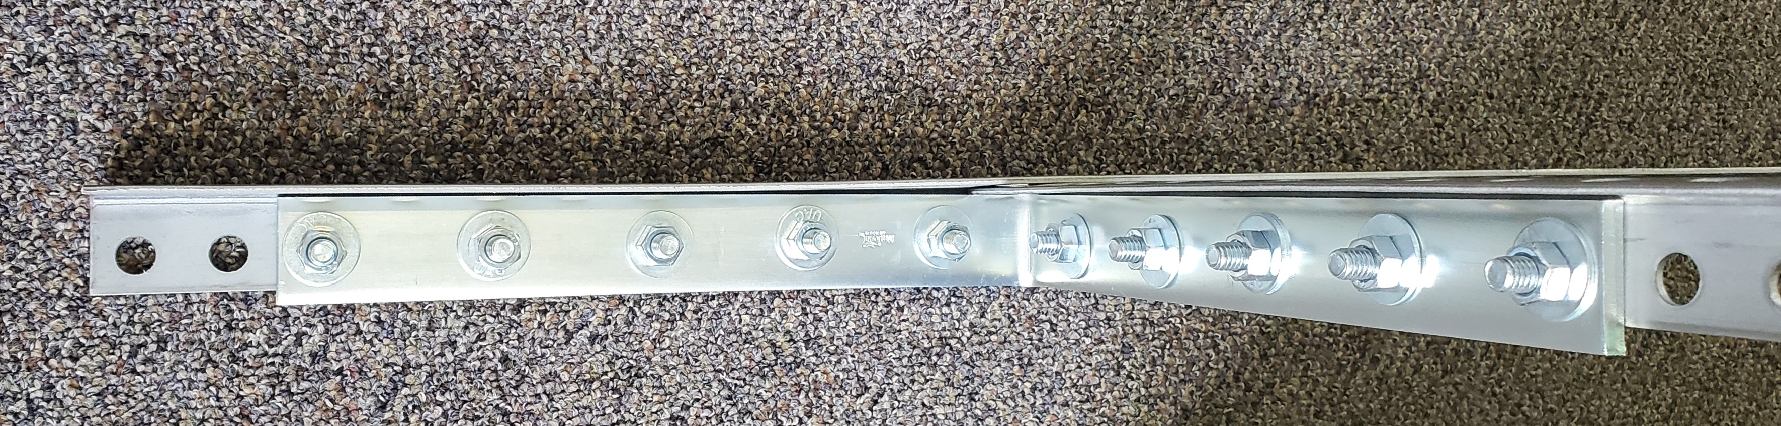
Details Device 2

Slide 10
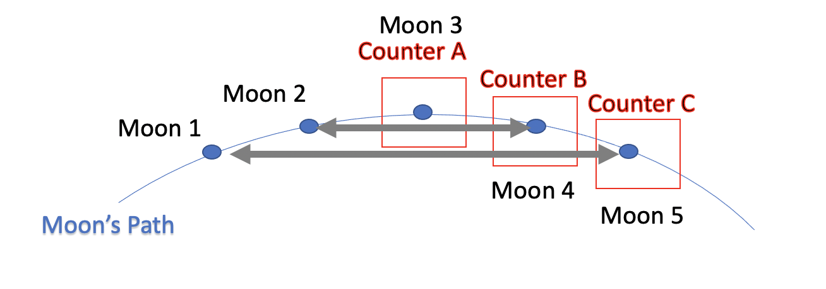

Slide 11
g-2 Prototype Criteria
Operate QuarkNet stack to study role of absorber in stopping muons.
Goals:
Stop cosmic ray muons, maintaining some polarization of the spin (in direction opposite of the m⁺ incoming direction).
Use metal absorber to stop muons and remove m⁻s through capture.
Measure muon polarization through decay electrons going upward versus downward using new Lifetime module currently under development.
Study different materials: copper; aluminum; and lead.
Optimize thickness of absorber to produce acceptable polarization and high efficiency for electron detection.

Slide 12
Design of stack and support
Design Issues
  Should we use one absorber between B and C or two absorbers between B-C and C-D?
  Should we keep the vertical space for absorber fixed to maintain acceptance as we change thickness, or minimize the space for each thickness? My first guess is to minimize
  We cannot find or afford copper at this moment – explore lead and aluminum
Criteria for stack and support stand
  Support absorber above counters C and D
  Support A and B above absorber
The vertical supports should probably have slots for
adjustable levels of L-brackets

Slide 13
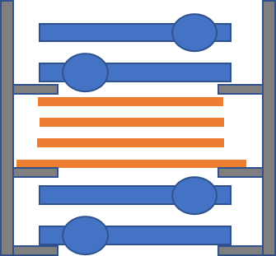
Scintillators with PVC, absorber, and stand

Slide 14
Issues
Cost of materials
Safety of electromagnet for classroom environment

Slide 15
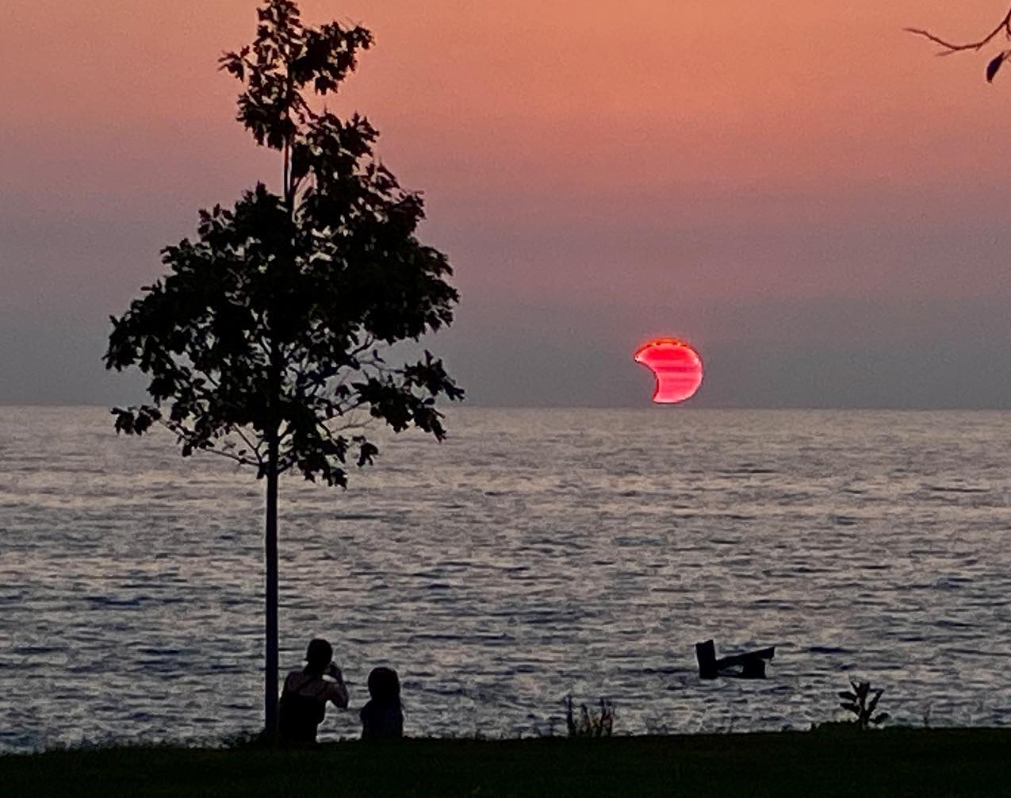
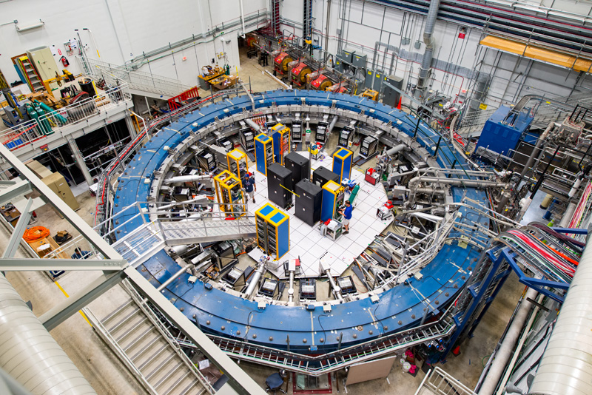
If Interested
Moon Shadow
  Nathan Unterman
g-2
  Mark Adams
  adams@fnal.gov

Slide 16
Shielding
g-2 experiment
Depth in building
Attempt to reduce low energy muons in studies
Pyramid project Chicago State University (Edmundo Garcia)

Slide 17
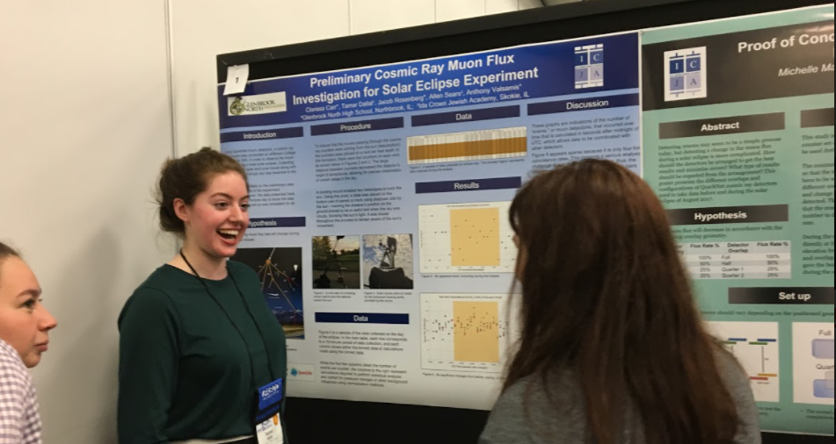
Questions?

Slide 18
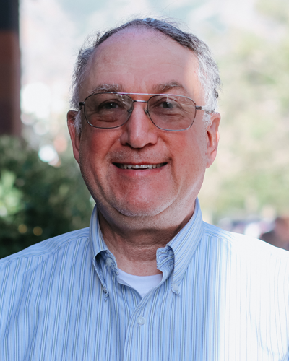
Contact
Nathan Unterman
nunterman@gmail.com
773 758-0464

