Slide 1




Learn more at STEPUPphysics.org
Changing the Culture
Workshop Leader Version

Slide 2

Which Hat to Wear?
The next two slides address the student activity. (Student Hat)
The remaining slides address the Everyday Actions for teacher growth and development. (Teacher Hat)

Slide 3

Guidelines for Discussion: Student Activity “Student Hat”
Join a group as a student.
Read your assigned guideline with your group.

Slide 4
Guidelines for Discussion: Student Activity “Student Hat”
Record a summary of your group answers using the question sheet.
Make a poster or slide of your group responses to share with the whole group.

Slide 5
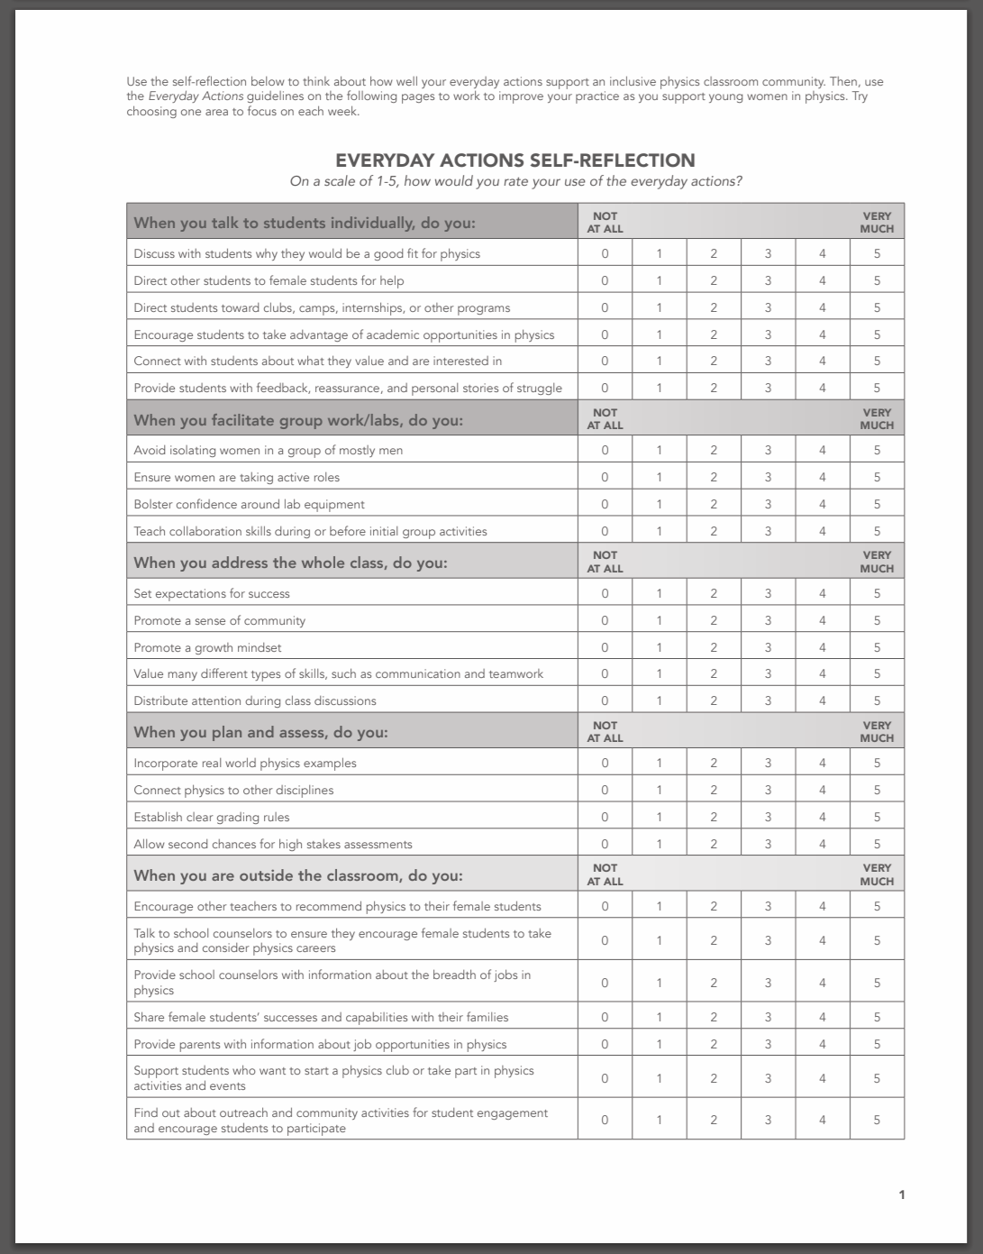

Everyday Actions “Teacher Hat”
  Now put on your teacher hat.
  Complete the self-reflection individually.
https://bit.ly/2szH7fy

Slide 6
Everyday Actions “Teacher Hat”
Which areas do you feel confident about implementing? How do you accomplish that?
Which were you the most unsure about?
On which would you like to improve? How can you do that?

Slide 7
Everyday Actions “Teacher Hat”
Join a new group as a teacher.
Read your assigned guideline with your group.
Summarize your group discussion to share with the whole group.

Slide 8
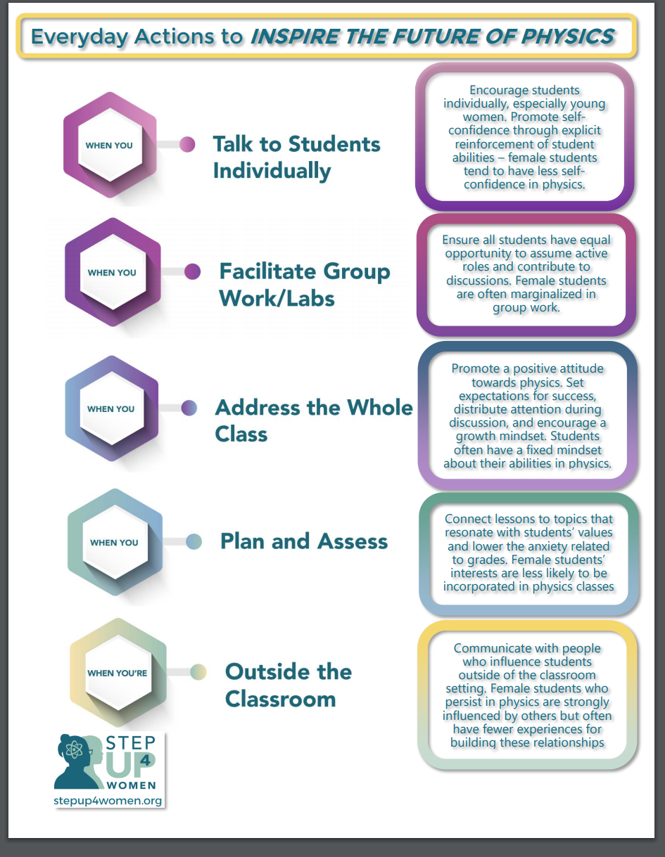
Everyday Actions “Teacher Hat”
Use Everyday Actions to Inspire the Future of Physics.
Discuss your assigned everyday action with your group and record your answers.
Summarize your group results to share in a whole group discussion.

Slide 9
Everyday Actions “Teacher Hat”
Reflection:
Record your personal goals for implementing Everyday Actions in your classroom.

