Slide 1
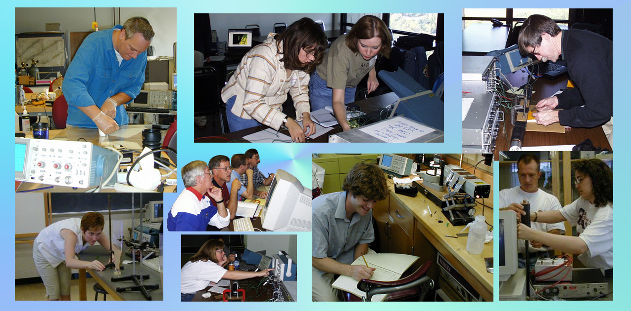


The QuarkNet Collaboration
quarknet.org
Teacher Professional Development
HEP Broader Impacts

Slide 2
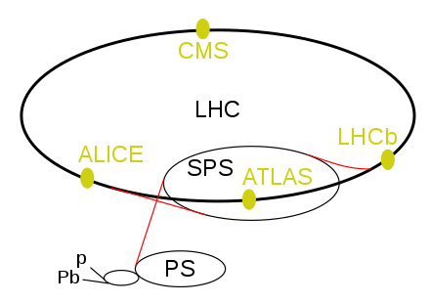
The QuarkNet Collaboration
Particle Physics: Our Home
Experiments of long duration with large datasets
Large international collaborations
Distributed work over many institutions
QuarkNet shares these characteristics
that help make us a dynamic, unique & transformative
teacher professional development (PD) program.
Notes:
Students can learn to replicate the work of real-world scientists

Slide 3
NSF Review, April 2023
QuarkNet Collaboration Review
Presentations
Organization & Connections - M. Bardeen
Key Program Components:
Center Workshops - S. Wood
Data Camp, Coding Camps 1 & 2 - A. LaMee
Data Activities Portfolio - D. Roudebush
Physics Masterclasses - K. Cecire
Broadening Participation - S. Wood
Outcomes-based Evaluation: Results and Plans - K. Race
Resources & Funding – M. Wayne

Slide 4
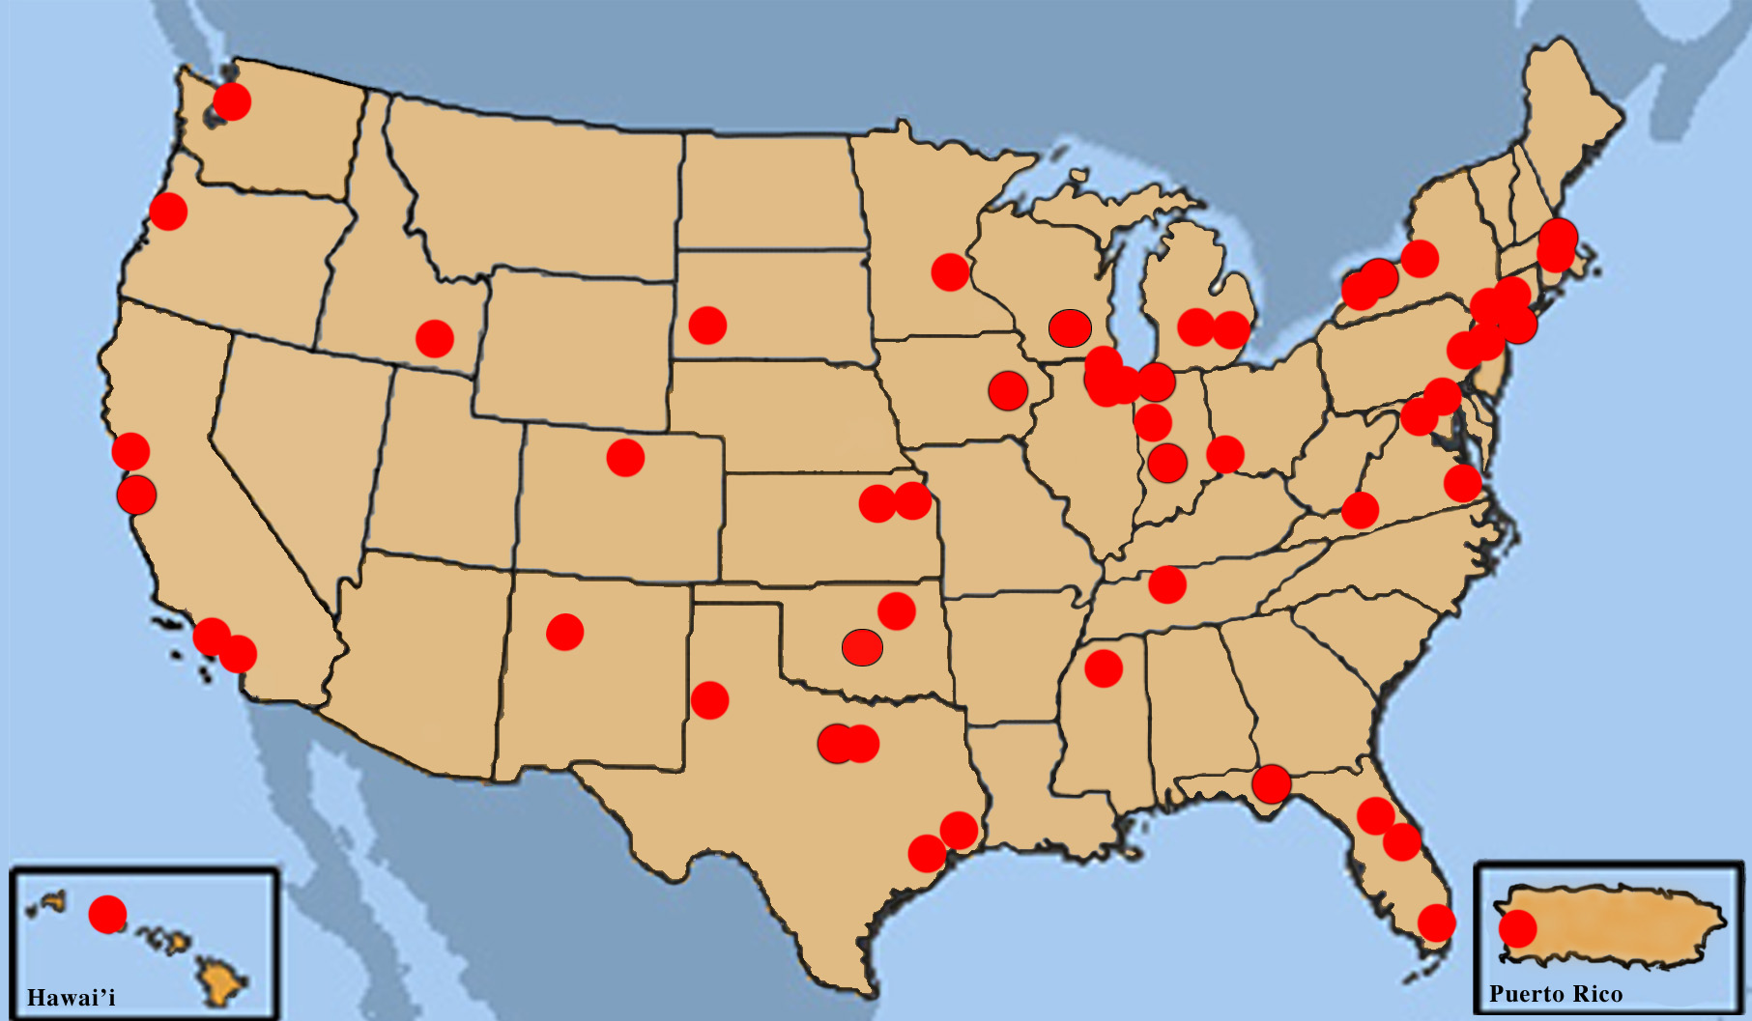

Organization & Connections
The QuarkNet Collaboration
A Network of 52 Local & Regional Centers . . .
QuarkNet is funded by
NSF to University of Notre Dame
& by DOE through Fermilab.

Slide 5
Organization & Connections
The QuarkNet Collaboration
with National Leadership & Coordination
National Office
Co-PIs
Staff supported at
University of Notre Dame
or Fermilab

Slide 6
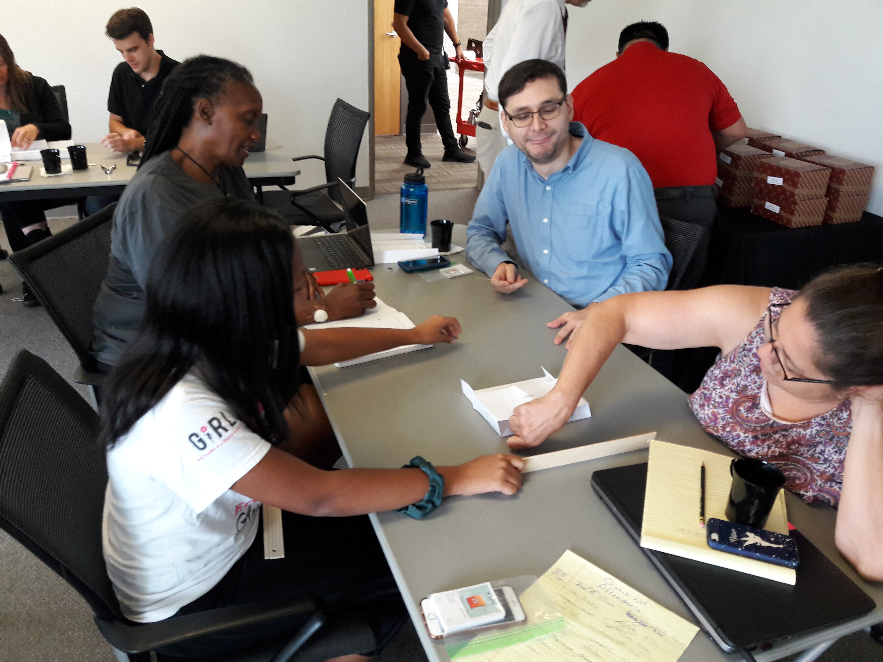
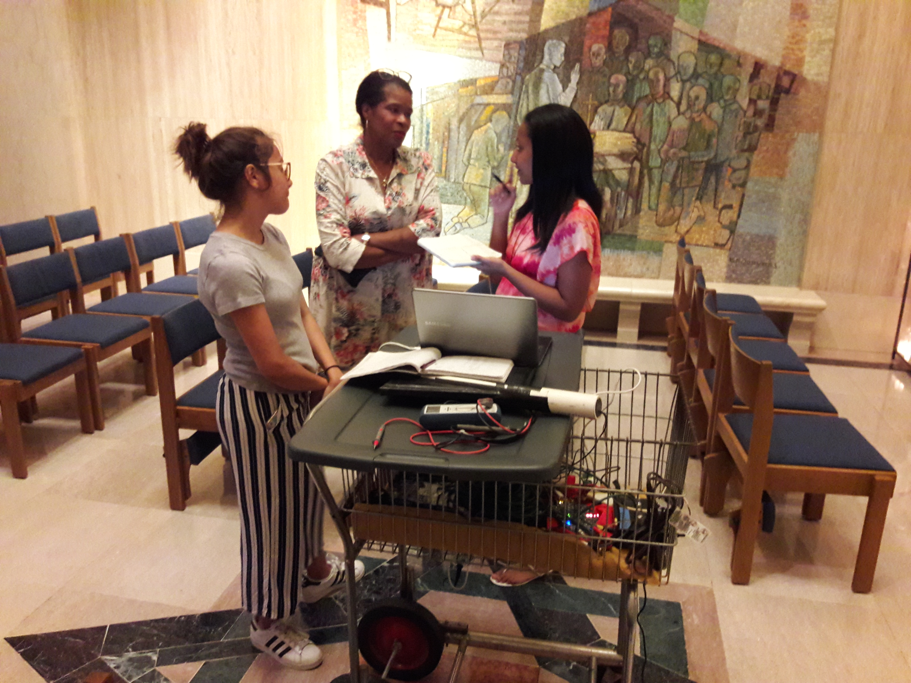
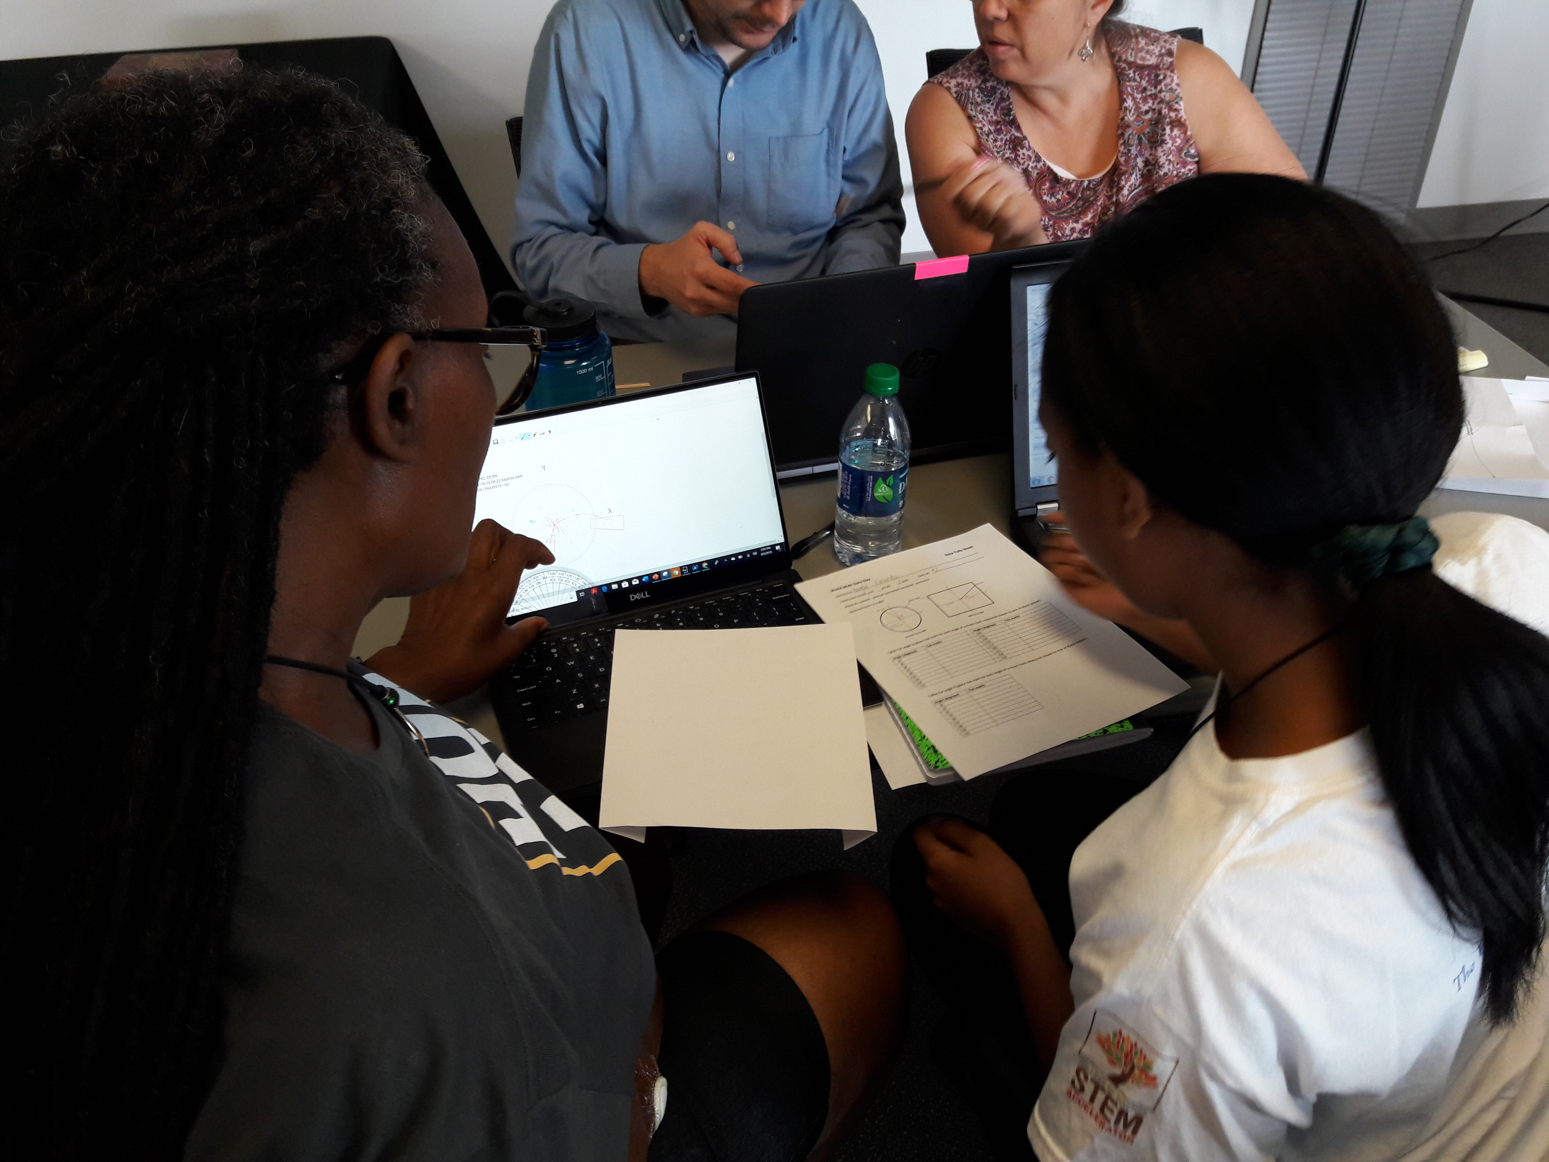
Center Organization
Centers: Heart of the Program
Initiated by 1-2 particle physicist mentors
Joined by 1-2 lead teachers
With, on average, 5 associate teachers

Slide 7
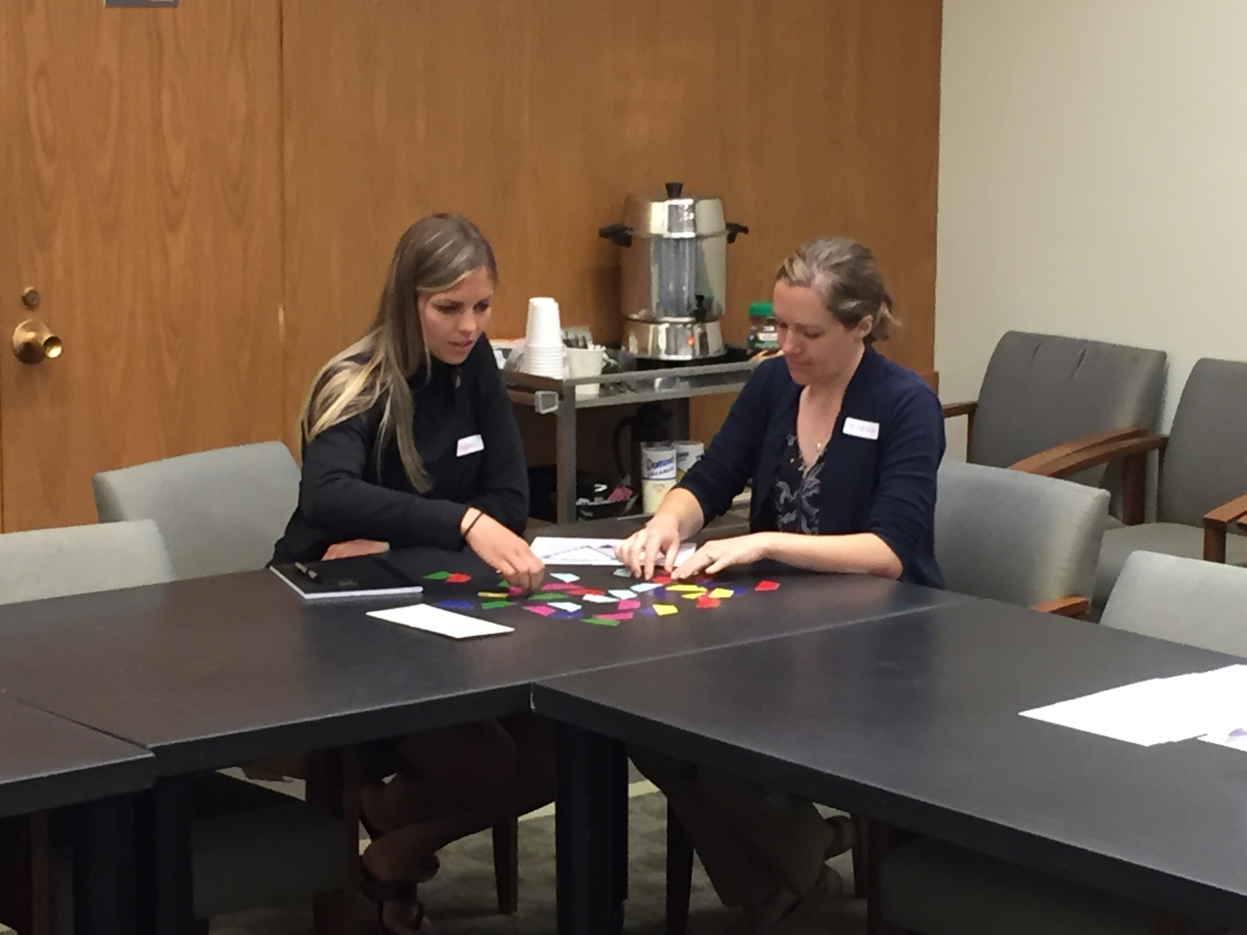
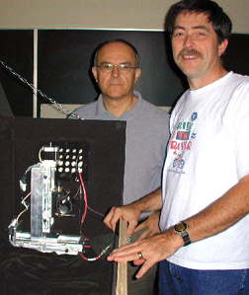
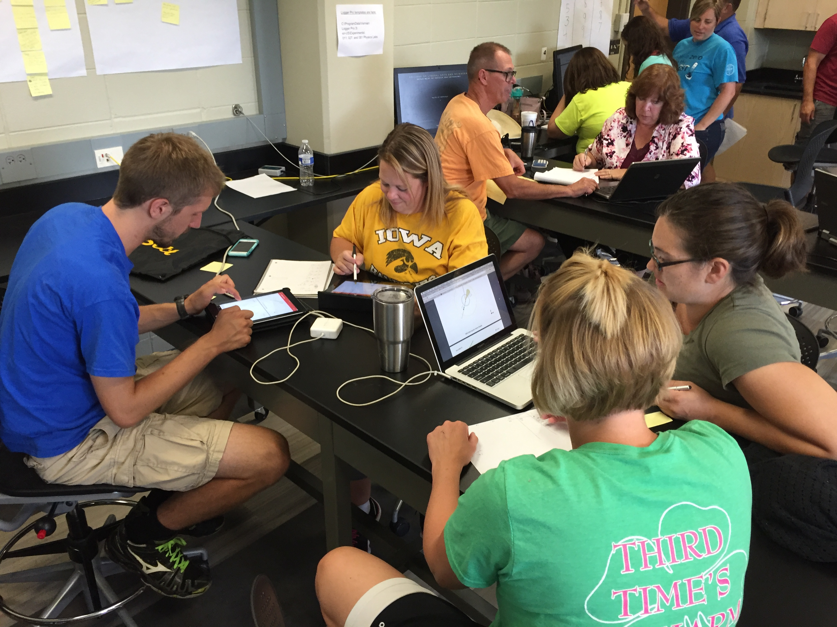
Center PD Program
QuarkNet: A Long-Term National Program
Based on 3 successful PD program types:
Research internships (Year 1) (2 centers)
Research-based workshops (Year 2)
Physics alliance workshops (Year 3+) (50 centers)

Slide 8
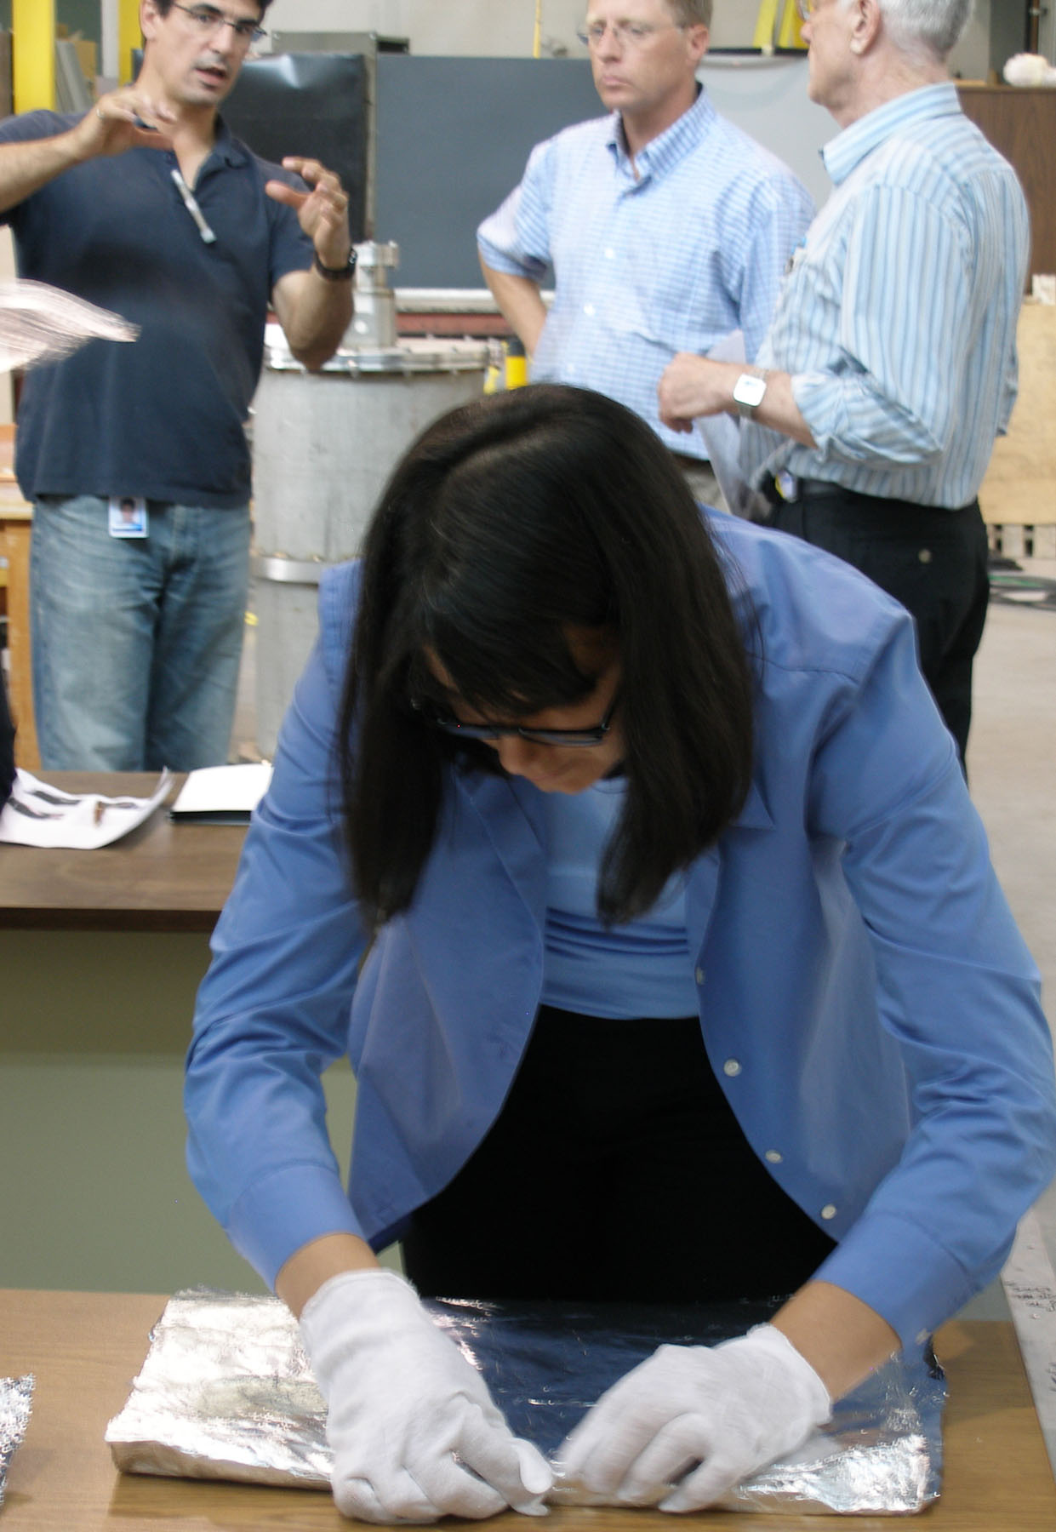
National PD Framework
Engagement with Scientific Investigations
Access to online HEP datasets
Center Workshops
Cosmic Ray Studies
Data Activities Portfolio
Data Camp & Coding Camps
Masterclasses for students
Ongoing support
Fellows Program

Slide 9
National PD Management
National Staff
Staff Teachers
Education Specialists
Cosmic Ray Team
Fellows
IT Staff
Administrative Assistant
External Evaluator

Slide 10
National PD Management
Who We Are
Co-PIs
Marge Bardeen
Angela Fava
Morris Swartz
Mitch Wayne
Staff Teachers
Ken Cecire (NSF)
Spencer Pasero (FNAL)
Shane Wood (NSF)
And 41 Fellows (NSF)
Anne Zakas, Admin (NSF)
Education Specialists
Adam LaMee (NSF)
Deborah Roudebush (NSF)
Jeremy Smith (NSF)
IT Staff
Joel Griffin (NSF)
Tom McCauley (NSF)
Edit Peronja (FNAL)
Cosmic Ray Team (FNAL)
Mark Adams, Coordinator
Dave Hoppert, Detector Tech

Slide 11
Project Management
What We Do
Provide assistance for planning and implementing effective center activities.
Create resources and tools, maintain the Web presence, and support teachers using resources.
Organize workshops and special opportunities.
Support QuarkNet fellows.
Participate in dissemination and broader impact activities.
Manage funds.
Prepare reports for funding agencies.

Slide 12
QuarkNet Collaboration
External Evaluator
QuarkNet PIs
Advisory Board
Education Specialist 1 DAP*
Administrative
Assistant
IT Staff
Education Specialist 2
Education Specialist 3
Cosmic Ray
Team
Staff
Teacher 1
Staff
Teacher 2
Staff
Teacher 3
Coding Camps
Data Camp
2 Centers
e-Lab &
Detectors
20 Centers
7 Centers
22 Centers
Virtual Center
Coding Fellows
Teaching and Learning Fellows
Cosmic Ray Fellows
Neutrino Fellows & Masterclasses
LHC Fellows & Masterclasses
*Data Activities Portfolio

Slide 13
Program Connections
Workshops
Cosmic Ray Studies
Masterclasses
Data Activities Portfolio
Coding Camps
Data Camp
Special Opportunities

Slide 14
Program Connections
Workshops & Special Opportunities
Cosmic Ray Studies
Masterclasses
Center
Program
Coding Camps
Data Camp
Data Activities Portfolio

Slide 15
Program Connections
Staff Teacher
Fellows
Masterclass Leaders
Center
Program
Coding Camps Leaders
Data Camp Leaders
Cosmic Ray Team

Slide 16
Program Connections
Bringing Center Participants Together
Data Camp & Coding Camps
Special Opportunities
Lead Teacher Camp
Fellows Camp
QuarkNet Educational Discussions (QED)
Friday Flyer
International Muon Week
World-Wide Data Day

Slide 17
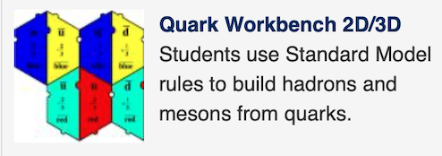
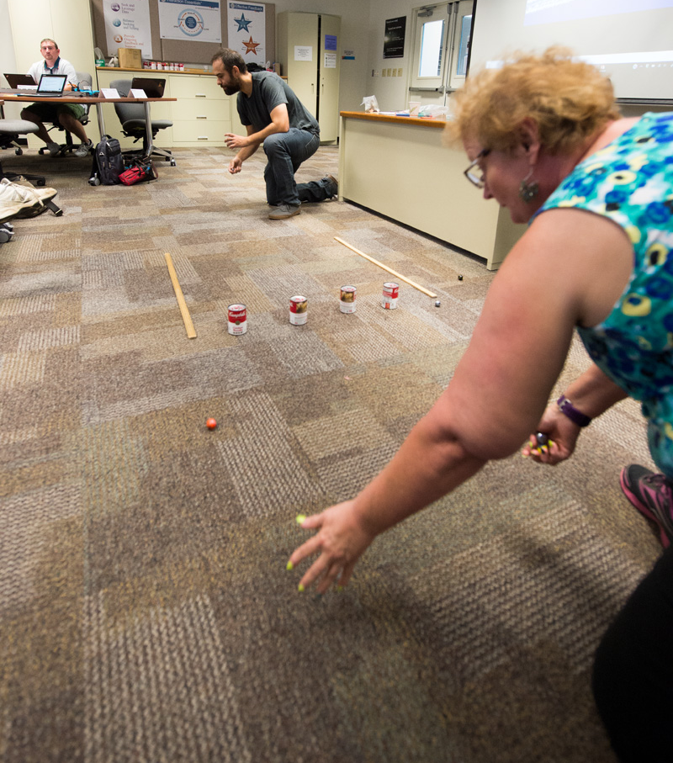
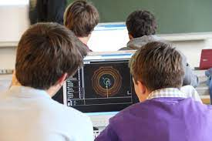
Closer Look at Key Programs
Professional Development Programming
Workshops at Centers
Data Camp & Coding Camps
Data Activities Portfolio
Masterclasses
Broadening
Participation

