Slide 1

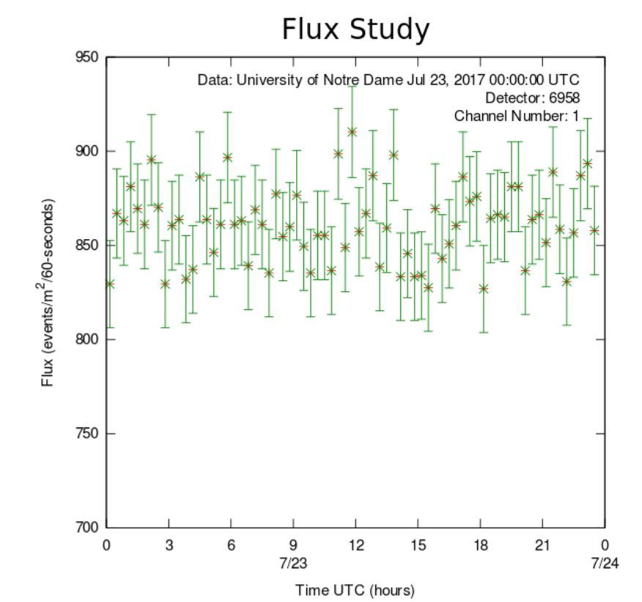
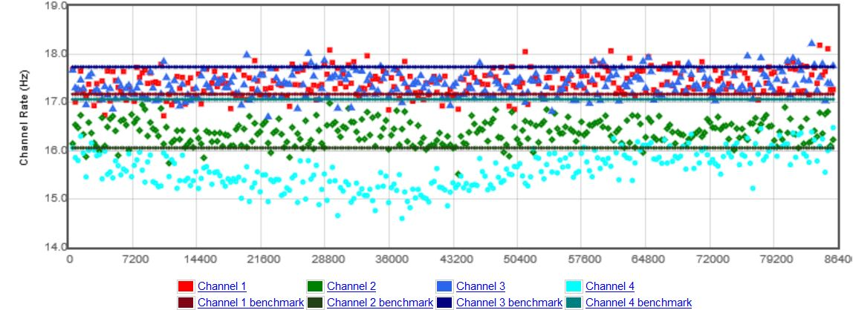
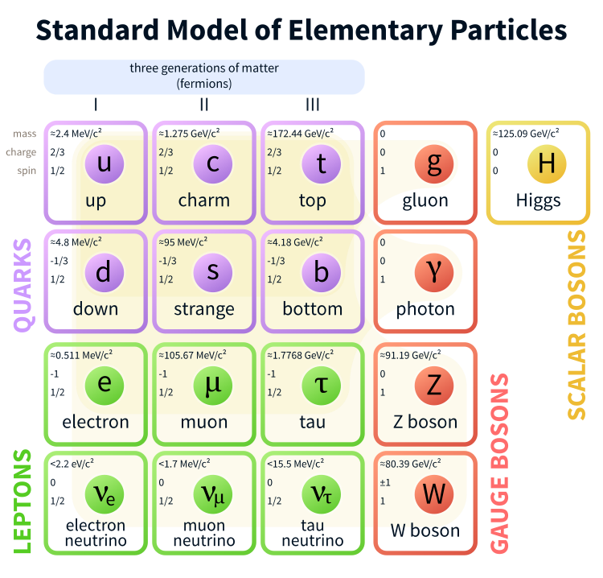
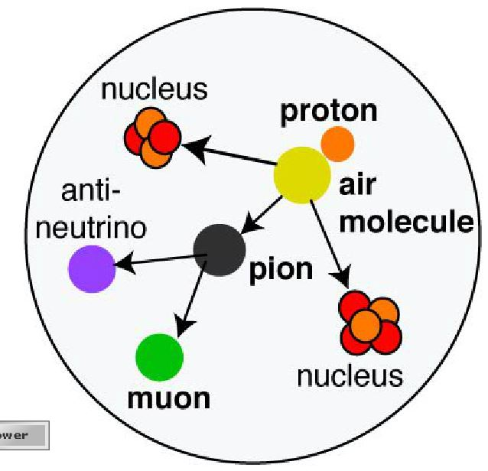
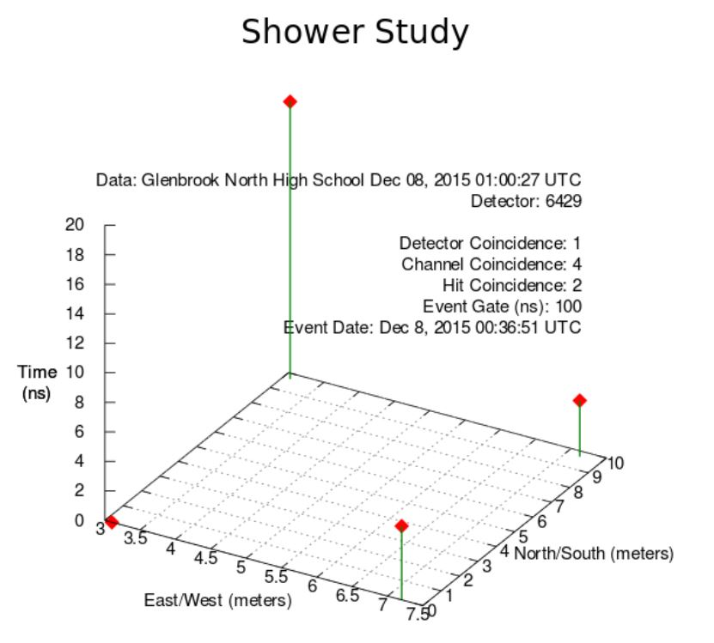
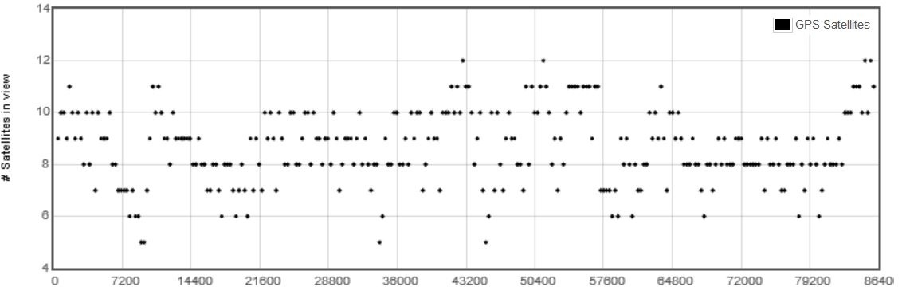
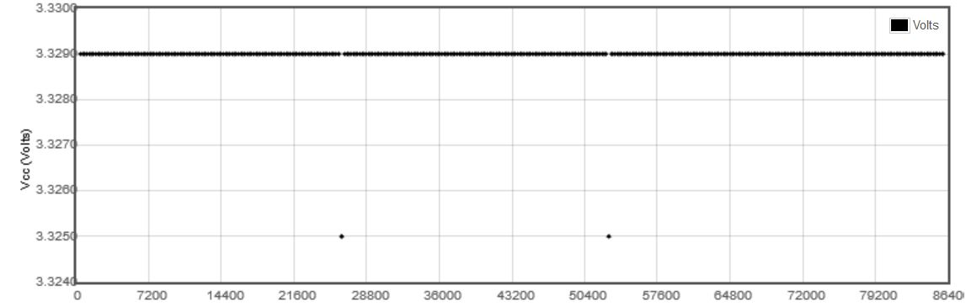
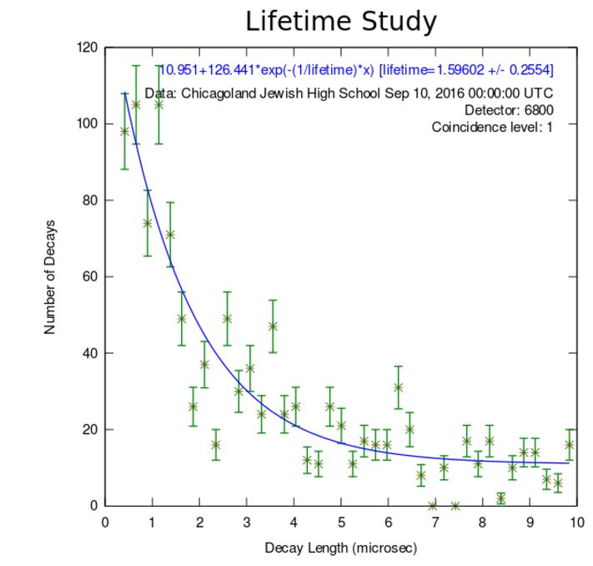
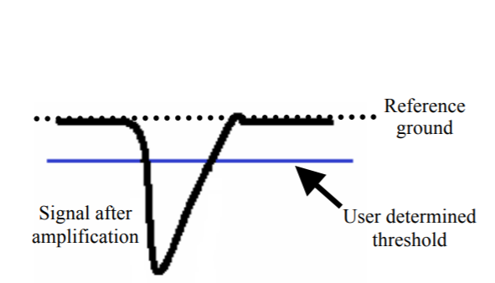
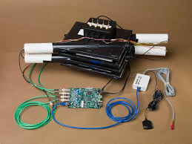
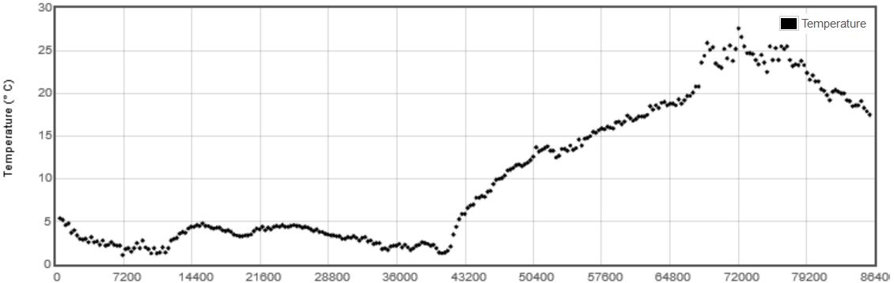
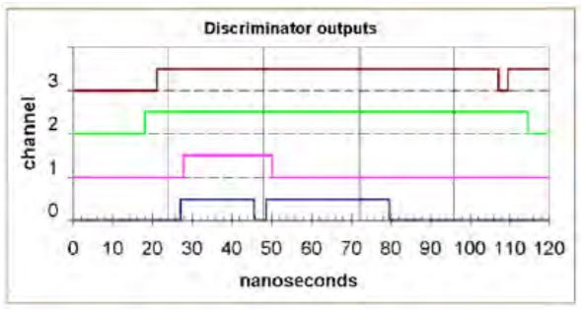
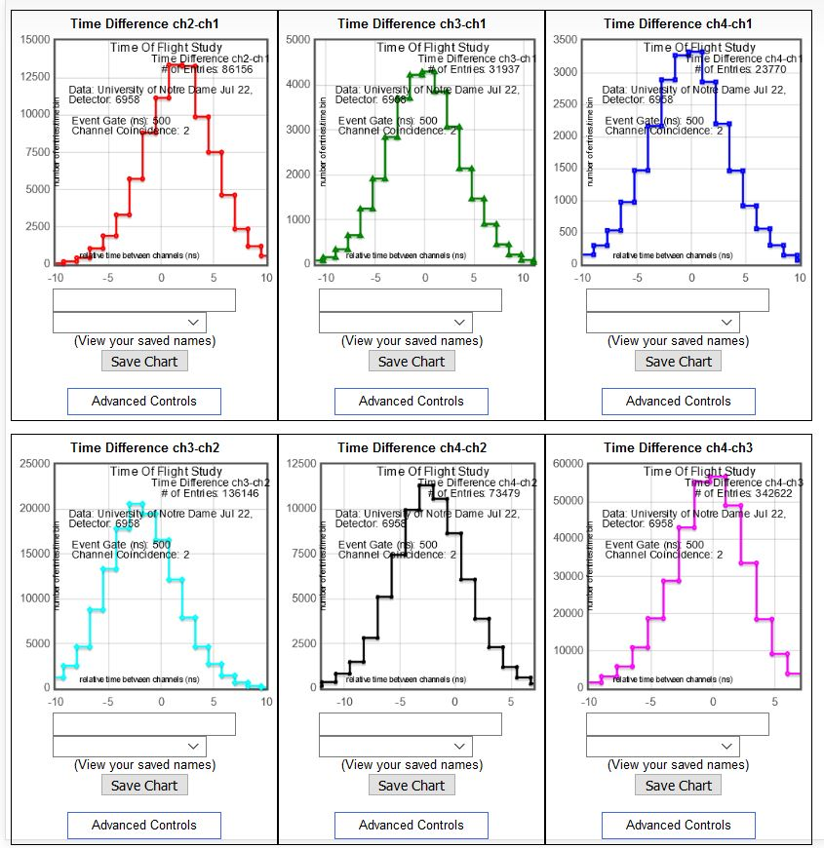
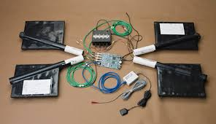
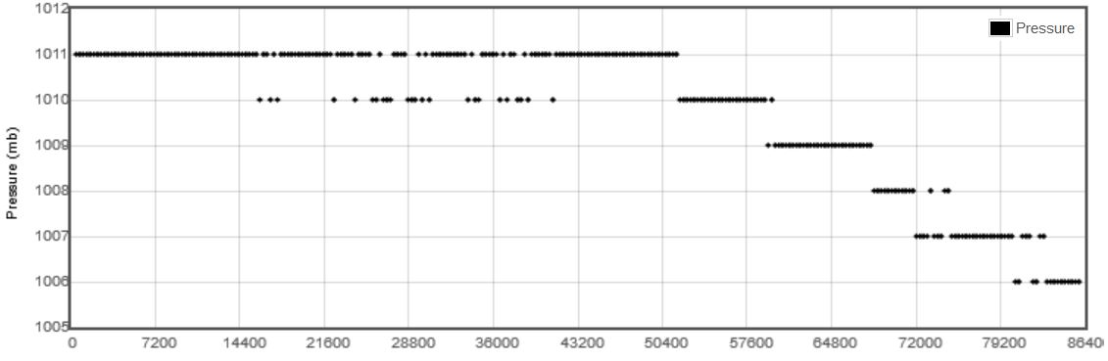
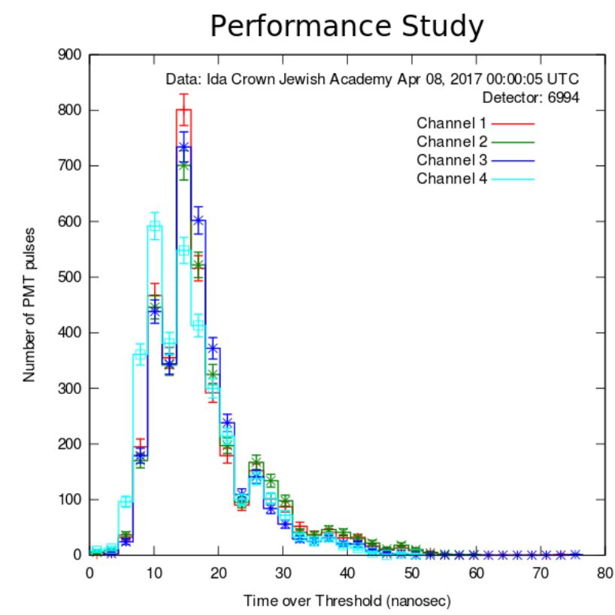

Cosmic Rays and Cosmic Ray Muon Detection
♦ Background
♦ Setup Specifications
♦ Sample Results
♦ Sample Studies
Cosmic rays are primarily high-energy protons and helium nuclei. When these particles collide with gas atoms in the upper atmosphere, an air shower is created. The air shower consists primarily of pions that decay into muons and other particles created by the high energy collision. Since the muons carry much energy, weakly interact with the air, and have a relatively long mean lifetime, many muons are detected at Earth’s surface.
Photo: H. J. Drescher, Universitat Frankfort
Plateauing
High voltage on each photomultiplier tube must be optimized for efficient performance.
Time over threshold
The photomultiplier tube sends electrical pulses to the data acquisition board. A balance needs to be struck between too low of a threshold, which yields a noisy signal, and too high of a threshold that discards legitimate counts.
Gate
The gate window is how close in time pulses must occur to cause a trigger.
Coincidence
To discern that counts in different channels are coming from the same event, 2-fold or higher coincidence is chosen. This means that within a certain gate of time, at least two counters show signal.
Blessing plots
These plots show characteristics of the detector behavior and helps determine the validity of the data. All horizontal axes are in seconds past midnight Universal Time.
RATES
SATELLITES
VOLTAGE on DAQ
TEMPERATURE
PRESSURE
PERFORMANCE
Flux Rate of Muons
Shower of Muons from a 100 TeV Event
Muon Lifetime
Time of Flight
gas
♦ Kinds of Measurement
Using a setup of various scintillators (counters) for a given detector, many aspects can be studied.
Stacked configuration:
Flux
Time of Flight
Muon Lifetime
Array configuration:
Shower study
Time over threshold
♦ Factors to be Considered
Geometry of setup
North-South versus East-West orientation
Overlap area, separation
Zenith angle
Amount of material muons pass through
Angle of Acceptance
Latitude, longitude, altitude
Barometric pressure
Veto
♦ Acknowledgements
Fermi National Accelerator Laboratory
2017
♦ ♦ ♦ ♦ ♦ ♦ ♦ ♦ ♦ ♦ ♦ ♦ ♦ ♦ ♦ ♦ ♦ ♦ ♦ ♦ ♦ ♦ ♦ ♦ ♦ ♦ ♦ ♦ ♦ ♦ ♦ ♦ ♦ ♦ ♦ ♦
Fermi National Accelerator Laboratory

