Slide 1
Exercise 1

Slide 2
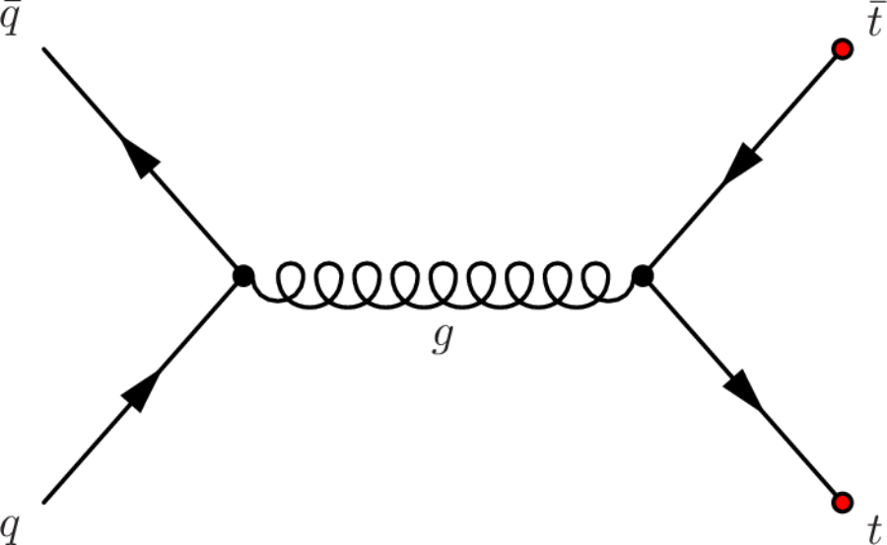

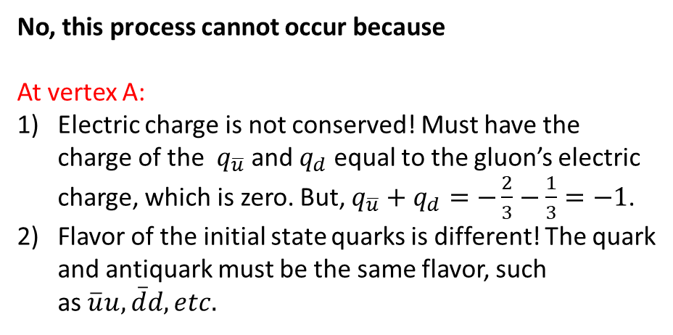

Example
Can this process occur?
Why or why not?
$$\overline{u}$$
No, this process cannot occur because
At vertex A:
Electric charge is not conserved! Must have the
charge of the $q_{\overline{u}}$and $q_{d}$ equal to the gluon’s electric
charge, which is zero. But, $q_{\overline{u}}+$ $q_{d}=−\frac{2}{3}−\frac{1}{3}=−1$.
Flavor of the initial state quarks is different! The quark
and antiquark must be the same flavor, such
as $\overline{u}u, \overline{d}d, etc.$
A
B
$$d$$

Slide 3
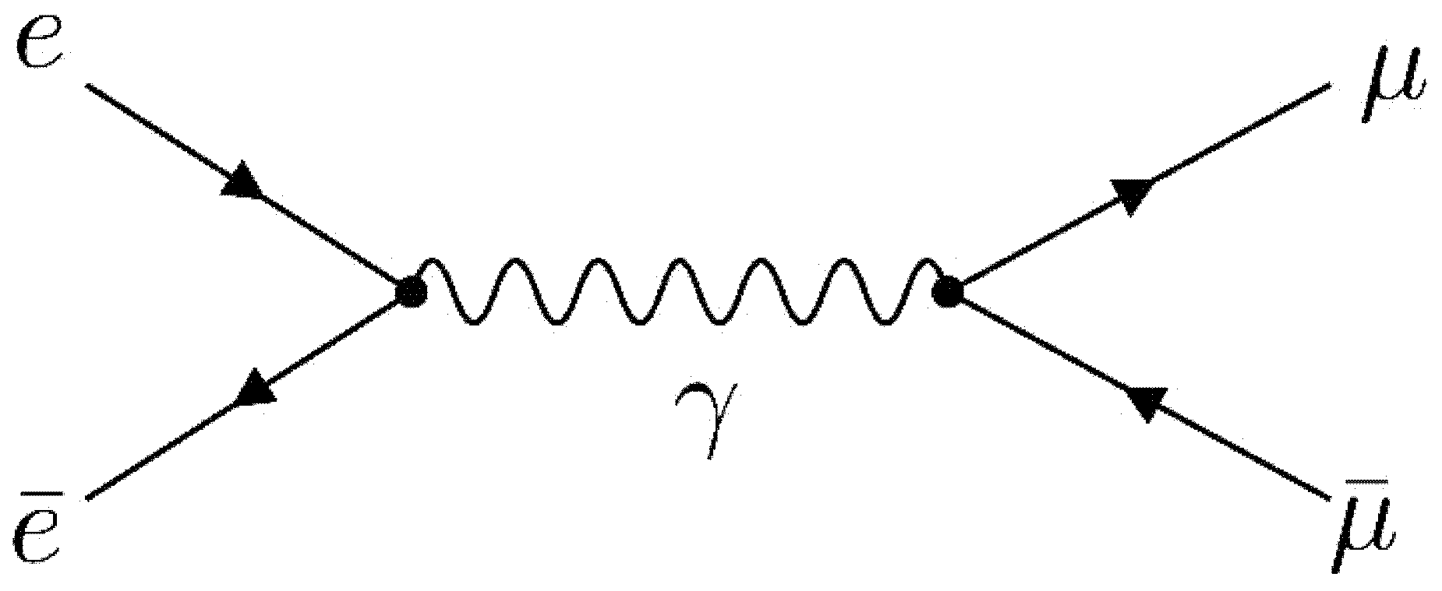




Question 1
$$e^{−}$$
$$μ^{−}$$
Can this process occur?
Why or why not?
$$μ^{+}$$
$$e^{+}$$

Slide 4
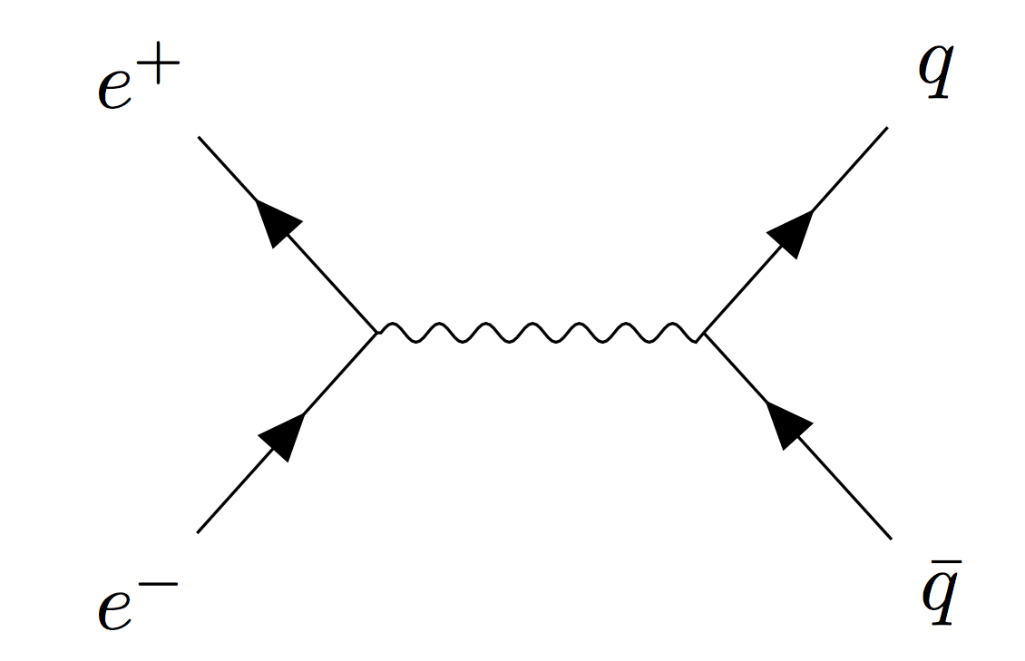



Question 2
$$u$$
Can this process occur?
Why or why not?
$$γ$$
$$\overline{c}$$

Slide 5
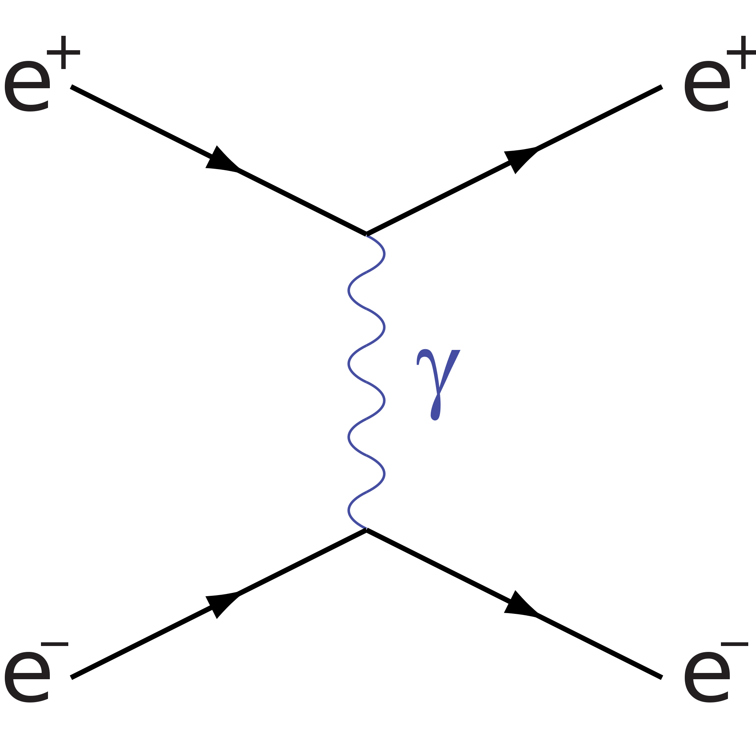




Question 3
$$e^{−}$$
$$e^{−}$$
Can this process occur?
Why or why not?
$$e^{−}$$
$$e^{−}$$

Slide 6



Question 4
$$e^{−}$$
$$μ^{−}$$
Can this process occur?
Why or why not?
$$e^{+}$$
$$μ^{+}$$

Slide 7



Question 5
$$e^{−}$$
$$ν_{e}$$
Can this process occur?
Can this process occur?
Why or why not?
$$e^{+}$$
$${\overline{ν}}_{e}$$

Slide 8


Question 6
Can this process occur?
Why or why not?
$$e^{+}$$
$$e^{−}$$

Slide 9
Question 7
Does this particle exist?
Why or why not?
u
u
u

Slide 10

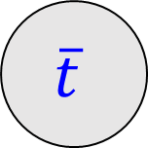

Question 8
Where does one get the antiquarks
if you wanted to try to make this
process happen?
t
Assuming the quark and antiquark
collide “head on”, what is the minimum energy the quark and antiquark must have?
$$\overline{t}$$
$$\overline{q}$$
$$q$$

Slide 11
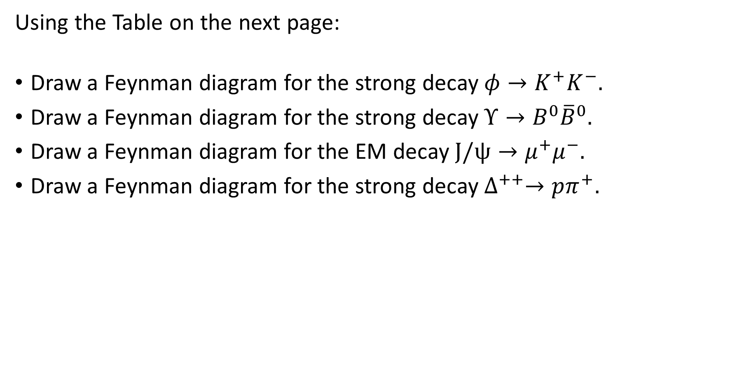
Exercises
Using the Table on the next page:
Draw a Feynman diagram for the strong decay $φ→K^{+}K^{−}.$
Draw a Feynman diagram for the strong decay $Υ→B^{0}{\overline{B}}^{0}.$
Draw a Feynman diagram for the EM decay $J/ψ→μ^{+}μ^{−}.$
Draw a Feynman diagram for the strong decay $∆^{++}→pπ^{+}.$

Slide 12
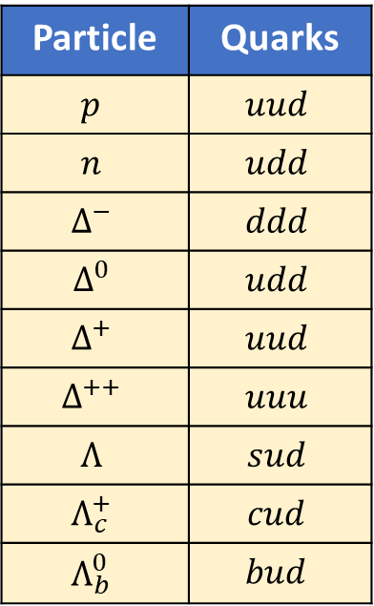
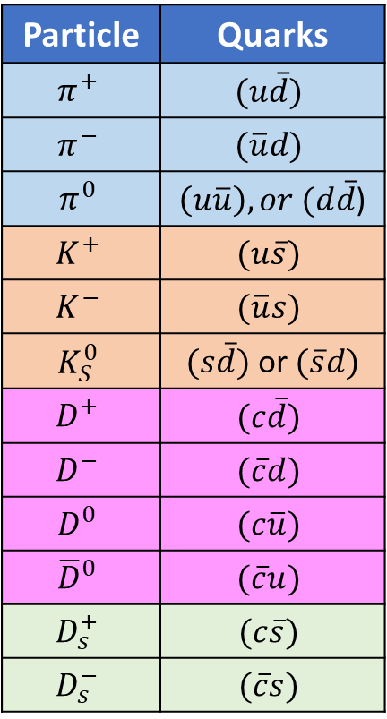
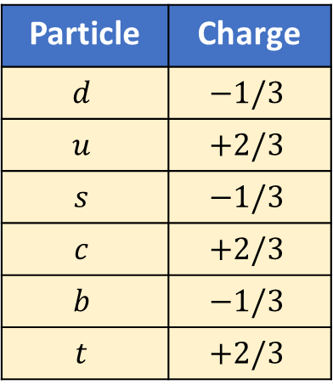
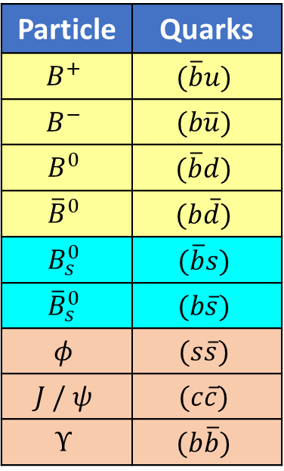
Some Mesons
Some Baryons
Quarks
Particle | Quarks
$$π^{+}$$ | $$(u\overline{d})$$
$$π^{−}$$ | $$(\overline{u}d)$$
$$π^{0}$$ | $\left(u\overline{u}\right), or (d\overline{d}$)
$$K^{+}$$ | $$(u\overline{s})$$
$$K^{−}$$ | $$(\overline{u}s)$$
$$K_{S}^{0}$$ | $(s\overline{d})$ or $(\overline{s}d)$
$$D^{+}$$ | $$(c\overline{d})$$
$$D^{−}$$ | $$(\overline{c}d)$$
$$D^{0}$$ | $$(c\overline{u})$$
$${\overline{D}}^{0}$$ | $$(\overline{c}u)$$
$$D_{s}^{+}$$ | $$(c\overline{s})$$
$$D_{s}^{−}$$ | $$(\overline{c}s)$$
Particle | Quarks
$$B^{+}$$ | $$(\overline{b}u)$$
$$B^{−}$$ | $$(b\overline{u})$$
$$B^{0}$$ | $$(\overline{b}d)$$
$${\overline{B}}^{0}$$ | $$(b\overline{d})$$
$$B_{s}^{0}$$ | $$(\overline{b}s)$$
$${\overline{B}}_{s}^{0}$$ | $$(b\overline{s})$$
$$φ$$ | $$(s\overline{s})$$
$$J / ψ$$ | $$(c\overline{c})$$
$$Υ$$ | $$(b\overline{b})$$
Particle | Quarks
$$p$$ | $$uud$$
$$n$$ | $$udd$$
$$Δ^{−}$$ | $$ddd$$
$$Δ^{0}$$ | $$udd$$
$$Δ^{+}$$ | $$uud$$
$$Δ^{++}$$ | $$uuu$$
$$Λ$$ | $$sud$$
$$Λ_{c}^{+}$$ | $$cud$$
$$Λ_{b}^{0}$$ | $$bud$$
Particle | Charge
$$d$$ | $$−1/3$$
$$u$$ | $$+2/3$$
$$s$$ | $$−1/3$$
$$c$$ | $$+2/3$$
$$b$$ | $$−1/3$$
$$t$$ | $$+2/3$$
Antiquarks have opposite
charge to the quarks

