Slide 1
Exercises 2

Slide 2
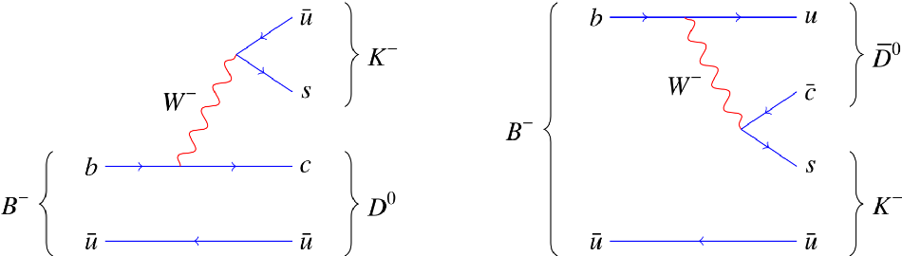




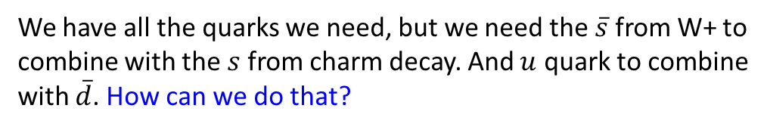







Example
Draw a Feynman diagram for the weak decay $D^{+}→φπ^{+}$
$$D^{+}$$ | $$(c\overline{d})$$
A) Identify the quarks (from tables) needed in the “initial” state:
$$π^{+}$$ | $$(u\overline{d})$$
B) Identify the quarks (from tables) needed in “final” state:
$$φ$$ | $$(s\overline{s})$$
C) There is a $\overline{d}$ in both the initial and final state, so, good chance it’s just a spectator quark in the decay
D) The charm quark does not appear in the final state, so it MUST have decayed!
Have the c-quark decay by emitting a W boson, and then the W boson decaying into a quark + antiquark.
$\overline{s}$
I need to get an “s” quark in the final state, so let me try c→sW⁺
(Must be a W⁺ by charge conservation)
$$u$$
I have $s, \overline{d}$ in final state, just need to get an $\overline{s}$ and $u$ !
$$W^{+}$$
Can $W^{+}→ \overline{s}$ $u$ ?
$$c$$
$$s$$
We have all the quarks we need, but we need the $\overline{s}$ from W+ to
combine with the $s$ from charm decay. And $u$ quark to combine
with $\overline{d}$. How can we do that?
$$\overline{d}$$
$$\overline{d}$$

Slide 3










Example
Draw a Feynman diagram for the weak decay $D^{+}→φπ^{+}$
$$D^{+}$$ | $$(c\overline{d})$$
A) Identify the quarks (from tables) needed in the “initial” state:
$$π^{+}$$ | $$(u\overline{d})$$
B) Identify the quarks (from tables) needed in “final” state:
$$φ$$ | $$(s\overline{s})$$
C) There is a $\overline{d}$ in both the initial and final state, so, good chance it’s just a spectator quark in the decay
D) The charm quark does not appear in the final state, so it MUST have decayed!
Have the c-quark decay by emitting a W boson, and then the W boson decaying into a quark + antiquark.
$$c$$
$$s$$
Draw it as an internal W diagram!
$$φ$$
$$W^{+}$$
$\overline{s}$
$$D^{+}$$
$$s$$
$$u$$
$$π^{−}$$
$$\overline{d}$$
$$\overline{d}$$

Slide 4
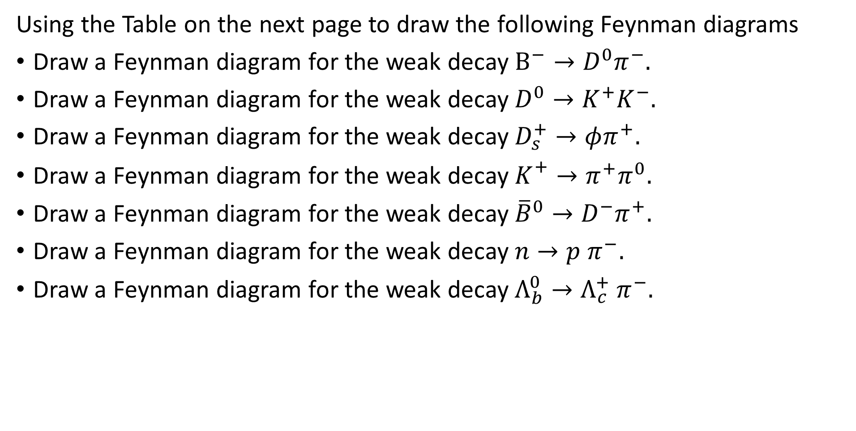
Exercises with Feynman diagrams, Weak decays
Using the Table on the next page to draw the following Feynman diagrams
Draw a Feynman diagram for the weak decay $B^{−}→D^{0}π^{−}.$
Draw a Feynman diagram for the weak decay $D^{0}→K^{+}K^{−}.$
Draw a Feynman diagram for the weak decay $D_{s}^{+}→φπ^{+}.$
Draw a Feynman diagram for the weak decay $K_{}^{+}→π^{+}π^{0}.$
Draw a Feynman diagram for the weak decay ${\overline{B}}^{0}→D^{−}π^{+}.$
Draw a Feynman diagram for the weak decay $n→p π^{−}.$
Draw a Feynman diagram for the weak decay $Λ_{b}^{0}→Λ_{c}^{+} π^{−}.$

Slide 5
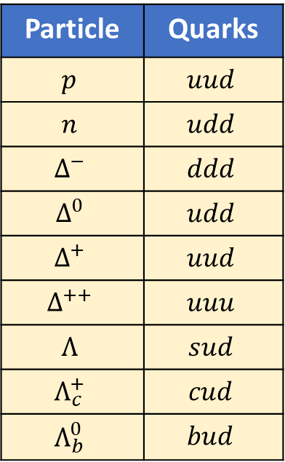
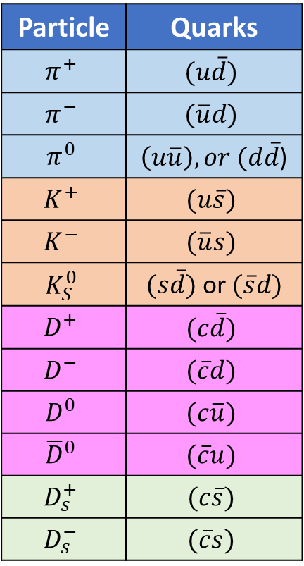
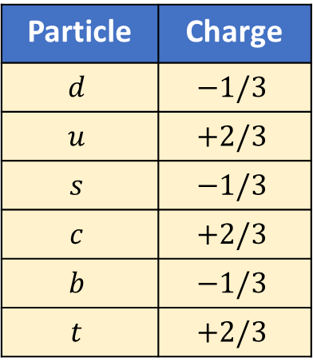
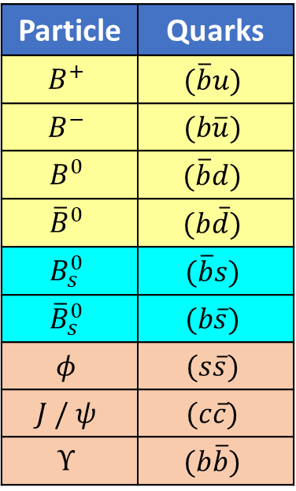
Some Mesons
Some Baryons
Quarks
Particle | Quarks
$$π^{+}$$ | $$(u\overline{d})$$
$$π^{−}$$ | $$(\overline{u}d)$$
$$π^{0}$$ | $\left(u\overline{u}\right), or (d\overline{d}$)
$$K^{+}$$ | $$(u\overline{s})$$
$$K^{−}$$ | $$(\overline{u}s)$$
$$K_{S}^{0}$$ | $(s\overline{d})$ or $(\overline{s}d)$
$$D^{+}$$ | $$(c\overline{d})$$
$$D^{−}$$ | $$(\overline{c}d)$$
$$D^{0}$$ | $$(c\overline{u})$$
$${\overline{D}}^{0}$$ | $$(\overline{c}u)$$
$$D_{s}^{+}$$ | $$(c\overline{s})$$
$$D_{s}^{−}$$ | $$(\overline{c}s)$$
Particle | Quarks
$$B^{+}$$ | $$(\overline{b}u)$$
$$B^{−}$$ | $$(b\overline{u})$$
$$B^{0}$$ | $$(\overline{b}d)$$
$${\overline{B}}^{0}$$ | $$(b\overline{d})$$
$$B_{s}^{0}$$ | $$(\overline{b}s)$$
$${\overline{B}}_{s}^{0}$$ | $$(b\overline{s})$$
$$φ$$ | $$(s\overline{s})$$
$$J / ψ$$ | $$(c\overline{c})$$
$$Υ$$ | $$(b\overline{b})$$
Particle | Quarks
$$p$$ | $$uud$$
$$n$$ | $$udd$$
$$Δ^{−}$$ | $$ddd$$
$$Δ^{0}$$ | $$udd$$
$$Δ^{+}$$ | $$uud$$
$$Δ^{++}$$ | $$uuu$$
$$Λ$$ | $$sud$$
$$Λ_{c}^{+}$$ | $$cud$$
$$Λ_{b}^{0}$$ | $$bud$$
Particle | Charge
$$d$$ | $$−1/3$$
$$u$$ | $$+2/3$$
$$s$$ | $$−1/3$$
$$c$$ | $$+2/3$$
$$b$$ | $$−1/3$$
$$t$$ | $$+2/3$$
Antiquarks have opposite
charge to the quarks

