Slide 1
Feynman diagrams and the Weak Force
S. Blusk
Quarknet 2023
Syracuse University
Aug 14-16, 2023

Slide 2
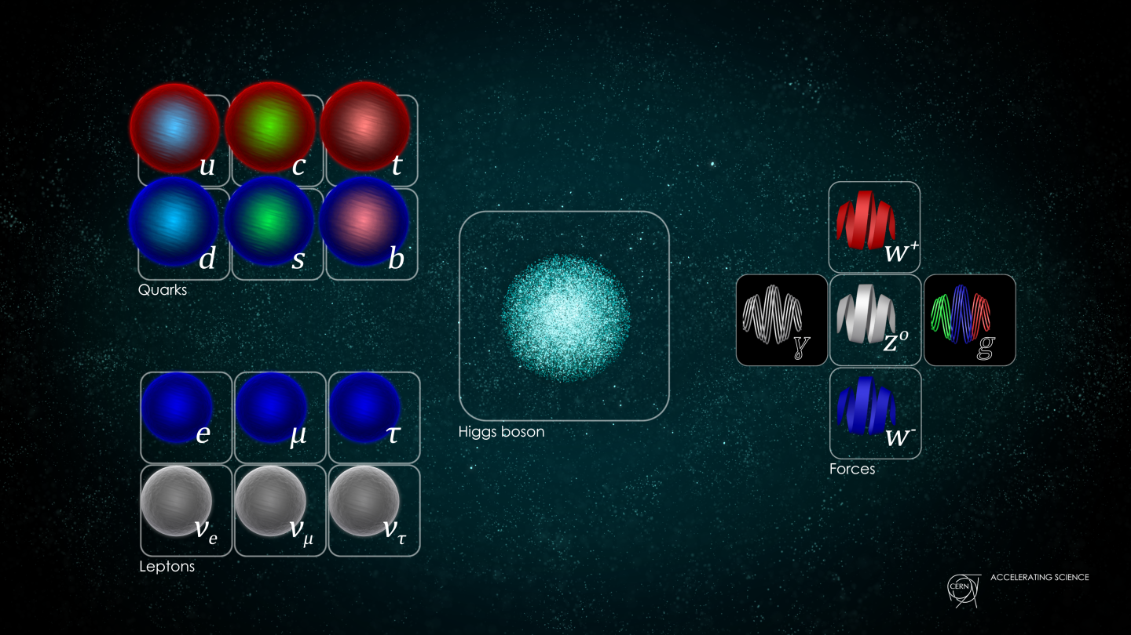
The Standard Model
That’s it, in
a nutshell!
3 families of quarks & leptons (differ only by their masses)
3 forces (Strong, EM, Weak), each with their own set of force carriers
Conservation Laws / Symmetries dictate how these particles interact

Slide 3
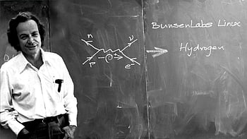
Part I
Feynman diagrams and how to understand them

Slide 4
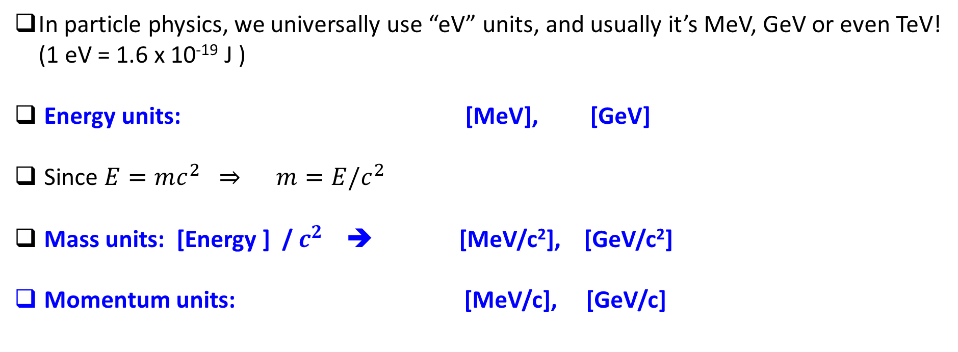
Preliminary
In particle physics, we universally use “eV” units, and usually it’s MeV, GeV or even TeV!
(1 eV = 1.6 x 10⁻¹⁹ J )
Energy units: [MeV], [GeV]
Since $E=mc^{2} ⇒ m=E/c^{2}$
Mass units: [Energy ] / $c^{2}$ ➔ [MeV/c²], [GeV/c²]
Momentum units: [MeV/c], [GeV/c]

Slide 5



Forces
Interactions
Particle decays
Cross-section (area)
Decay rate (1/s)
$$σ(a+b→c+d)$$
$$N=N_{0}e^{−Γt}$$
$$Γ(A→anything)$$

Slide 6
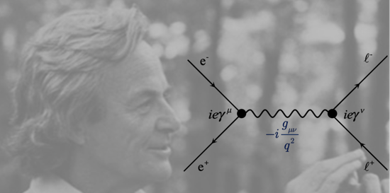
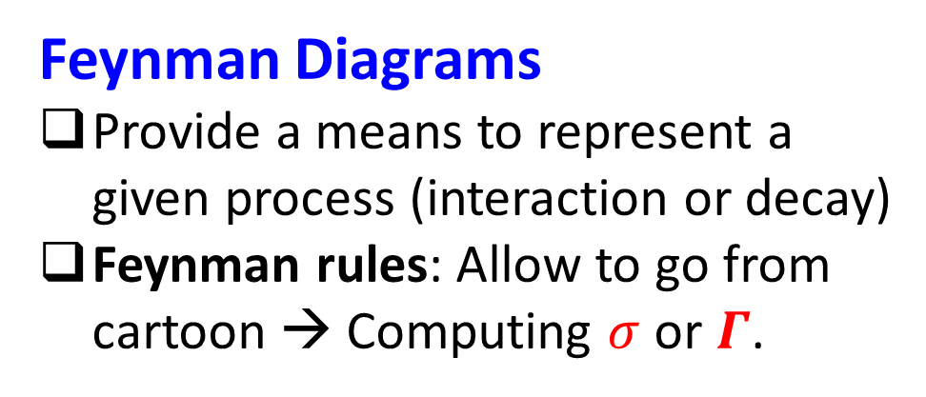
Forces
Interactions
Particle decays
Cross-section (area)
Decay rate (1/s)
$$σ(a+b→c+d)$$
$$N=N_{0}e^{−Γt}$$
$$Γ(A→anything)$$
Feynman Diagrams
Provide a means to represent a
given process (interaction or decay)
Feynman rules: Allow to go from
cartoon → Computing $σ$ or $Γ$.

Slide 7
Forces
Interactions
Let’s begin with interactions
Cross-section (area)
$$σ(a+b→c+d)$$
Feynman Diagrams
Provide a means to represent a
given process (interaction or decay)
Feynman rules: Allow to go from
cartoon → Computing $σ$ or $Γ$.

Slide 8

Feynman Diagrams (1)
space
time

Slide 9
Feynman Diagrams (1)
space
time

Slide 10
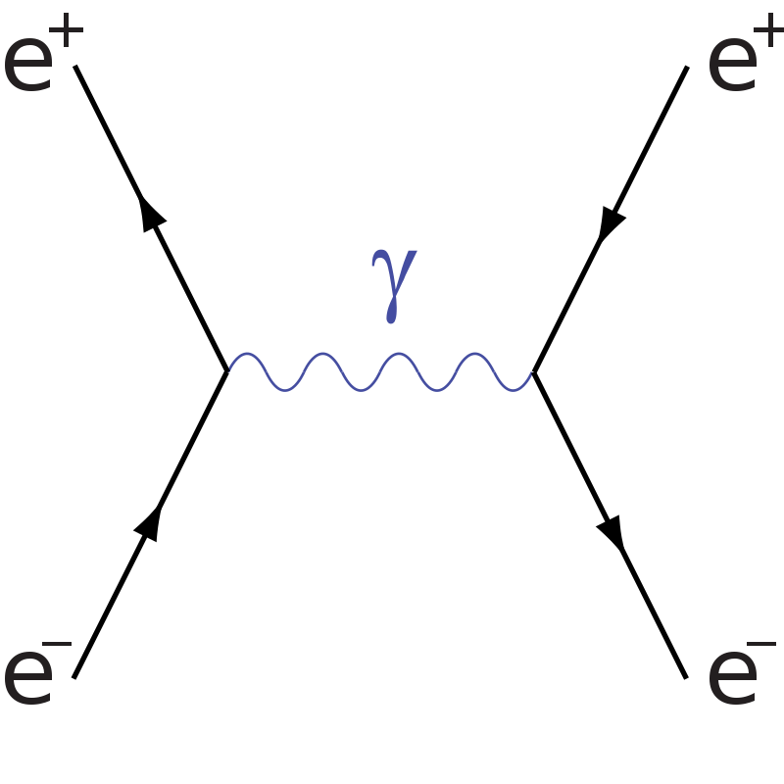
Feynman Diagrams (1)
space
time

Slide 11
Feynman Diagrams (1)
space
time
Whallah, a Feynman diagram ☺

Slide 12
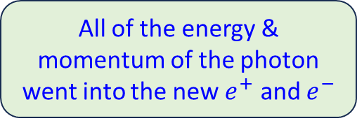
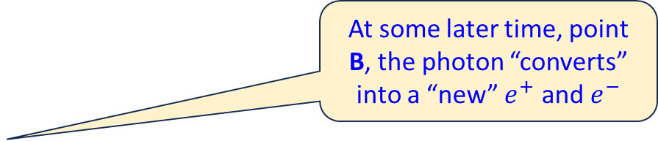
Feynman Diagrams (2)
space
At some later time, point B, the photon “converts” into a “new” $e^{+}$ and $e^{−}$
Electron and positron
move toward each
other and “annihilate”
at point A into a photon
A
B
All of the energy & momentum of the photon went into the new $e^{+}$ and $e^{−}$
All of the energy & momentum of the e⁺ and e⁻ went into the photon!
A “mediator” of the
interaction (one of the force carriers)
time
What kind of interaction does this represent?
  ELECTROMAGNETIC INTERACTION (how do we know this?)
A detail: Antiparticles have their arrows drawn backward in time.

Slide 13
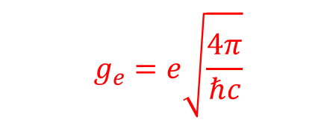

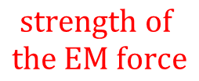
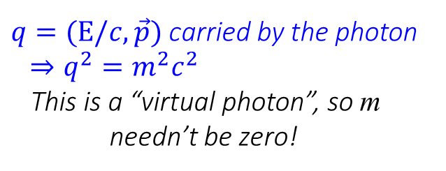
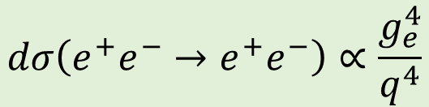



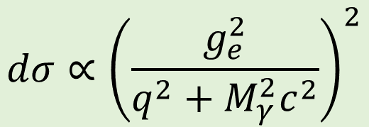
Key parts of the Feynman rules
space
$$g_{e}=e\sqrt{\frac{4π}{ℏc}}$$
$$\text{strength} of$$
$$the EM force$$
$$g_{e}$$
$$g_{e}$$
$q=(E/c,\vec{p})$ carried by the photon
$$⇒q^{2}=m^{2}c^{2}$$
This is a “virtual photon”, so m
needn’t be zero!
$$\frac{1}{q^{2}+M_{γ}^{2}c^{2}}$$
time
$$dσ∝{\left(\frac{g_{e}^{2}}{q^{2}+M_{γ}^{2}c^{2}}\right)}^{2}$$
$$dσ\left(e^{+}e^{−}→e^{+}e^{−}\right)∝\frac{g_{e}^{4}}{q^{4}}$$
$$M_{γ}^{}= ?$$

Slide 14

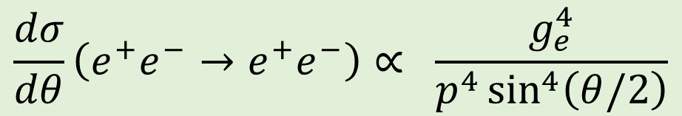


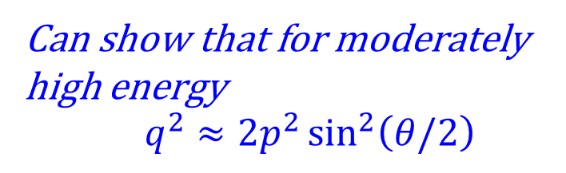
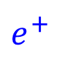





Collision in the “center of mass”
$e^{+}$
$$[p cosθ, psinθ]$$
$$θ$$
$$\vec{p}$$
$$−\vec{p}$$
$e^{+}$
$e^{−}$
$e^{−}$
$$[p cos\left(180+θ\right), psin\left(180+θ\right)]$$
Can show that for moderately high energy
$q^{2}≈2p^{2}\sin^{2}\left(θ/2\right)$
$$\frac{dσ}{dθ}\left(e^{+}e^{−}→e^{+}e^{−}\right)∝ \frac{g_{e}^{4}}{p^{4}\sin^{4}\left(θ/2\right)}$$

Slide 15
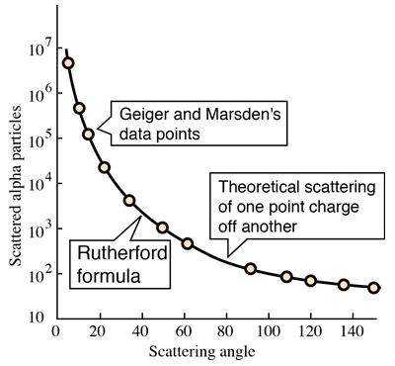



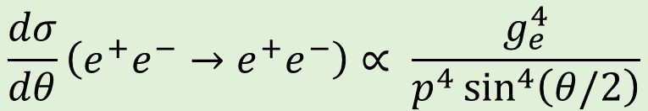






Collision in the “center of mass”
Log scale!
$e^{+}$
$$[p cosθ, psinθ]$$
$$θ$$
$$\vec{p}$$
$$−\vec{p}$$
$e^{+}$
$e^{−}$
$e^{−}$
$$[p cos\left(180+θ\right), psin\left(180+θ\right)]$$
$$\frac{dσ}{dθ}\left(e^{+}e^{−}→e^{+}e^{−}\right)∝ \frac{g_{e}^{4}}{p^{4}\sin^{4}\left(θ/2\right)}$$
Predicts that scattering angle
strongly peaked at small angles!
Precisely what Rutherford & his students found!

Slide 16
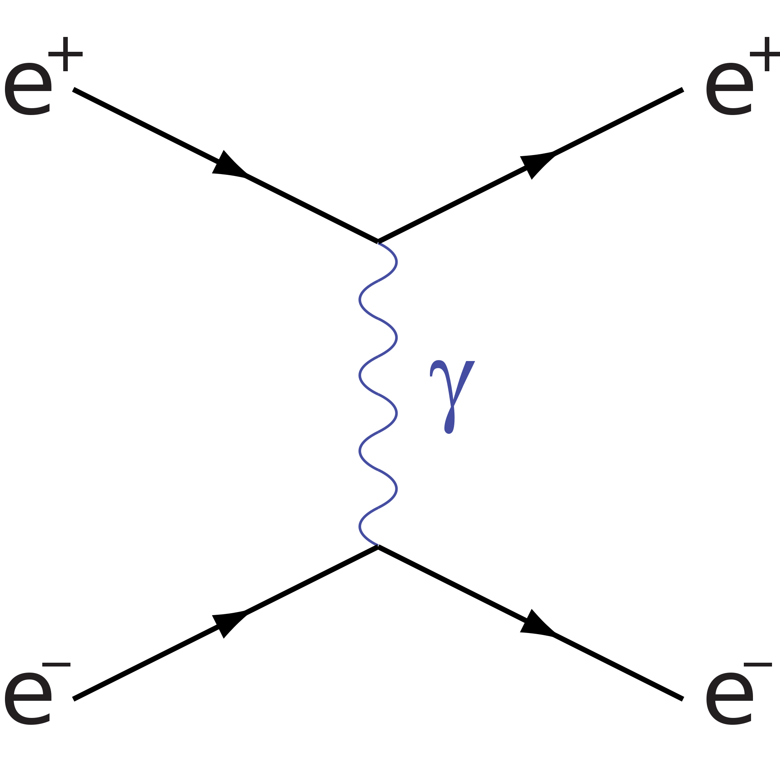
An important detail I skipped
Must include ALL possible diagrams, so this one also needs to be computed and included in the calculation.
space
This represents the e⁻ “emitting” a photon,
and the e⁺ “absorbing” it (or vice versa).
In this case, there is no “annihilation”.
There is “exchange” of energy & momentum,
(via the photon) which is synonymous with
“force”.
time

Slide 17
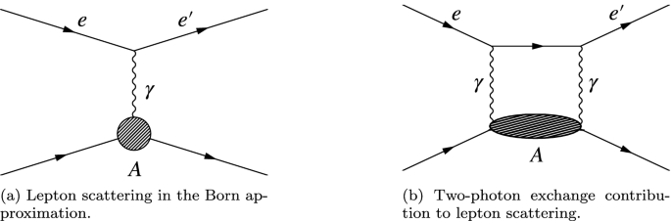




Oh, and what about this?
$$e^{+}$$
$$e^{+}$$
$$e^{−}$$
$$e^{−}$$
Luckily: Every extra photon being exchanged is suppressed by ~100X!

Slide 18
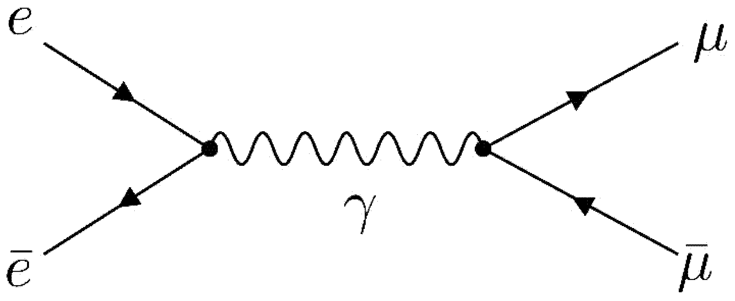
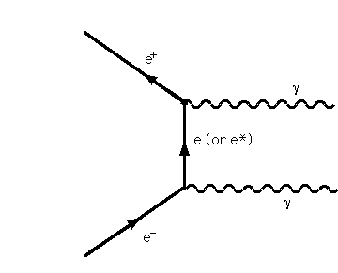
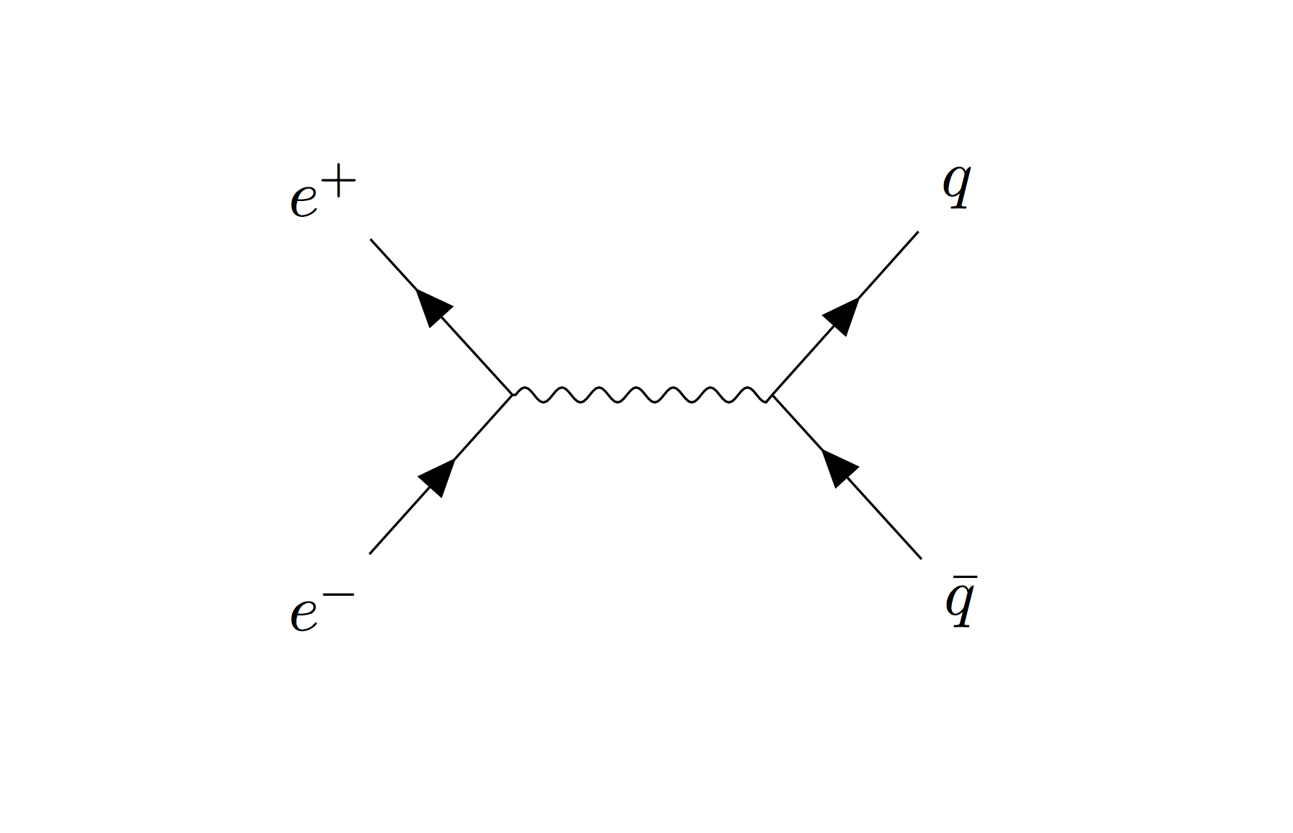









Other Feynman diagrams, EM Interactions
$$e^{−}$$
$$μ^{−}$$
$$e^{+}$$
$$γ$$
$$e^{+}$$
$$μ^{+}$$
$$γ$$
$$e^{−}$$
$$γ$$

Slide 19
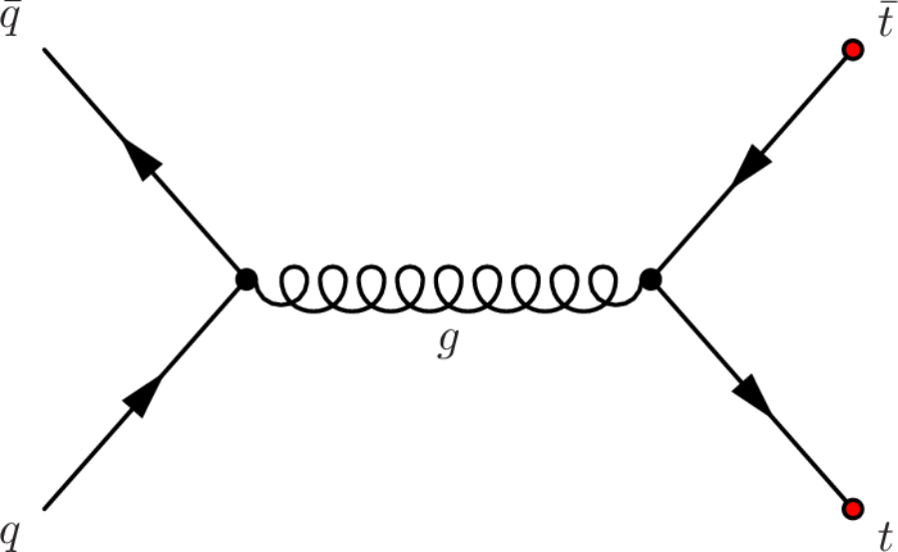
Example of Feynman diagram (1)
What force is responsible for this interaction?

Slide 20
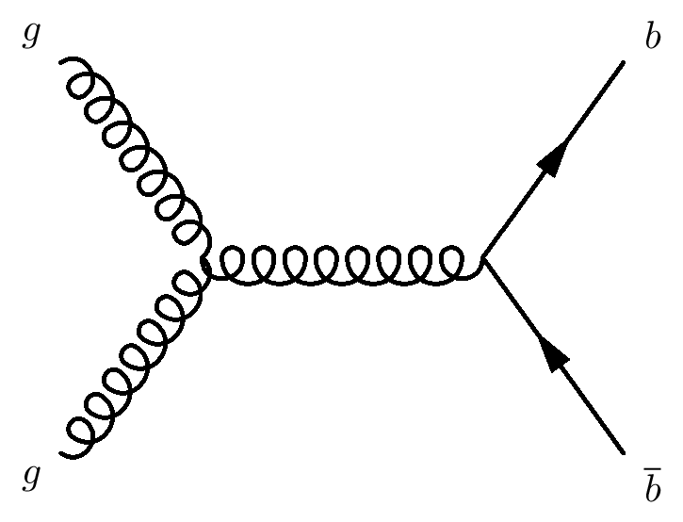
Example of Feynman diagram (2)
What force is responsible for this interaction?
How does one “collide gluons” ?

Slide 21
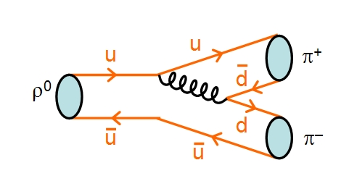
Example of a strong decay
Mass = 139.6 MeV/c²
g
Mass = 770 MeV/c²
Mass = 139.6 MeV/c²
What signals to you that this is a
decay mediated by the strong interaction?

Slide 22



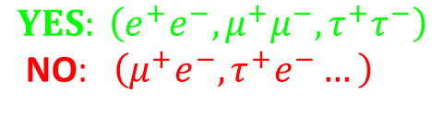
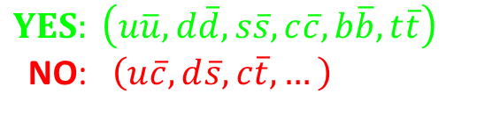


Conservation Laws
Various quantities must be conserved
at each of the vertices.
A partial list of conserved quantities
for BOTH EM and Strong Forces
$$e^{−}$$
$$μ^{−}$$
$$YES: \left(e^{+}e^{−},μ^{+}μ^{−},τ^{+}τ^{−}\right)$$
NO: $\left(μ^{+}e^{−},τ^{+}e^{−}…\right)$
Conserved quantity
Energy
Linear Momentum
Angular momentum
Electric charge
Color charge (Strong force only, next slide)
Quark or lepton “flavor”
$$e^{+}$$
$$μ^{+}$$
$$YES: \left(u\overline{u},d\overline{d},s\overline{s},c\overline{c},b\overline{b},t\overline{t}\right)$$
NO: $\left(u\overline{c},d\overline{s},c\overline{t},…\right)$
$$γ$$
If ANY of these are violated,
the process cannot occur.

Slide 23








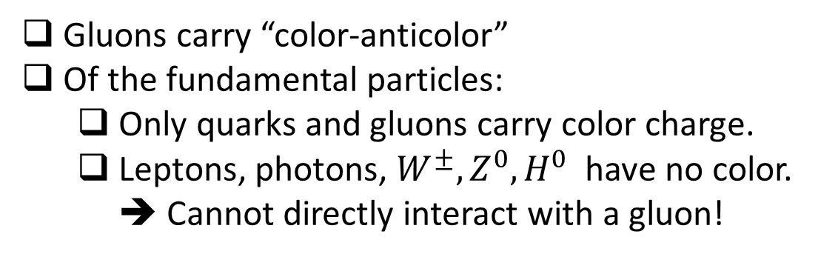








Conservation of “strong” charge
What does conservation of color charge mean?
  Quarks carry “strong charge”: 3 values
  Colorful idea: red(r), green(g), blue(b)
Net color charge needs to be preserved
at each vertex.
$$b$$
$$g$$
No color
$$r$$
No color
$$γ$$
No color
$$\overline{r}$$
$$\overline{g}$$
$$\overline{b}$$
$$\overline{q}$$
$$\overline{t}$$
$$\overline{r}$$
$$\overline{r}$$
Gluons carry “color-anticolor”
Of the fundamental particles:
  Only quarks and gluons carry color charge.
  Leptons, photons, $W^{±}, Z^{0},H^{0}$ have no color.
  ➔ Cannot directly interact with a gluon!
$$g\overline{r}$$
gluon
$$g$$
$$g$$
$$q$$
$$t$$

Slide 24

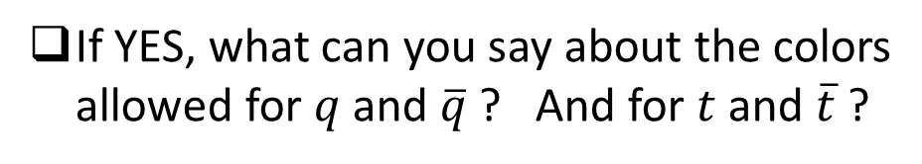








Questions
$$e^{+}$$
$\overline{t}$
Is this a valid Feynman diagram?
Why or why not?
gluon
$$e^{−}$$
$$t$$
$\overline{t}$
$$\overline{q}$$
Is this a valid Feynman diagram?
Why or why not?
$$γ$$
If YES, what can you say about the colors
allowed for $q$ and $\overline{q}$ ? And for $t$ and $\overline{t}$ ?
$$q$$
$$t$$

Slide 25
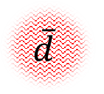
Hadrons, baryons and mesons
Hadrons: Particles containing quarks.
  All known hadrons have zero net color
Conventional
baryon (proton)
Conventional
meson (pion)
u
$$\overline{d}$$
d
u
u
Any 3 quarks (except top) w/ different color
can form a baryon that should exist in nature
Any quark + antiquark (with color-anticolor)
can form a meson that should exist in nature

Slide 26
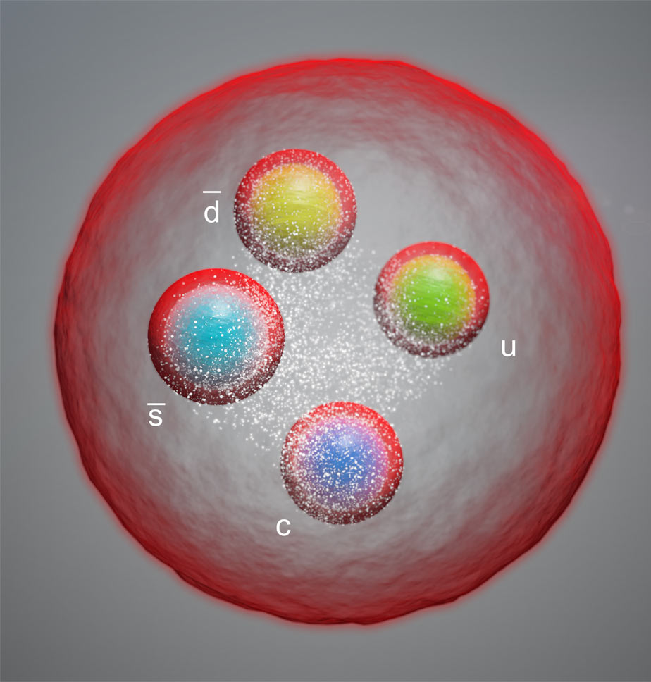
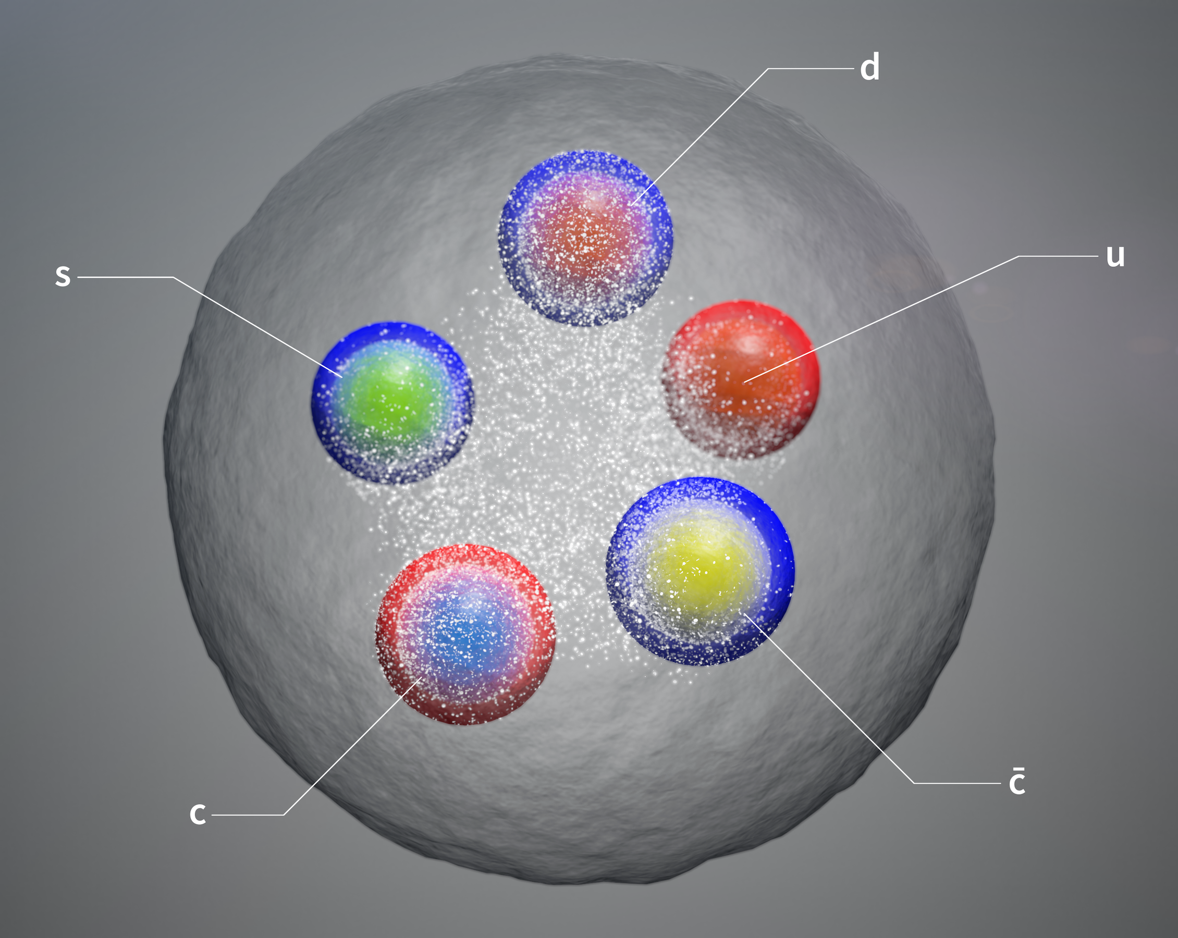
Non-conventional hadrons
In recent years, strong evidence of tetraquarks and pentaquarks, much of it
spear-headed by LHCb
The nature of these states still under active investigation: tightly bound or molecular?

