Slide 1
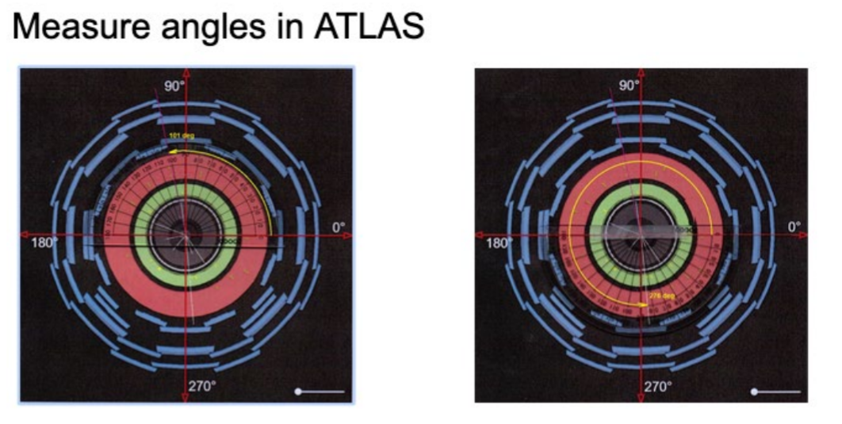
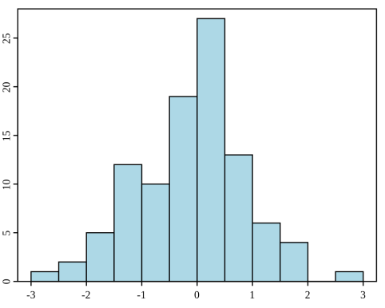
HISTOGRAMS: UNCERTAINTY

Slide 2
INTRODUCTION
Particle physicists rely on histograms to find new particles and to measure the characteristics of particles.
Sometimes the probability of a particular interaction occurring is small.
In such cases, particle physicists collect huge amounts of data in the hope of finding this interaction as a small bump in the histogram.
This activity builds histogram skills required in many of the other activities in the Data Activities Portfolio.
In this activity, students will construct histograms, identify the best value to represent the data, and report the uncertainty in their answers.

Slide 3
LEARNING OBJECTIVES
Students will know and be able to:
• Determine the uncertainty for a particular bin. • Determine the best value to represent the data.
• Determine the uncertainty in the best value to represent the data.

Slide 4
Part 1- Rolling of dice
Part 2- Measuring the angle phi (ϕ) at which muons emerge after collisions in ATLAS.
Part 3- Defining uncertainty for a Gaussian distribution.

Slide 5
Part 1-Rolling of Dice
The student pages present the following histograms and ask questions to lead them to see that there is no preferred number when rolling a six-sided die.
Also, they should notice that each set of 100 rolls yields a different result, but if the number of rolls is large, then there seems to be no preferred number.
When all of the sides have equal probability of being rolled, then the die is said to be a fair die.

Slide 6
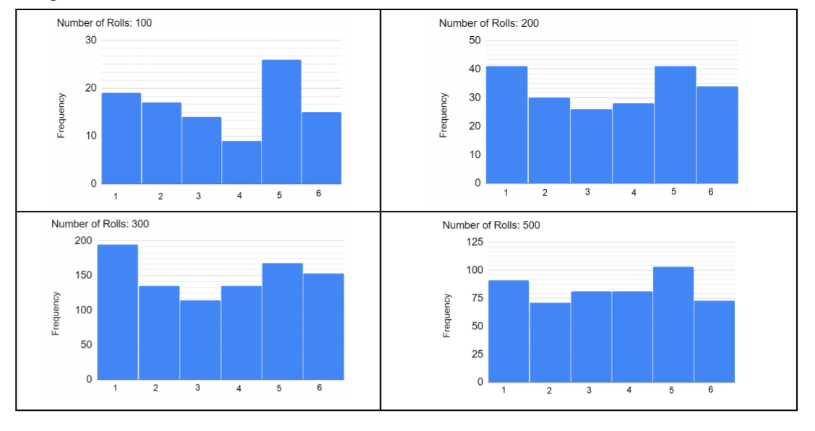
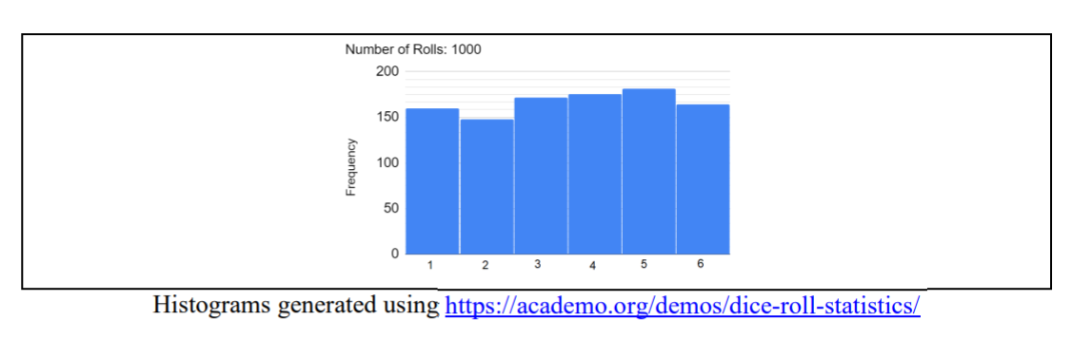

Slide 7
Part 2
ATLAS Measuring the ANGLE phi (ϕ)
Muons emerge at a particle angle phi (ϕ) after collision events inside the ATLAS detector.
The physicists wanted to see if there was a preferred angle for the muons to emerge from a collision. The angle phi (ϕ) is measured around the LHC beam pipe which is the direction of motion for the incoming particles. Figure 1 shows how to measure the angle.

Slide 8
Part 2
ATLAS Measuring the Angle phi (ϕ)

Slide 9
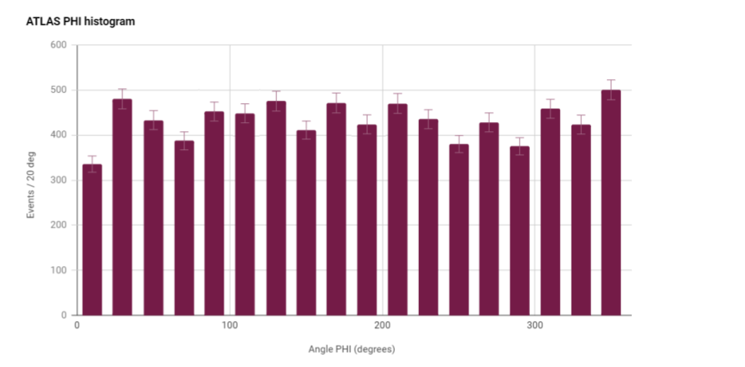
Part 2
ATLAS Measuring the ANGLE phi (ϕ)

Slide 10
Part 3: Defining uncertainty for a Gaussian distribution.
In a Gaussian (or normal) distribution, the data values can be less than or greater than the mean.
Figure 3 below shows the shape of a typical Gaussian distribution.
The standard deviation in the Gaussian distribution is approximated by finding the width of the Gaussian when the frequency is half of the maximum value and dividing by 2
(Full-Width Half-Maximum over 2, or FWHM/2).

Slide 11
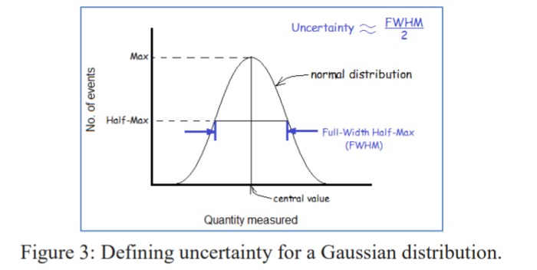

Slide 12
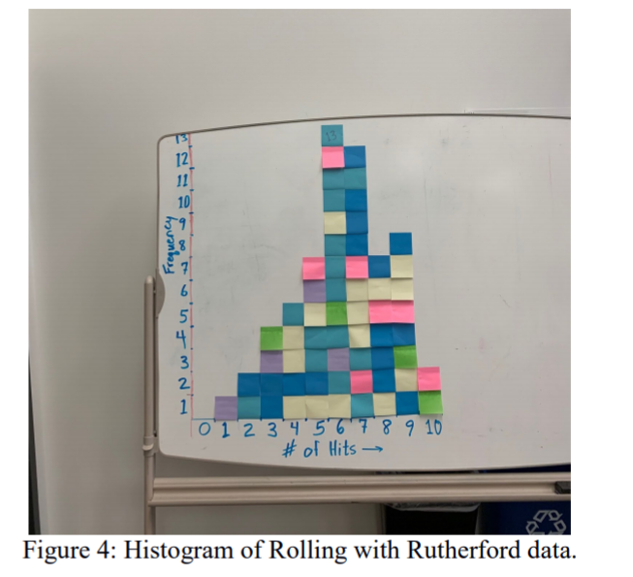

Slide 13
The uncertainty for each bin is found by using the standard deviation Poisson distribution √N.
The uncertainty of the histogram is found using the approximation of the standard deviation of the Gaussian distribution FWHM/2.

Slide 14
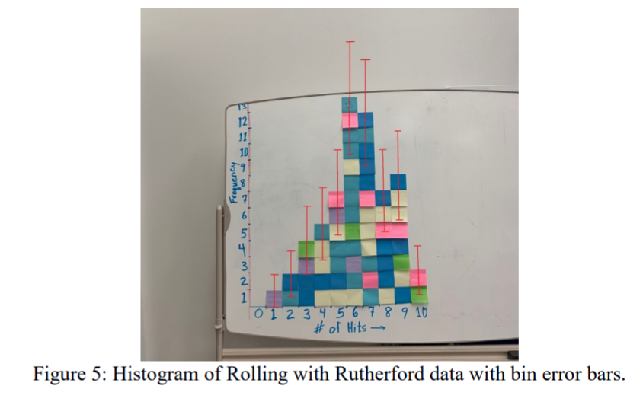

Slide 15
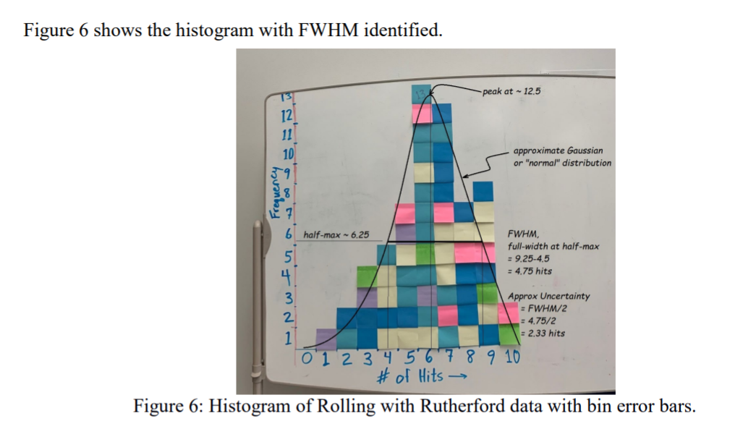

Slide 16
Three Histograms for Assessment
Student Instructions:
For Histogram 1:
• Calculate the uncertainty of each bin.
• Draw the error bars on each bin.
For Histograms 2 and 3:
• Calculate the uncertainty of each bin.
• Draw the error bars on each bin.
• Determine the uncertainty of the peak using FWHM.
• Make a claim about the most likely particle mass in GeV including uncertainty. Support your claim with evidence and reasoning.

Slide 17
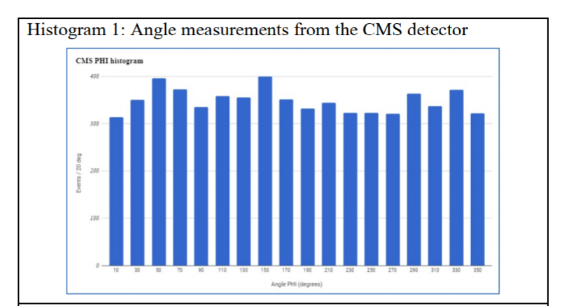

Slide 18
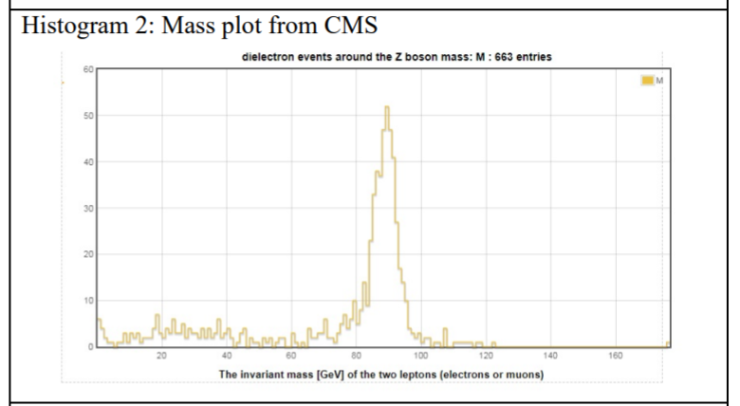

Slide 19
