Slide 1
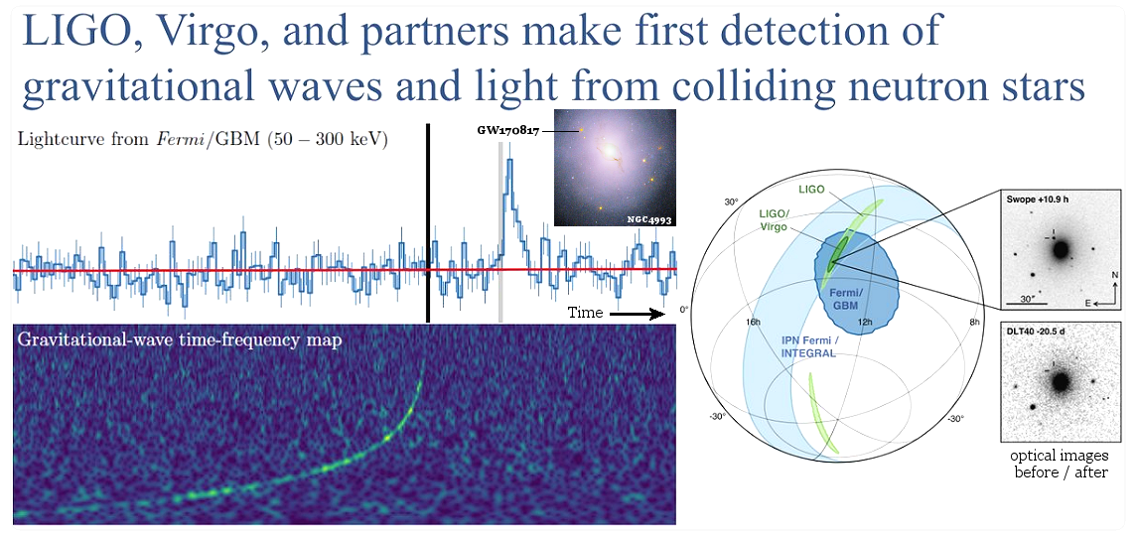
Multimessenger Astronomy – a new field gravity waves + photons
TELESCOPES (ALL WAVELENGTHS)

Slide 2
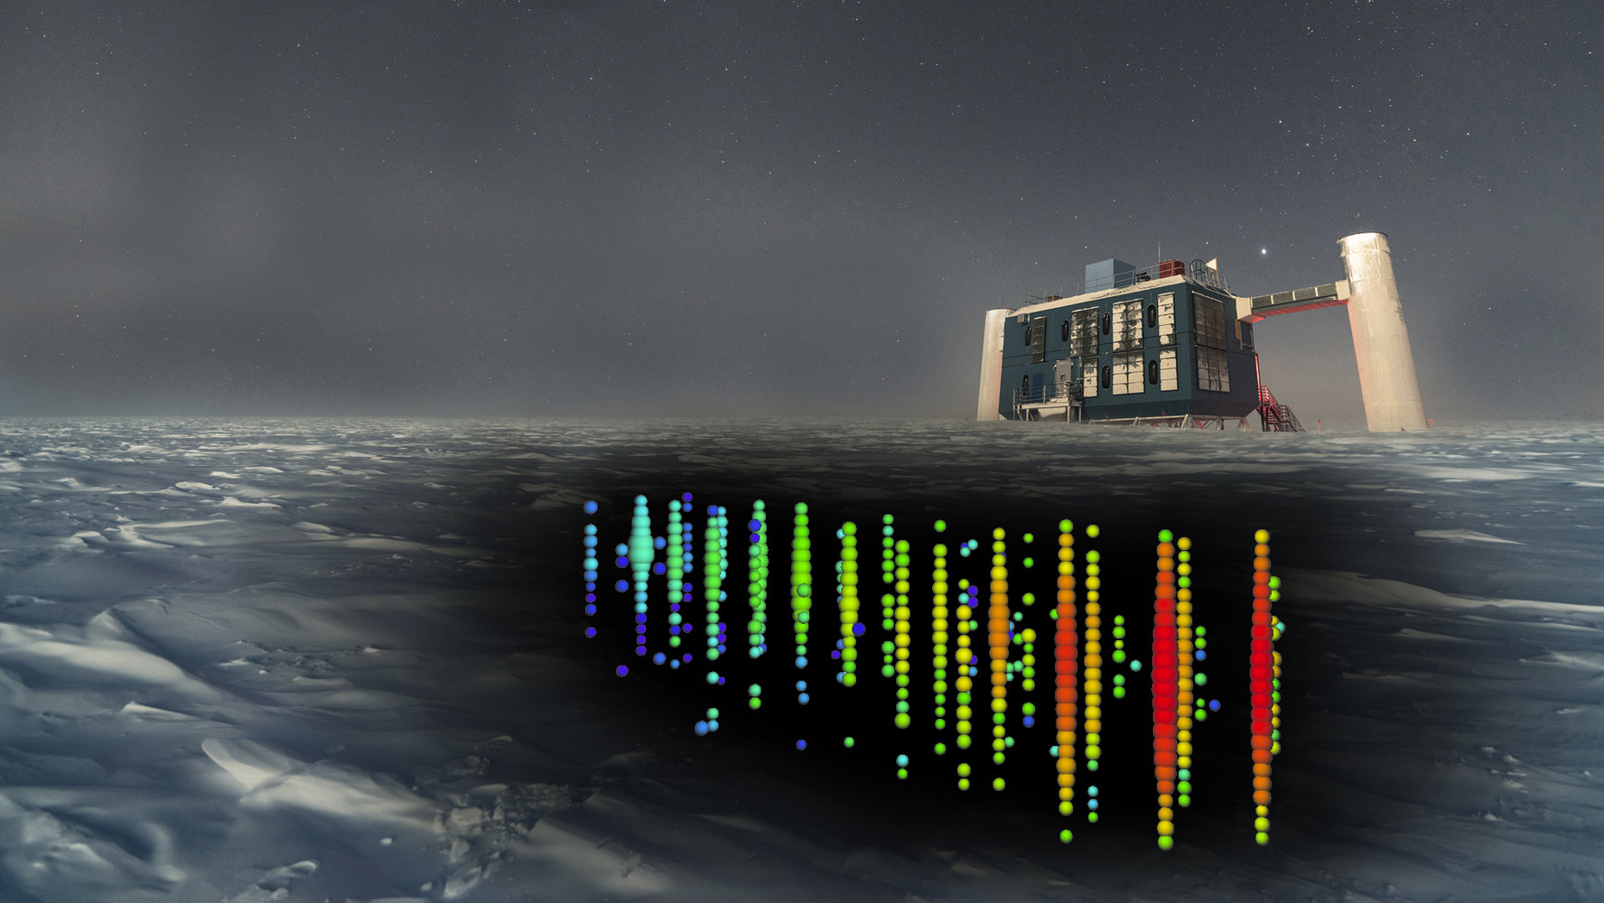
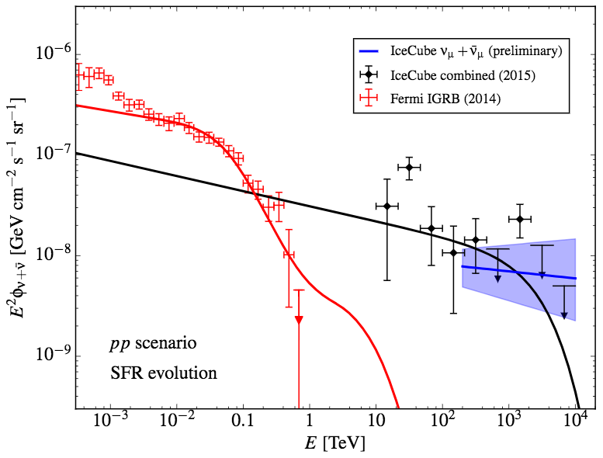
Multimessenger Astronomy – a new field neutrinos + photons

Slide 3
MMA Signatures Masterclass – proposed
Conference
Neutrino group 1 (UG)
Gravity wave group
Gamma ray group
Neutrino group 2 (ICECube)
Other EM Signatures
Conclusions
One event chosen for each year’s masterclass
Some signatures might be null (e.g., neutrinos in GW170817)

