Slide 1
Introducing the “Particle Players”
Neutrino
ν
Leptonic “Little Neutral One”
Proton
p⁺
Neutron
n⁰
Quarky & Positive
Quarky & Neutral
Electron
e⁻
Leptonic & Negative
muon
μ
Electron’s Heavier Unstable Cousin

Slide 2
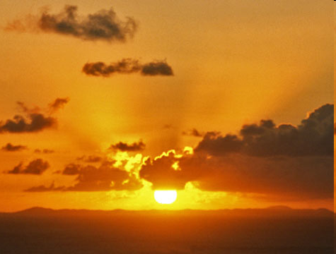
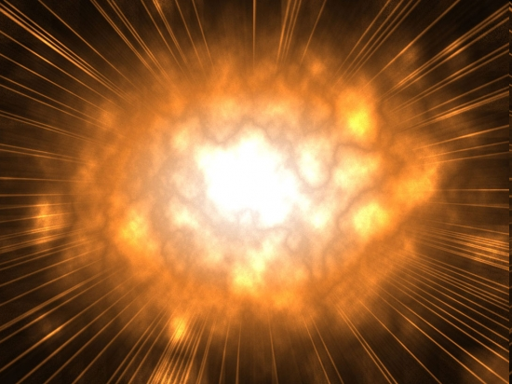
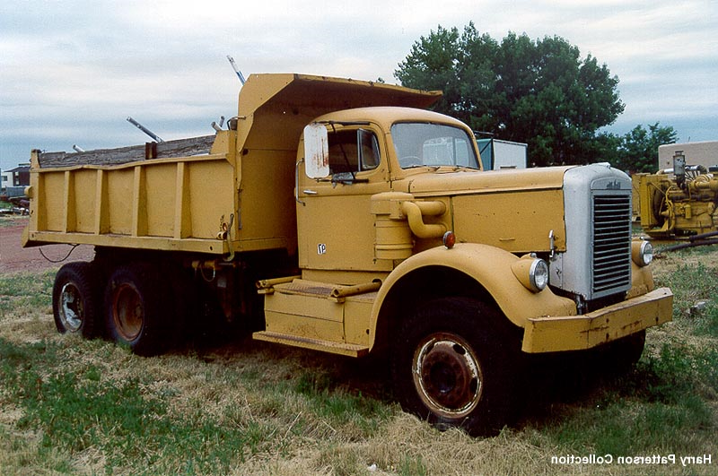

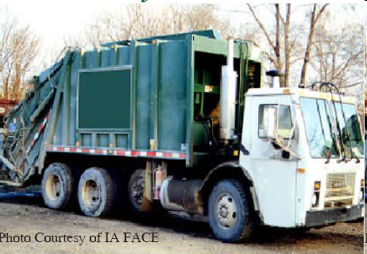
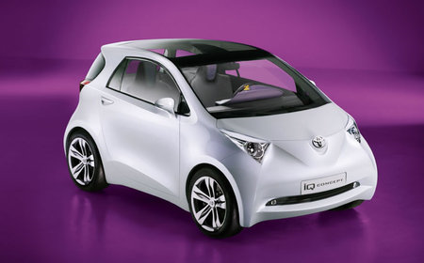
Our Reaction is Kind of Like This:
Imagine a bug…
flying very fast…
and there’s a garbage truck sitting there…
that our bug crashes into!!!
Oddly enough, a
dump truck & small
electric car appear
in its wake…
And they drive off into the sunset!
Make
Sense!?

Slide 3
LET’S LOOK
AT THIS IN A
MORE SCIENTIFIC
LIGHT

Slide 4
MINERvA’s Principal Interaction
Of Interest (What we see)
A proton and muon “appear” out of nowhere
in the scintillating target
υ_{μ}
p⁺
n⁰
μ⁻
Scintillating Target Material

Slide 5
MINERvA’s Principal Interaction
Of Interest (Revealed)
neutrino + neutron → proton + muon
ν_{μ-} + n⁰ → p⁺ + μ⁻
p⁺
υ_{μ}
n⁰
μ⁻
Scintillating Target Material

Slide 6
What’s Going On?
A neutrino with kinetic energy strikes a neutron at ‘rest’ in the nucleus of an atom…
Which causes one of the neutron’s down quarks to flip “up” (udd) to (uud) … transforming it to a proton!
Simultaneously, a muon is generated as the neutrino annihilates
p⁺
υ_{μ}
n⁰
udd —> uud
μ⁻
Scintillating Target Material

Slide 7
What’s Going On?
p⁺
υ_{μ}
n⁰
μ⁻
Also, there is a net gain of mass & a loss of energy during the interaction (E = Δmc²)…
Some of the neutrino’s pre-collision kinetic energy changes into new mass (the muon) and some is transferred to the kinetic energies of the muon and proton.

Slide 8
Important Momentum Ideas
At the position and time
of the interaction only!
Momentum is
conserved in
all 3 axes
p⁺
υ_{μ}
n⁰
μ⁻
Before Collision
After Collision
p_{neutrino} + p_{neutron}
= p_{proton} + p_{muon}

Slide 9
Predictions:
Sketch a graph representing what you might expect for the combined momentum of the resulting muon plus proton…
Along the z-direction (beamline direction)
Along the x-direction (L-R)
Along the y-direction (up-down)

Slide 10
Data Analysis 1
Follow instructions to analyze data from MINERvA
Once done
  Compare momentum graphs with predictions
  Determine neutrino beam energy

Slide 11
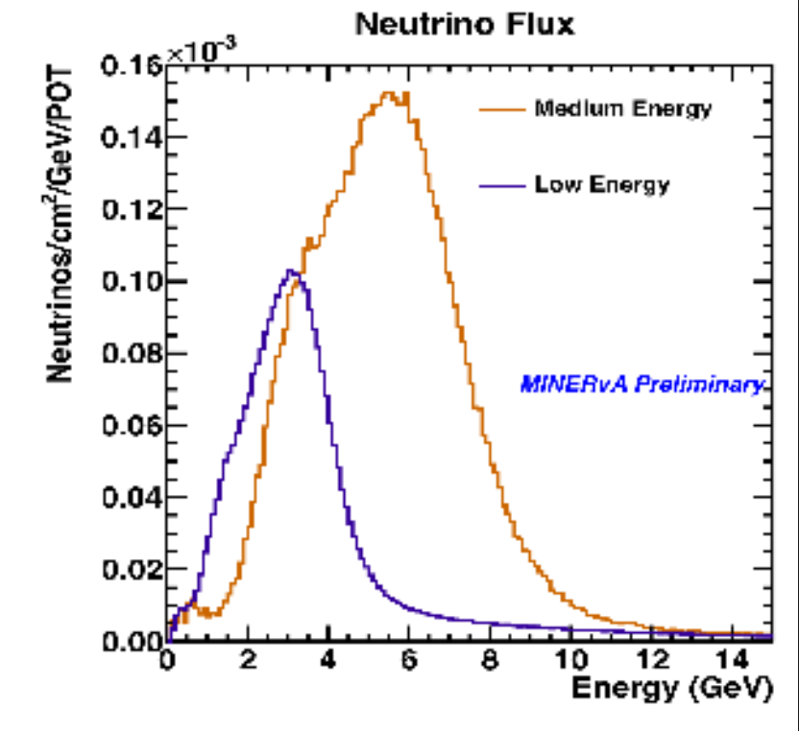
Neutrino Beam Energy

Slide 12
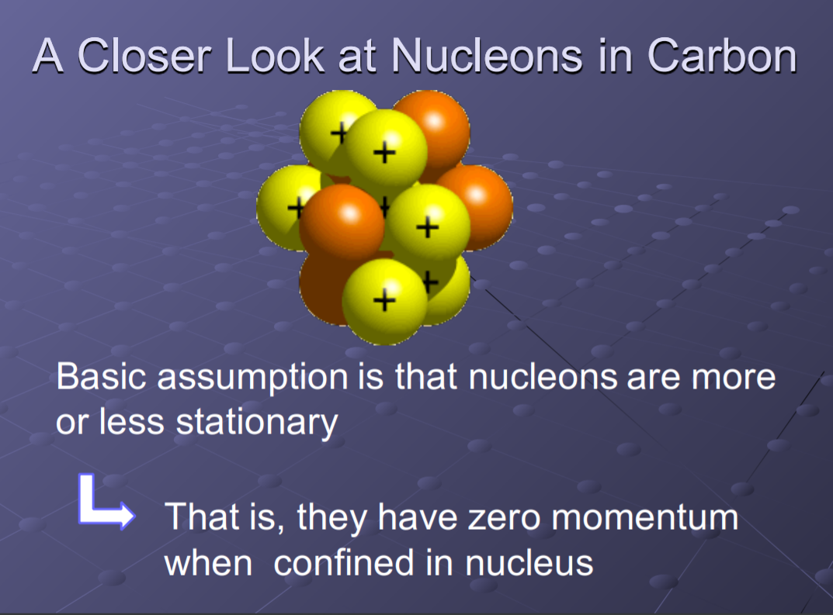

Slide 13
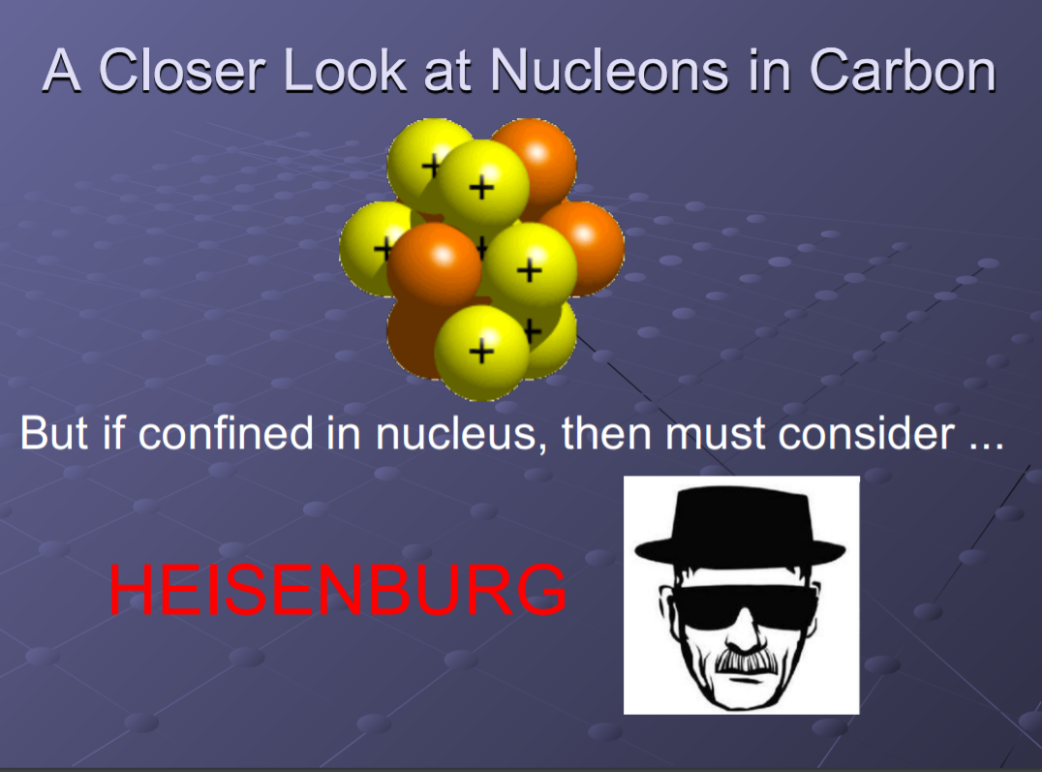

Slide 14
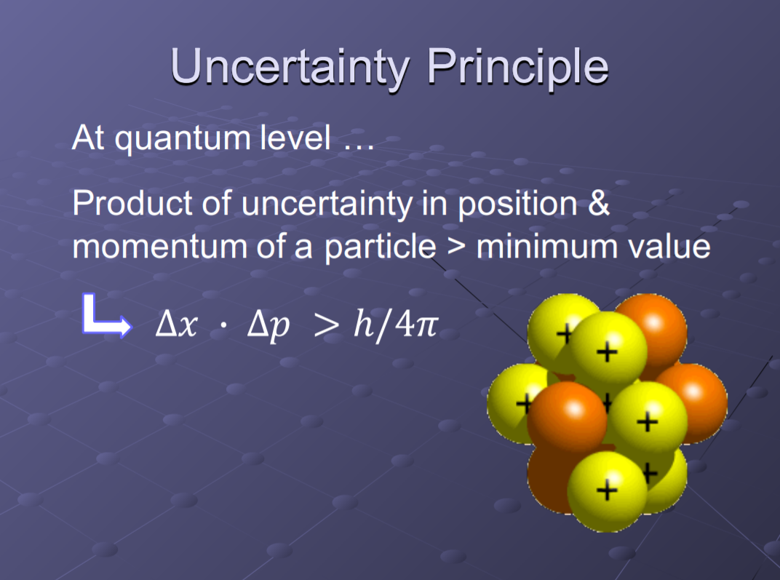

Slide 15
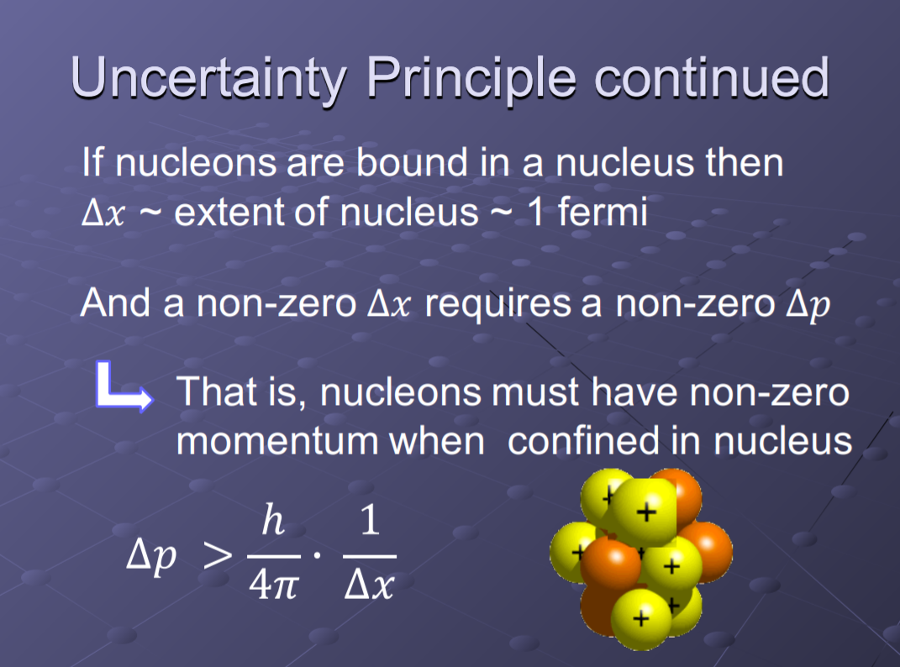

Slide 16
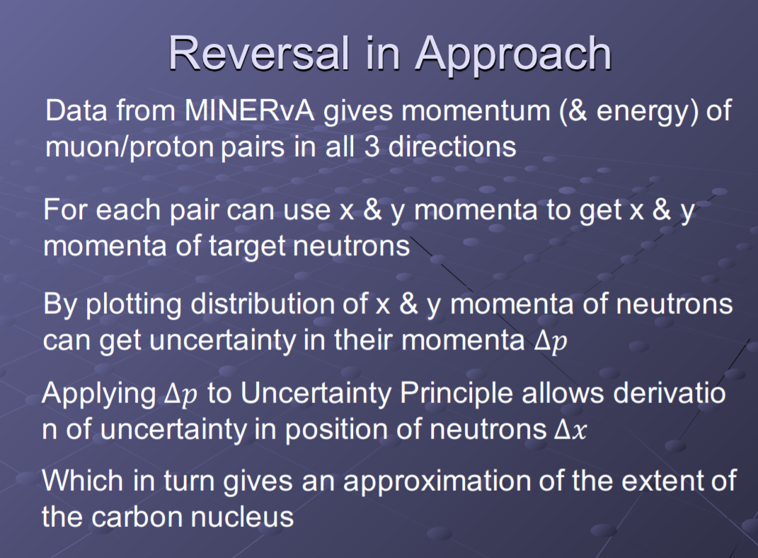

Slide 17
