Slide 1


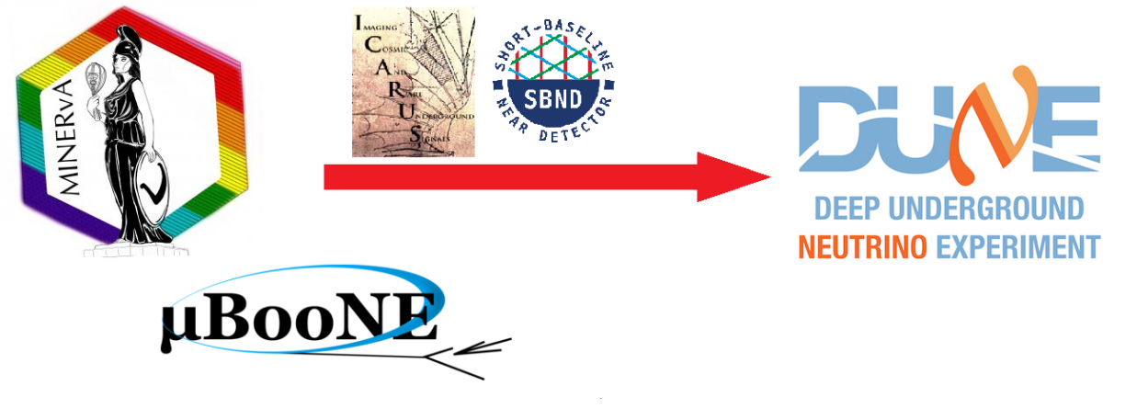

Neutrino Data
MMA
Notes:
Question: How much should we focus on expanding our content to include a variety of neutrino experiments vs. building up an audience for each of them as we go?

Slide 2
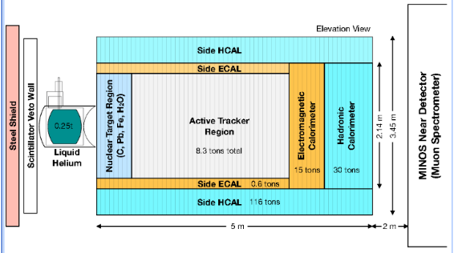
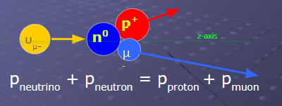
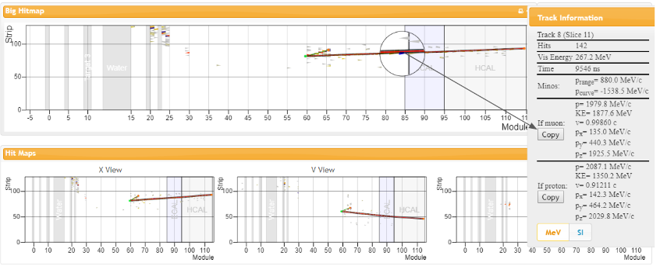
MINERvA Masterclasses
MINERvA Masterclass
Now mature; Will continue in IMC 2023

Slide 3

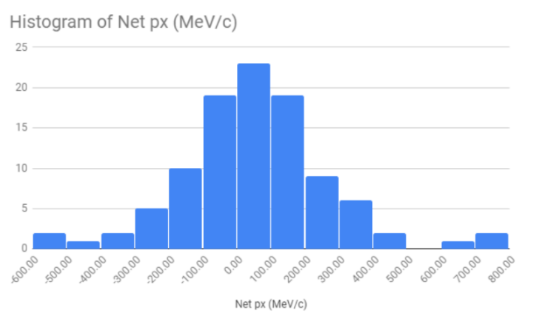
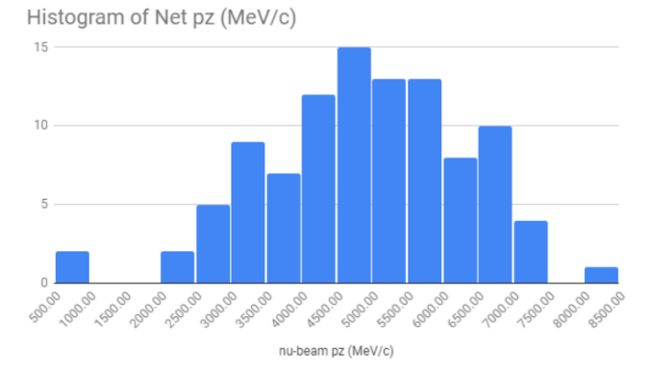
MINERvA Masterclasses

Slide 4
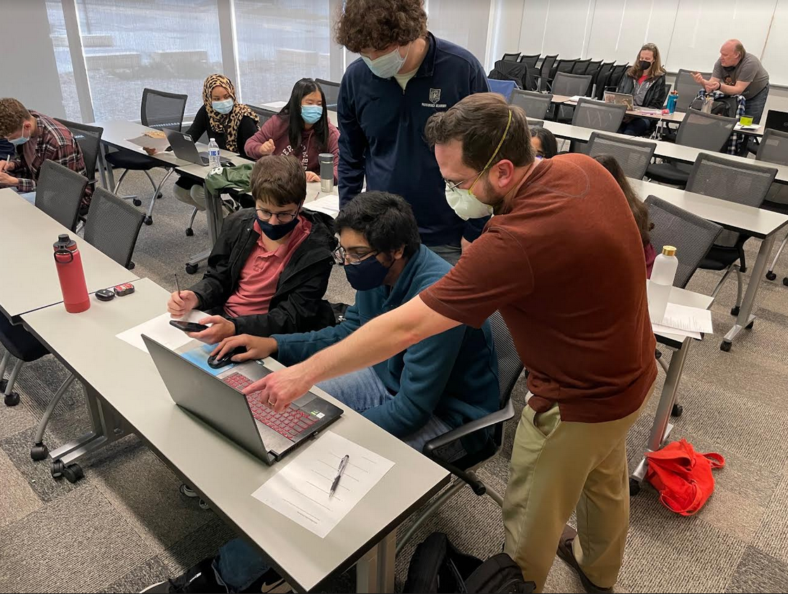
NOvA Masterclass
New NOvA masterclass focuses on a result about the neutrino as a particle.
Piloting with teachers:
  University of MN Center
  Neutrino Fellows
  Summer 2022 workshops (4)
  AAPT Winter 2023 meeting
Piloting with students:
  April 23, 2022 @ U. of MN
  Phase 2 pilot in IMC 2023

Slide 5
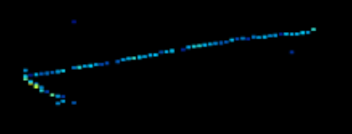

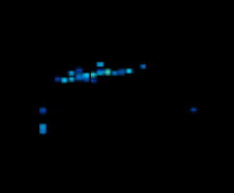
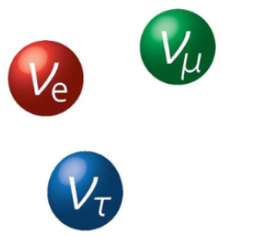
NOvA Masterclass

Slide 6
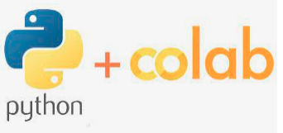
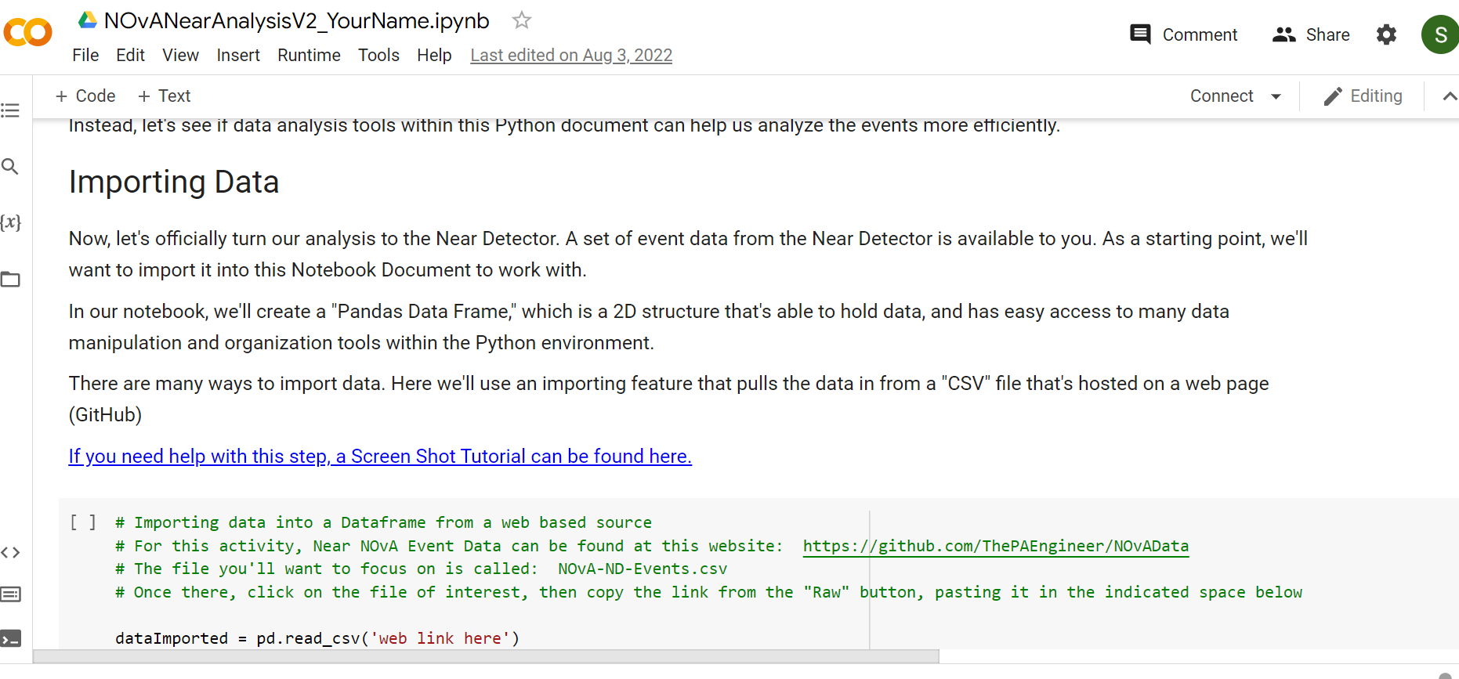
NOvA Masterclass

Slide 7
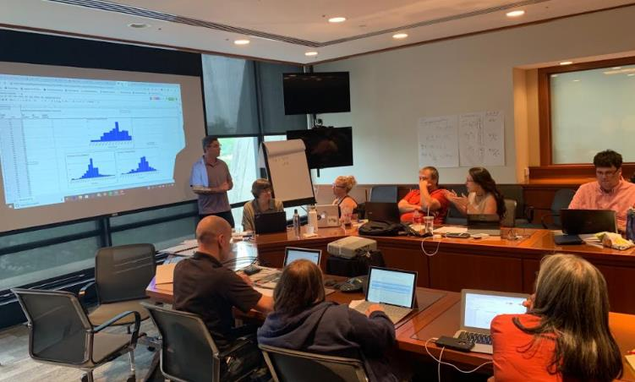
Workshops
Neutrino Data Workshops in 2022
Held at 10 centers. (up from 7 in 2021)
Led by staff and/or fellows.
Based on data from MINERvA and/or NOvA.

