Slide 1
Neutrino Physics
Samuel Santana
Physics Department
University of Puerto Rico
Mayagüez, PR
1

Slide 2
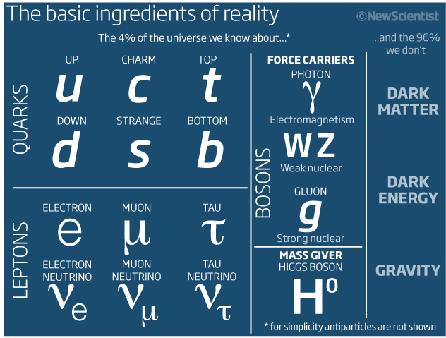
The Standard Model
2

Slide 3
These are not “classical particles”
These particles obey the Principles of Special Relativity
  The laws of Physics are the same in all inertial reference frames.
  The speed of light is the same in all inertial frames.
These particles obey the laws of Quantum Mechanics
  The Heisenberg Uncertainty Principle.
  Probabilistic nature, subjective properties.
  Described by a wavefunction.

Slide 4
Some things we know about neutrinos

Slide 5
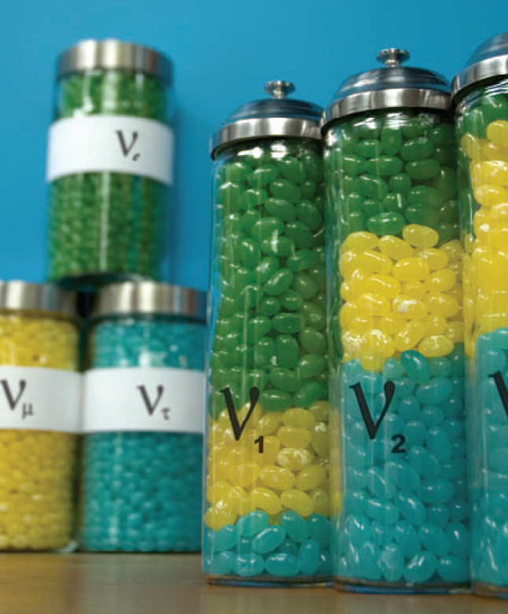
There are three types of neutrinos
Electron neutrinos
Muon neutrinos
Tau neutrinos
5

Slide 6
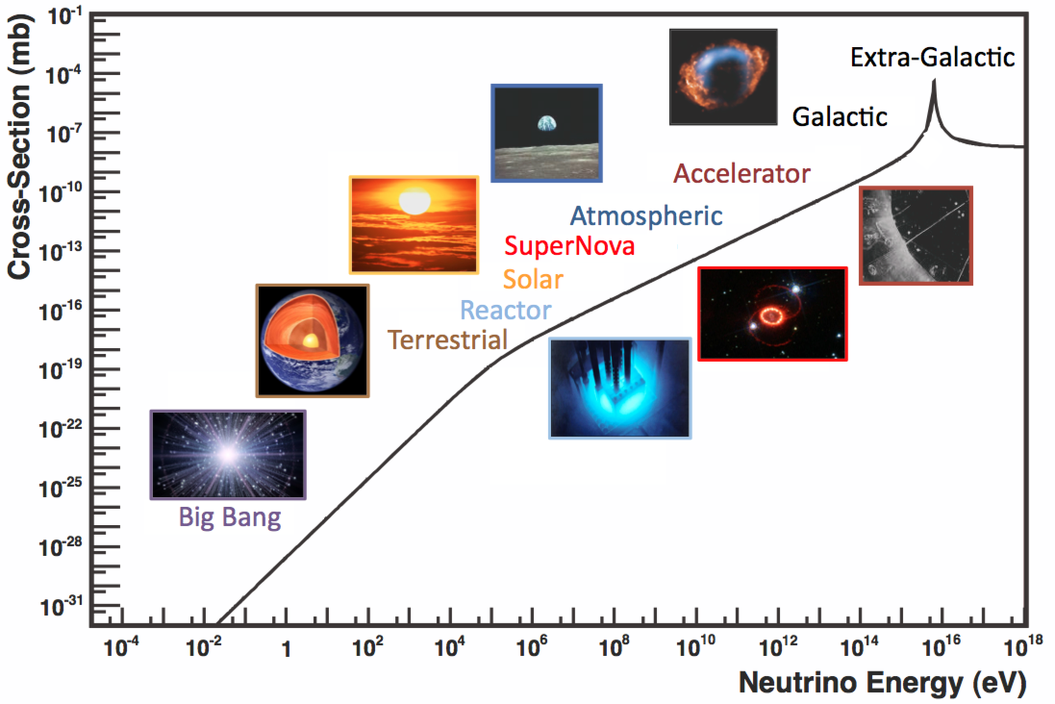
They come from different sources
6

Slide 7
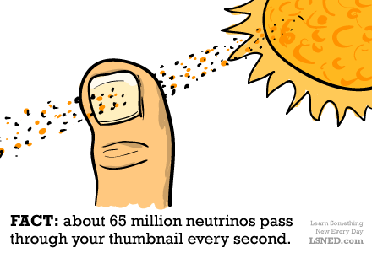
They are everywhere.
about 65 billion neutrinos are passing through just one square centimeter of area on earth, every second.
11:25:26 PM
7
Notes:
7

Slide 8
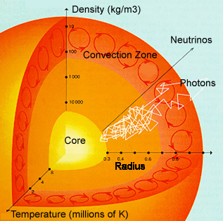
neutrinos are very weakly interacting
No charge
No color
Almost no mass
8
Notes:
Both photons and neutrinos are created in the core of stars. But while photons take tens of thousands of years to reach the edge of the Sun, neutrinos make the trip in just over two seconds.
8

Slide 9
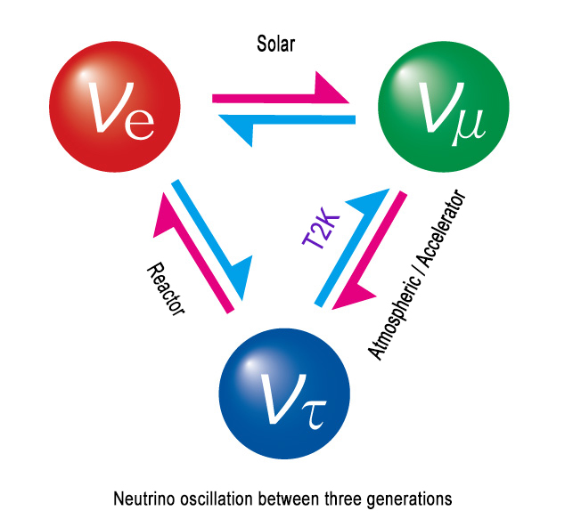
Neutrinos have (very small) mass…and oscillate!
9

Slide 10
(some of)
what we don’t know
10

Slide 11
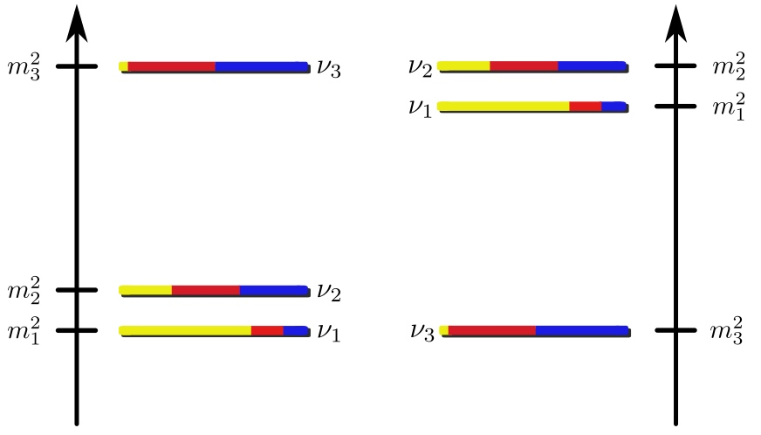
Mass Hierarchy
11
Notes:
Mass hierarchy
CP phase / Majorana phases
Are there more types of neutrinos?
Absolute scale of neutrino mass
What kind of mass they have?
11

Slide 12
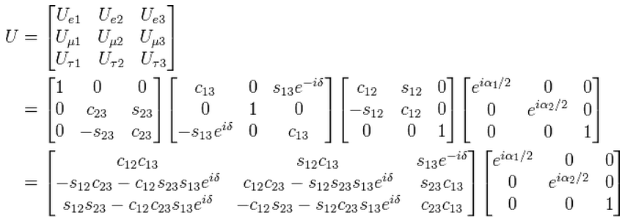
Missing parameters
12
Notes:
Mass hierarchy
CP phase / Majorana phases
Are there more types of neutrinos?
Absolute scale of neutrino mass
What kind of mass they have?
12

Slide 13
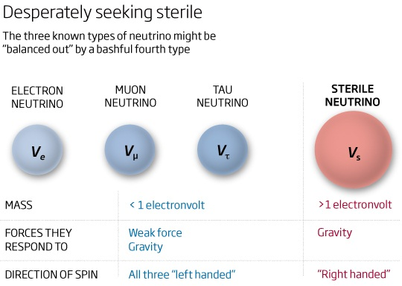
Are there more neutrinos?
13
Notes:
Mass hierarchy
CP phase / Majorana phases
Are there more types of neutrinos?
Absolute scale of neutrino mass
What kind of mass they have?
13

Slide 14
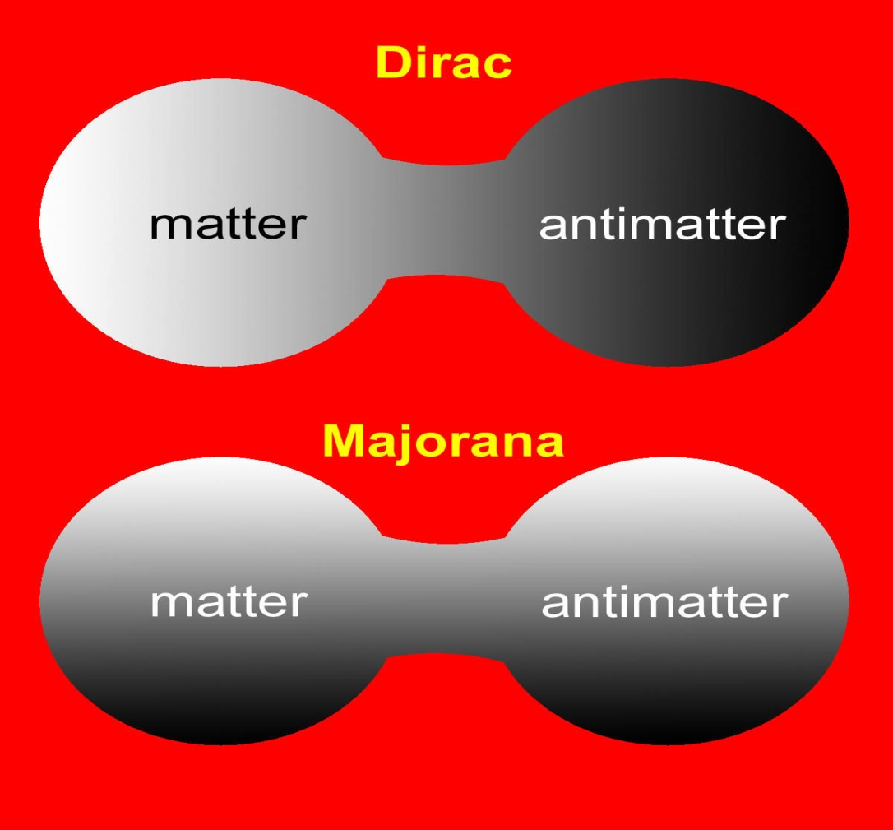
What kind of mass do they have?
14

Slide 15
Why are neutrinos important?
15

Slide 16
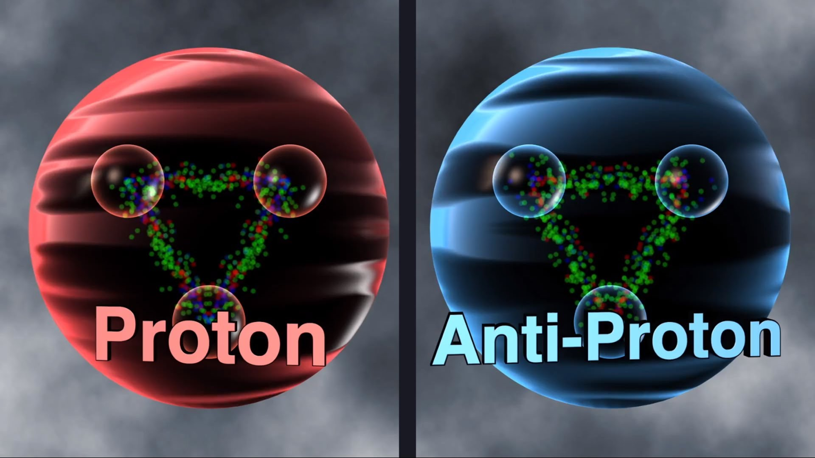
Could be responsible for the origin of Baryon asymmetry in the universe.
16
Notes:
LSS – large scale structures
BBN – big bang nucleosynthesis
16

Slide 17
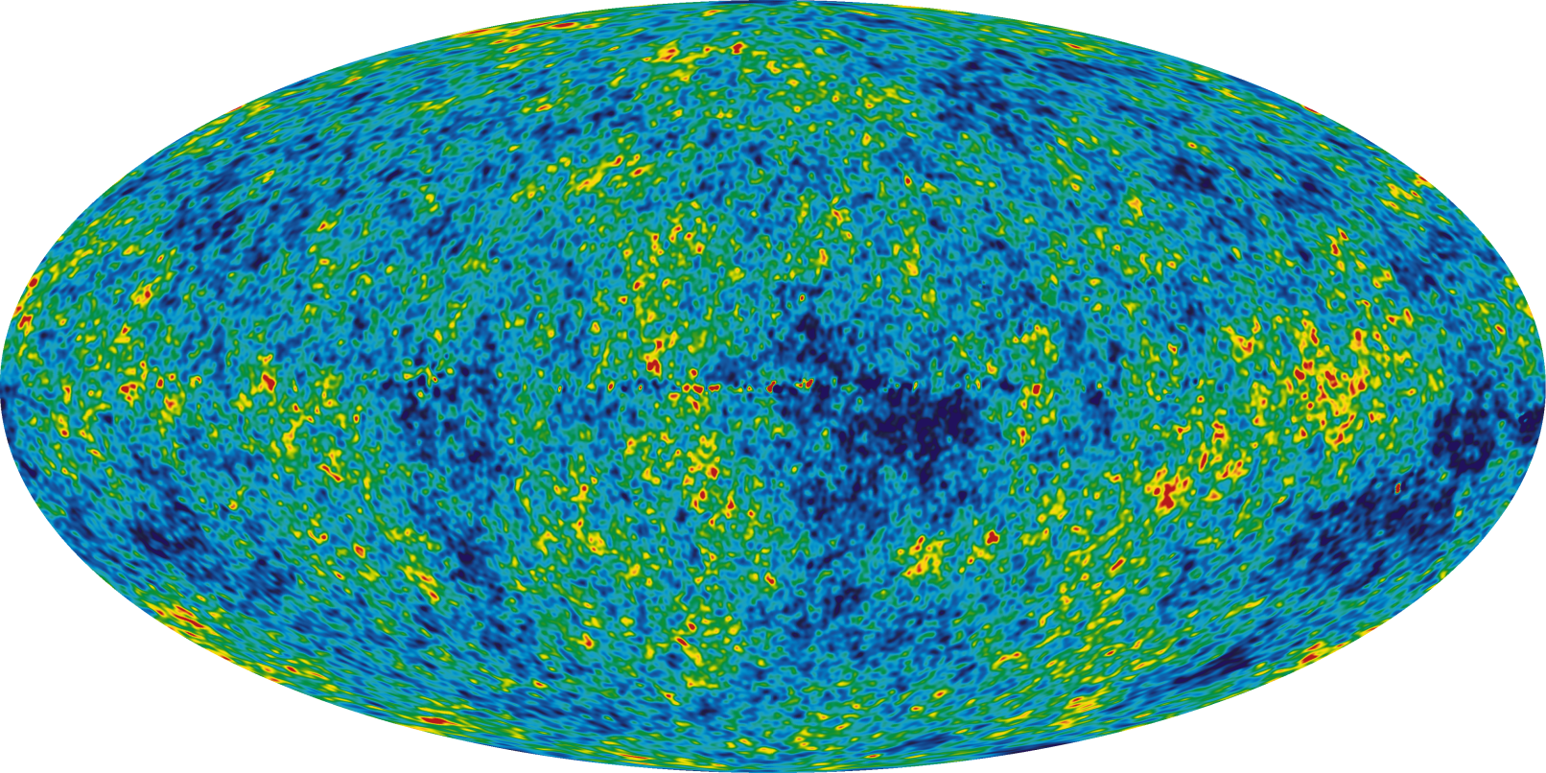
Enter in the determination of
  the spectrum of the CMB
  the LSS in the universe
  the delicate chemical equilibriums determining the light element abundances during BBN
17

Slide 18
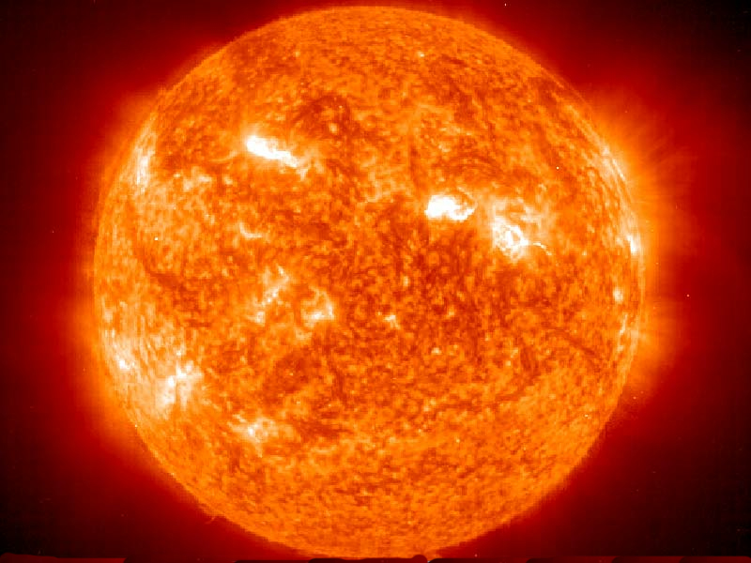
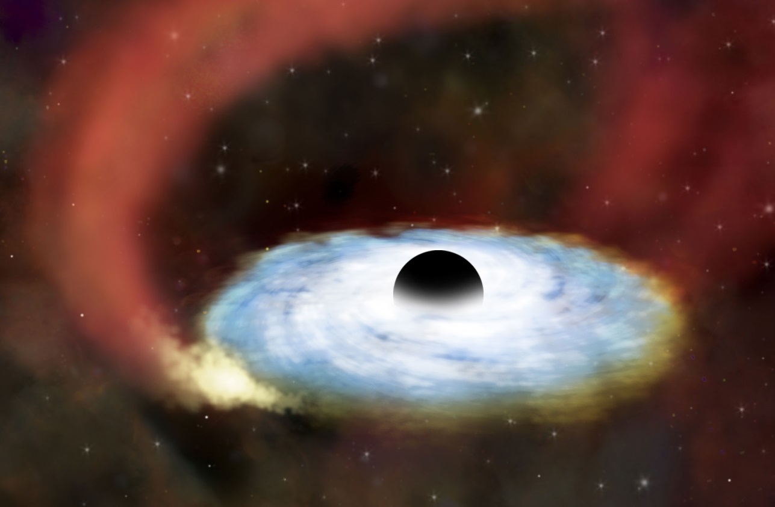
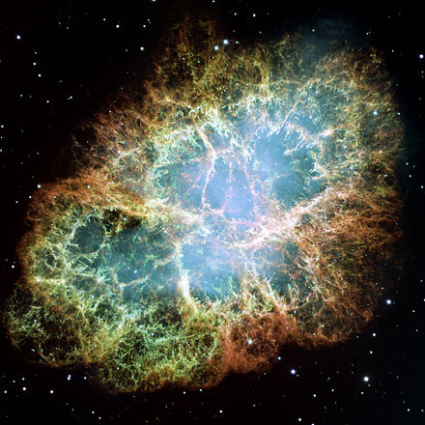
They represent a powerful probe of
the dynamics of stars, supernova collapse
and accretion disks encircling supermassive black holes.
11:25:26 PM
18
Notes:
Represent a powerful probe of the dynamics of the sun, of core-collapse supernovae, accretion disks encircling supermassive black holes.
Dominate the cooling of many astrophysical objects.
18

Slide 19
Play an important role in many particle physics models and phenomenology.
May allow indirect access to energy scales otherwise largely out of the reach of particle accelerators.
Are important ingredients of GUTs, flavor models, lepton flavor violation, etc.
Sterile neutrinos are good dark matter candidates!
11:25:26 PM
19

Slide 20
Thank you for your attention
20

