Slide 1
Indiana
Physics Standards
https://www.in.gov/doe/students/indiana-academic-standards/science-and-computer-science/

Slide 2
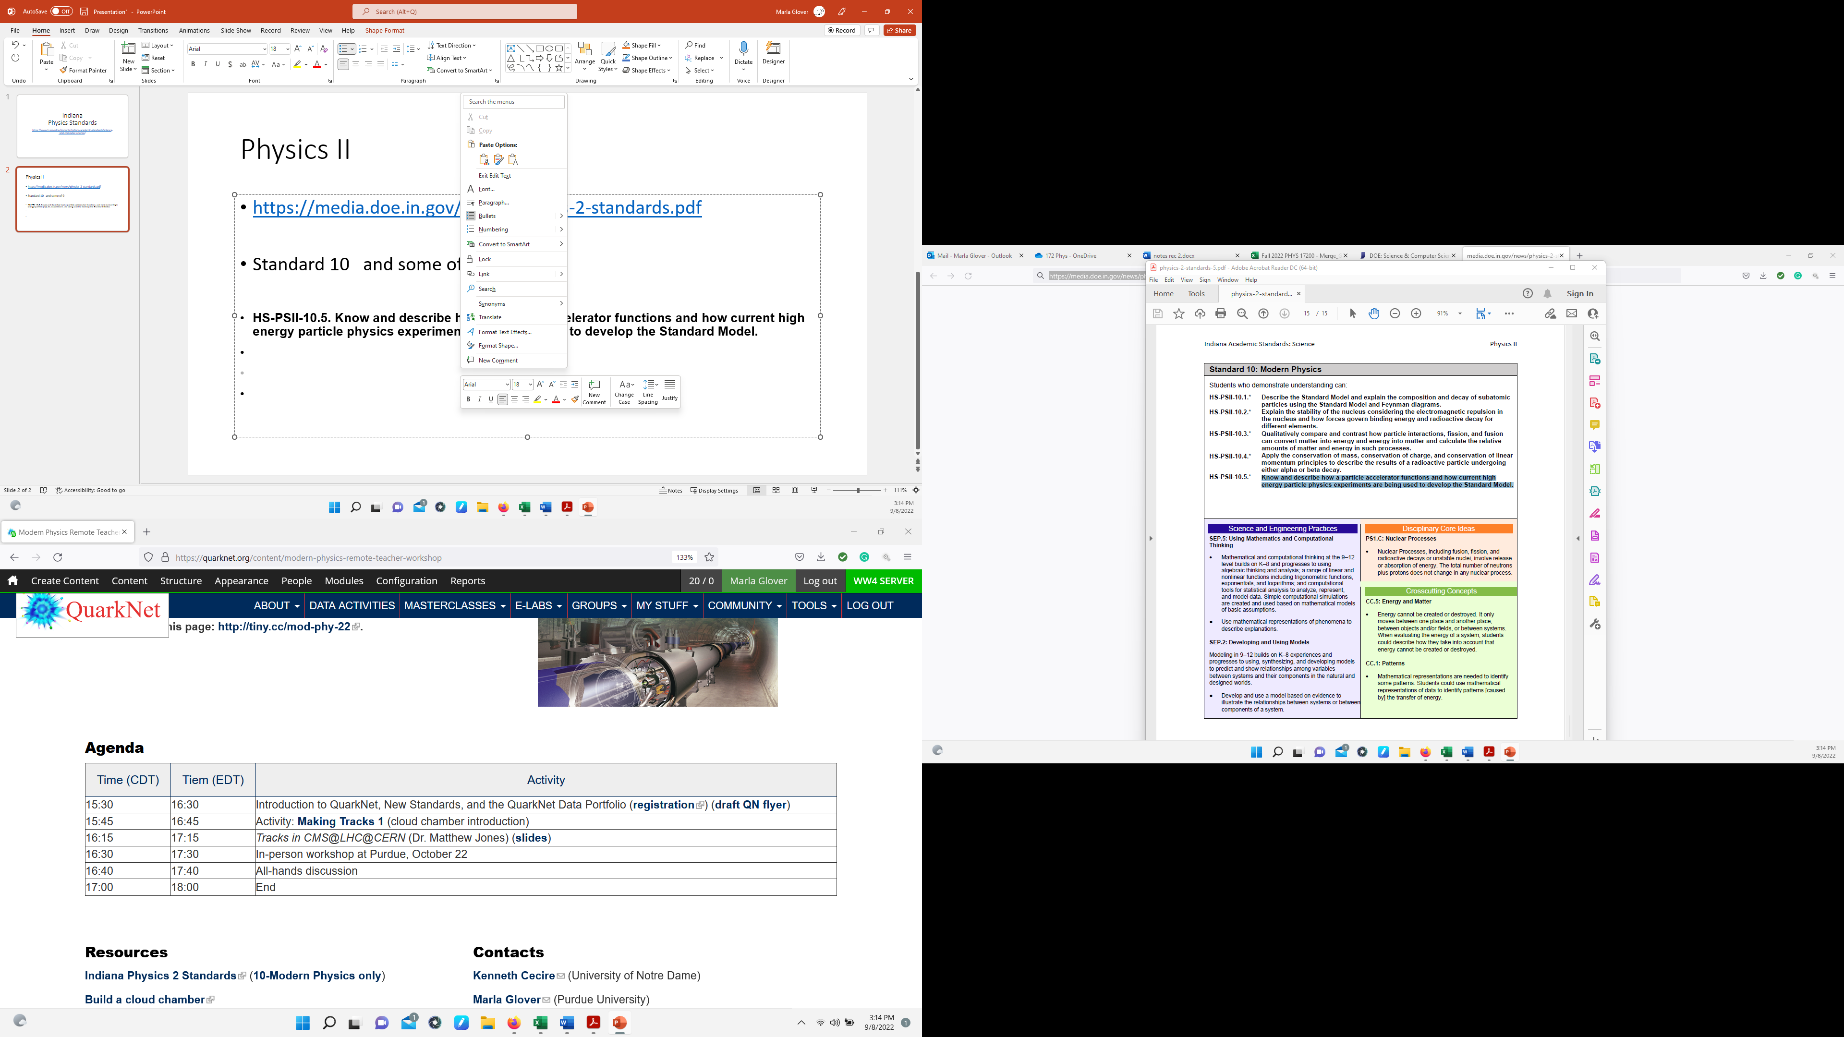
Physics II
https://media.doe.in.gov/news/physics-2-standards.pdf
Standard 10 and some of 9
HS-PSII-10.5. Know and describe how a particle accelerator functions and how current high energy particle physics experiments are being used to develop the Standard Model.

Slide 3
QuarkNet Data Portfolio
https://quarknet.org/data-portfolio

