Slide 1
Preliminary Evaluation Results
Kathryn Race
Race & Associates, Ltd.
race_associates@msn.com

Slide 2
Evaluation Focus
Three Themes:
Development (and use) of a Program Theory Model (PTM) ✔
Teacher-level Program Outcomes (based on PTM)
at National- and Center-level -- on going
Center-level Program Outcomes and Program
Sustainability Assessment (based on PTM and Sustainability Framework) – on going

Slide 3
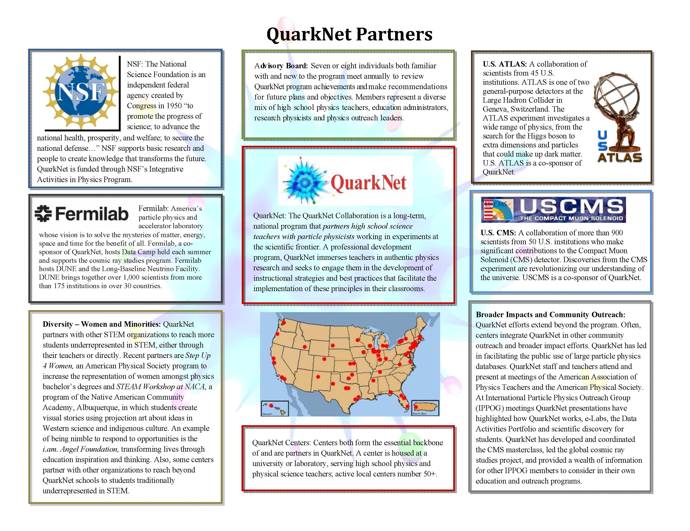
Notes:
The complete Program Theory Model (PTM) is seven pages in full. The abbreviated model, shown here and in the next slide, is intended to provide an overview of the Theory of the QuarkNet program. It is seen as an “approximate fit,” of the program articulating the logical link between program core strategies and outcomes for teachers, their students and centers. In addition, the PTM is used to direct the evaluation. This first page shows the many partners associated with QuarkNet.

Slide 4
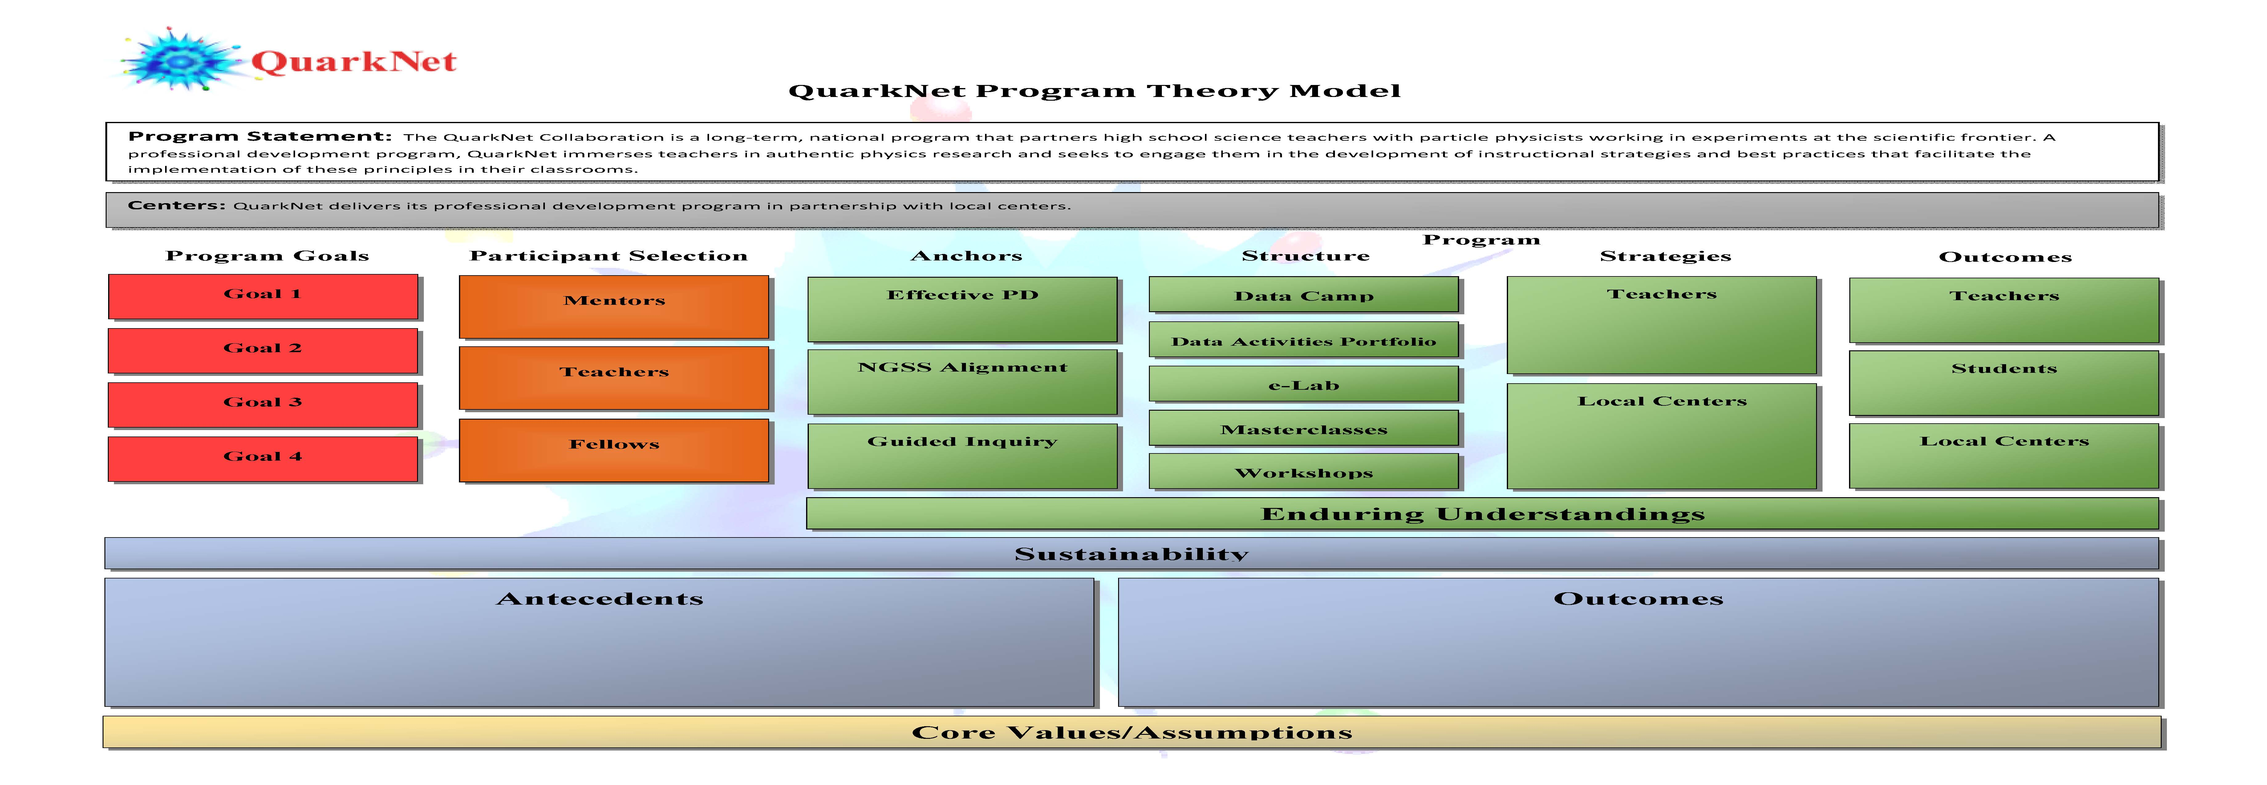
Notes:
This second page overviews or maps the significant components of the QuarkNet providing a snap shot or profile of the program. Details of these components are outlined in the remaining pages of the PTM. If you use the PTM please reference it as QuarkNet Program Theory Model 2019. You can review the full PTM in the full evaluation report or at https://quarknet.org/group/evaluation-team.

Slide 5
Teacher Outcomes
Measured Two Principal Ways:
1. Full Teacher Survey, and
2. Shorter Annual Updates
Notes:
The focus of the evaluation is on outcomes articulated in the PTM. That is, Teacher Outcomes directed toward classroom implementation and the engagement of their students. Center outcomes, which we’ll discuss in a bit, are used in two ways: to help inform our understanding of teacher outcomes; and to assess the centers in their own right.
We have focused analyses on discovering patterns in the data and using multiple methods/sources when feasible.

Slide 6
2019-2020
QuarkNet Teacher Survey
Focused on (Six Themes) based on PTM
Who are the teachers (e.g., number of years: in QuarkNet, teaching, at school; at what center; brief information about school, teaching physics)?
Participation in QuarkNet: What does this look like?
Use of materials in the Data Activities Portfolio in classroom.
Program engagement opportunities align with Core Program Strategies.
How has this translated to the Classroom and QuarkNet’s contribution?
How has QuarkNet supported teacher-observed student outcomes?
Notes:
For the 2019 Survey, there were 265 responses (useable surveys) for a response rate of about 78%. The response rate for both 2020 surveys (the full survey and the shorter survey) as of now is around 70%. We are currently analyzing responses from both the 2019 and 2020 surveys; however, results presented here are based on responses from the 2019 survey.

Slide 7
Annual Updates
Focused on Implementation Plans:
How teachers implemented or
will implement QN content and
practices in their classroom
2. Which DAP Activities?
Notes:
This year, we have added the Update Survey, which is designed to build on information to explore in more detail how teachers are implementing (or are planning on implementing) QuarkNet content and practices in their classrooms and which DAP activities they are using.

Slide 8
Overview of Analyses Related to Teacher (and their Students) Outcomes
Program Exposure
Teacher Outcomes
Student Outcomes
Data Camp
Exposure to Implemented
Core Strategies
Approach to Teaching
Student Engagement
Workshops
Masterclasses
Use of DAP
Notes:
Overview of the analyses being conducted to look at outcomes in relationship to program engagement. Supporting analyses and statistical summary tables are showed in the Appendix. All analyses are fully described in the evaluation report, https://quarknet.org/group/evaluation-team.

Slide 9
Scale Scores
Based on Teacher Responses:
Exposure to Core Strategies
Approach to Teaching
QN’s Influence of Teaching
Student Engagement (SE)
QN’s Influence on SE
Notes:
To begin we created scale scores, based on specific sets of individual survey items by summing responses to these items. For example, the measure “Exposure to Core Strategies” is based on the sum of 12 survey items that each asked about the QuarkNet experience by teachers relative to core strategies of the program; for example, “Opportunities to engage as active learner (as a student).”

Slide 10
Type of Program Engagement
Data Camp
Variety of Workshops
Masterclasses
and
Use of DAP Activities

Slide 11
Exposure to Core Strategies
In preliminary analyses (highlighted in Table 19 in Appendix) …..
Regarding Core Strategies, program engagement and measurement of exposure to core program strategies were shown to be related in a meaningful way (that is, the more engagement by type of event, the higher the perceived exposure to core strategies; and more reported use of activities from the Data Activities Portfolio in the classroom).
This speaks to the fidelity of the implemented program as compared to the program as designed as perceived by participating teachers who completed the Teacher Survey.

Slide 12
Approach to Teaching
In preliminary analyses…..
Regarding, Approach to Teaching, teaching outcomes were shown to be related to perceived QuarkNet's Influence on Teaching and the Use of DAP activities in the classroom as reported by participating teachers. (See Tables 21 and 22 in Appendix.)
Use of DAP activities was shown to be related to exposure to Core Strategies, Approach to Teaching, and all of the types of QuarkNet program events (Data Camp, Variety of Workshops, and Masterclass engagement). (Summary statistics table is not shown.)
Notes:
Analyses are based on multiple regression models to assess the influence of individual variables together in one model. See Appendix for statistical summary tables.

Slide 13
Student Engagement
In preliminary analyses (See Table 24 in Appendix)….
Regarding, Student Engagement, QuarkNet’s Influence on Student Engagement and Approach to Teaching were related to perceived student engagement in inquiry-based science based on the perceptions of their participating teachers.
Notes:
In summary and although preliminary, the weight of these analyses suggests that there is a positive relationship between teacher engagement in QuarkNet and exposure to core program strategies; and, that the type and degree of program engagement is related to teacher outcomes (Approach to Teaching), the use of activities from the Data Activities Portfolio in the classroom, and teachers’ perceptions of Student Engagement in inquiry-based science.

Slide 14
In Summary
So far ….
the weight of these analyses suggests that there is a positive relationship between Teacher Engagement in QuarkNet and exposure to Core Program Strategies; and, that the type and degree of program engagement is related to teacher outcomes Approach to Teaching; the use of activities from the Data Activities Portfolio in the classroom; and teachers’ perceptions of Student Engagement in inquiry-based science.

Slide 15
Building on These Analyses
We plan on adding information based on teachers’ classroom implementation plans.
Buttress these analyses with information obtained from QuarkNet centers.
And add Sustainability Factors into the mix in the future analyses.

Slide 16
Center Program Outcomes
Delivery of Program through Center Partnerships
Teacher Outcomes analyzed in relationship to program exposure
Center Outcomes used to determine implementation level of program and to better understand teacher outcomes, and
Centers assessed through Center Outcomes and Sustainability
Notes:
Using strategies rather than activities to describe the program allows centers to implement those activities that best meet their needs; while offering a framework in which the consistency of the program can be assess; thus, it acknowledges program variation across centers and permits a framework to gauge and assess these variations.

Slide 17
Center Feedback Template
In Four Sections:
I. Who from the Center has participated
II. Past QN Programs last 2 year
III. Rating of Center-level Outcomes
IV. Review of Sustainability Factors
Notes:
Section II of the Template is completed by the evaluator and reviewed by QuarkNet staff before a center is given their template to complete. This helps save the Center time in completing this form but also gives us the opportunity to learn about activities or events that were not captured in the workshop agenda and/or in their annual report. For Section III, examples of center-level outcomes include perceptions as to the level of engagement of participating teachers (as active learners) as well as the degree to which this engagement aligns with the Next Generation Science Standards Engineering and Science Practices. Section IV incorporates success factors developed by previous evaluators that speaks to the potential longevity of the center’s engagement.

Slide 18
Center Feedback Process
So far, 10 Centers have participated in gathering Center Outcomes
Notes:
A conference call involving the center (mentor and lead teachers), QuarkNet staff and evaluator occurs before the template is completed by the Center. This is designed to help answer any questions that the Center may have and ease the task of completing the form. To date, the 10 participating centers include four centers that participated in the pilot test; and six centers that participated in round two. Process has been seen as helpful for: QuarkNet Staff, Centers, Lead Teachers and the Evaluation.
The implications of COVID-19 has had on the centers and teachers has been a significant part of the center discussions for the centers who participated in this process in spring 2020.

Slide 19
Center Feedback Process
Compare Teacher and Center Responses when possible, for example ….
Participating Centers report:
All or most teachers engaged as active learners (as students)
Teachers report:
The opportunity to engage as active learners (as students) was “Excellent.”

Slide 20
Multiple Sources ….
An example…..
Looking at the alignment of Next Generation Science Standards Practices and the DAP activities as:
Designed
Implemented (in workshops), and
Measured by Centers based on
in individual teacher engagement

Slide 21
Program and Evaluation Recommendations
Program:
Continue to work with evaluator to embed evaluation requirements into the program as much as possible. -- Staff are doing a great job.
Use the Program Theory Model as helpful.
Evaluation:
Continue to be sensitive to QuarkNet staff
program demands.
Simplify evaluation demands (for staff, teachers)
as much as possible.
Notes:
The full set of program and evaluation recommendations are proffered in the executive summary and in the full evaluation report, https://quarknet.org/group/evaluation-team.
This slide represents an overarching summary of these recommendations. I belief both staff and the evaluator work well together with an eye on the impact these activities may have on participating teachers and centers; and to seek to gather authentic data as much as possible.

