Slide 1
Calibration of the Counters with efficiency
University of Puerto Rico - Mayaguez Campus
November 2-3, 2019
By
Jose A. Martinez Rodriguez
Mentor: Hector Mendez

Slide 2
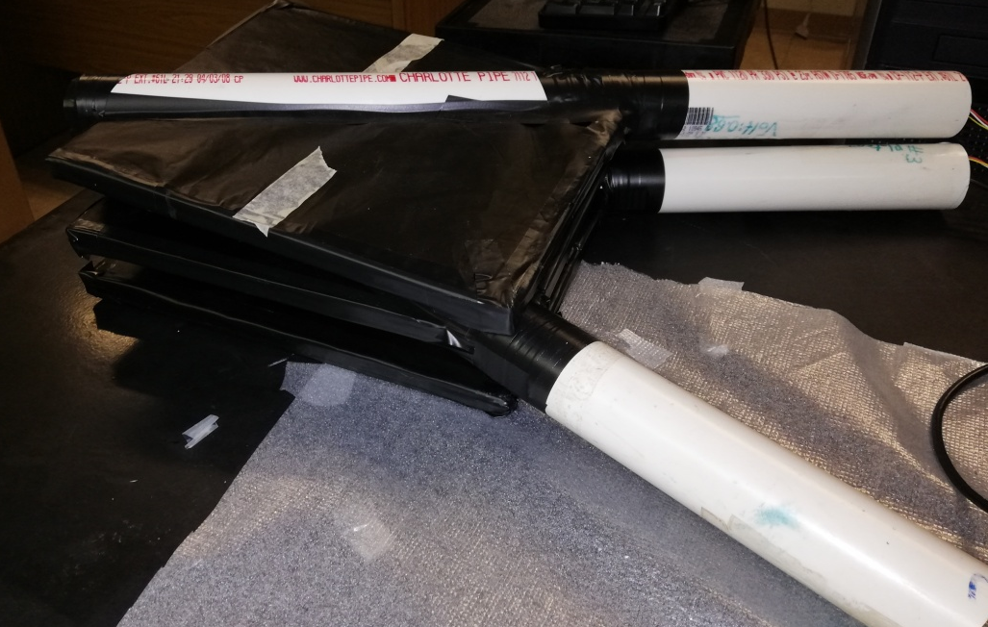
Step 1
Select three Counters and put them stacked.
The counter to be calibrate is going to be placed in the middle.

Slide 3

Step 2
Take five set of coincidence between the top (1) and bottom (3) counter in a time interval of 2 min and make an average. Use that average as the denominator in the efficiency equation:
where N₁₃ is the coincidence between counter number 1 (top) and number 3 (bottom) and N₁₂₃ the coincidence between the 3 counters.
Efficiency =

Slide 4
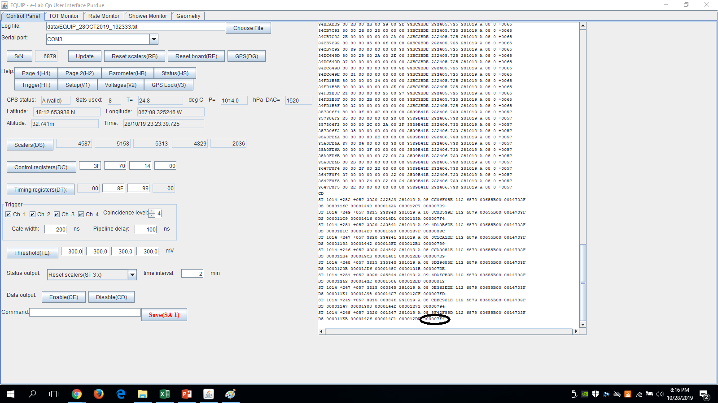
The number of coincidence are here.

Slide 6
Step 3
We measure the numbers of coincidence for the three counters (N₁₂₃). We start counter 2 at low voltage and then start to increase it (You only change the voltage of the middle one). Remember to do it in the same time interval as the N₁₃ and to take an average of five numbers.

Slide 7
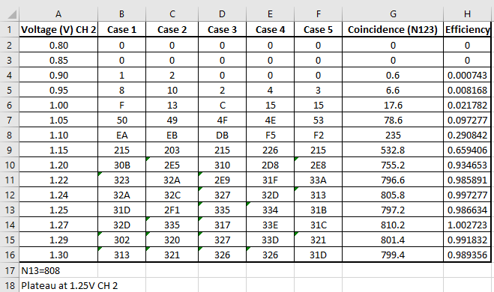
All this numbers can be organize as this.

Slide 8
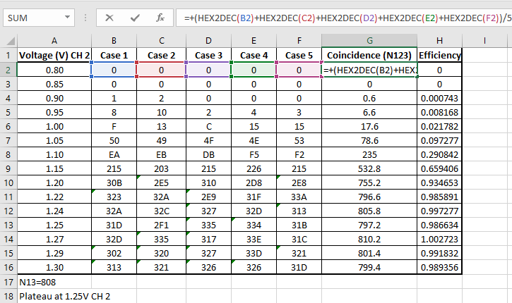
This is the Excel equation for the coincidence.

Slide 9
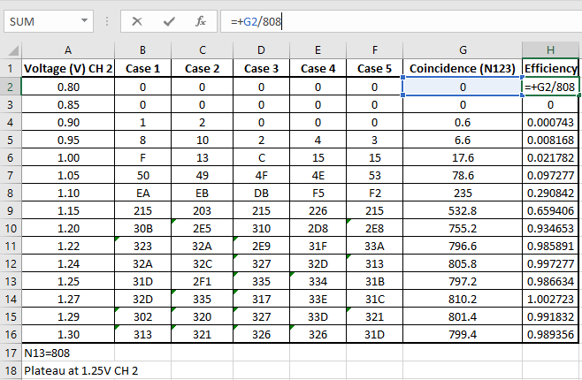
Step 4
Then calculate the efficiency and make the graph.

Slide 10
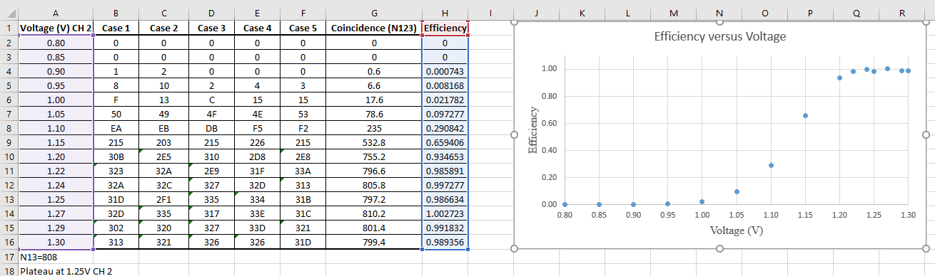
Select the voltage and efficiency column to make the graph.

Slide 11
The plateau occurs when the efficiency start to be constant.
The interval of the optimize voltage is the one below.

Slide 12
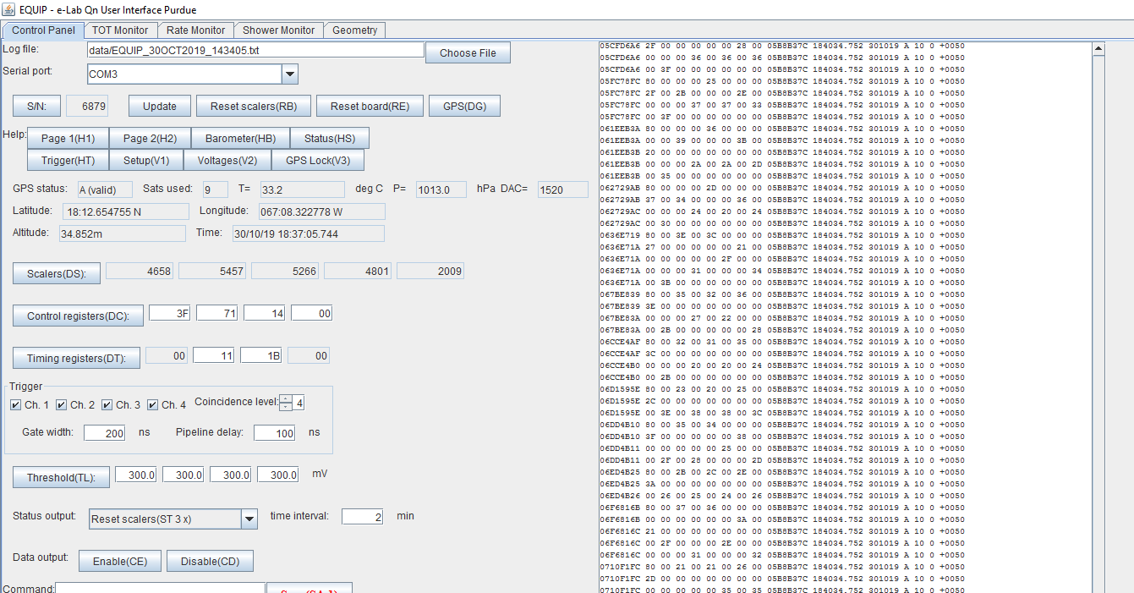
Step 5
Now repeat all the steps before for the other counters.
Once the optimize voltage has been selected for all the counters, collect data for a performance study.

Slide 13
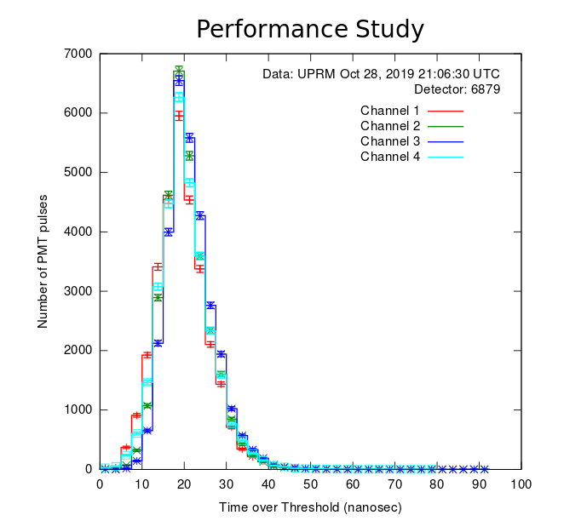
Step 6
Run a performance Study in e-Lab

Slide 14
Thanks for your attention
Any Questions?

