Slide 1


CCRI Educator Ambassadors 2021-22
Community STEM Engagement Series
Elana Resnick

Slide 2

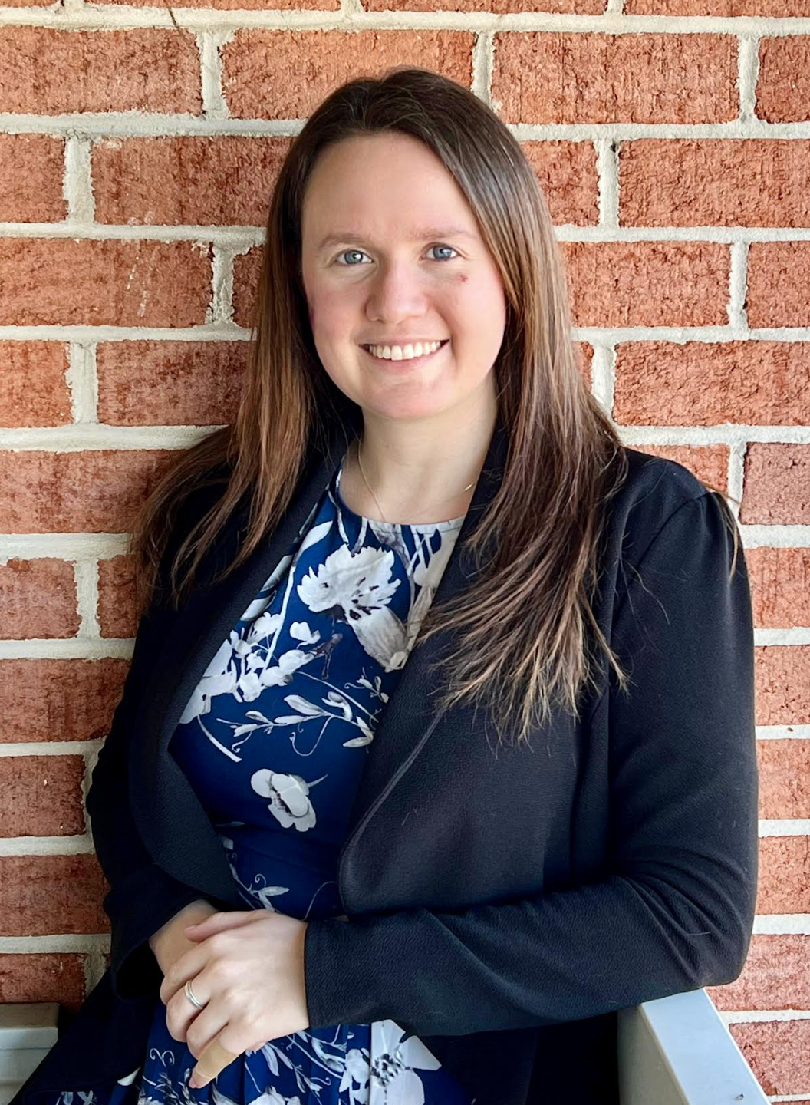






Introduction
School Years
2013-2016: Glen Rock High School
Glen Rock, NJ
2016-2020: Saddle Brook High School
Saddle Brook, NJ
2020-2022: Gilman School
August 2022: Starting work @
GSFC’s Heliophysics Division
Summer 2016
Summer 2017
Fall 2017
Notes:
BEST Training
Niki Werkheiser: Project Manager for the NASA In-space Manufacturing (ISM) Initiative

Slide 3









CCMC
Mission: To enable, support, and perform research for next generation space science and operational space weather models through an interagency partnership.
Goal: Develop and execute next generation research models in support of the advancement of space sciences and deployment of new operational space weather capabilities.

Slide 4
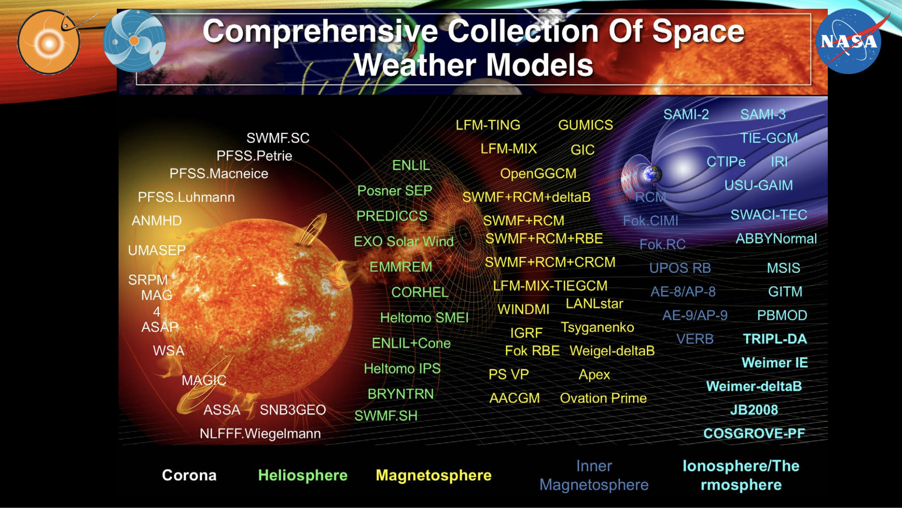
Notes:
https://ntrs.nasa.gov/api/citations/20190027052/downloads/20190027052.pdf

Slide 5
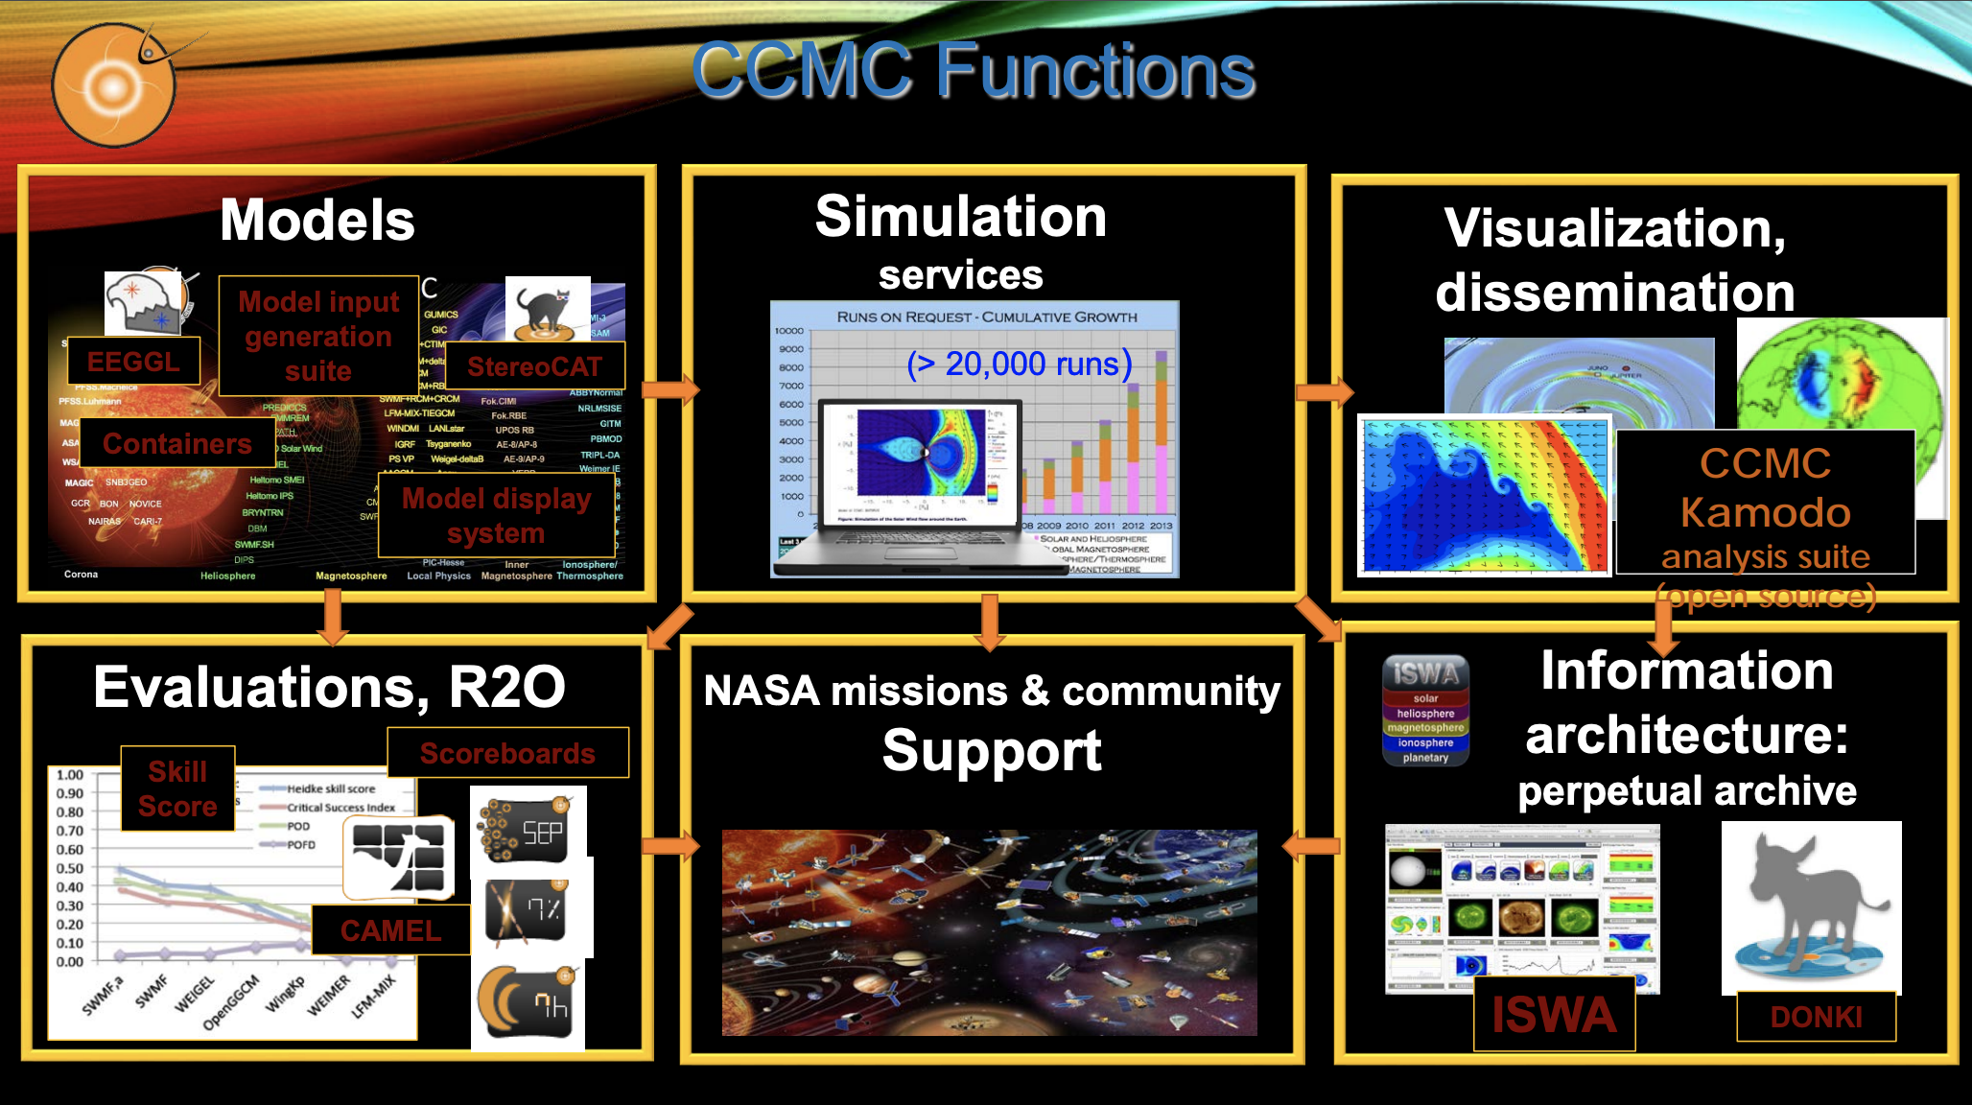

Slide 6
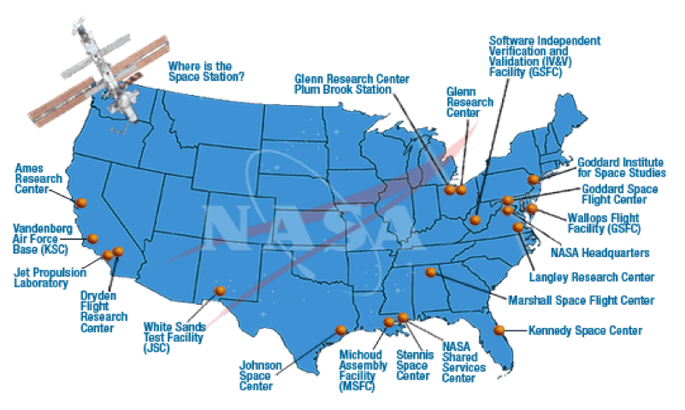
NASA Centers

Slide 7
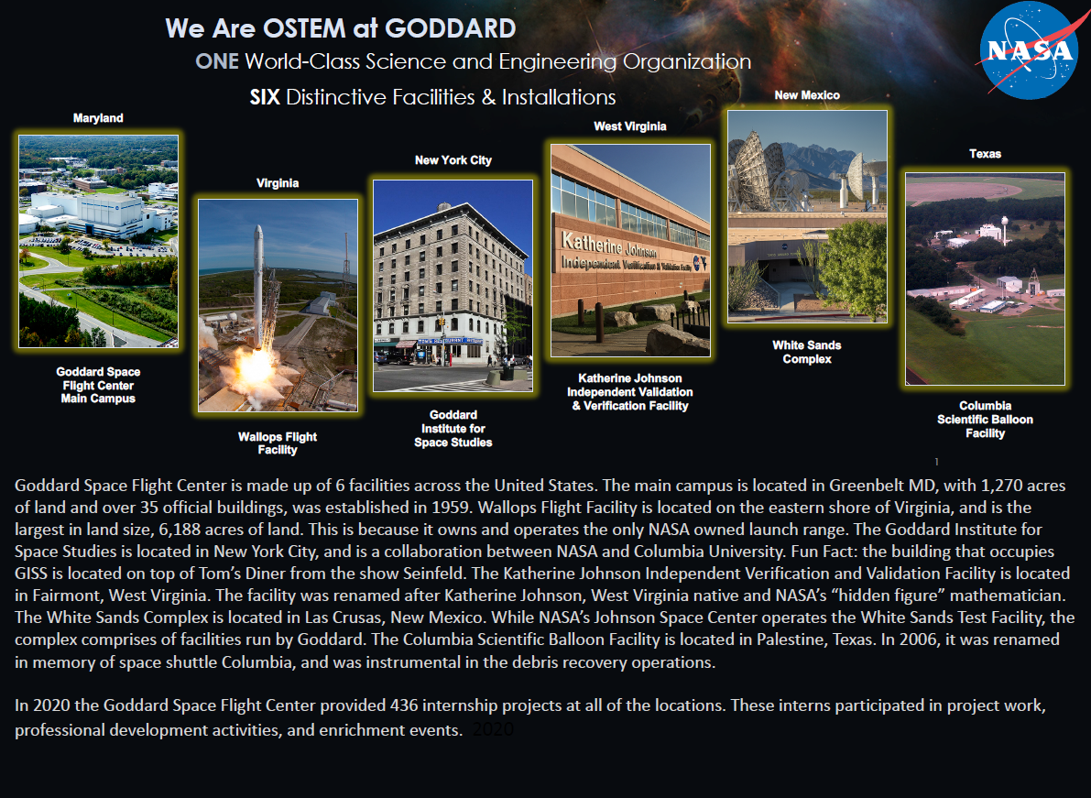
NASA Goddard Space Flight Center

Slide 8


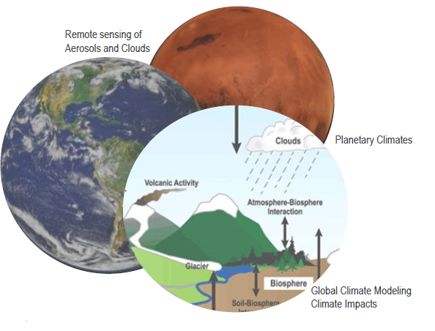
GISS
The NASA Goddard Institute for Space Studies is a laboratory in the Earth Sciences Division of NASA’s Goddard Space Flight Center.
GISS conducts theoretical and experimental research on the causes and consequences of long-term global change, with an emphasis on education and outreach.
Areas of research include climate modeling, climate impacts, remote sensing of climate system features such as aerosols and clouds, and comparative planetary climates.
GISS Director, Dr. Gavin Schmidt, is NASA’s Acting Senior Climate Advisor.
  Feb 2021 to Jan 2022 - acting Senior Advisor on Climate to the NASA Administrator

Slide 9



OSTEM
NASA Office of STEM Engagement’s Vision: We immerse the public in NASA’s work, enhance STEM literacy and inspire the next generation to explore.
NASA Office of STEM Engagement’s Mission: We engage the nation in NASA’s mission.
  Create unique opportunities for students and the public to contribute to NASA’s work in exploration and discovery.
  Build a diverse future STEM workplace by engaging students in authentic learning experience with NASA’s people, content and facilities.
  Strengthen public understanding by enabling powerful connections to NASA’s mission and work.

Slide 10
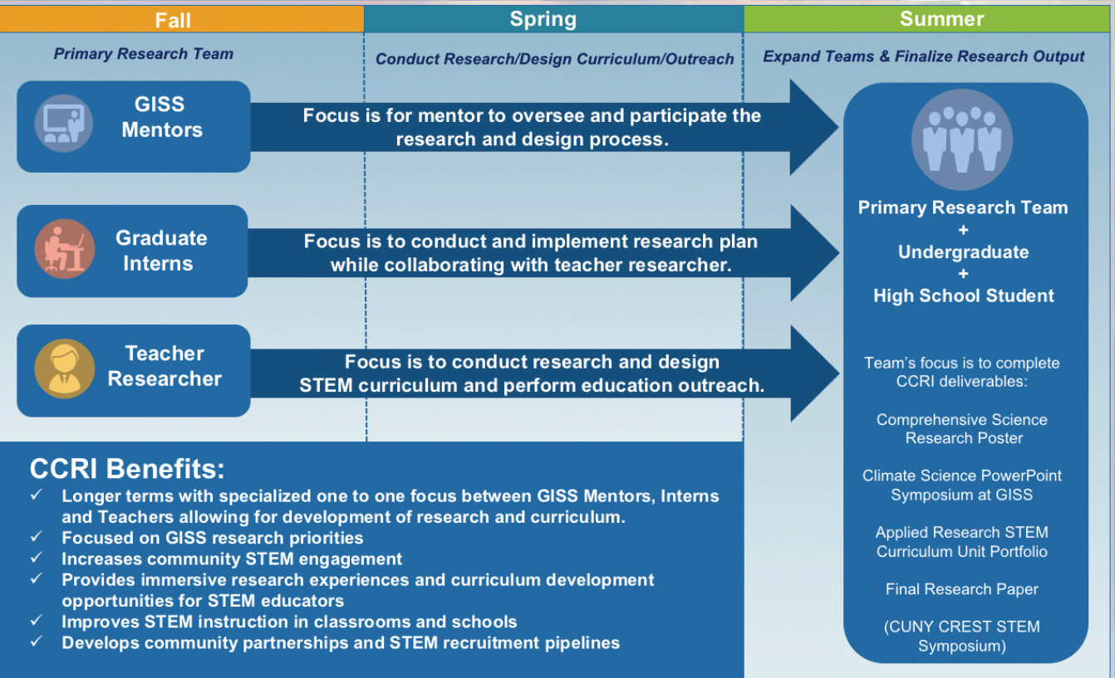
CCRI
The NASA GISS Climate Change Research Initiative (CCRI) is a year-long STEM engagement opportunity for NYC metropolitan area educators and graduate students to work directly with NASA scientists and lead research teams in a NASA research project.

Slide 11
CCRI 2021-22 Projects
Atmospheric Rivers in a Changing Climate @ GISS
Characterizing the Urban Land Surface Temperature via an Innovative, Multi-Platformed Suite of Satellite and Ground-Based Remote Sensing Technologies @ GISS
Climate Change in the Hudson Estuary — Past, Present, and Future @ GISS
Earth Observation Applications for Resiliency: Assessing Climate Change Impacts in Urban, Agricultural, and Natural Environments @ GISS
NEW 2022
Connecting the Local Urban Fabric to Global Climate Change @ GSFC
The Expanding Legacy of Landsat — Documenting Environmental Change Beyond Five Decades @ GSFC
https://tinyurl.com/CCRISummer2022

Slide 12
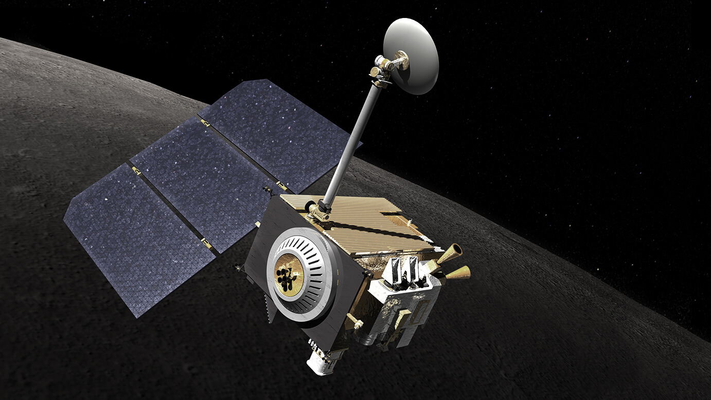
Lunar Reconnaissance Orbiter
  Terra
  Aqua
  GPM
  IceSat-2
  Aura
  SMAP
  JWST
  Sentinel-6
  Landsat

Slide 13
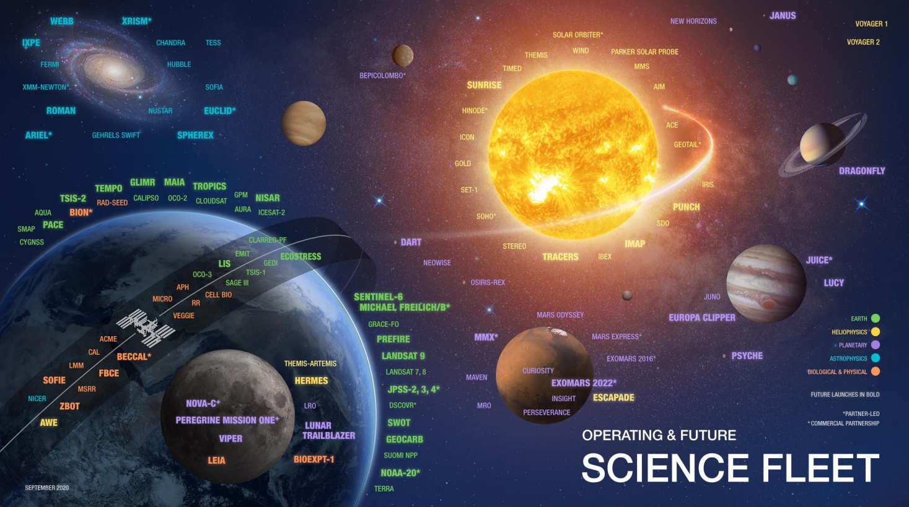
Operating & Future Science Fleet

Slide 14
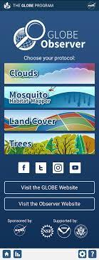


NASA Educational Resources
GLOBE Highlight
Examples of NASA educational resources:
  ARSET / EARTHDATA
  Earth Now
  GLOBE
  My NASA Data
  NEO
  Worldview

Slide 15
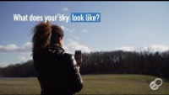
NASA GLOBE Observer Clouds

Slide 16
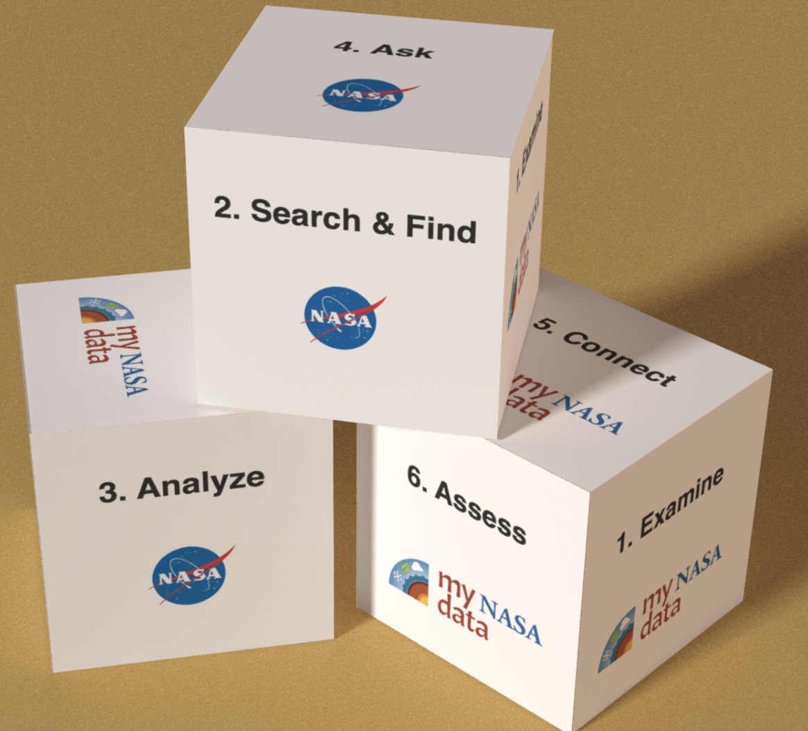

My NASA Data

Slide 17
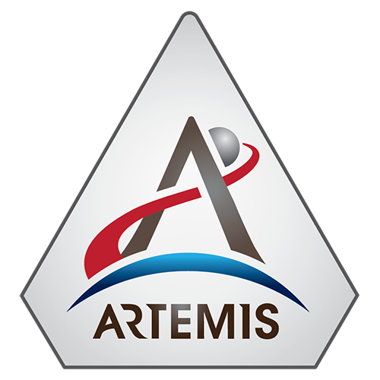
Artemis
With the Artemis program, NASA will land the first woman and next man on the Moon by 2024, using innovative technologies to explore more of the lunar surface than ever before. We will collaborate with our commercial and international partners and establish sustainable exploration by the end of the decade. Then, we will use what we learn on and around the Moon to take the next giant leap – sending astronauts to Mars.

Slide 18
Next Gen STEM
STEM products and opportunities that provide a platform for students to contribute to NASA’s endeavors in exploration and discovery.
Four areas:
  Commercial Crew Program
  Aeronaut-X
  STEM on Station
  Moon to Mars

Slide 19
Next Gen STEM – Commercial Crew
Engineering challenges
Coding
Digital badging
Virtual reality

Slide 20
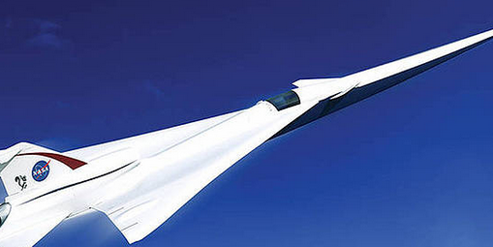
Next Gen STEM – Aeronaut-X
Engineering Design Challenges
Activities
Videos

Slide 21
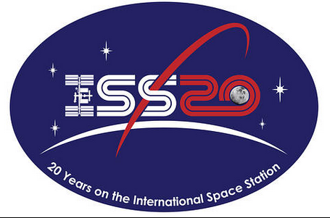
Next Gen STEM – STEM On Station
Collections of lessons for Science, Technology, Engineering and Mathematics
STEMonstrations
In-flight Education Downlinks
Citizen Science Opportunities

Slide 22
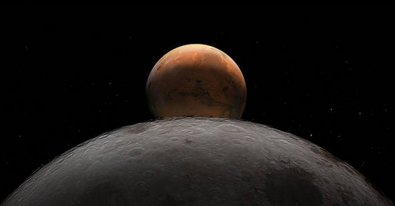
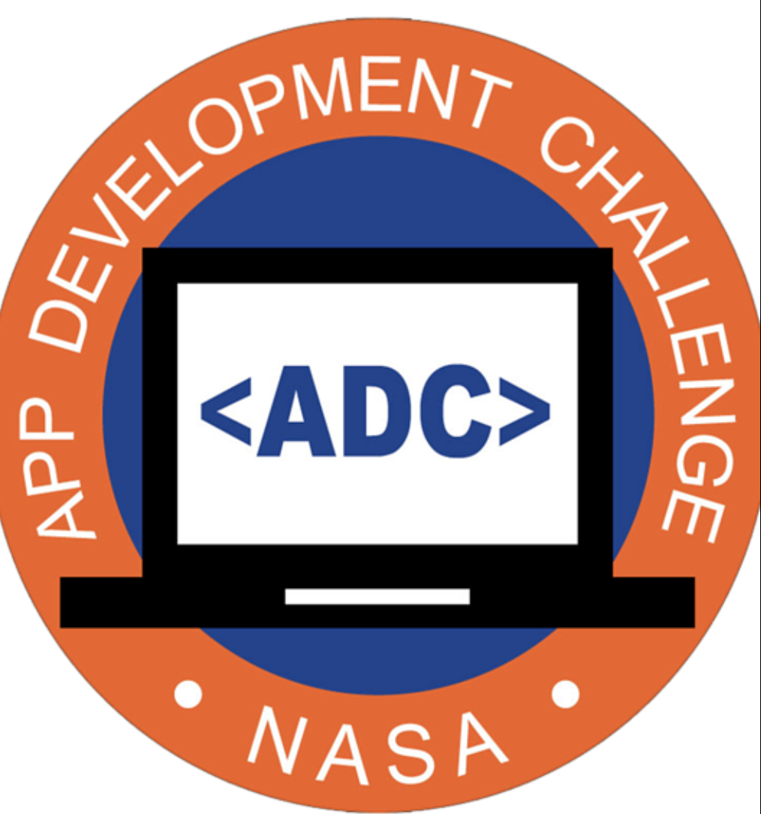
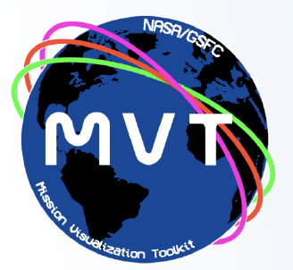

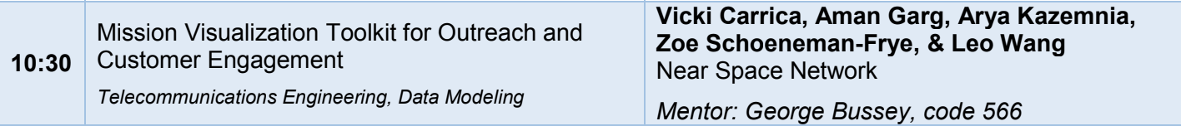
Next Gen STEM - Moon to Mars
Drawing
Hands – on Science Activities (Orion, SLS, Gateway)
App Development / Citizen Science Challenges
Digital Badges
Animations
Feb 11, 2021
NASA App Development Challenge Selects Artemis Generation Coders for Virtual Culminating Event
Academies of Loudoun: Leesburg, Virginia
Bell Creek Academy High School: Riverview, Florida
Bishop O’Connell High School: Arlington, Virginia
Falcon Cove Middle School: Weston, Florida
Gilman School: Baltimore, Maryland
McNeil High School: Austin, Texas
Middlesex County Academy for Science, Mathematics and Engineering Technologies: Edison, New Jersey
Millburn High School: Millburn, New Jersey
Moore Norman Technology Center: Norman, Oklahoma
Gretchen Whitney High School: Cerritos, California

Slide 23
NASA EPDC
EPDC is a national educator professional development system composed of and designed to serve STEM educators at all levels including K-12 educators, pre-service teachers, higher education faculty and informal educators.
The EPDC coordinates the delivery of these learning experiences through a team of Texas State University educational specialists located regionally at each of NASA's 10 research and space centers.
The EPDC provides professional learning experiences and resources to thousands of educators per year using integrated delivery mechanisms such as NASA Face to Face Institutes, Partner-delivered Educator Professional Development, Online Educator Professional Development and Community-Requested Educator Professional Development.

Slide 24

NASA Express
Keep up with the latest NASA STEM happenings by subscribing to the NASA EXPRESS newsletter.

Slide 25
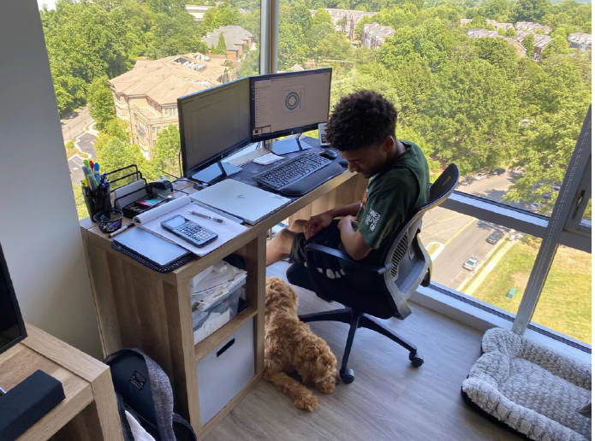
OSTEM Internships Program
OSTEM Internships provide high school to graduate level students with research and other experiential learning opportunities across the agency
Internships are available for STEM and non-STEM students, up to 6 months post-graduation
3 internship sessions: spring, summer, and fall
Students participate in enrichment activities during internship.
intern.nasa.gov

Slide 26

Links to resources
Earth Minute: https://climate.nasa.gov/climate_resource_center/earthminute
Earth Now : https://climate.nasa.gov/earth-now/
BEST: https://www.nasa.gov/audience/foreducators/best/activities.html
Earth Observatory Kids: https://earthobservatory.nasa.gov/blogs/eokids/
Worldview: https://worldview.earthdata.nasa.gov/
ARSET: https://arset.gsfc.nasa.gov/
Commercial Crew: https://www.nasa.gov/stem/nextgenstem/commercial_crew/commercial-crew-launch-kit.html
EPDC: https://www.txstate-epdc.net/
GLOBE Observer @ Home: https://observer.globe.gov/do-globe-observer/do-more/at-home
Scientific Visualization Studio: https://svs.gsfc.nasa.gov/
My NASA Data: https://mynasadata.larc.nasa.gov/
Climate Kids: https://climatekids.nasa.gov/
NASA STEM @ Home: https://www.nasa.gov/stem
NASA Express: https://www.nasa.gov/stem/express

Slide 27

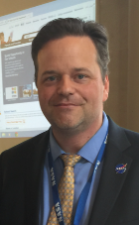
Contacts
Matthew Pearce
Education Program Specialist
Office of STEM Engagement
Goddard Institute for Space Studies
Goddard Space Flight Center
Headquarters
646-419-0144
matthew.d.pearce@nasa.gov

Slide 28
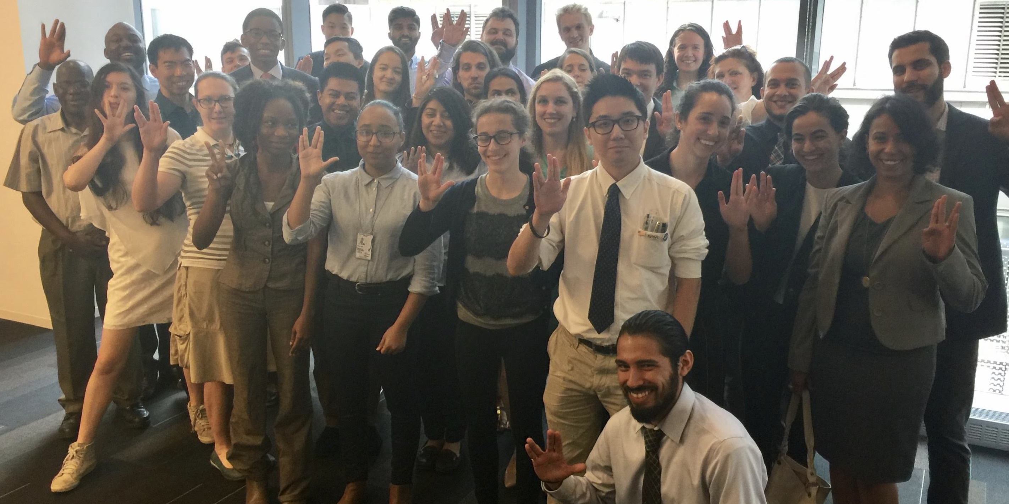
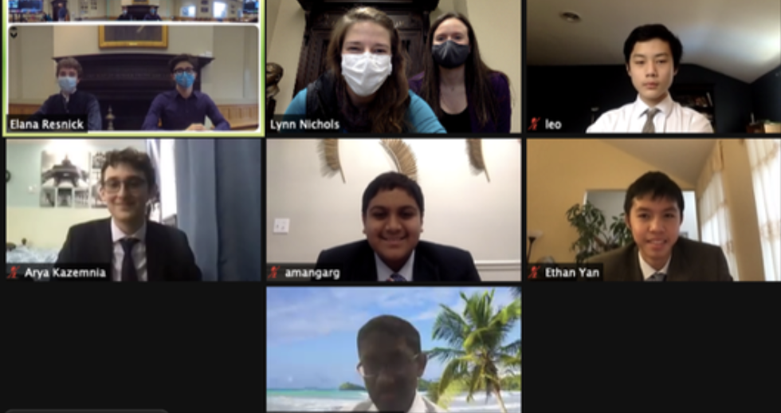
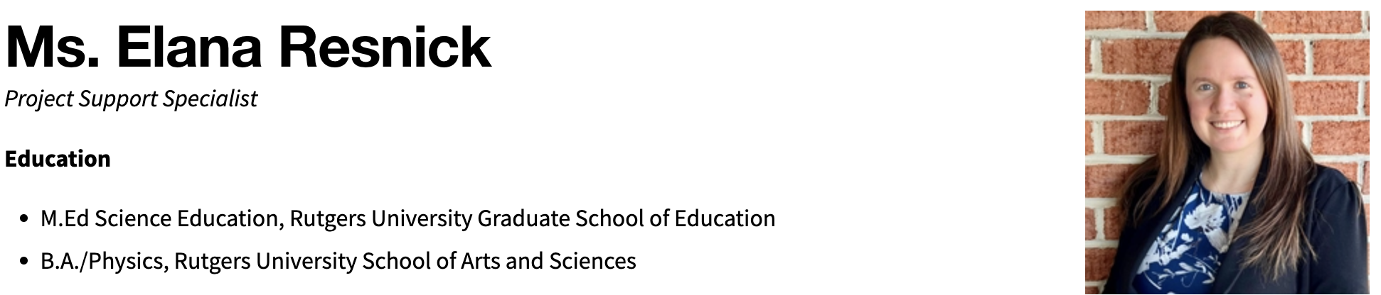
Thank You
Elana Resnick
resnickem@gmail.com

