Slide 1
QuarkNet
Outcomes-based Evaluation:
Results and Plans
Kathryn Race
Race & Associates, Ltd.
race_associates@msn.com
Notes:
Apologies to those who have seen previous presentations. This presentation represents the culmination of one-year of planning and four years of data collection.

Slide 2
Approach to Evaluation
Three Themes:
Develop (and use) of a Program Theory Model (PTM) ✔
Teacher-level Program Outcomes (based on PTM) at National- and Center-level -- on going
Center-level Program Outcomes and Program Sustainability Assessment (based on PTM and Sustainability Framework – on going
Notes:
The three evaluation goals are: (1) Develop and use a Program Theory Model (PTM); (2) Assess program outcomes at the national and center levels through teacher-level outcomes; and, (3) Assess the sustainability of program centers, based on center-level and sustainability outcomes.

Slide 3
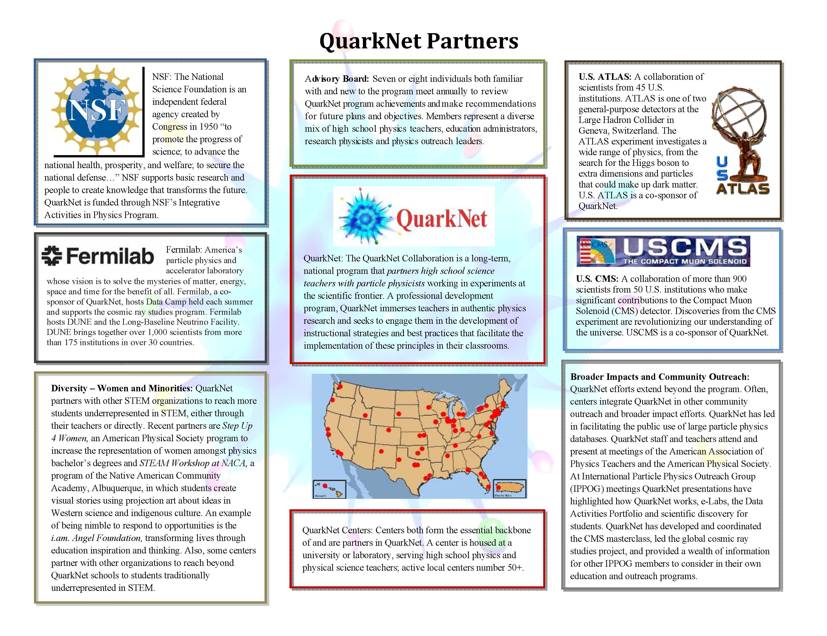
Notes:
The complete Program Theory Model (PTM) is seven pages in full. The abbreviated model, shown here and in the next slide, is intended to provide an overview of the Theory of the QuarkNet program. It is seen as an “approximate fit,” of the program articulating the logical link between program core strategies and outcomes for teachers, their students and centers. In addition, the PTM is used to direct the evaluation. This first page shows the many partners associated with QuarkNet.

Slide 4
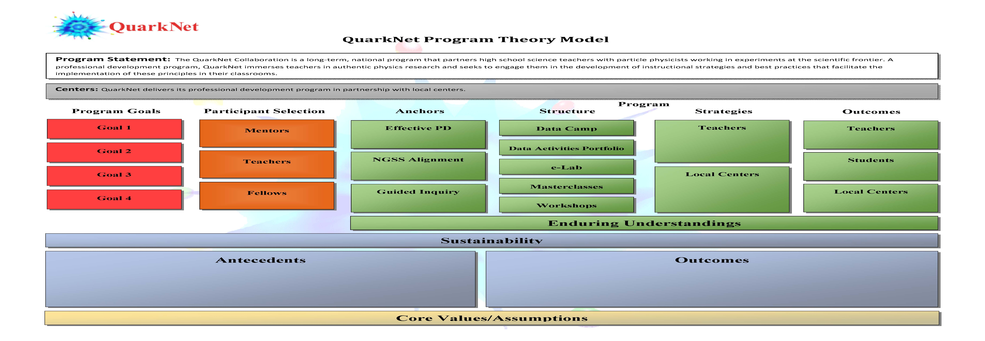
Notes:
This second page overviews or maps the significant components of QuarkNet providing a snap shot or profile of the program. Details of these components are outlined in the remaining pages of the PTM. If you use the PTM please reference it as QuarkNet Program Theory Model 2019. You can review the full PTM in the full evaluation report or at https://quarknet.org/group/evaluation-team. The evaluation focuses on the components outlined in green boxes.

Slide 5
Multiple Sources of Information
Workshop Agendas captured from QN website
Used to create a workshop table which summarizes implemented workshops for each program year
Focused on capturing which DAP activities are embedded in workshops, and time
allocated for teacher implementation planning and discussion
Center Annual Reports posted on QN website
Provides summary of QuarkNet opportunities at each center each program year; reviewed to inform center-level activities beyond workshop (e.g., masterclass; in-school year meetings)
Data Activities Portfolio (DAP) activities summarized by alignment with
NGSS Science Practices -- as designed and as implemented
Enduring Understandings
Virtual Workshop Visits by Evaluator
Via Zoom, visits focused on teachers’ discussions of implementation plans during workshops (coordinated by QuarkNet staff and center mentor)
Uses to:
Compare designed to implemented program
Provide context and inform outcomes assessment
Notes:
Additional source documents are included to provide further details and support for the Program Theory Model and to highlight the QuarkNet program as implemented.

Slide 6
Sources of Outcomes Data
Teacher Full Survey (unique count of 483 teachers)
Highlights information about who is the QN teacher
Primary focus: Quantitative analysis of teacher- and student– outcomes (to be explained next)
Update Survey (362 completed – 327 linked to full survey)
Follow up (completed annually) responses linked to full survey
Primary focus: How/what/why QN content and materials are used in the classrooms (e.g., DAP activities)
Center Feedback Form: Center-level Outcomes
Used to corroborate (or not) teacher-level responses
Assessed through alignment with NGSS practices and alignment with Matrix of Effective Practices (M.J. Young & Associates, September, 2017)
Notes:
Using multiple sources of information when feasible, we search for patterns in the data. Information about Who is the QuarkNet Teacher? is provided in the Evaluation Report.

Slide 7
Overview of Analyses Related to Teacher (and their Students) Outcomes
Program Exposure
Teacher Outcomes
Student Outcomes
Data Camp
Exposure to Implemented
Core
Strategies
Approach to Teaching
Student Engagement
Workshops
Masterclasses
Use of DAP
Centers
Notes:
All analyses are fully described in the evaluation report, https://quarknet.org/group/evaluation-team.

Slide 8
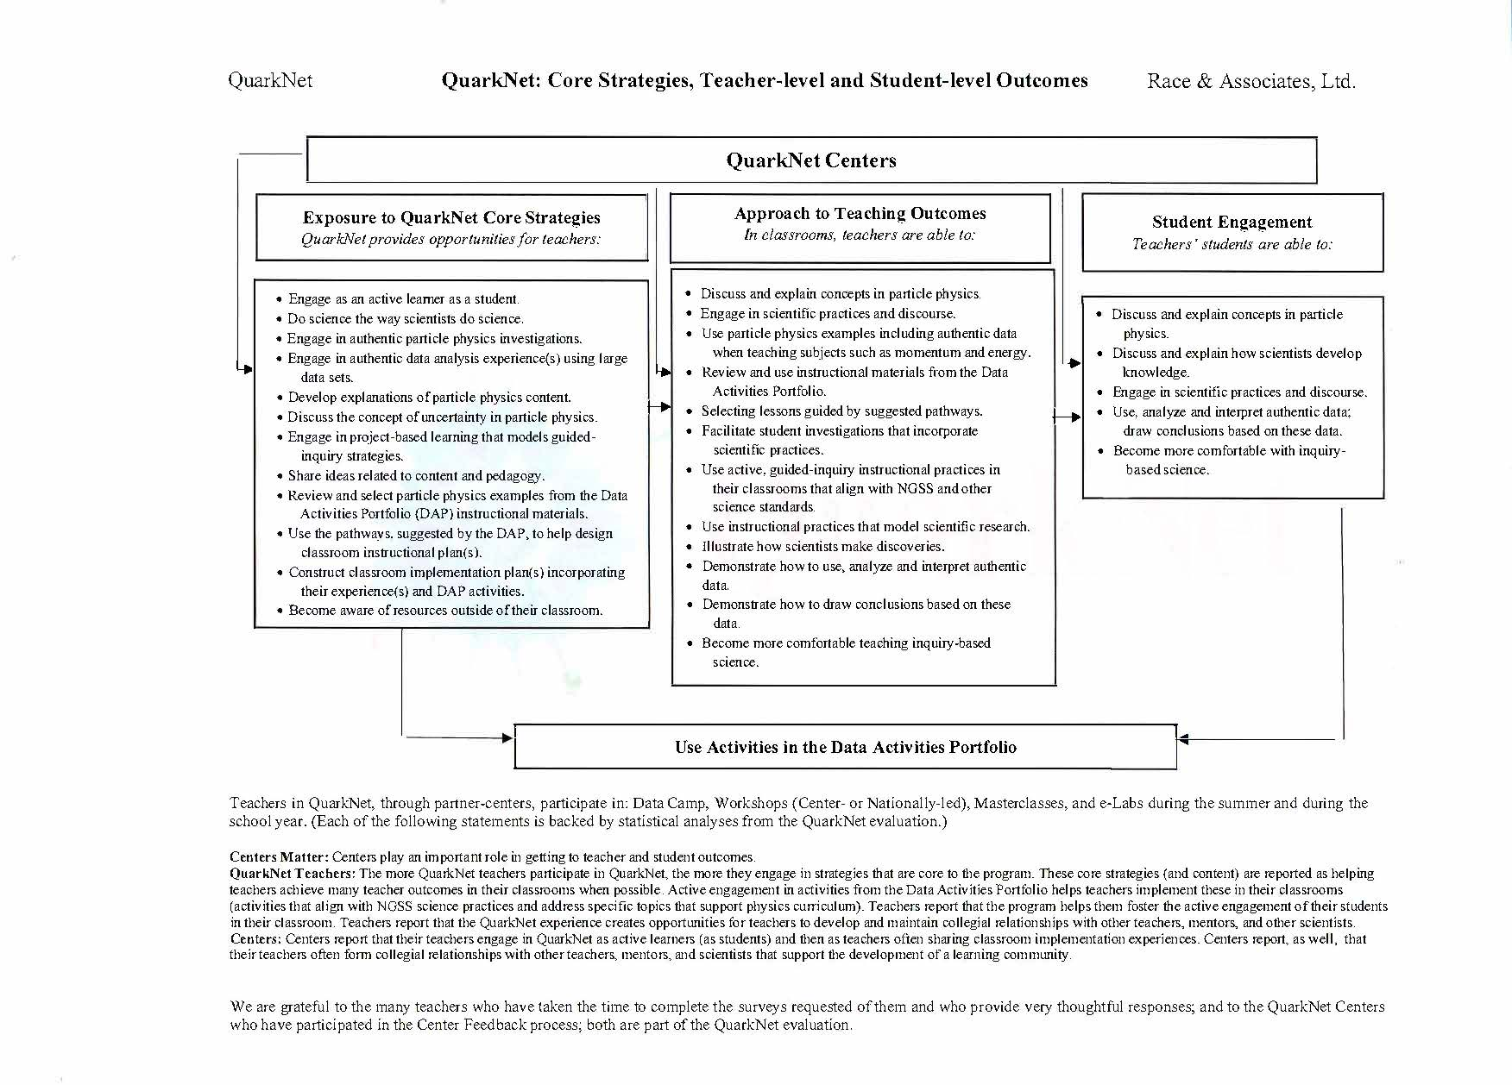
Notes:
This one-page summary shows the relationship between program exposure and teacher (and their students) outcomes. Student Engagement is measured by teacher perceptions of this behavior.

Slide 9
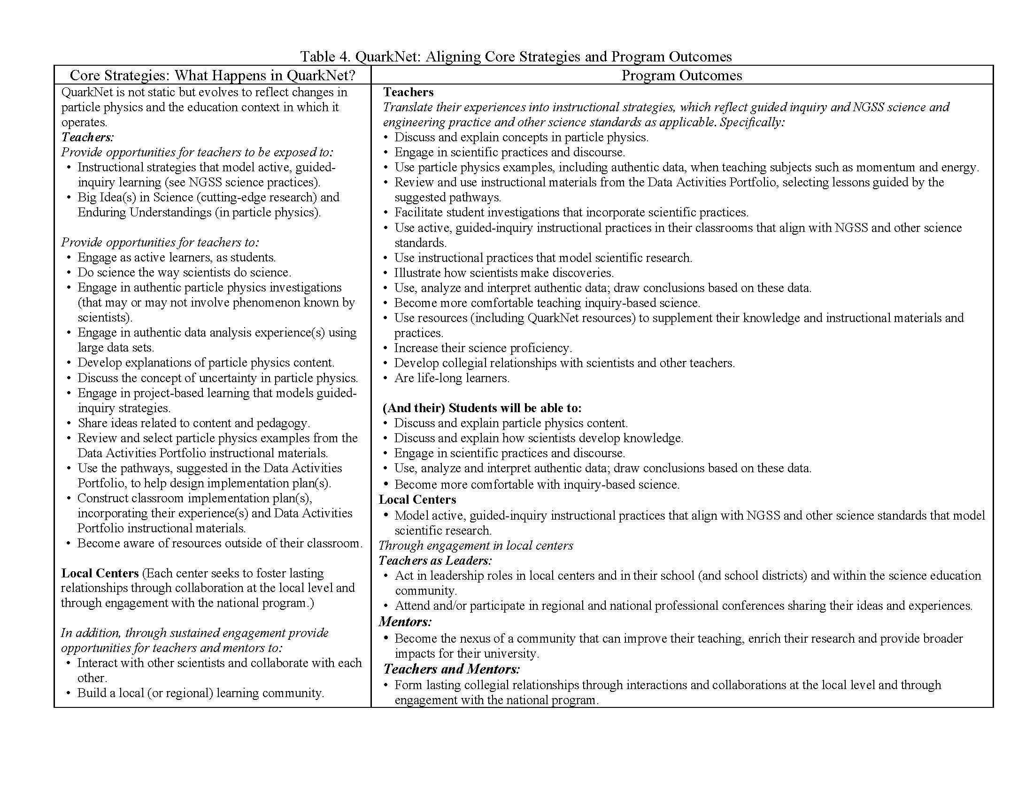

Slide 10
Teacher-level Measures
Program Exposure:
Core Strategies
Outcomes:
Approach to Teaching
QuarkNet’s Influence on Approach to Teaching
Student Engagement (as perceived by teachers)
QuarkNet’s Influence on Student Engagement
Each is measured by a score (based on full survey responses) – where the higher the score the more positive the perception.
Notes:
Using strategies rather than activities to describe the program allows centers to implement those activities that best meet their needs; while offering a framework in which the consistency of the program can be assess; thus, it acknowledges program variation across centers and permits a framework to gauge and assess these variations. Scale scores, rather than individual survey items, increase the reliability of these measures and provides confidence that when these vary we are measuring something that varies in a systematic way.

Slide 11
Scale Scores
Table 21
Building Scales for Analysis of Program Engagement and Outcomes
Scale | What’s Measured | # of Items | N | Mean | Standard Deviation | Cronbach’s Alpha
Core Strategies | Teachers’ perceived exposure to program core strategies articulated in PTM | 12 | 464 | 54.10 | 6.97 | 0.86
Approach to Teaching | Perceived assessment of QN teacher outcomes | 12 | 447 | 42.85 | 8.38 | 0.87
QN’s Influence on Teaching | Perceived assessment of how QN has influenced teaching practices and content | 12 | 402 | 48.04 | 9.51 | 0.91
Student Engagement (SE) | Teachers’ perceptions of student engagement in their classroom | 5 | 425 | 18.38 | 3.66 | 0.84
QN’s Influence on SE | How QN has influenced this student engagement | 5 | 357 | 19.63 | 4.06 | 0.91

Slide 12
Exposure to Core Strategies: Assessment
Single-variable analyses suggest that:
Engagement in QuarkNet (the type and degree of program engagement) is positively related to Core Strategies scores; and,
Use of activities from the Data Activities Portfolio (Use of DAP) is positively related to QuarkNet engagement as well.
Notes:
Statistical summary tables of these analyses can be shared if desired.

Slide 13
Approach to Teaching
In hierarchical linear regression, based on 24 (31combined) centers
Teacher outcomes (Approach to Teaching scores), are positively related to perceived QuarkNet's Influence on Teaching and Core Strategies scores, and – also the QuarkNet Center (as measured by Approach to Teaching center-level means).
Centers play an important role in teacher outcomes
Notes:
Statistical summary tables are included in the Evaluation Report.

Slide 14
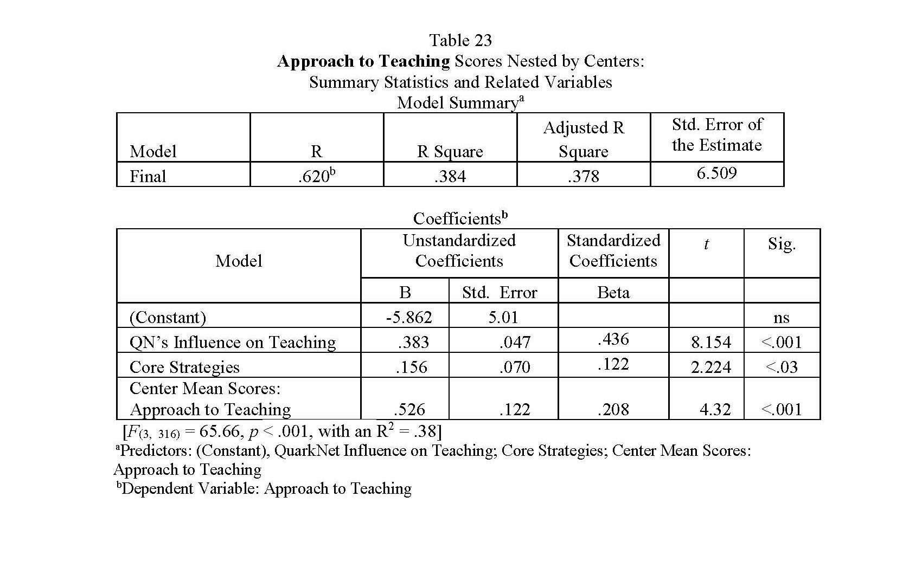
Approach to Teaching
(slide 14)

Slide 15
Student Engagement
In hierarchical linear regression, based on 24 (31 combined) centers
Student Outcomes (Student Engagement scores as perceived by their teachers) are positively related to perceived QuarkNet’s Influence on Student Engagement, Approach to Teaching scores (teacher outcomes) and QuarkNet’s Influence on Teaching and – also the QuarkNet Center (as measured by Center-level Student Engagement and QuarkNet Influence on Teaching mean scores)
Centers play an important role in student outcomes

Slide 16
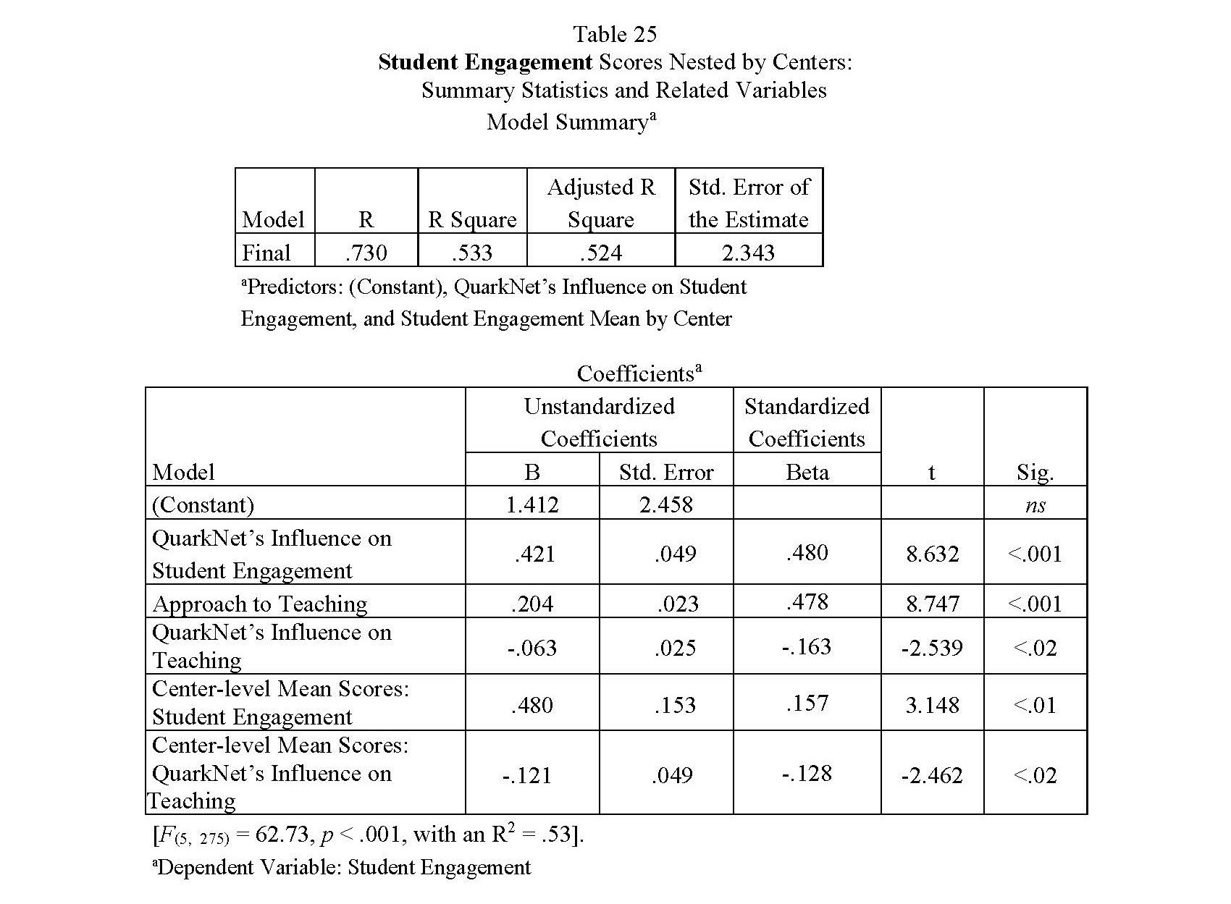
Student Engagement

Slide 17
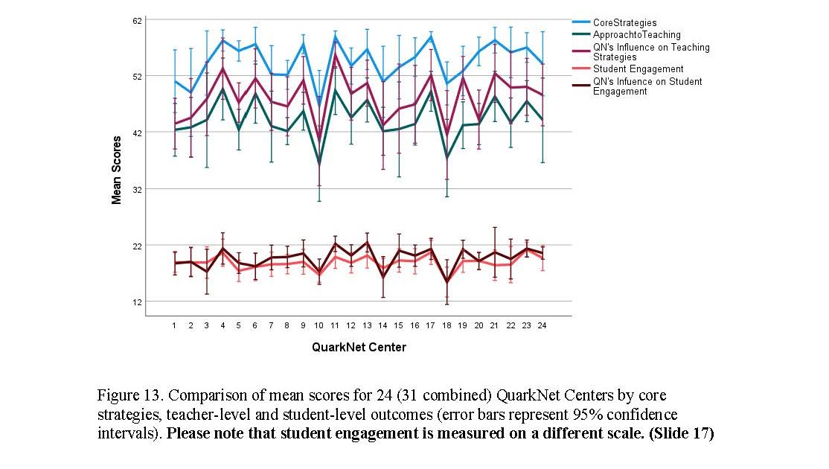
Teacher and (their Students) Outcomes

Slide 18
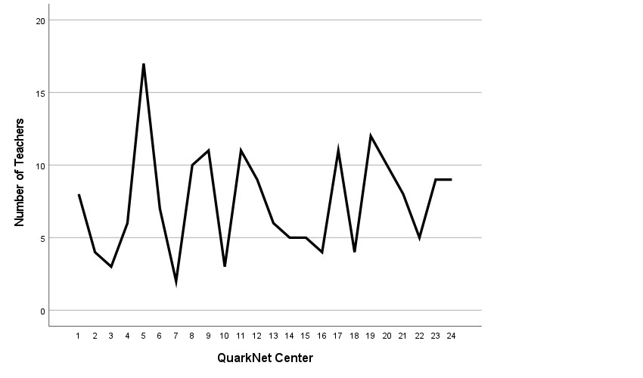
Reported Use of DAP Activities
Figure 14. Number of teachers who reported using Data Activities Portfolio (DAP)
activities in their classroom for 24 (31 combined) QuarkNet Centers. [Total number
of yes/no responses per center ranged from 11 to 41.] (Slide 18)
Notes:
It is important to note that the Data Activities Portfolio has not remained static during this grant period. In fact, the number of activities included in the DAP has doubled from the end of the last grant period to now. Also, many older activities have been revamped or modified to include more recent scientific findings or other ways to implement. Teachers knowledge of the DAP has increased over the course of the current grant period as well as QuarkNet staff embedding DAP activities presentations into workshop agendas and opportunities for teachers to engage in these.

Slide 19
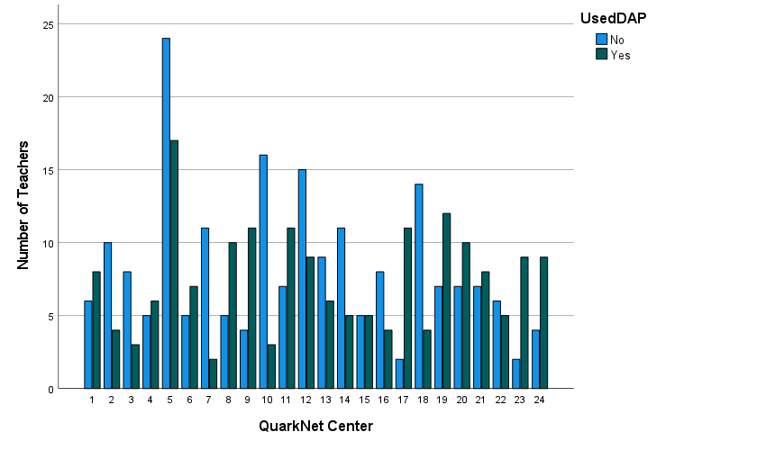
Reported Use/Non-use DAP
Figure 15. Comparison of use (and not used as yet) of Data Activities (DAP) activities by
teachers within 24 (31 combined) QuarkNet Centers. [Total number of yes/no responses per
center ranged from 11 to 41.] (Slide 19)

Slide 20
Still Exploring: Building on Analyses
Through descriptive analyses:
Using responses from Update Surveys to explore how teachers are using DAP activities and QN content and materials in general
Suggest – that center-level differences in teacher and student outcomes may be due to:
Frequency in which DAP activities are embedded in workshops
and time allocated for implementation plans and discussion
Centers working more closely with QN staff teachers
Reported use of DAP activities by teachers in descriptive analyses of their teaching practices over time (i.e., repeated responses to Update Survey over time)

Slide 21
Program Engagement and Teacher Outcomes
The more QuarkNet teachers participate in QuarkNet, the more opportunities to engage in strategies that are core to the program.
These core strategies (and content) are reported as helping teachers achieve many teacher outcomes in their classrooms when possible.
Active engagement in DAP activities helps teachers implement these in their classrooms.
Centers play an important role in getting to teacher and student outcomes.

Slide 22
Center-Level Outcomes
Captured through a combined survey/review process by each center:
Complete an assessment form at the center-level
Based on consensus review among mentor, lead teacher, and/or fellows
Assess workshop engagement through NGSS science practices
Assess the center based on Matrix of Effective Practices

Slide 23
Teachers and Centers
Tend to Agree, Examples
Teachers report: the program helps them foster the active engagement of their students in their classroom.
Centers report: their teachers engage in QuarkNet as active learners (as students) and then as teachers often sharing classroom implementation experiences.
Teachers report: the QuarkNet experience creates opportunities for teachers to develop and maintain collegial relationships with other teachers, mentors and other scientists.
Centers report: their teachers often form collegial relationships with other teachers, mentors, and scientists that support the development of a learning community.

Slide 24
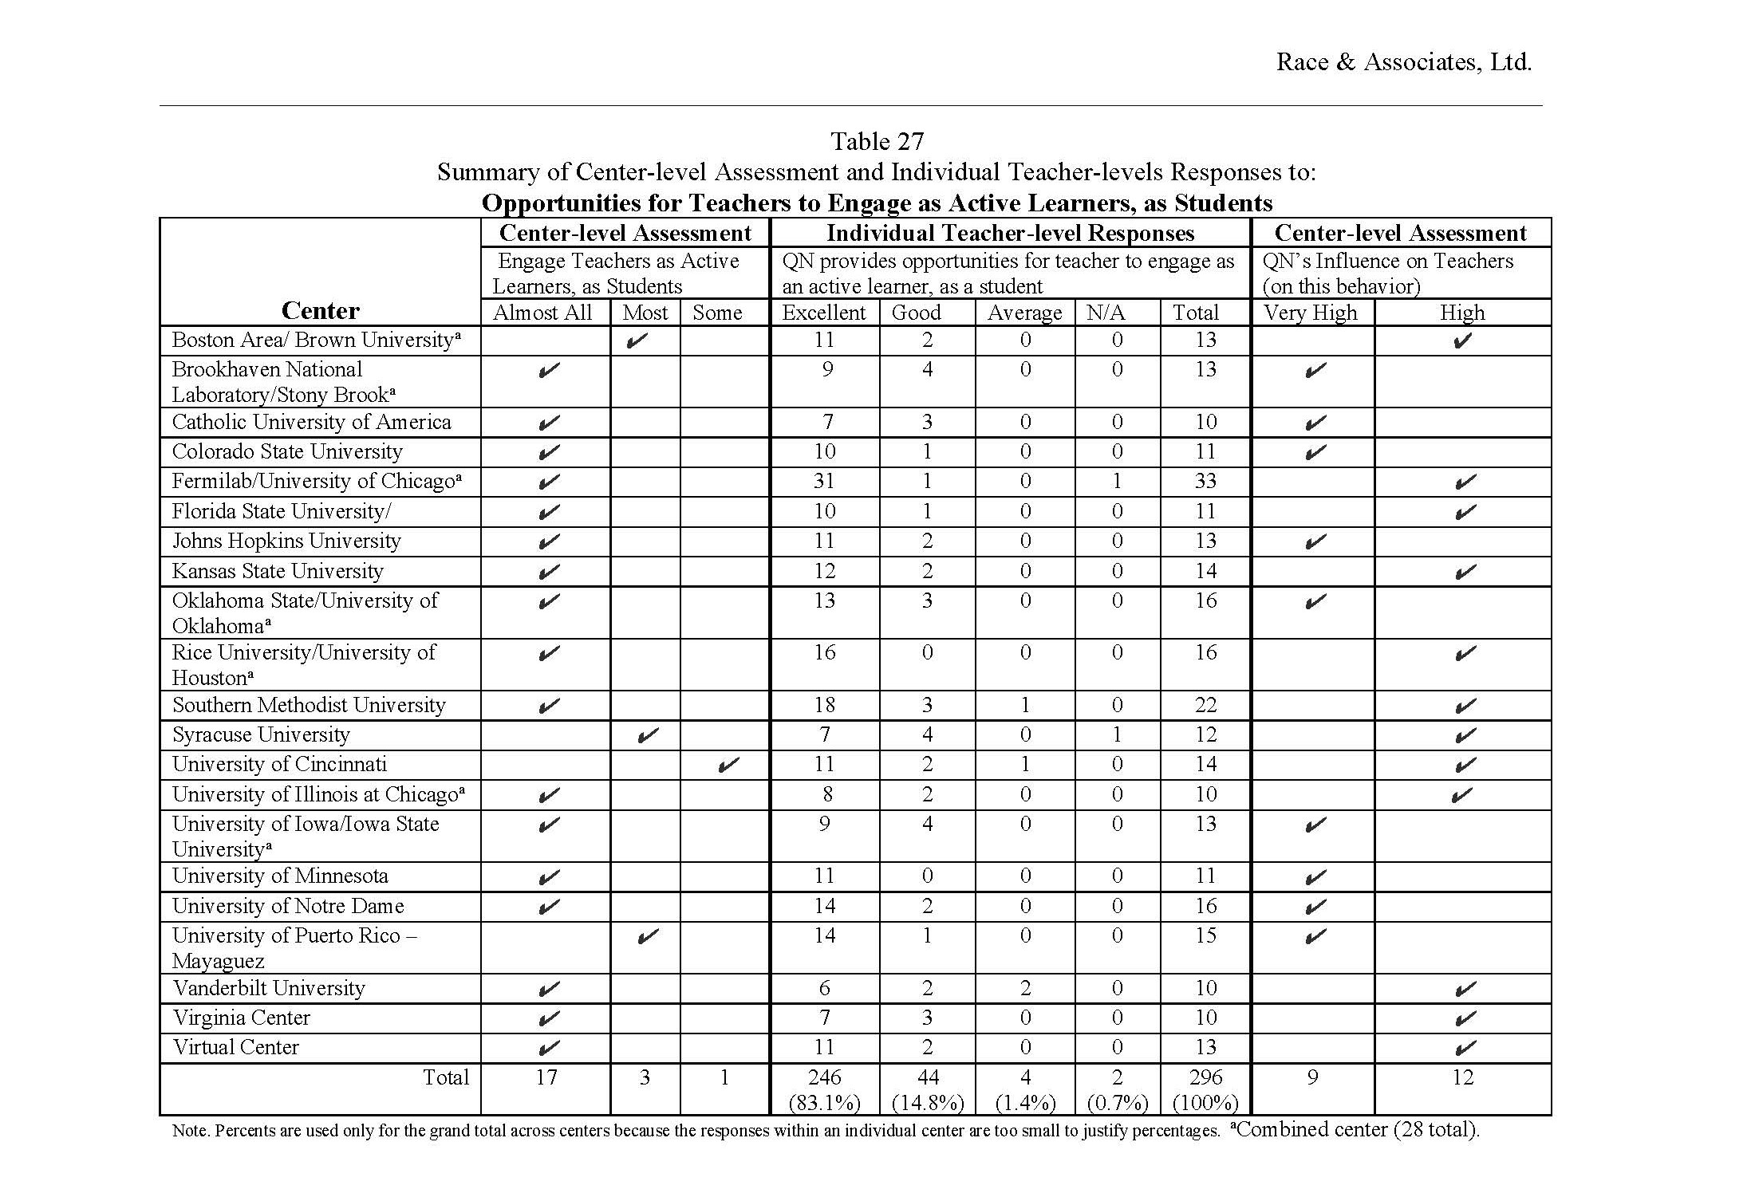
Teacher/Center Responses

Slide 25
Evaluation Plans
Continue to focus on an outcomes-based evaluation that:
Is guided by the Program Theory Model (e.g., update to include Coding Camp)
Uses the Teacher Full Survey (slightly modified) and
the Update Survey
Uses multiple sources of information when feasible and look for patterns in the data
Expands descriptive analyses of teachers’ reported use of QN content and materials in their classrooms
Simplifies the protocol used to gather center-level outcomes focused toward review/helping to restart a small group of centers
As confidence in results from these analyses grow, help QN staff work with centers

