Slide 1
Data Camp
Summary
Coordinates: Fermilab visit for 1-week, mid-July
Dataset: CMS Run 1
Tasks:
  Create mass plots showing particle resonances
  (“student hat”)
  Develop implementation plan for classroom, using QN resources from the Data Activities Portfolio
  (“teacher hat”)
Extras: Talks, tours, site visits, collab sessions

Slide 2
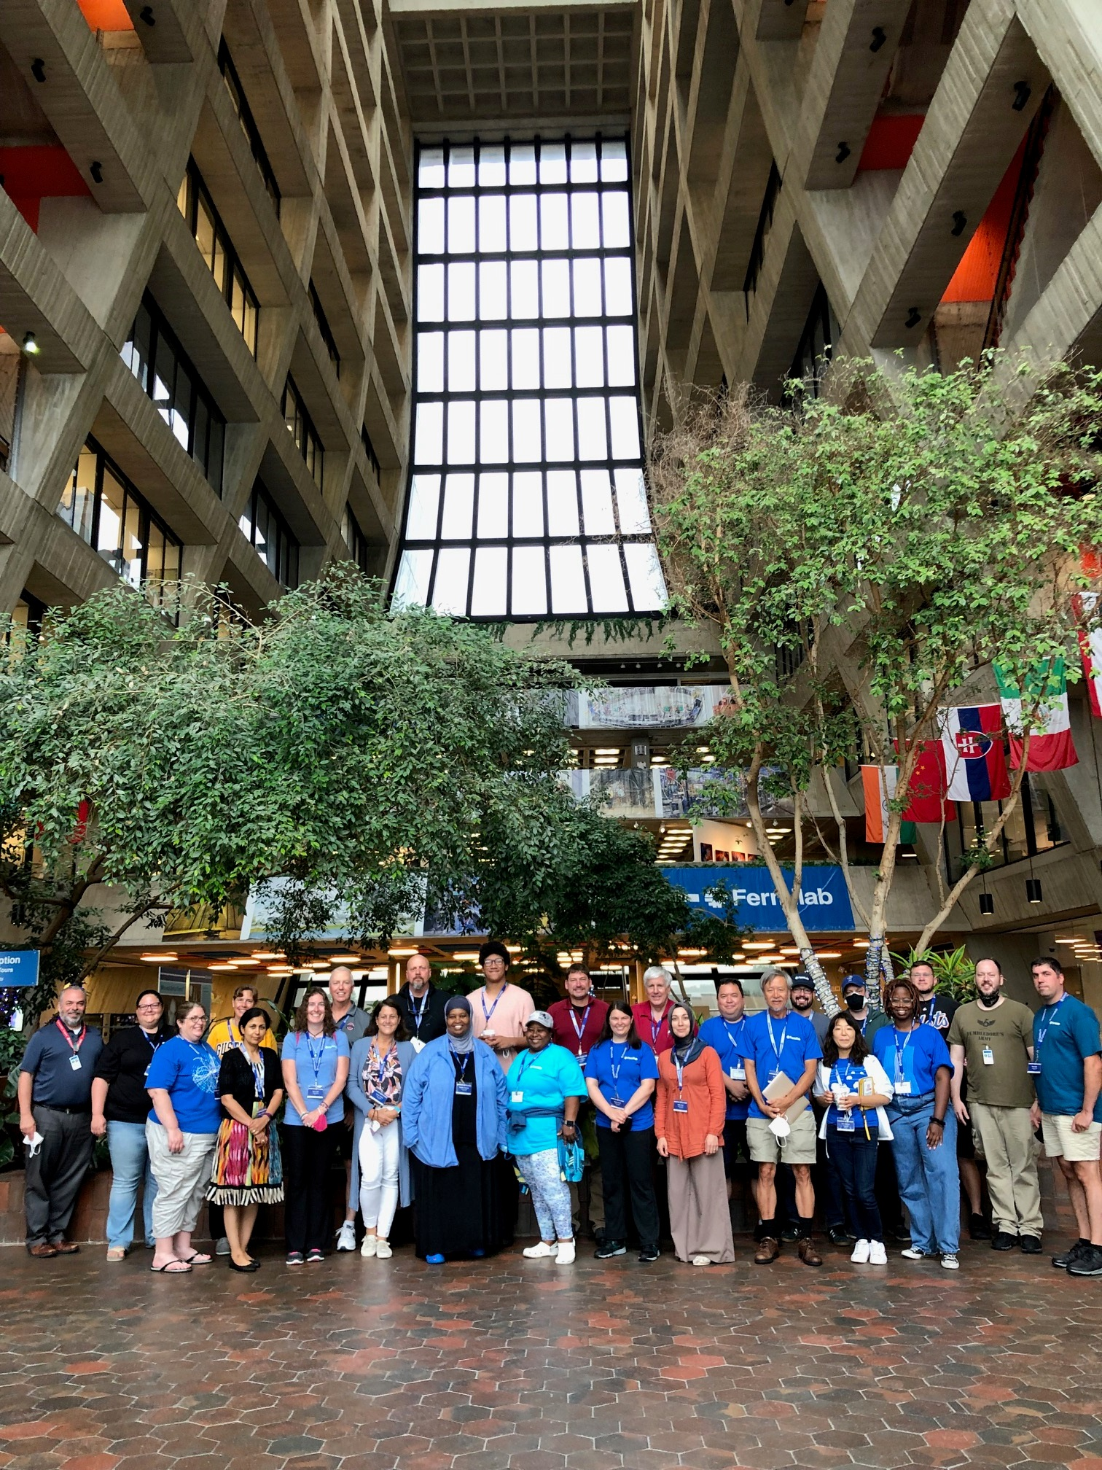
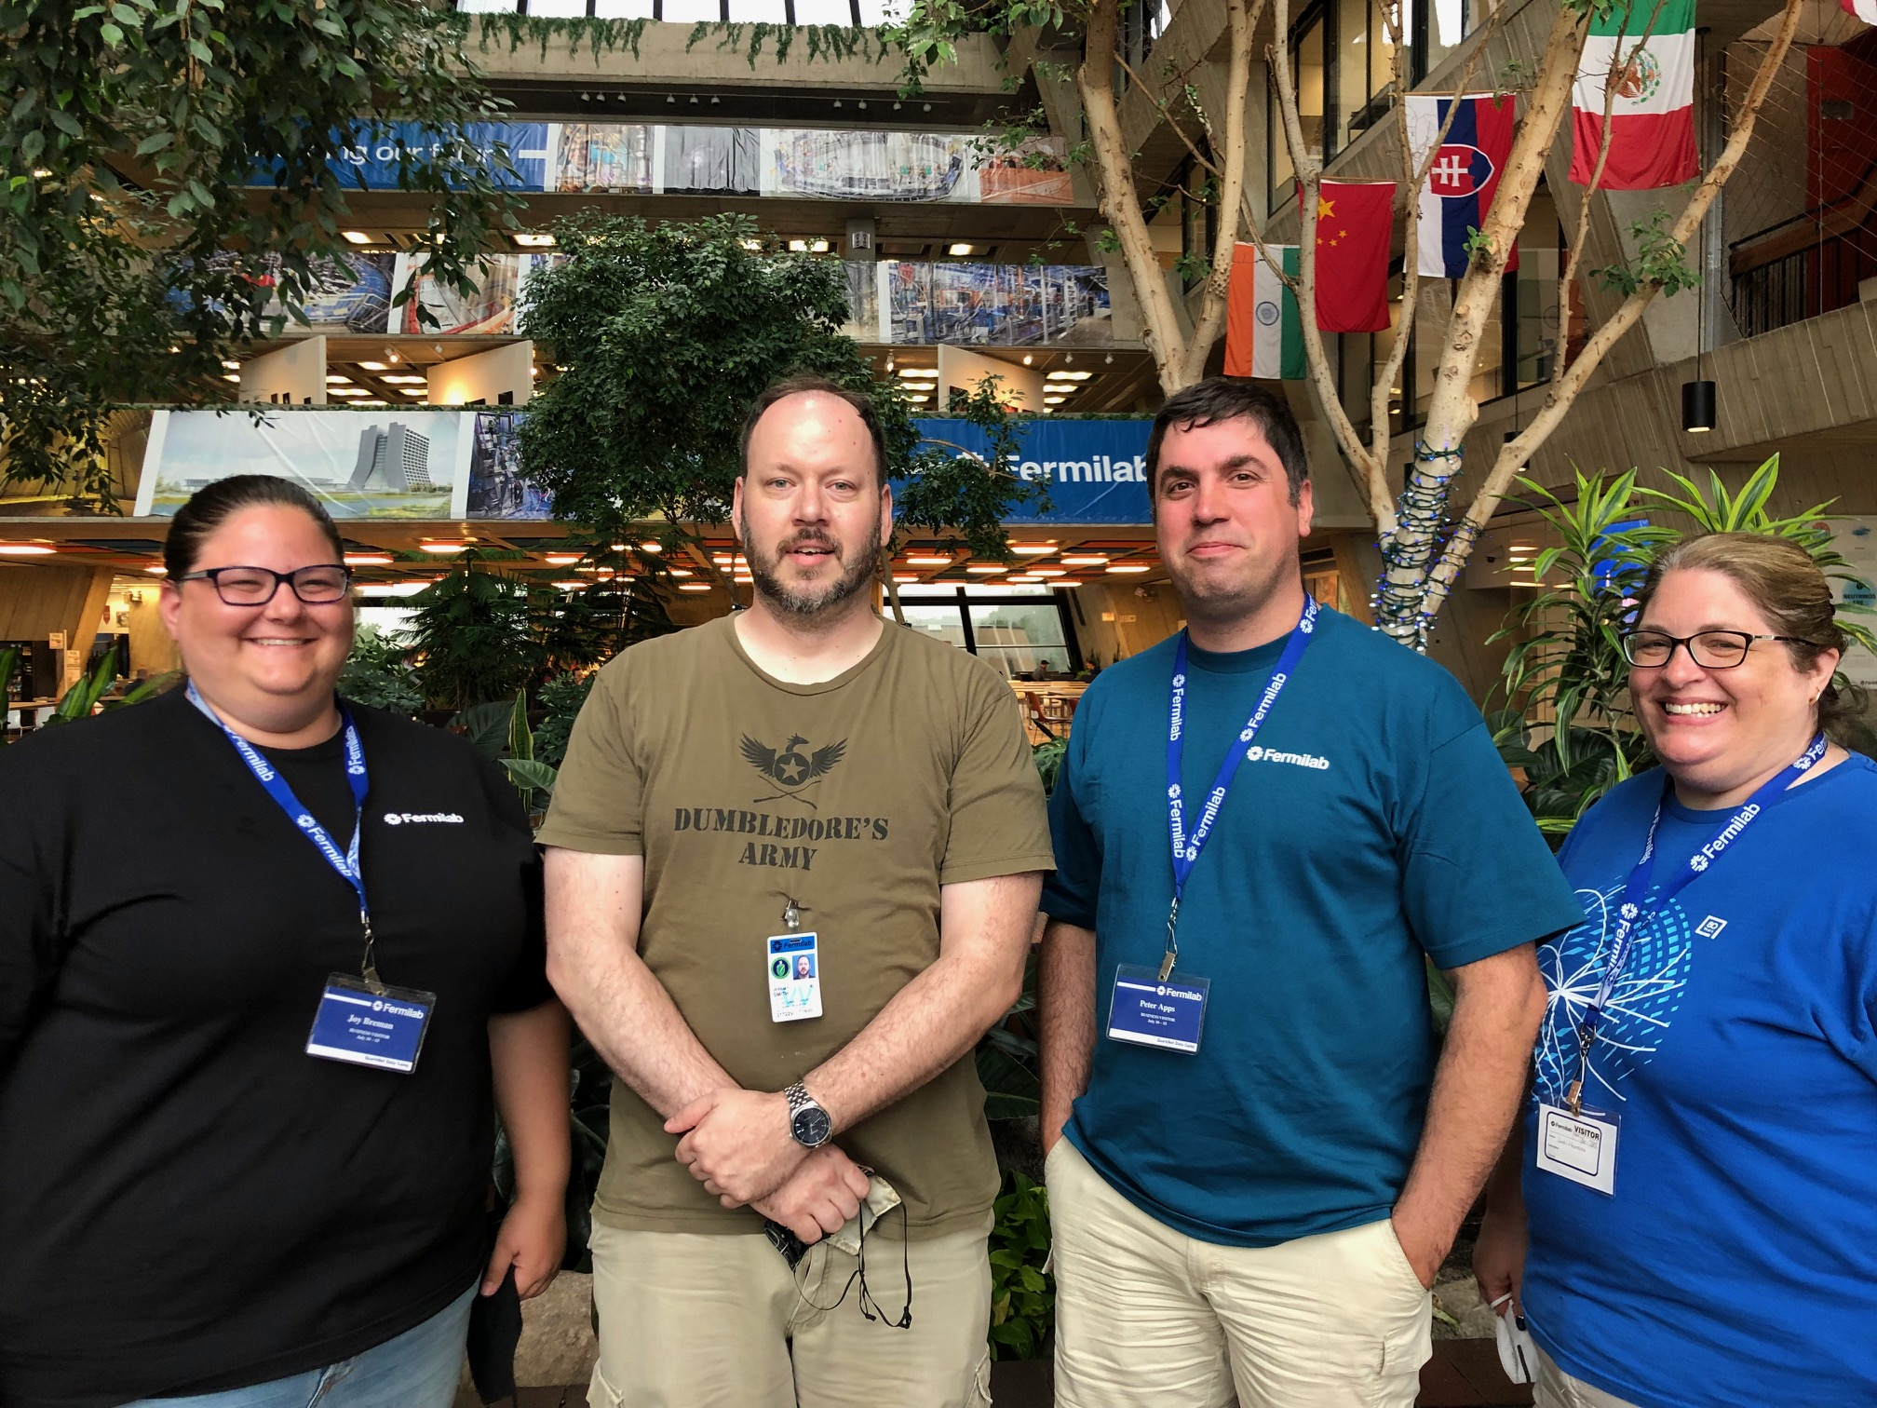
2022 Campers

Slide 3
Data Camp
Results / Goals
Positive feedback from 20 of 21 in final survey; generally positive feedback in daily surveys
Proposed changes:
  Varied goalposts in student hat
  (i.e. not all must do mass plot)
  Greater emphasis on fluid grouping & lane-changes
  (grouping turns out to be super important)
  Springboard for coding camps, less overlap
  Push high-flyers more, support beginners more
  (don’t clip wings or push out of nest)

