Slide 1
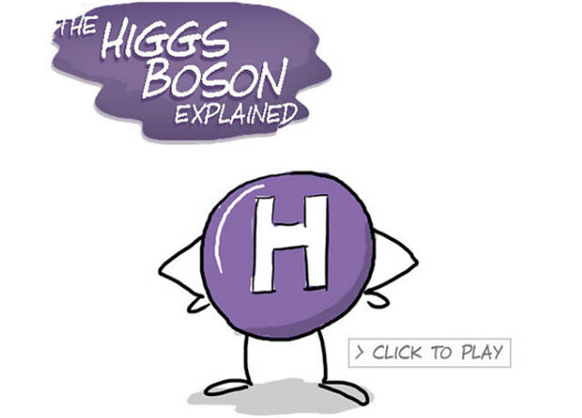




Quarknet 2022
The Standard Model,
Higgs Boson, Multiquark states,
Neutrinos
??
$$ν_{e}$$
S. Blusk
Syracuse University
Aug 9, 2022
$$ν_{μ}$$
$$ν_{τ}$$

Slide 2
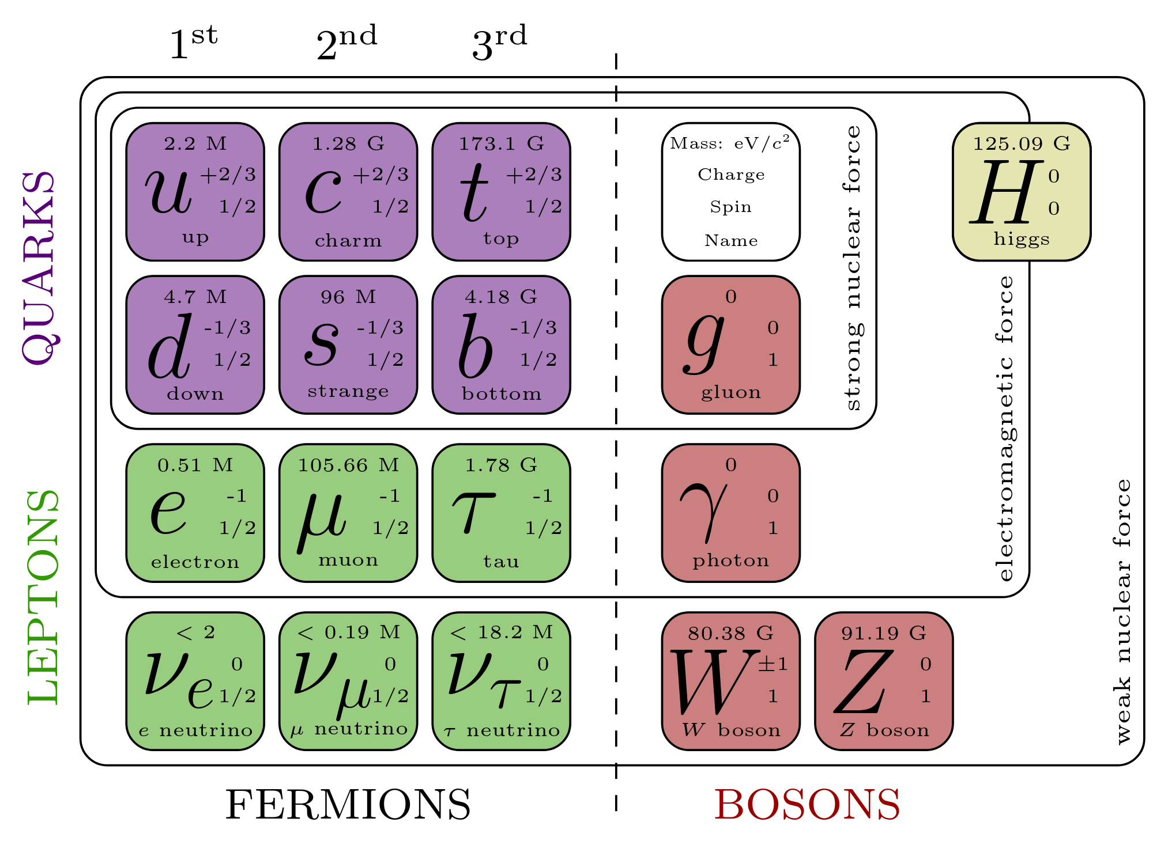
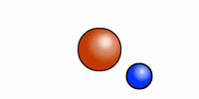
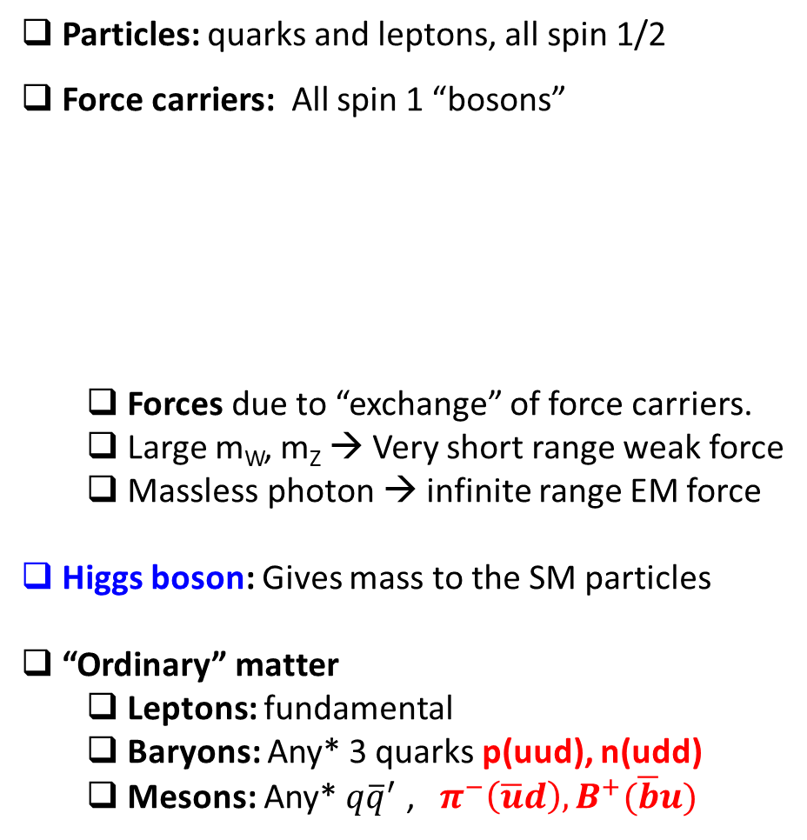
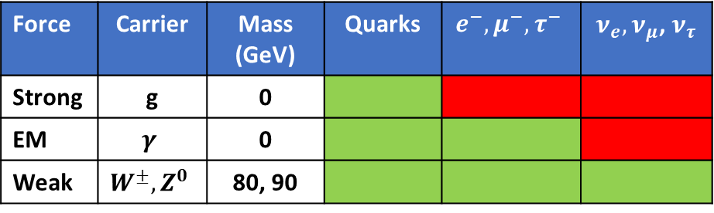
The Standard Model (SM), in a nutshell
Particles: quarks and leptons, all spin 1/2
Force carriers: All spin 1 “bosons”
  Forces due to “exchange” of force carriers.
  Large m_{W}, m_{Z} → Very short range weak force
  Massless photon → infinite range EM force
Higgs boson: Gives mass to the SM particles
“Ordinary” matter
  Leptons: fundamental
  Baryons: Any* 3 quarks p(uud), n(udd)
  Mesons: Any* $q{\overline{q}}^{′}$ , $π^{−}\left(\overline{u}d\right),B^{+}(\overline{b}u)$
Force | Carrier | Mass (GeV) | Quarks | $$e^{−},μ^{−},τ^{−}$$ | $ν_{e},ν_{μ}$, $ν_{τ}$
Strong | g | 0
EM | $$γ$$ | 0
Weak | $$W^{±},Z^{0}$$ | 80, 90
* Except top quark

Slide 3
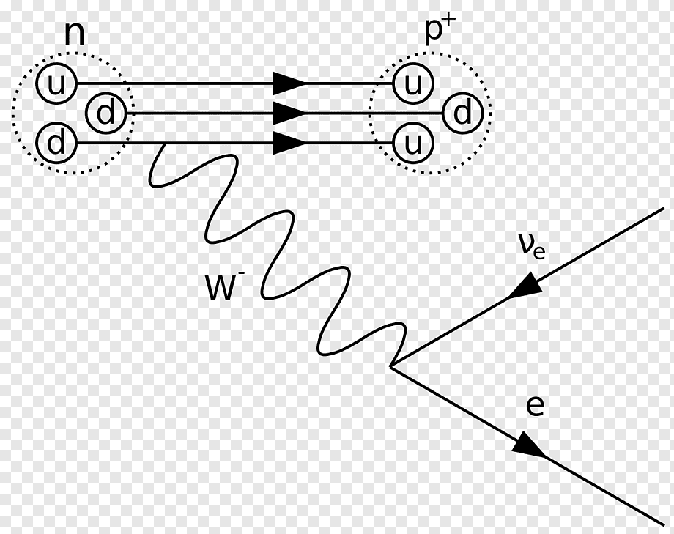


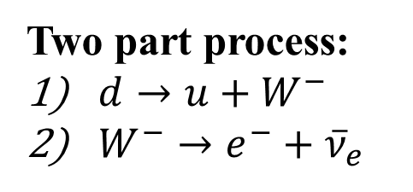
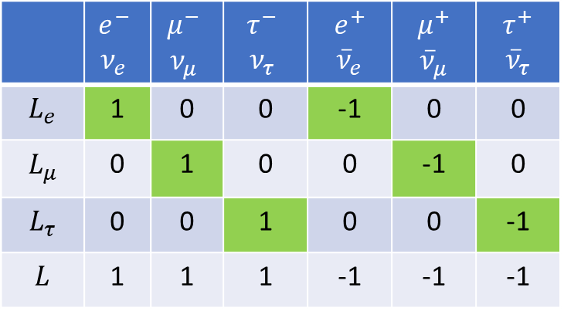

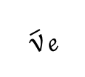

Neutron decay and conservation laws
$$n→{p+e}^{−}+{\overline{ν}}_{e}$$
Two part process:
$d→u+W^{−}$
$W^{−}→e^{−}+{\overline{ν}}_{e}$
1
$${\overline{ν}}_{e}$$
Various conservation laws must be respected
at each stage, including
Energy
Momentum
Charge
Lepton number: Yes, but …..
2
$$e^{−}$$
 | $$e^{−}$$ $ν_{e}$ | $$μ^{−}$$ $ν_{μ}$ | $$τ^{−}$$ $ν_{τ}$ | $$e^{+}$$ $${\overline{ν}}_{e}$$ | $$μ^{+}$$ $${\overline{ν}}_{μ}$$ | $$τ^{+}$$ $${\overline{ν}}_{τ}$$
$$L_{e}$$ | 1 | 0 | 0 | -1 | 0 | 0
$$L_{μ}$$ | 0 | 1 | 0 | 0 | -1 | 0
$$L_{τ}$$ | 0 | 0 | 1 | 0 | 0 | -1
$$L$$ | 1 | 1 | 1 | -1 | -1 | -1
$$n→{p+e}^{−}+{\overline{ν}}_{e}$$
$L_{e}$: 0 0 1 -1 ✓

Slide 4
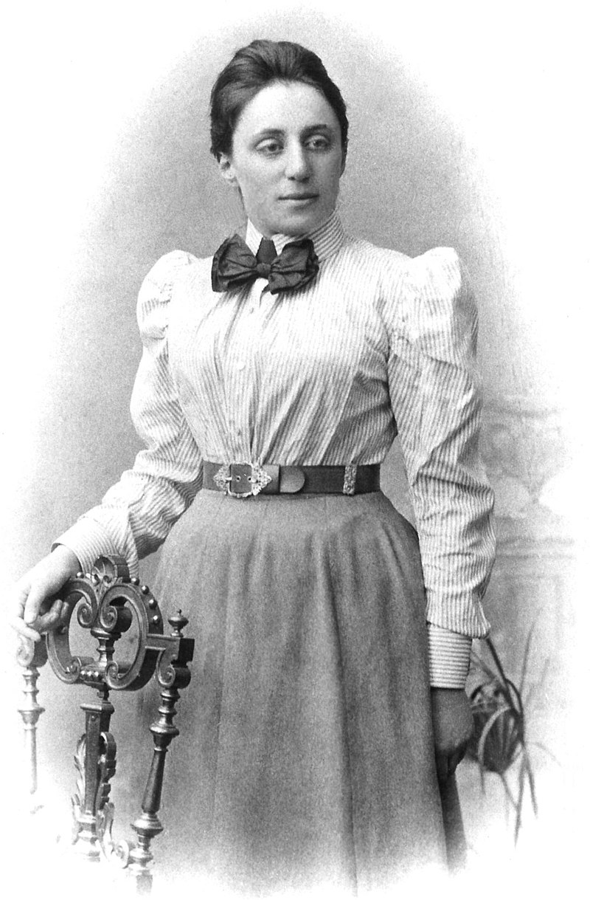
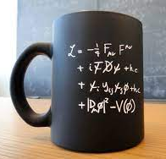
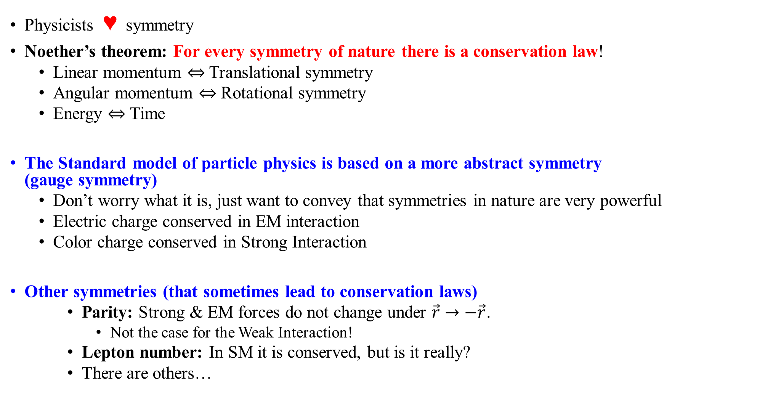
Symmetries in nature
Physicists ♥ symmetry
Noether’s theorem: For every symmetry of nature there is a conservation law!
  Linear momentum $⇔$ Translational symmetry
  Angular momentum $⇔$ Rotational symmetry
  Energy $⇔$ Time
The Standard model of particle physics is based on a more abstract symmetry
(gauge symmetry)
  Don’t worry what it is, just want to convey that symmetries in nature are very powerful
  Electric charge conserved in EM interaction
  Color charge conserved in Strong Interaction
Other symmetries (that sometimes lead to conservation laws)
    Parity: Strong & EM forces do not change under $\vec{r}→−\vec{r}$.
      Not the case for the Weak Interaction!
    Lepton number: In SM it is conserved, but is it really?
    There are others…
Emmy Noether
1882-1935

Slide 5
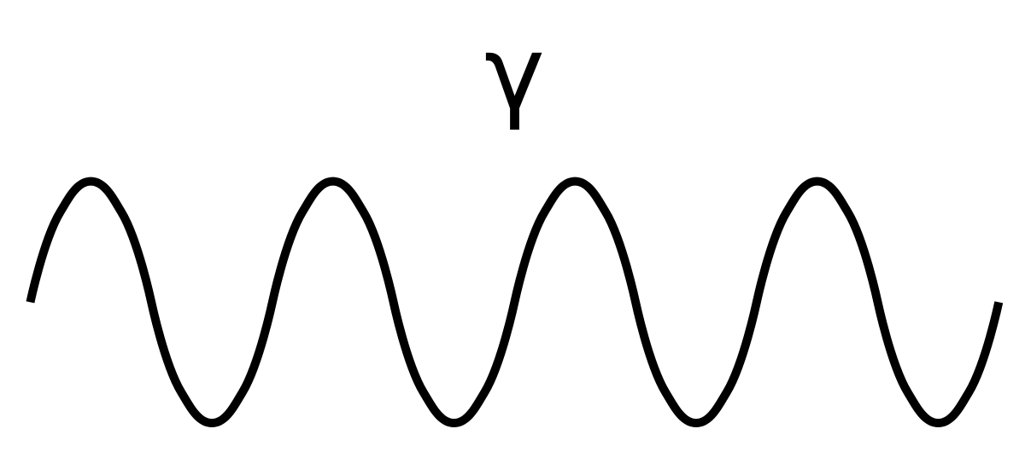




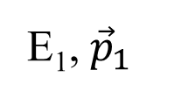

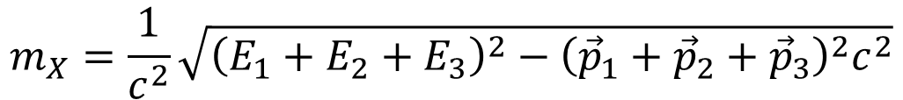
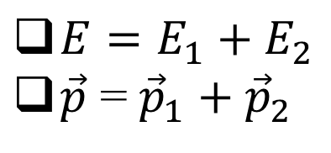
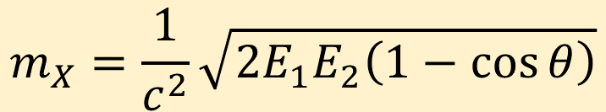

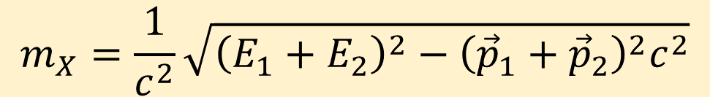
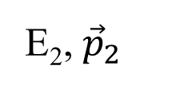
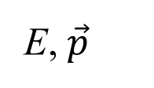
What is an invariant mass?
${E=E}_{1}+E_{2}$
$\vec{p}$ = ${\vec{p}}_{1}+{\vec{p}}_{2}$
$$E_{X}^{2}={\left|{\vec{p}}_{X}\right|}^{2}c^{2}+m_{X}^{2}c^{4}$$
E₁, ${\vec{p}}_{1}$
$$γ$$
X
$$m_{X}=\frac{1}{c^{2}}\sqrt{{\left(E_{1}+E_{2}\right)}^{2}−{\left({\vec{p}}_{1}+{\vec{p}}_{2}\right)}^{2}c^{2}}$$
θ
Since E = pc for a photon
E, $\vec{p}$
$$γ$$
$$m_{X}=\frac{1}{c^{2}}\sqrt{2E_{1}E_{2}\left(1−\cos{θ}\right)}$$
E₂, ${\vec{p}}_{2}$
Note: $m_{X}≠m_{γ}+m_{γ}=0!$
If there were 3 particles in the decay
$$m_{X}=\frac{1}{c^{2}}\sqrt{{\left(E_{1}+E_{2}+E_{3}\right)}^{2}−{\left({\vec{p}}_{1}+{\vec{p}}_{2}+{\vec{p}}_{3}\right)}^{2}c^{2}}$$

Slide 6

What’s new and exciting in Particle Physics!
Higgs boson @ 10
Multiquark states
If time permits
Pesky neutrinos
Tomorrow
Hints of NP? (See Rafael’s talk)

Slide 7
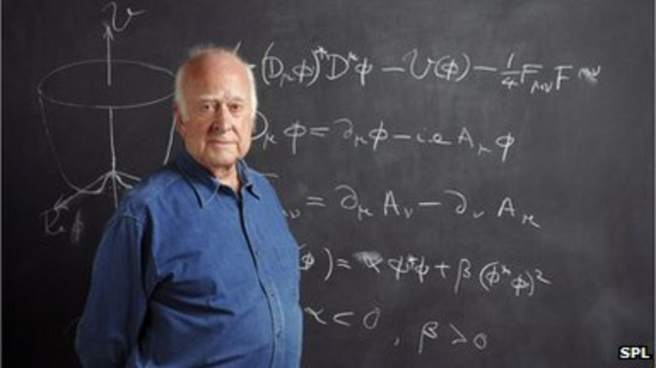
The Higgs Boson

Slide 8

Higgs boson (1)
In the SM:
The Higgs “field” permeates all of space
Particles “acquire” mass through their interaction with the Higgs field
No interaction
-> Zero mass
Interacts a lot
-> Large mass
d, t
Imagine all
have
momentum
p
Which one
gets here
first & last?
t = (d/p) m

Slide 9
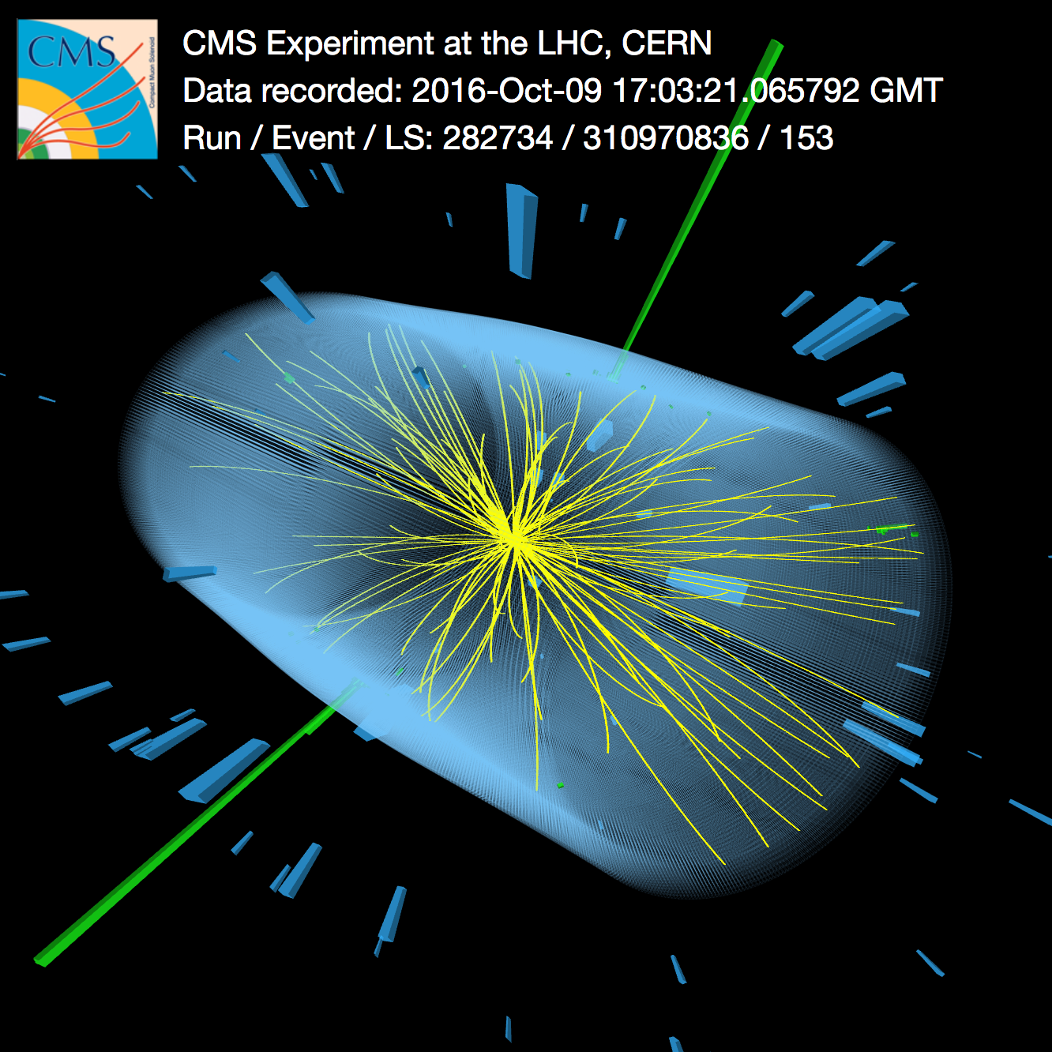


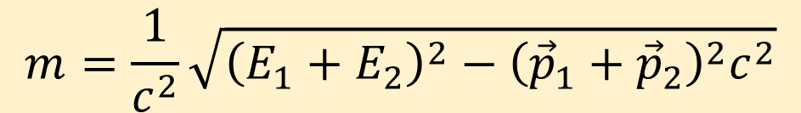


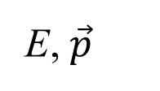
Interlude: How do we ‘observe’ the Higgs boson
Ideally, measure E, $\vec{p}$ of all of its decay products
$$γ$$
E₁, ${\vec{p}}_{1}$
?
Expect this
happens 0.2%
of the time.
E, $\vec{p}$
$$γ$$
E₂, ${\vec{p}}_{2}$
$$m=\frac{1}{c^{2}}\sqrt{{\left(E_{1}+E_{2}\right)}^{2}−{\left({\vec{p}}_{1}+{\vec{p}}_{2}\right)}^{2}c^{2}}$$
Can’t say much with “1 such event”
But with many events, maybe a “peak” will emerge at a specific mass?

Slide 10
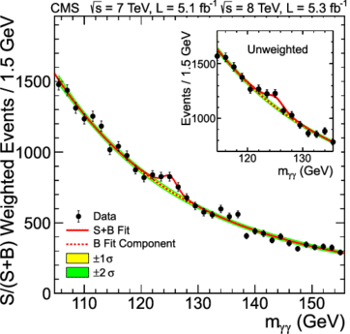
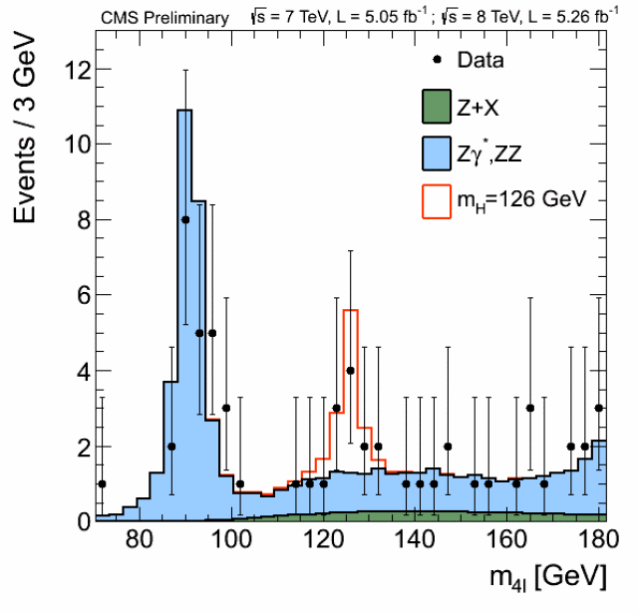
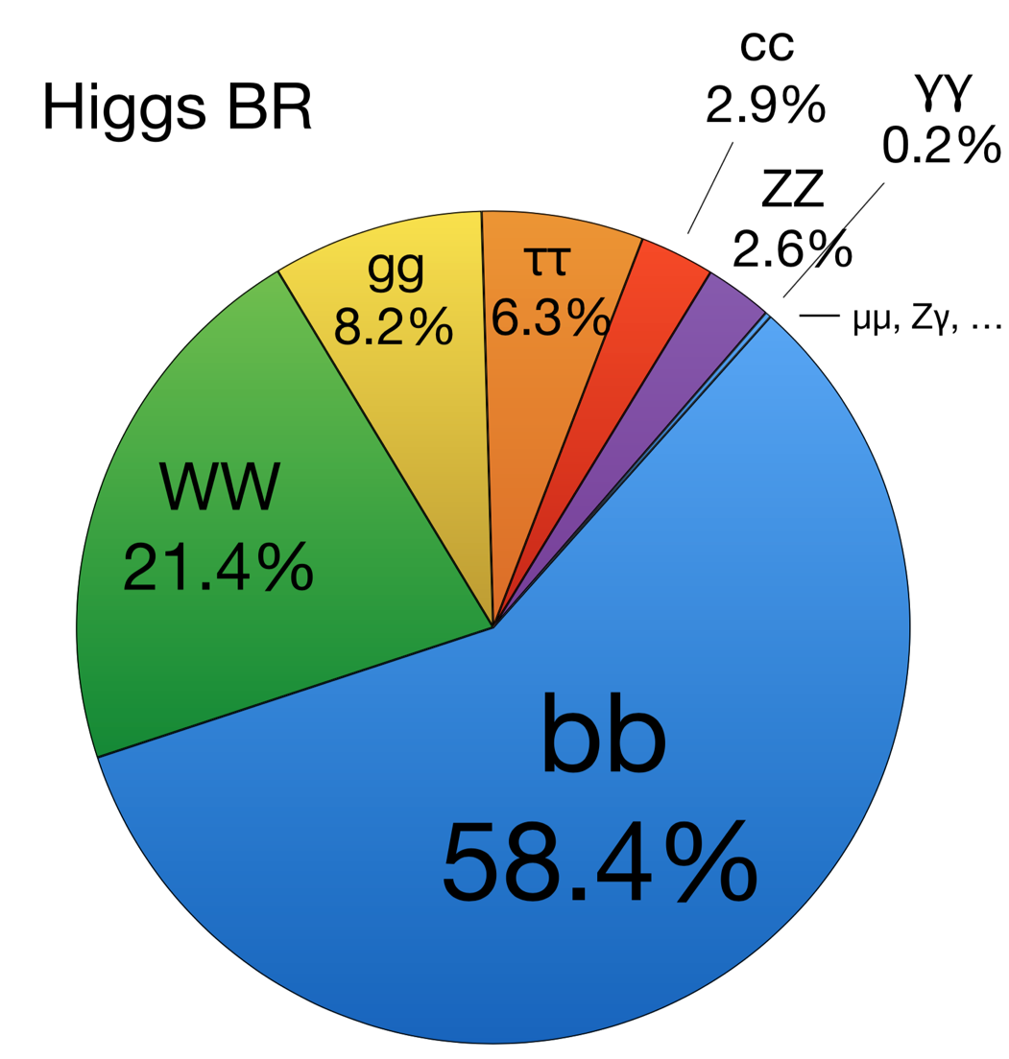


Higgs (2): Mass
$$H^{0}→γγ$$
$$H^{0}→ℓ^{+}ℓ^{−}ℓ^{+}ℓ^{−}$$
The Higgs boson is unstable
(like almost all particles), and decays
CMS
2012
Z⁰
H⁰
10
Y
E
A
R
S
H⁰
H⁰
H⁰
CMS
Nature 607
2022
Similar plots in ATLAS

Slide 11

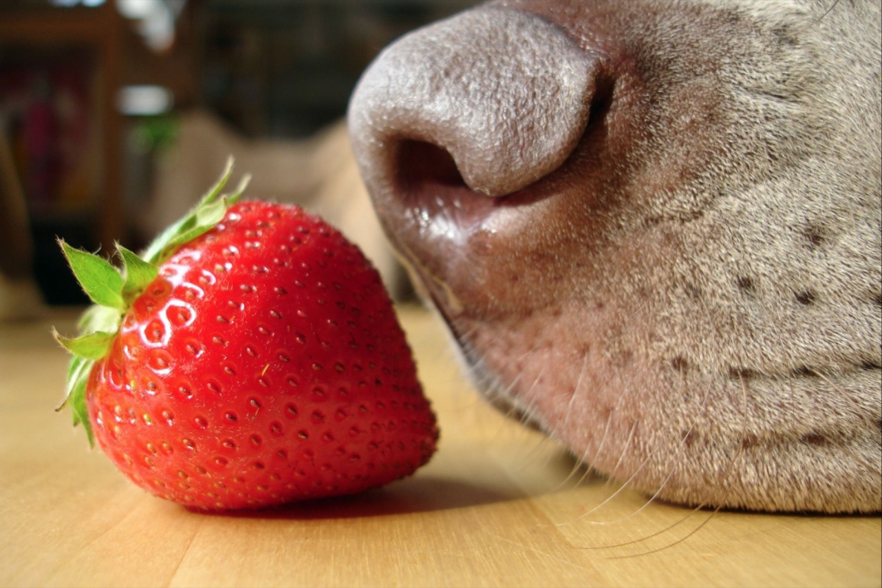
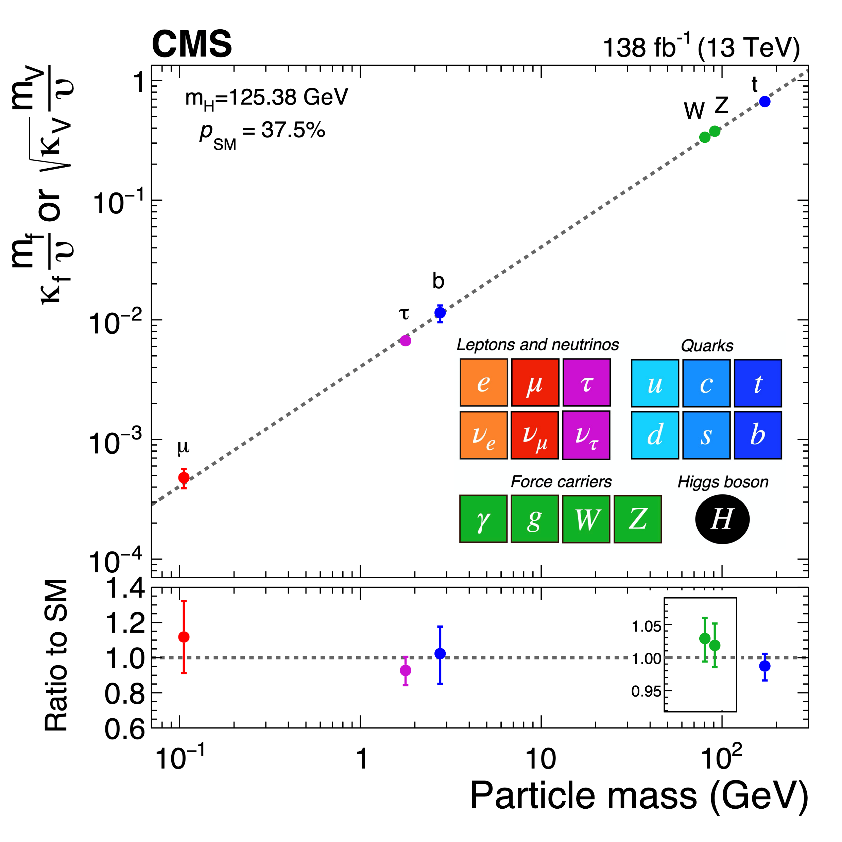
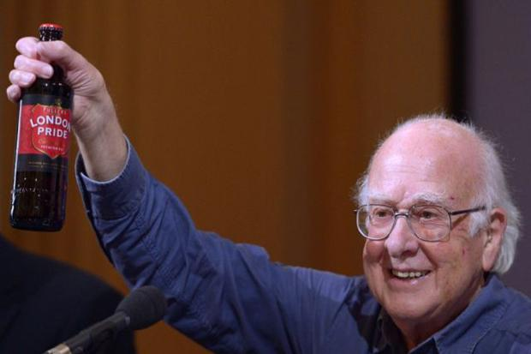

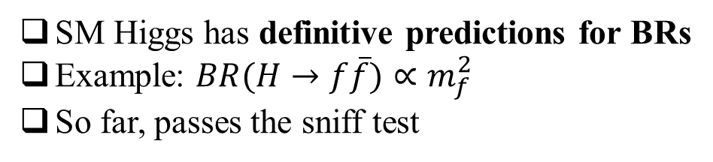
Higgs (3): Is it the SM Higgs?
SM Higgs has definitive predictions for BRs
Example: $BR(H→f\overline{f})∝m_{f}^{2}$
So far, passes the sniff test
H
$$\sim \sqrt{BR}$$
Peter Higgs, 1929 -
Still much work to be done to understand if this really is the SM Higgs
Are there more Higgs bosons?
Could be the case!

Slide 12
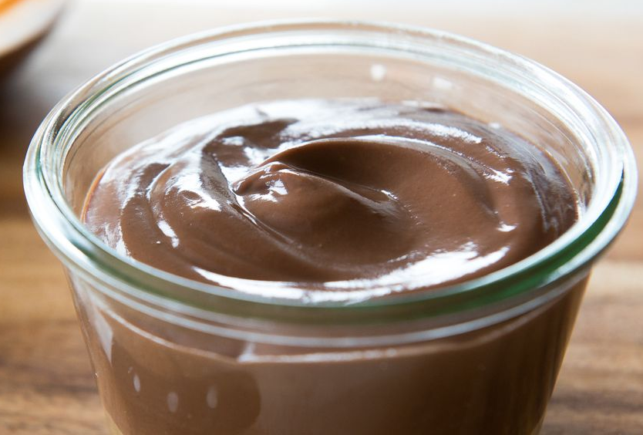
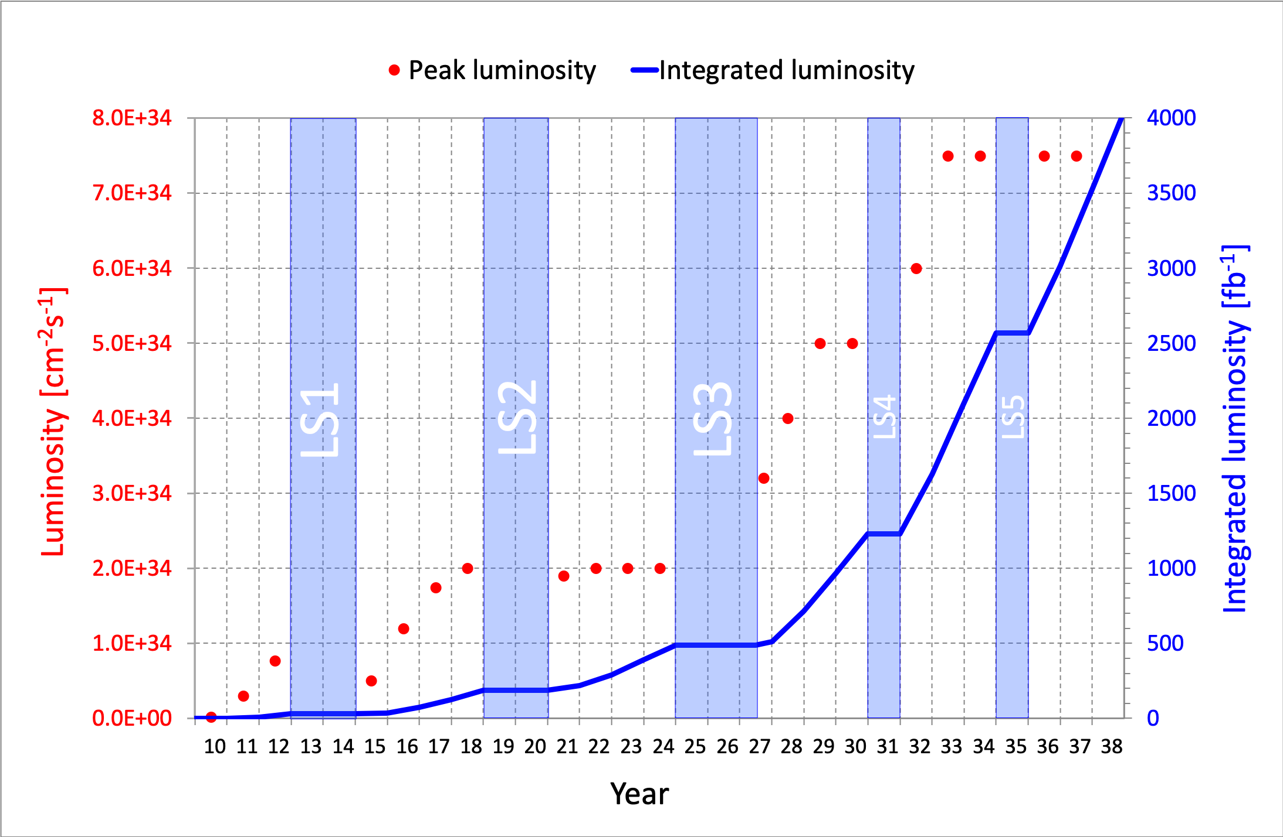
Higgs wrapup
Particles acquire mass through their interactions with a Higgs field that permeates all of space.
Hard to imagine, but hard to argue with! The proof is in the pudding!
  We can’t see the O₂ in the room, but it’s there (trust me ☺ )
So far, everything consistent with SM Higgs boson.
But:
  Still many measurements have large
  uncertainties (more data needed)
  Other measurements have no signal
  yet (more data needed)
Significant upgrades in the
future LHC to collect much
larger data samples

Slide 13
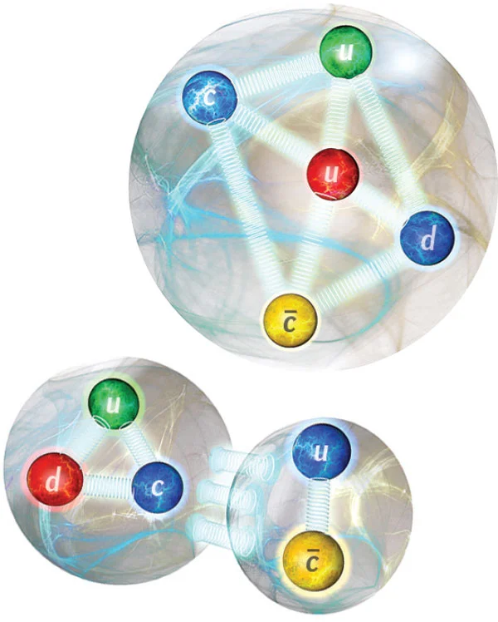
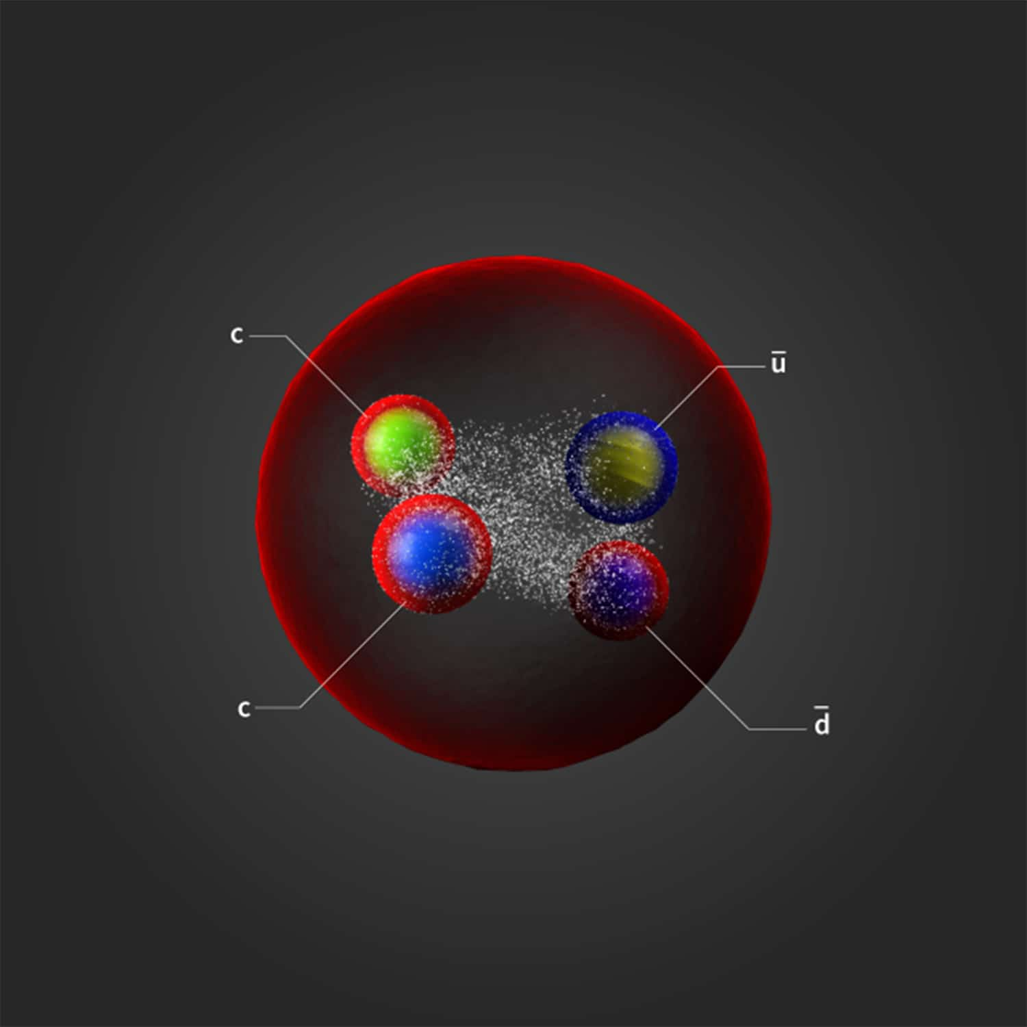
Multiquark states

Slide 14
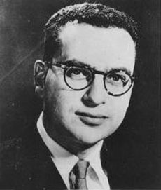
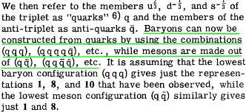
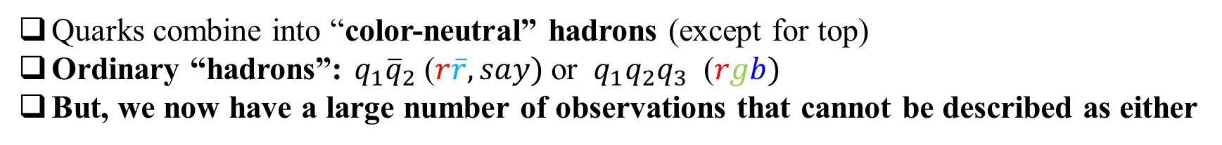
Multiquark states
Quarks combine into “color-neutral” hadrons (except for top)
Ordinary “hadrons”: $q_{1}{\overline{q}}_{2}$ ($r\overline{r}, say)$or ${ q}_{1}q_{2}q_{3}$ ($rgb)$
But, we now have a large number of observations that cannot be described as either
Strange? Not at all.
  4 quarks (2 quarks + 2 antiquarks) can also make a color-neutral object, or
  5 quarks (4 quarks + 1 antiquark) can also be color-neutral
Both of these kinds
seem to have emerged!
Gell-mann, Physics Letters, 1964
“A schematic model of baryons and mesons”
Murray Gell-mann
1929 - 2019

Slide 15
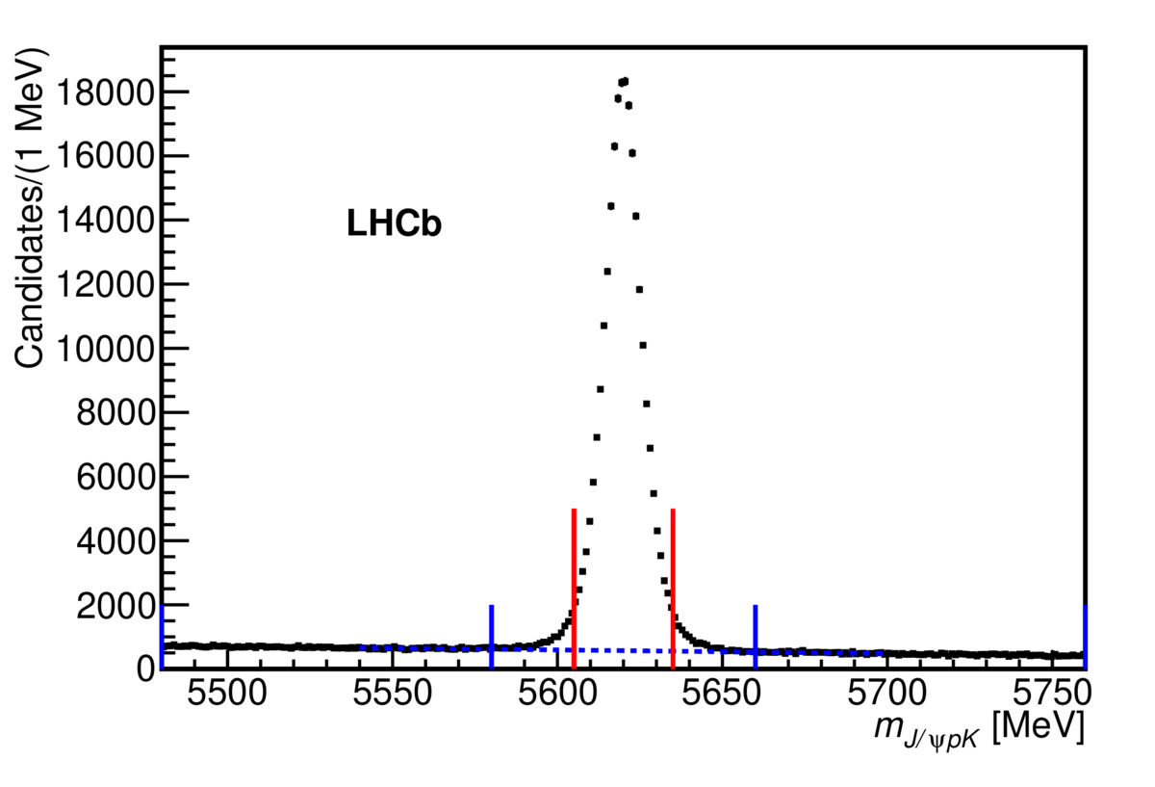


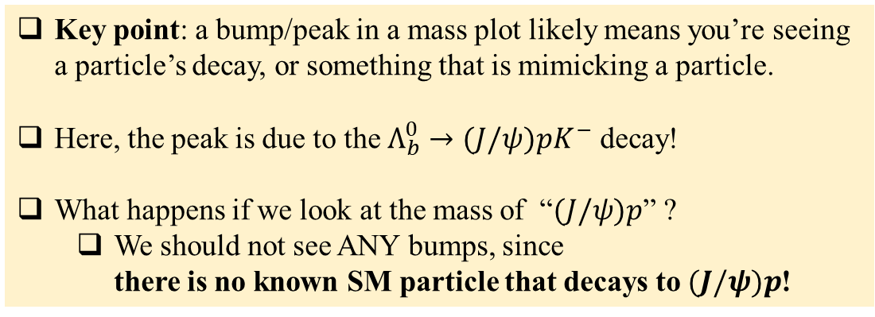






The amazing mass plot
We reconstruct decays of “$Λ_{b}^{0}$” (bud)
$$J/ψ$$
$$p{ K}^{−}$$
$$Λ_{b}^{0}→(J/ψ)pK^{−}$$
$$\left(c\overline{c}\right)+\left(uud\right)+(s\overline{u})$$
b
u
$$μ^{+}μ^{−}$$
d
$$m=\frac{1}{c^{2}}\sqrt{{\left(E_{J/ψ}+E_{p}+E_{K}\right)}^{2}−{\left({\vec{p}}_{J/ψ}+{\vec{p}}_{p}+{\vec{p}}_{K}\right)}^{2}c^{2}}$$
$$Λ_{b}^{0}$$
Key point: a bump/peak in a mass plot likely means you’re seeing a particle’s decay, or something that is mimicking a particle.
Here, the peak is due to the $Λ_{b}^{0}→(J/ψ)pK^{−}$ decay!
What happens if we look at the mass of “$(J/ψ)p$” ?
  We should not see ANY bumps, since
  there is no known SM particle that decays to $(J/ψ)p$!
Background
aka, junk!
Background

Slide 16
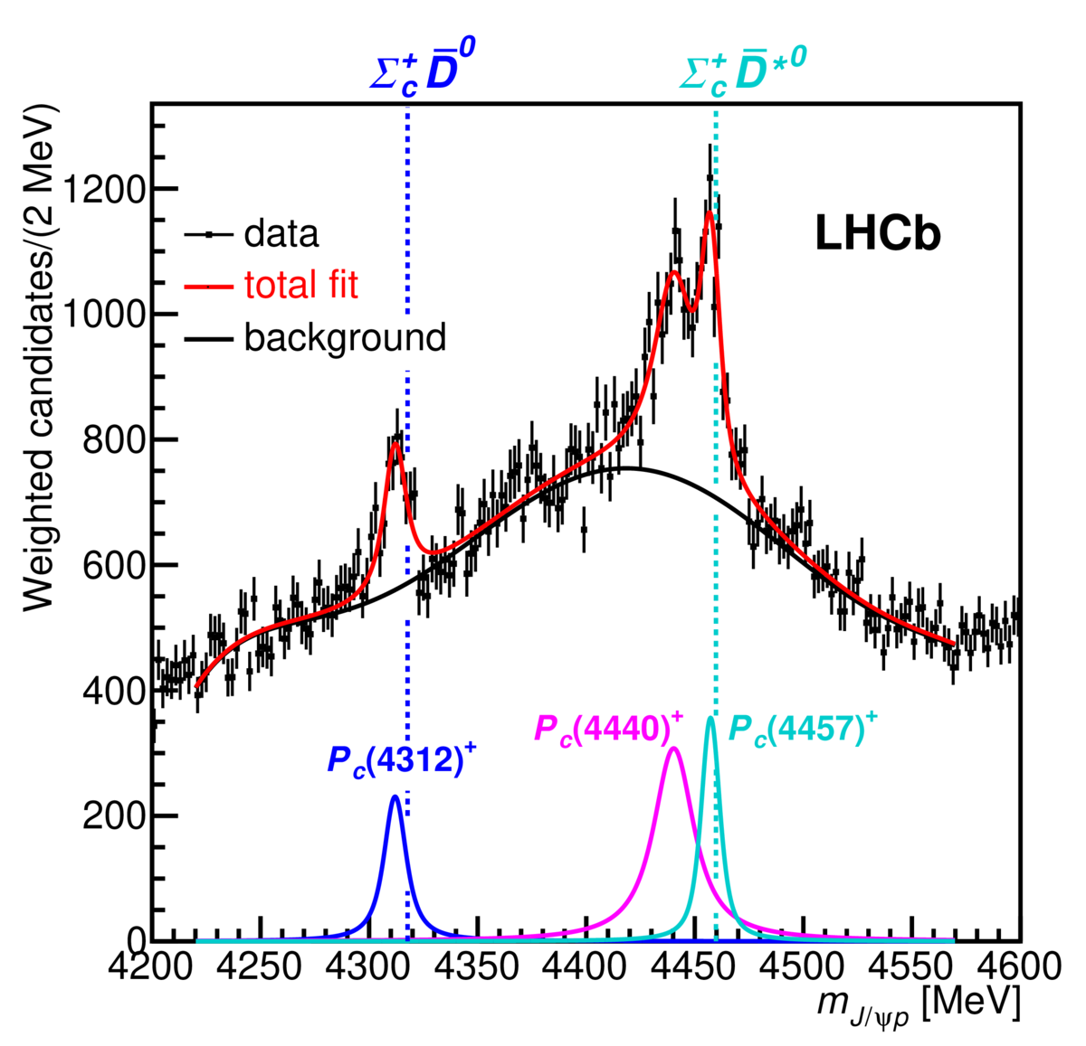


The J/ψ p mass plot
Houston: Peaks in m(J/ψ p)!
Repeat: There is no known
baryon that can decay into
J/ψ p.
So what are these peaks
due to?
We reconstruct decays of “$Λ_{b}^{0}$” (bud)
$$J/ψ$$
$$p{ K}^{−}$$
$$Λ_{b}^{0}→(J/ψ)pK^{−}$$
$$\left(c\overline{c}\right)+\left(uud\right)+(s\overline{u})$$
b
u
$$μ^{+}μ^{−}$$
d
$$Λ_{b}^{0}$$
Background
aka, junk!
Background

Slide 17
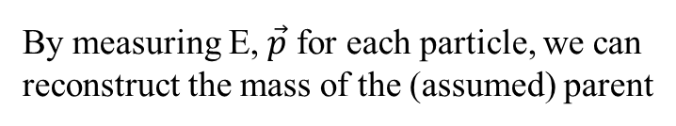
What can it be?
We don’t know yet!
Understanding their nature will require more investigations
They could be either of these, or some combination, or
something else!
We reconstruct decays of “Λ_{b}” (bud)
$$Λ_{b}^{0}→(J/ψ)pK^{−}$$
b
u
$$μ^{+}μ^{−}$$
d
By measuring E, $\vec{p}$ for each particle, we can
reconstruct the mass of the (assumed) parent
$$Λ_{b}^{0}$$
Background
aka, junk!
Background

Slide 18
Explosion of new particles
And each of these new
particles has a story to tell!

Slide 19
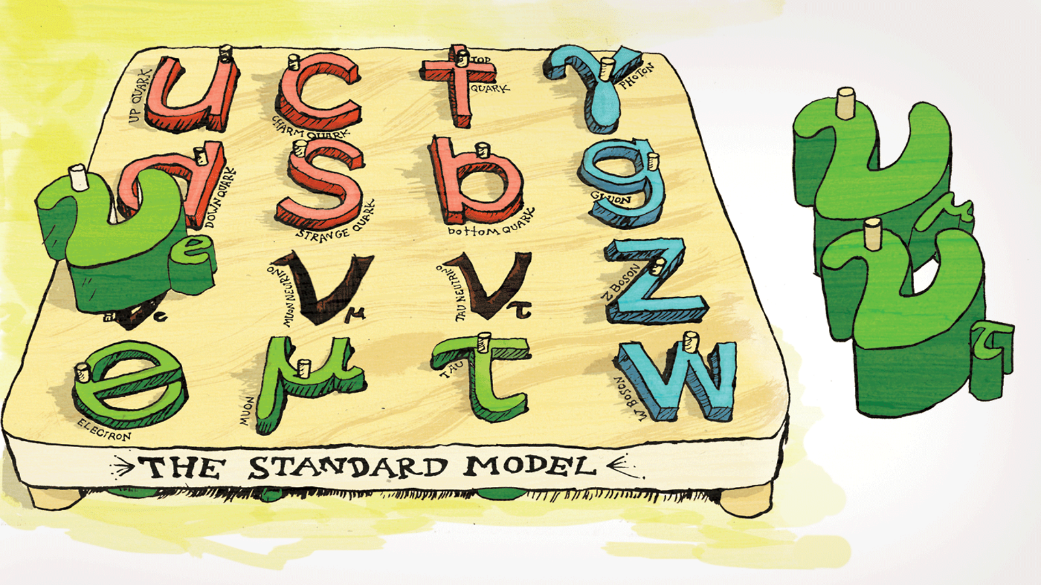
Neutrinos

Slide 20

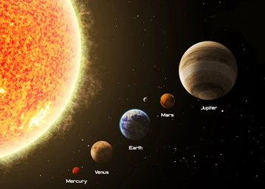
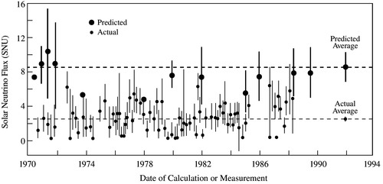
Neutrinos (1)
In SM, neutrinos were massless, neutral leptons.
Buuuuuuuttttttt, a storm was brewing…
Theorists: We know how to predict the $ν_{e}$ flux from the sun! The experiments must be wrong!
Experimentalists: We know how to measure the $ν_{e}$ flux from the sun! The theorists must be wrong!
Turns out…. They were both right!

Slide 21

Neutrinos (2)
More sophisticated experiments … $ν_{e}$ “oscillate” into other types of neutrinos.
https://www.youtube.com/watch?v=eBT1-dV1BTM
e
Neutrino oscillations show that $L_{e}, L_{μ}$ and $L_{τ}$ are not strictly conserved in the SM.
  Not conserved in neutrino oscillations!

Slide 22
Summary
The Higgs boson
  Proposed 60 years ago – appears to be the explanation of how elementary particles (and the W±, Z⁰, and even H) acquire mass.
  Exhaustive testing underway to see if it is “the SM Higgs boson”, or “one of several”. Does it fit all predictions of the SM?
Multiquark states
  What is their nature? Are they “molecular-like”, or tightly bound? Are there di-baryons (6 quark) states? If you could “see inside” a baryon, what would it look like?
Neutrinos
  Fascinating little creatures. Why are their masses and why are they so light? Are they Majorana particles? Can they be behind the matter-antimatter asymmetry in the Universe? How to extend the SM to include neutrino mass?
Physics beyond the SM
  “Must” be a deeper theory to answer the big questions of our time!
  Dark matter? Dark energy? Matter-antimatter asymmetry? Neutrinos?
  LFU? … (See Rafael’s talk tomorrow)

Slide 23
Backup

Slide 24
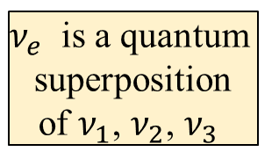





Neutrinos (2)
More sophisticated experiments … $ν_{e}$ “oscillate” into other types of neutrinos.
Let’s say:
m(ν₁) < m(ν₂) < m(ν₃)
“Definite Flavor”
“Definite Mass”
ν_{e}
$$e^{−}$$
$$W^{−}$$
ν₃
ν₃
ν₃
ν_{μ}
$$E$$
ν₂
ν₂
ν₂
$$μ^{−}$$
ν₁
ν₁
ν₁
ν_{τ}
$$τ^{−}$$
μ
μ
μ
1
ν₁
ν_{t1}
1
ν_{t2}
1
ν₁
ν₂
ν₁
$ν_{e}$ is a quantum
superposition
of $ν_{1}$, $ν_{2}$, $ν_{3}$
ν_{t0}
e
e
e
ν₂
ν₂
2
2
2
ν(t=0) = ν_{e}
ν(t=t₁) = 0.71 ν_{μ} + 0.71 ν_{e}
ν(t=t₂) = ν_{μ}

Slide 25
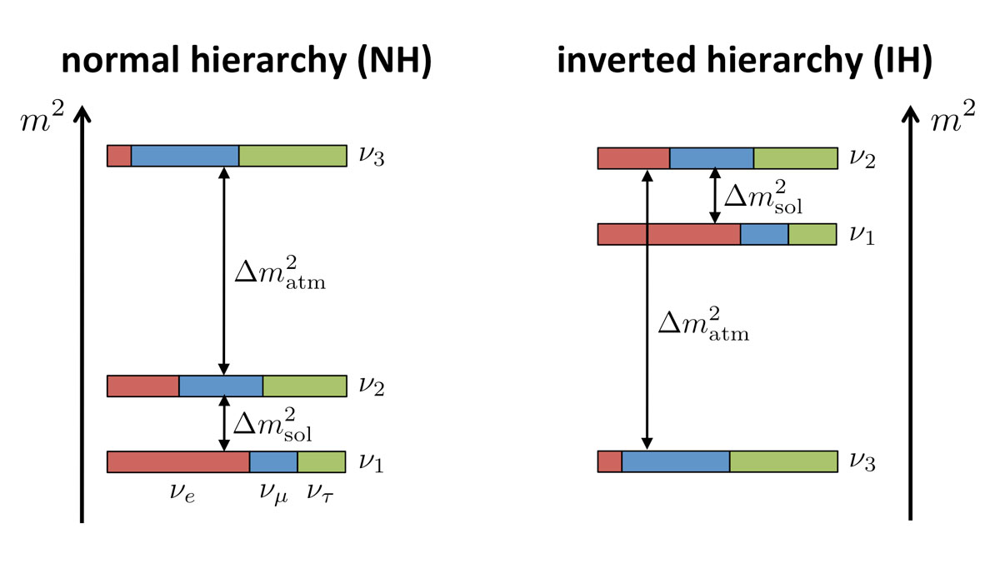
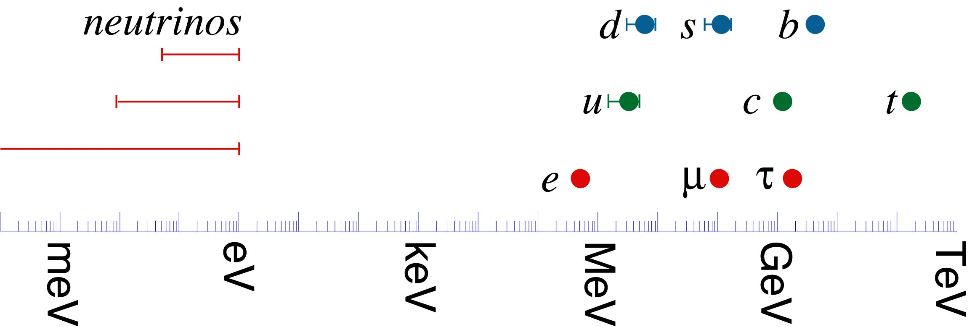
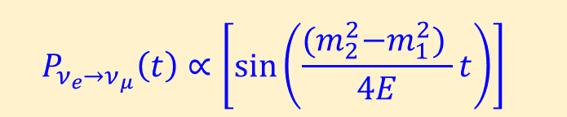


Neutrinos (3)
Neutrino of one flavor can “oscillate” into another flavor if they have mass.
2
$${ P}_{ν_{e}→ν_{μ}}\left(t\right)∝{\left[\sin\left(\frac{{(m}_{2}^{2}−m_{1}^{2}) }{4E}t\right)\right]}^{}$$
Only sensitive to |$m_{2}^{2}−m_{1}^{2}|$.
Can’t probe absolute mass scale!
  Suppose |$Δm^{2}|=1$
  Works with m₂=$\sqrt{2}$, m₁=1.0
  But also: m₂=9.055, m₁=9.0
Experiments tell us the $Δm^{2}$ scale and
mixing look like one of these two possibilities
Other kinds of experiments can probe the
absolute mass scale,
→ m_{ν} <1 eV (< 1.8 x 10⁻³⁶ kg!)
(m_{e} = 511,000 eV)!
Why are neutrinos so light????

Slide 26











Neutrinos (4)
Massless in SM & there is $ν_{L}$ and ${\overline{ν}}_{R}.$
Other 2 states do not exist, or do not participate in the weak interaction (if so, why?)
Problem: If ν have mass and acquire mass through interactions with SM Higgs field
→ requires $ν_{R}$ and ${\overline{ν}}_{L}$ (in they are like other fermions) !
  No problema if m(ν) = 0!
Possible solution
There is a distinct possibility that
$\overline{ν}$ does not exist, namely $ν$ = $\overline{ν}$.
(If this bothers you, think of photon or Z⁰!)
Ettore Majorana
1906 - ??
Advisor: E. Fermi
$$ν_{L}$$
$$ν_{R}$$
$$ν_{L}$$
$$ν_{R}$$
$${\overline{ν}}_{L}$$
$${\overline{ν}}_{R}$$
“Majorana”
Oddly enough, no experiment to date
rules this possibility out.
Think of L and R as related
to the spin (-1/2, +1/2)
Lepton
#
If ν are Majorana, SM would need more modifications.
Lepton number conservation goes out the window!
Experiments underway to search for evidence that $ν$ = $\overline{ν}$.

