Slide 1

Part II
The Weak Force

Slide 2
Preliminary
As we progress through, you’ll want to take note of the charges of the
various quarks.
Family
Charge | 1 | 2 | 3
-1/3 | d | s | b
+2/3 | u | c | t
Antiquarks have opposite
charge to the quarks

Slide 3
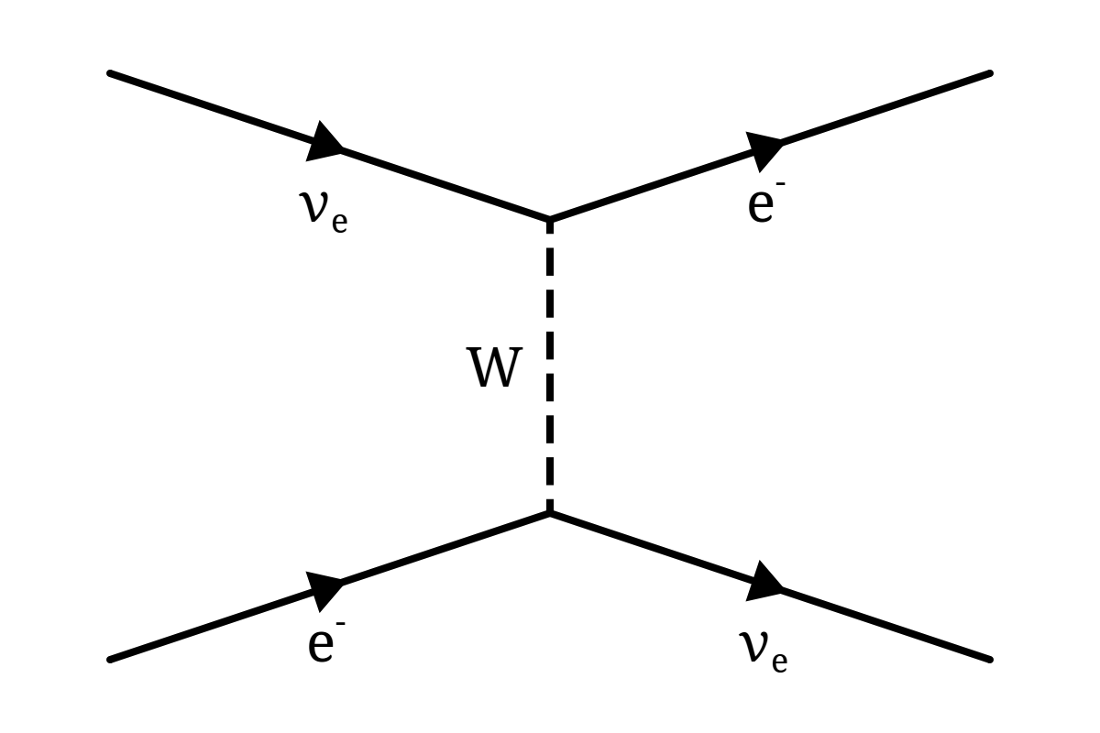

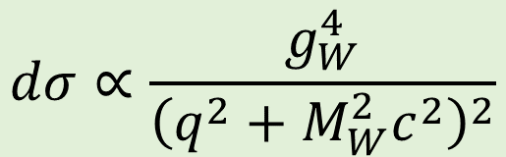
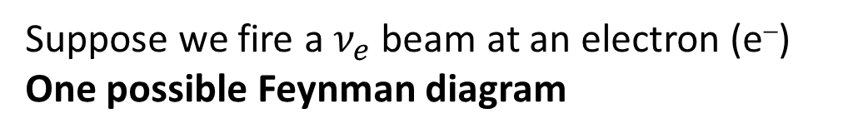
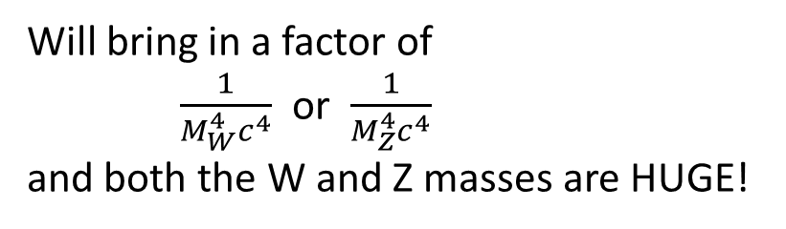


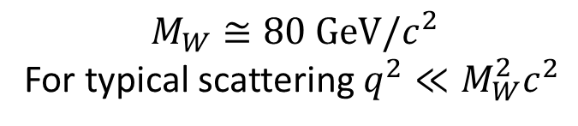

Suppose we fire a $ν_{e}$ beam at an electron (e⁻)
One possible Feynman diagram
space
$$M_{W}≅80 GeV/c^{2}$$
For typical scattering $q^{2}≪M_{W}^{2}c^{2}$
$$g_{W}$$
Will bring in a factor of
$\frac{1}{M_{W}^{4}c^{4}}$ or $\frac{1}{M_{Z}^{4}c^{4}}$
and both the W and Z masses are HUGE!
$$\frac{1}{q^{2}+M_{W}^{2}c^{2}}$$
$$g_{W}$$
time
$$dσ∝\frac{g_{W}^{4}}{{\left(q^{2}+M_{W}^{2}c^{2}\right)}^{2}}$$
$$⇒ dσ∝\frac{g_{W}^{4}}{M_{W}^{4}c^{4}}$$

Slide 4
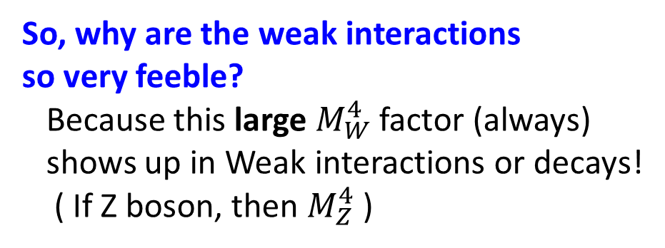
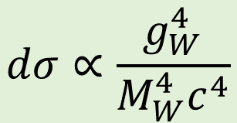
space
$$dσ∝\frac{g_{W}^{4}}{M_{W}^{4}c^{4}}$$
$$g_{W}$$
So, why are the weak interactions
so very feeble?
Because this large $M_{W}^{4}$factor (always)
shows up in Weak interactions or decays!
( If Z boson, then $M_{Z}^{4}$)
$$\frac{1}{q^{2}+M_{W}^{2}c^{2}}$$
$$g_{W}$$
time
Consequence #1) Small cross-sections:
Example, a neutrino can pass through the entire Earth without interacting!

Slide 5
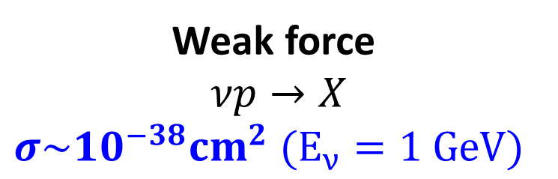
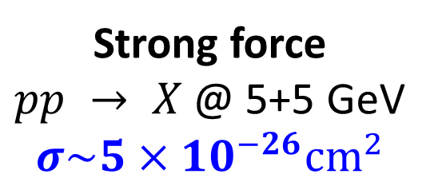

Just to set the scale
Strong force
$pp → X$@ 5+5 GeV
$$σ\sim {5×10}^{−26}{cm}^{2}$$
Weak force
$νp→X$
$$σ\sim {10}^{−38}{cm}^{2} (E_{ν}=1 GeV)$$
$$σ_{strong}\sim 10^{12}× σ_{Weak}$$

Slide 6
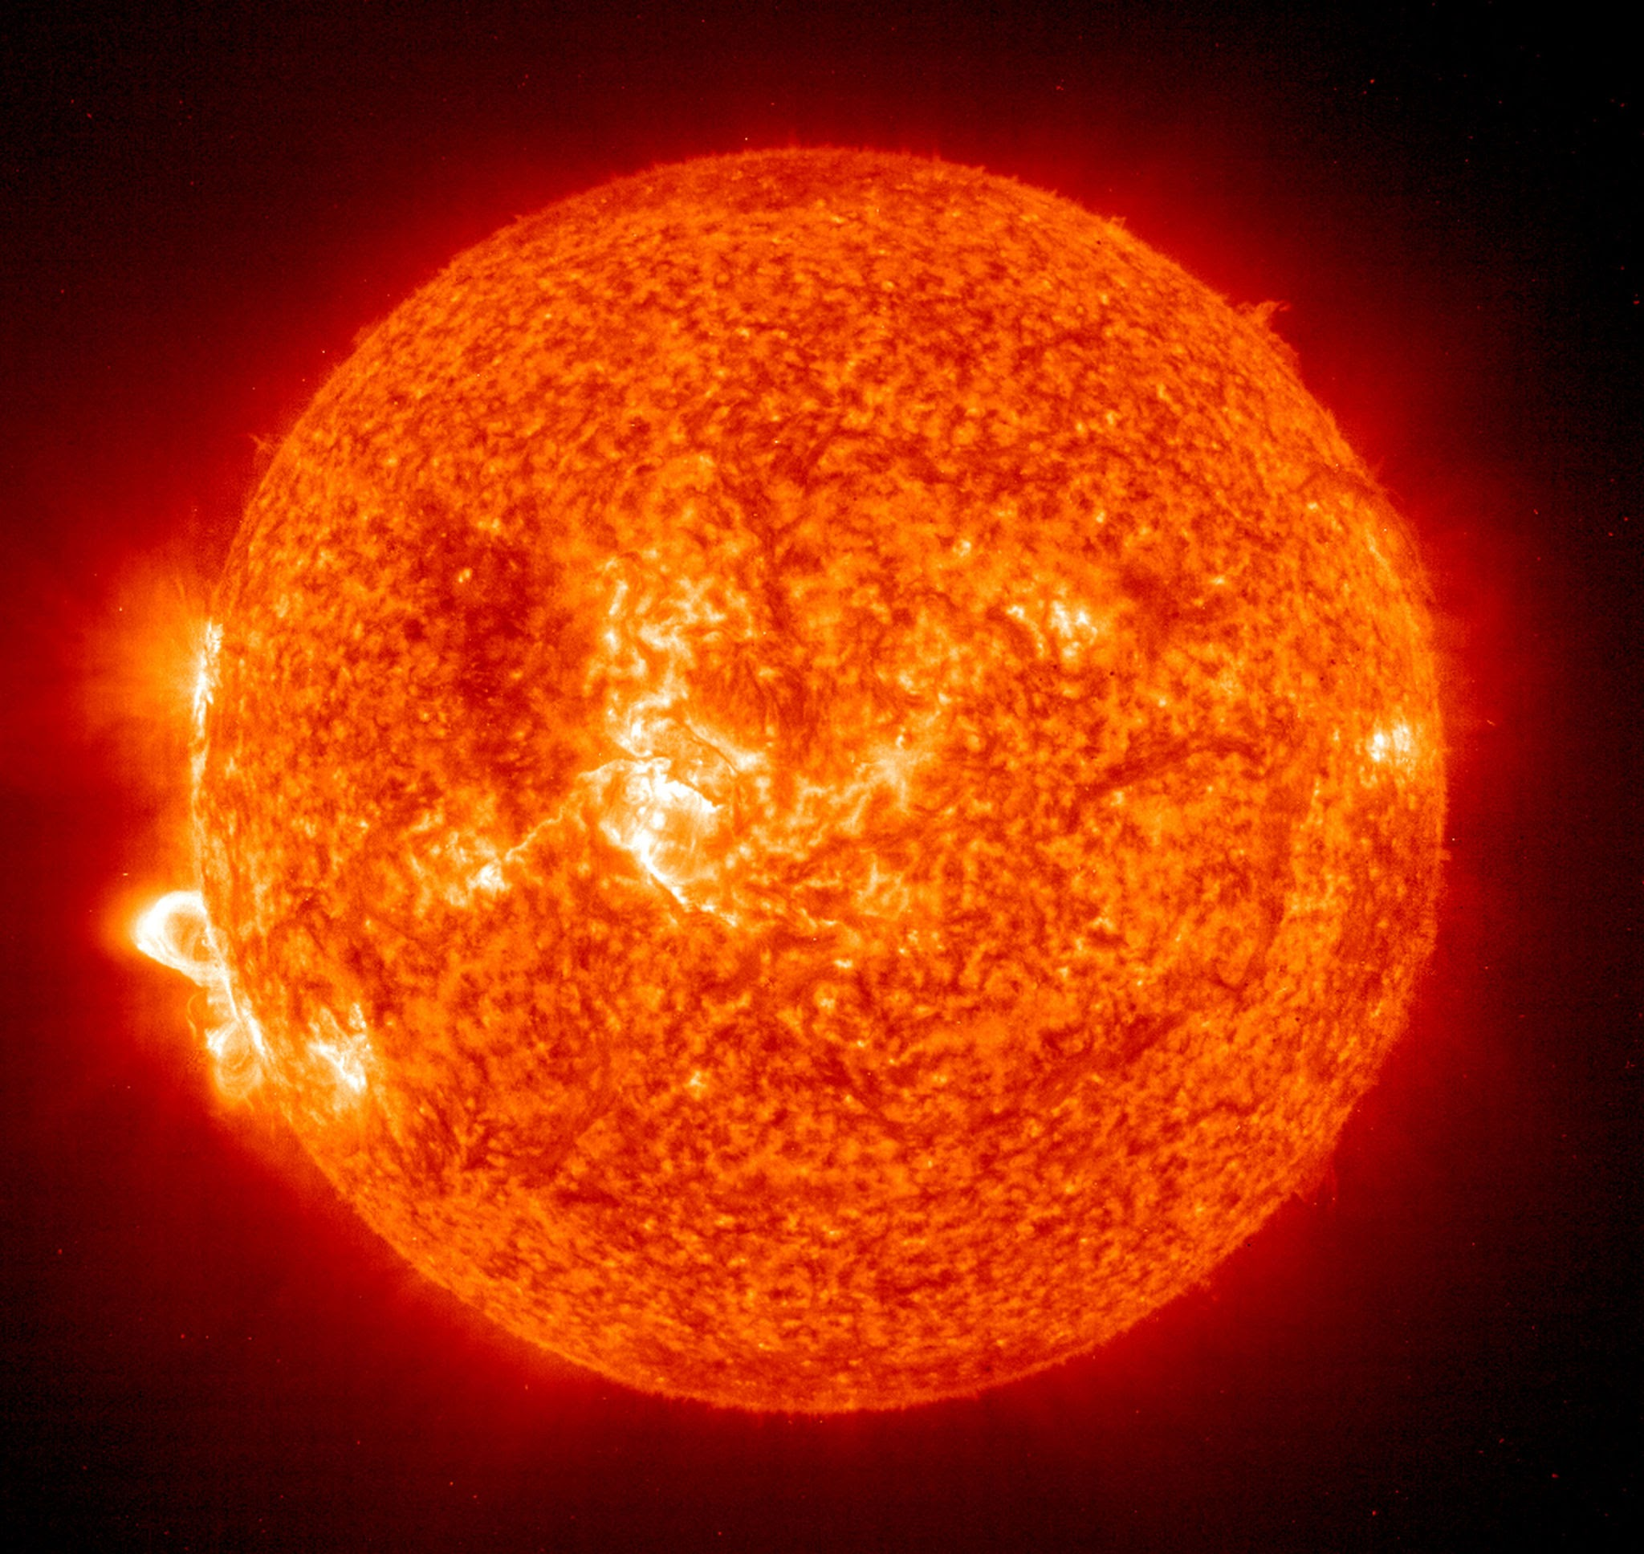
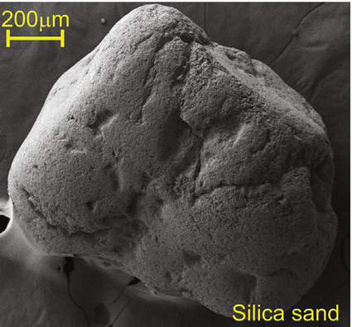
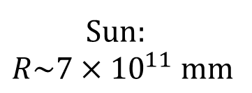
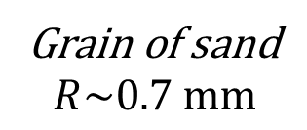
Sun:
$$R\sim 7×{10}^{11} mm$$
Grain of sand
$$R\sim 0.7 mm$$
To put the ratio of “strength” in perspective,
imagine shooting a grain of sand at:
  Another grain of sand (Weak)
  The Sun (Strong)
and trying to get a strike!

Slide 7
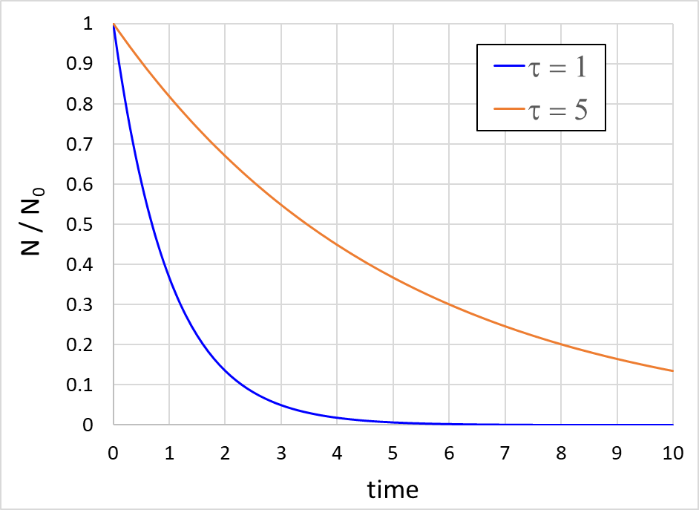





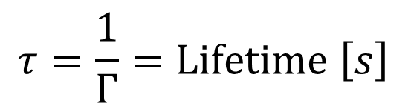
Decays
Decay rates
$$N=N_{0}e^{−Γt}$$
$$N=N_{0}e^{−t/τ}$$
$$τ=\frac{1}{Γ}=Lifetime \left[s\right]$$
$$e^{−1}$$
$$e^{−2}$$
Short lifetimes $⇔$ Large decay rates
Aside: Lifetime t is related to half-life by $t_{\frac{1}{2}}=τ ln⁡(2)$

Slide 8
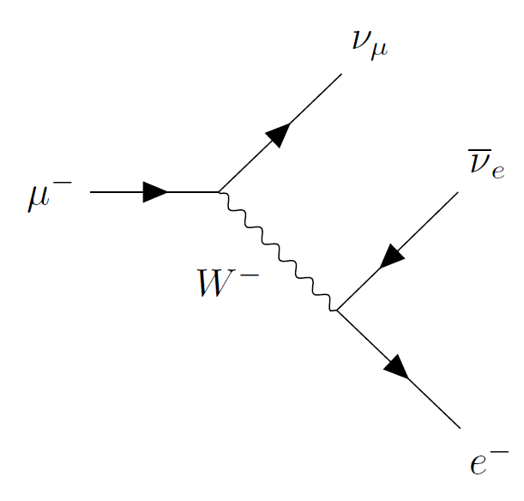
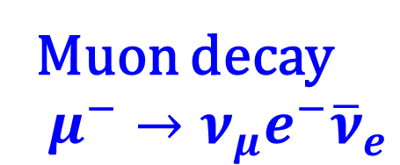

Simplest weak decay
space
Muon decay
$$μ^{−}→ν_{μ}e^{−}{\overline{ν}}_{e}$$
A
What quantities are conserved
at each vertex?
B
time
The W- boson mediates the decay. It’s a 2-step process
  At A: $μ^{−}→ν_{μ}+W^{−}$
  At B: $W^{−}→e^{−}+{\overline{ν}}_{e}$

Slide 9
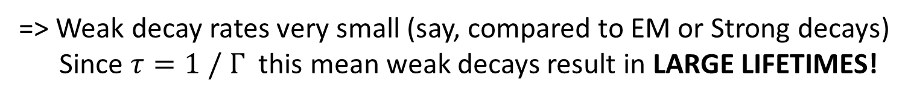
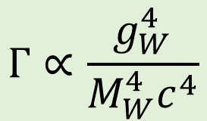
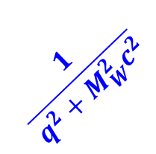


Simplest weak decay
space
Muon decay
$$μ^{−}→ν_{μ}e^{−}{\overline{ν}}_{e}$$
$$g_{W}$$
$$\frac{1}{q^{2}+M_{W}^{2}c^{2}}$$
All of the same factors enter into
the Feynman diagram for decays
as well!
$$g_{W}$$
time
$$Γ∝\frac{g_{W}^{4}}{M_{W}^{4}c^{4}}$$
=> Weak decay rates very small (say, compared to EM or Strong decays)
Since $τ=1 / Γ$ this mean weak decays result in LARGE LIFETIMES!

Slide 10










Can W decay into other leptons?
Dau
P
$${\overline{ν}}_{e}$$
$${\overline{ν}}_{μ}$$
$${\overline{ν}}_{τ}$$
Lepton - neutrino
* There must be sufficient
energy to create the lepton pair.
$$e^{−}$$
$$μ^{−}$$
$$τ^{−}$$
$$W^{−}$$
Parent
Dau
$$n → p + e^{−} + {\overline{ν}}_{e}$$
YES
Mass (MeV /c²)
939.6
938.3
0.5
tiny
$$n → p + μ^{−} + {\overline{ν}}_{μ}$$
NO
Mass (MeV/c²)
939.6
938.3
105
tiny
$${\overline{B}}^{0} → D^{+} + τ^{−} + {\overline{ν}}_{τ}$$
YES
Mass (MeV /c²)
5279
1869
1777
tiny

Slide 11






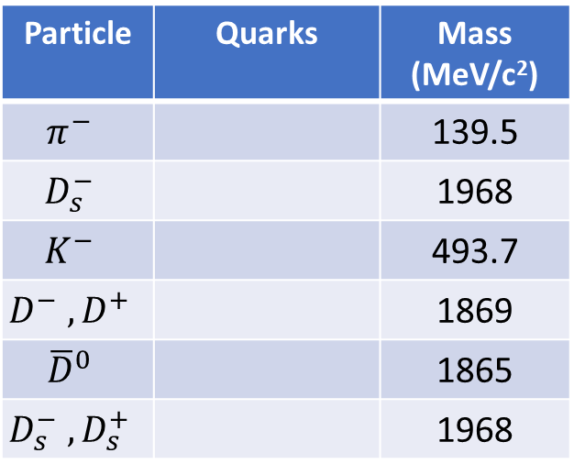













What about quarks?
Dau
P
These quarks/antiquarks will combine
to form 1 (or more) hadrons
Also limited by energy conservation!
$$d$$
$$s$$
$$s$$
$$d$$
Quark + antiquark
$$\overline{u}$$
$$\overline{c}$$
$$\overline{u}$$
$$\overline{c}$$
$$W^{−}$$
Parent
Dau
Particle | Quarks | Mass (MeV/c²)
$$π^{−}$$ |  | 139.5
$$D_{s}^{−}$$ |  | 1968
$$K^{−}$$ |  | 493.7
$$D^{−} , D^{+}$$ |  | 1869
$${\overline{D}}^{0}$$ |  | 1865
$$D_{s}^{−} , D_{s}^{+}$$ |  | 1968
$$n → p + π^{−}$$
NO
Mass (MeV /c²)
939.6
938.3
139.5
$$(\overline{u}d)$$
$$(\overline{c}s)$$
$${\overline{D}}^{0} → K^{+}+ K^{−}$$
YES
Mass (MeV/c²)
1865
493.7
493.7
$$(\overline{u}s)$$
$$D_{s}^{+}→ K^{+}+ D^{0}$$
NO
$$\left(\overline{c}d\right), (c\overline{d})$$
1865
Mass (MeV/c²)
1968
493.7
$$(c\overline{u})$$
$${\overline{B}}^{0} → D^{+}{ + D}_{s}^{−}$$
YES
$$\left(\overline{c}s\right), (c\overline{s})$$
Mass (MeV /c²)
5279
1869
1777

Slide 12








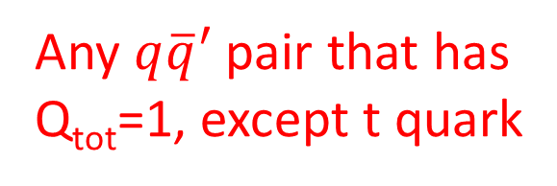
Top quark decay
b
~5,000 MeV/c²
t
175,000 MeV/c²
$${\overline{ν}}_{e}$$
$${\overline{ν}}_{μ}$$
$${\overline{ν}}_{τ}$$
Any of these 3
can occur
$$e^{−}$$
$$μ^{−}$$
$$τ^{−}$$
b
~5,000 MeV/c²
t
175,000 MeV/c²
$\overline{q}′$
Hadrons
(many)
“Jet”
Any $q\overline{q}′$ pair that has
Q_{tot}=1, except t quark
$$q$$

Slide 13
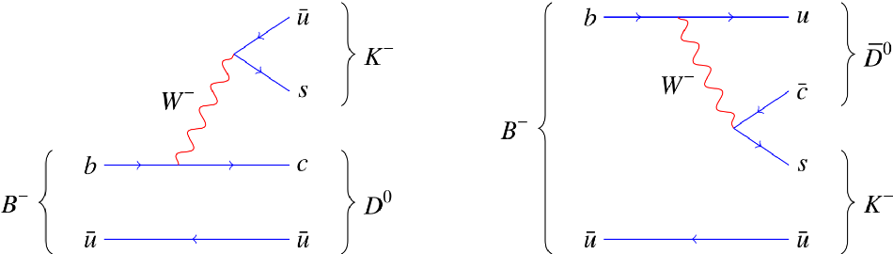
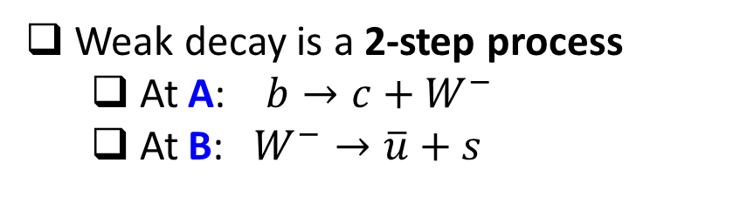

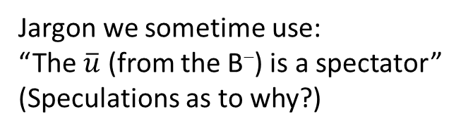
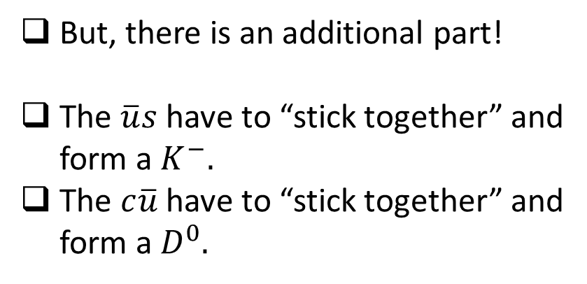
Example Weak decay (1)
What tells us this is a weak decay?
$$B^{−}→D^{0}K^{−}$$
Weak decay is a 2-step process
  At A: $b→c+W^{−}$
  At B: $W^{−}→\overline{u}+s$
B
But, there is an additional part!
The $\overline{u}s$ have to “stick together” and
form a $K^{−}.$
The $c\overline{u}$ have to “stick together” and
form a $D^{0}.$
A
Jargon we sometime use:
“The $\overline{u}$ (from the B⁻) is a spectator”
(Speculations as to why?)
What interaction do you think is
responsible for this “binding”?

Slide 14




Example Weak decay (2)
Here the $W^{−}$ goes “internal”
$$B^{−}→{\overline{D}}^{0}K^{−}$$
Weak decay is a 2-step process
  At A: $b→u+W^{−}$
  At B: $W^{−}→\overline{c}+s$
A
The $\overline{u}c$ bind “to form a ${\overline{D}}^{0}.$
The $s\overline{u}$ bind to form a $K^{−}.$
B
Both this “internal W” or “external W” (prev slide) are possible

Slide 15
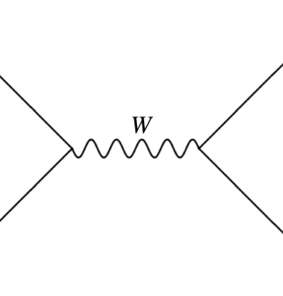
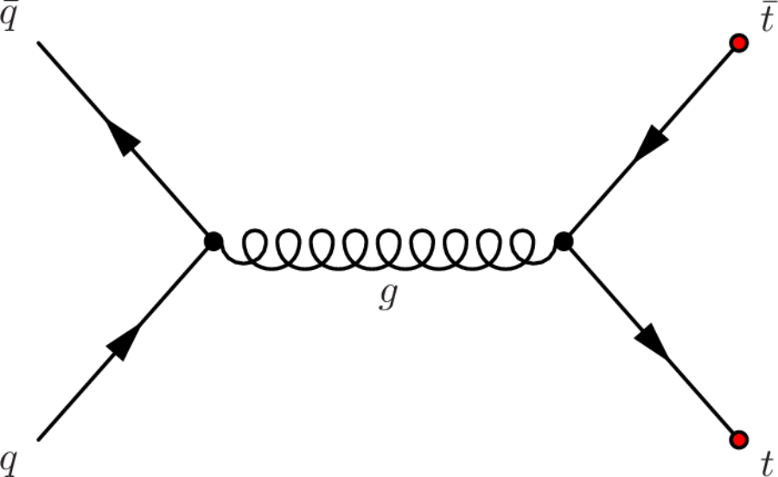




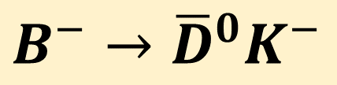



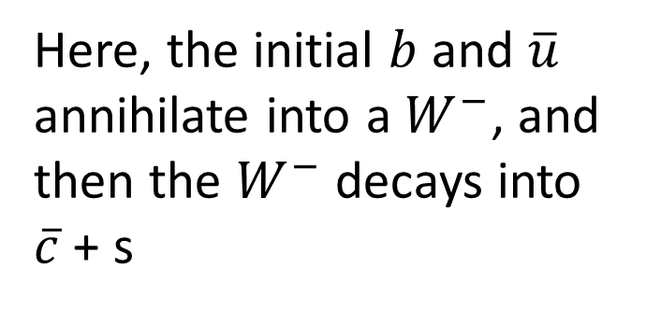


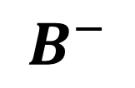
Are there other diagrams ?
$$B^{−}→{\overline{D}}^{0}K^{−}$$
$$b$$
$$\overline{c}$$
$${\overline{D}}^{0}$$
Here, the initial $b$ and $\overline{u}$
annihilate into a $W^{−}$, and
then the $W^{−}$ decays into
$\overline{c}$ + s
$$W^{−}$$
$$\overline{u}$$
g
$$B^{−}$$
$$\overline{u}$$
$$K^{−}$$
$$\overline{u}$$
$$s$$

Slide 16









Could also have W+
$$B^{+}→{\overline{D}}^{0}K^{+}$$
$$K^{+}$$
$$W^{+}$$
$$\overline{b}$$
$$\overline{c}$$
$$B^{+}$$
$${\overline{D}}^{0}$$
$$u$$
$$u$$
You must conserve electric charge at each vertex. In weak decays of heavy quarks, the charge must change by
+1 unit or -1 unit! Here: $\overline{b}$(+1/3) → $\overline{c}$ (-2/3), so the W MUST be +1 charge.

Slide 17
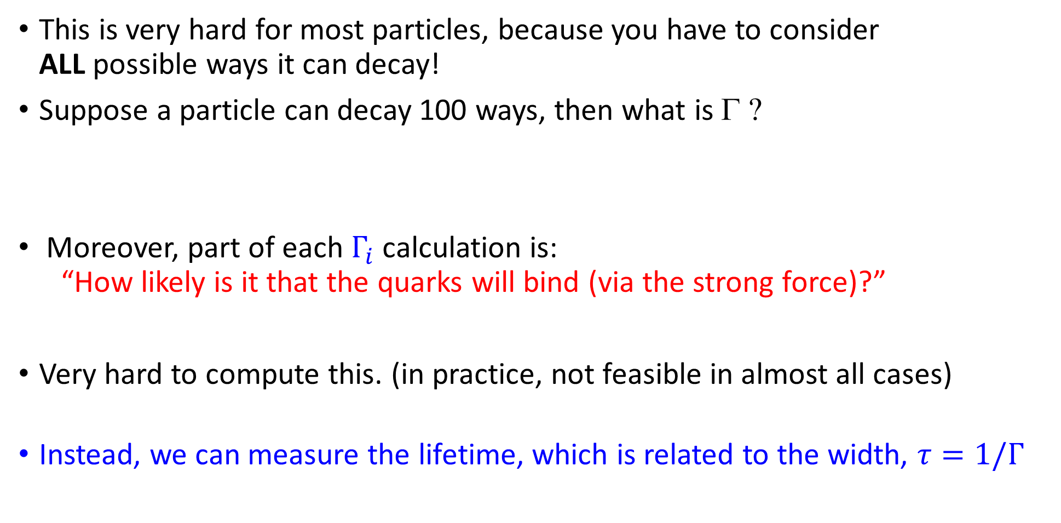
Computing weak decay rates (Γ)
This is very hard for most particles, because you have to consider
ALL possible ways it can decay!
Suppose a particle can decay 100 ways, then what is Γ ?
Moreover, part of each $Γ_{i}$ calculation is:
“How likely is it that the quarks will bind (via the strong force)?”
Very hard to compute this. (in practice, not feasible in almost all cases)
Instead, we can measure the lifetime, which is related to the width, $τ=1/Γ$
$Γ=Γ_{1}+Γ_{2}+$ $Γ_{3}+ … + Γ_{100}$

Slide 18
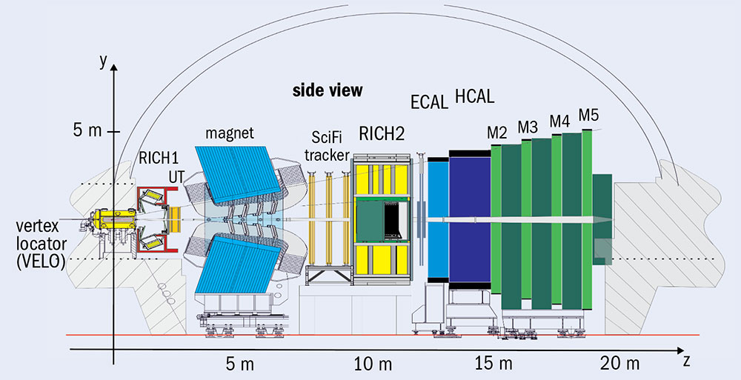
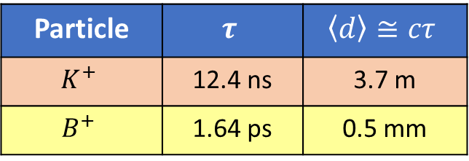
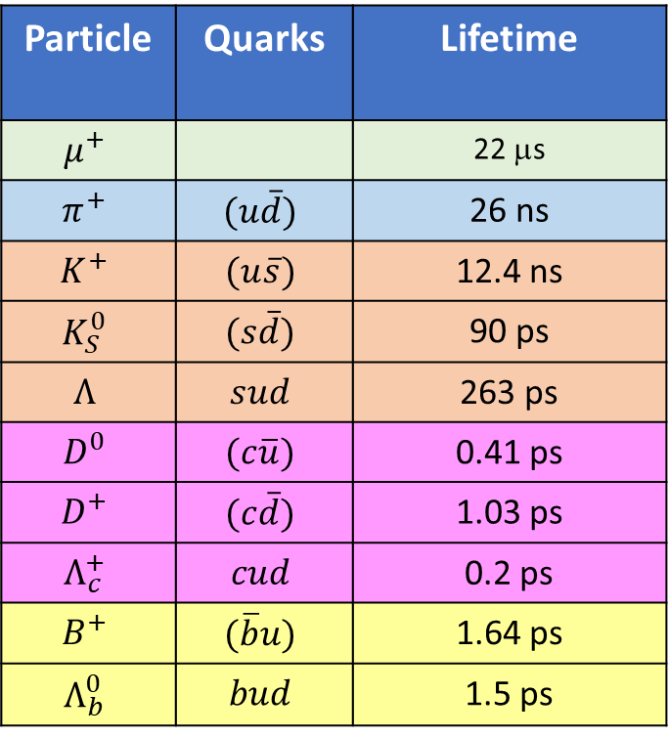
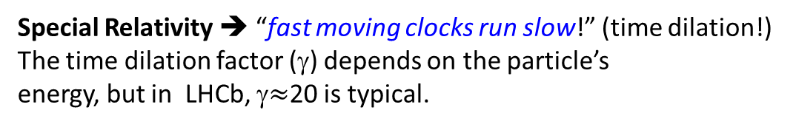
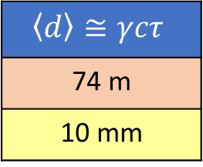
Some particle lifetimes (Weak decays)
Particle | Quarks | Lifetime
$$μ^{+}$$ |  | 22 μs
$$π^{+}$$ | $$(u\overline{d})$$ | 26 ns
$$K^{+}$$ | $$(u\overline{s})$$ | 12.4 ns
$$K_{S}^{0}$$ | $$(s\overline{d})$$ | 90 ps
$$Λ$$ | $$sud$$ | 263 ps
$$D^{0}$$ | $$(c\overline{u})$$ | 0.41 ps
$$D^{+}$$ | $$(c\overline{d})$$ | 1.03 ps
$$Λ_{c}^{+}$$ | $$cud$$ | 0.2 ps
$$B^{+}$$ | $$(\overline{b}u)$$ | 1.64 ps
$$Λ_{b}^{0}$$ | $$bud$$ | 1.5 ps
Micro (10⁻⁶), nano (10⁻⁹) and pico (10⁻¹²) second lifetimes may not seem very long, but they are directly measurable!
Particle | $$τ$$ | $$\left\langle d\right\rangle ≅cτ$$
$$K^{+}$$ | 12.4 ns | 3.7 m
$$B^{+}$$ | 1.64 ps | 0.5 mm
$$\left\langle d\right\rangle ≅γcτ$$
74 m
10 mm
Special Relativity ➔ “fast moving clocks run slow!” (time dilation!)
The time dilation factor (γ) depends on the particle’s
energy, but in LHCb, γ$≈$20 is typical.
Unstable particles like K⁺, π⁺, μ⁺ usually traverse
the entire LHCb detector before decaying!

Slide 19
Some particle lifetimes (Weak decays)
Particle | Quarks | Lifetime
$$μ^{+}$$ |  | 22 μs
$$π^{+}$$ | $$(u\overline{d})$$ | 26 ns
$$K^{+}$$ | $$(u\overline{s})$$ | 12.4 ns
$$K_{S}^{0}$$ | $$(s\overline{d})$$ | 90 ps
$$Λ$$ | $$sud$$ | 263 ps
$$D^{0}$$ | $$(c\overline{u})$$ | 0.41 ps
$$D^{+}$$ | $$(c\overline{d})$$ | 1.03 ps
$$Λ_{c}^{+}$$ | $$cud$$ | 0.2 ps
$$B^{+}$$ | $$(\overline{b}u)$$ | 1.64 ps
$$Λ_{b}^{0}$$ | $$bud$$ | 1.5 ps
For comparison:
  EM decay: Lifetimes ~10⁻¹⁷ to 10⁻²⁰ sec
  Strong decay: Lifetimes ~10⁻²³ sec
  These lifetimes are too short for us to measure.

Slide 20
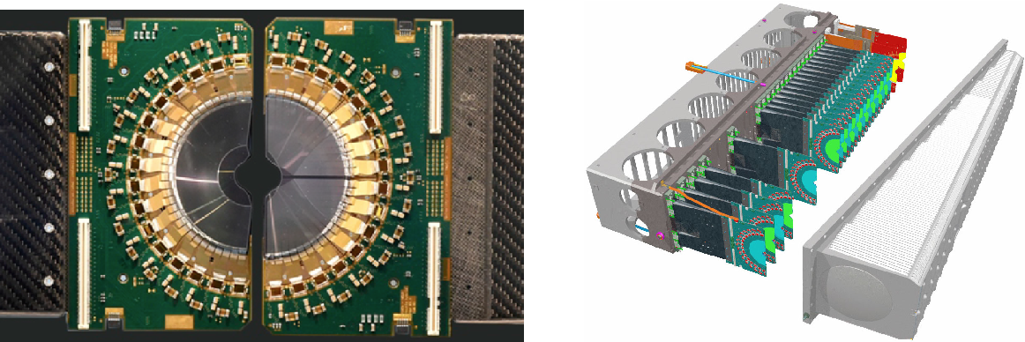
Measuring lifetimes of particles that decay weakly
VELO
sensors
Build detectors with hair-thin (~50 μm)
active detection elements.
1000’s of such detection elements in
this “module”

Slide 21
Measuring lifetimes of particles that decay weakly
Put many of them in a row so that
charged particles pass through many
of them.
➔ VELO detector

Slide 22
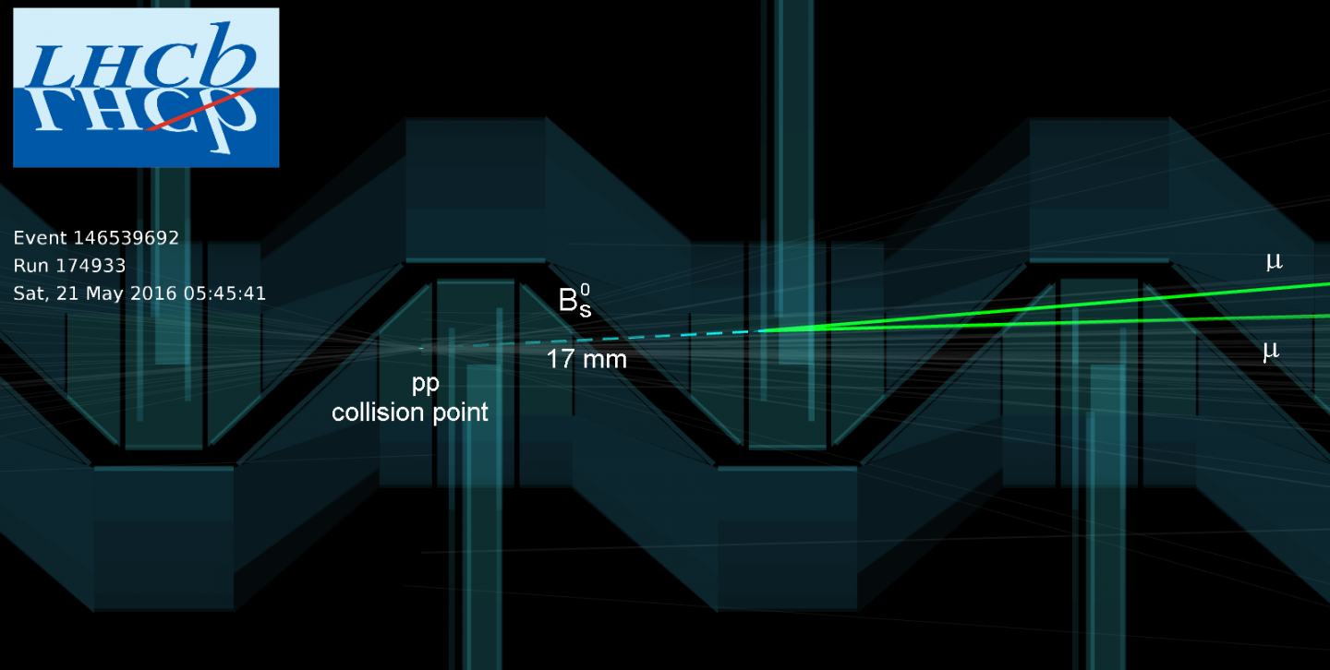

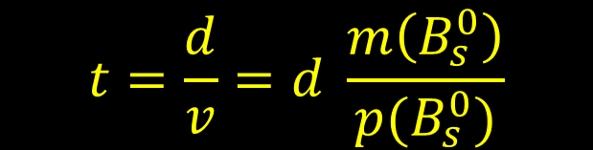
A candidate $B_{s}→μ^{+}μ^{−}$ decay
2 VELO
sensors
$$t=\frac{d}{v}=d \frac{m\left(B_{s}^{0}\right)}{p(B_{s}^{0})}$$
2 VELO
sensors
2 VELO
sensors
2 VELO
sensors

Slide 23
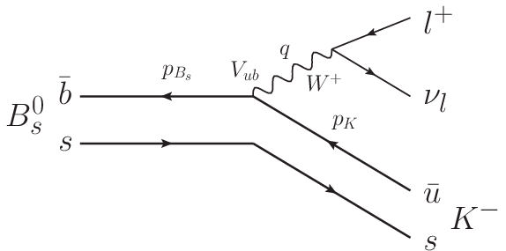




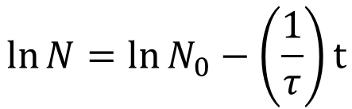


A real (early) measurement
$$B_{s}→K^{+}K^{−}$$
$$N=N_{0}e^{−t/τ}$$
$u$
$$\ln{N}=\ln{N_{0}−\left(\frac{1}{τ}\right)}t$$
$$K^{+}$$
$$\overline{s}$$
Fitting the logN plot versus time
→ Slope = 1/τ !
$$K^{−}$$
$$τ=1.455±0.046\left(stat\right)±0.006\left(syst\right) ps$$

Slide 24
Backup

Slide 25
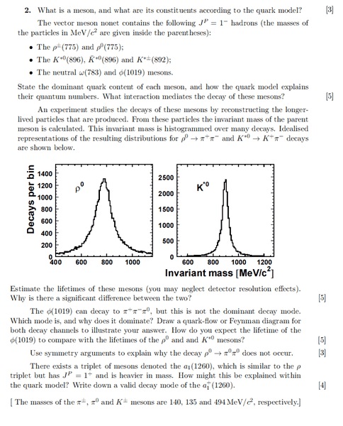




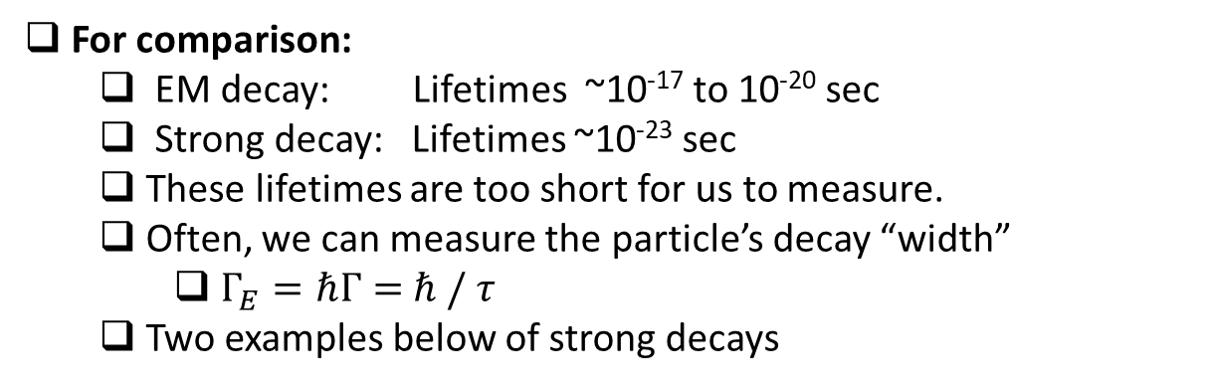
Some particle lifetimes (Weak decays)
Particle | Quarks | Lifetime
$$μ^{+}$$ |  | 22 μs
$$π^{+}$$ | $$(u\overline{d})$$ | 26 ns
$$K^{+}$$ | $$(u\overline{s})$$ | 12.4 ns
$$K_{S}^{0}$$ | $$(s\overline{d})$$ | 90 ps
$$Λ$$ | $$sud$$ | 263 ps
$$D^{0}$$ | $$(c\overline{u})$$ | 0.41 ps
$$D^{+}$$ | $$(c\overline{d})$$ | 1.03 ps
$$Λ_{c}^{+}$$ | $$cud$$ | 0.2 ps
$$B^{+}$$ | $$(\overline{b}u)$$ | 1.64 ps
$$Λ_{b}^{0}$$ | $$bud$$ | 1.5 ps
For comparison:
  EM decay: Lifetimes ~10⁻¹⁷ to 10⁻²⁰ sec
  Strong decay: Lifetimes ~10⁻²³ sec
  These lifetimes are too short for us to measure.
  Often, we can measure the particle’s decay “width”
    $Γ_{E}=ℏΓ=$ $ℏ / τ$
  Two examples below of strong decays
$Γ_{ρ}\sim 150 MeV$/c²
$Γ_{K^{∗}}\sim 50 MeV$/c²
$$M_{ρ}\sim 770 MeV/c^{2}$$
$$M_{K^{∗}}\sim 892 MeV/c^{2}$$

