Slide 1
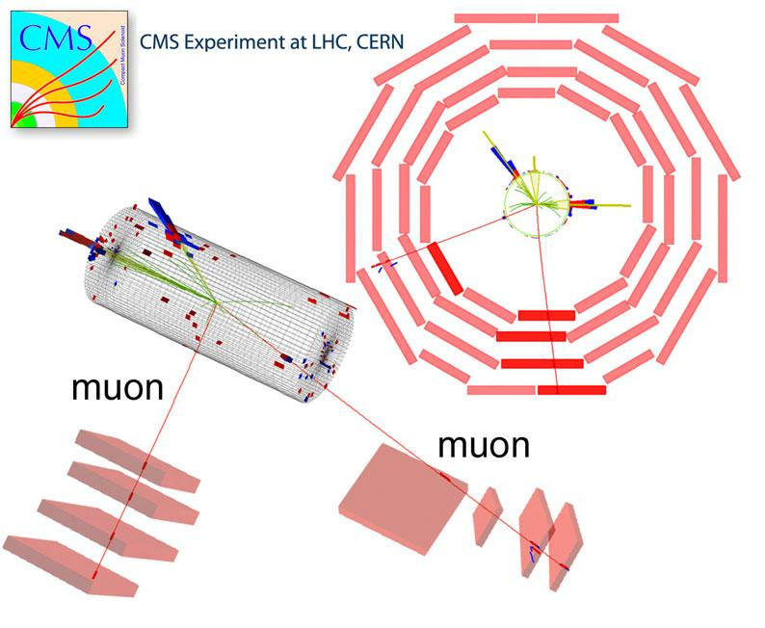
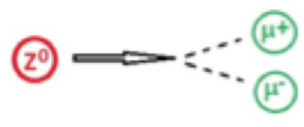
Measuring the Mass of the Z Boson

Slide 2
Mass, Energy & Momentum
[ Lorentz transform ]
At Rest
In Motion
[ Squaring ]
[ Rearranging ]

Slide 3
Mass, Energy & Momentum
[ Distributing ]
[ Simplifying ]
[ Using p = mv ]

Slide 4
Mass, Energy & Momentum
[ Using E=mc² ]
[ Rearranging ]
If using units of eV for Energy,
eV/c² for the units of Mass and
eV/c for the units of Momentum
Notes:
Natural Units

Slide 5
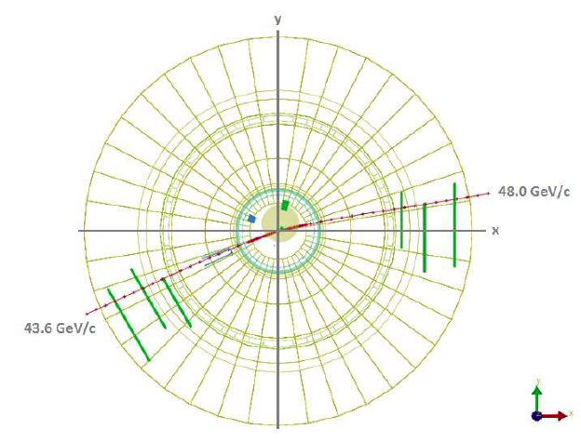
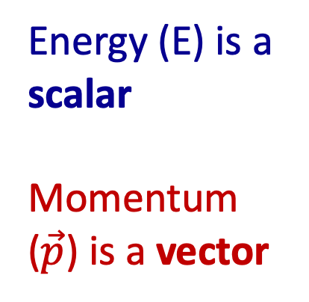
Measuring the Mass of the Z Boson
E² = p² + m_{o}²
m_{o}² = E² - p²
Energy (E) is a scalar
Momentum ($\vec{p}$) is a vector

Slide 6
Measuring the Mass of the Z Boson
Energy is a scalar
Momentum is a vector
m_{o}² = E² - p²
At high energies, the magnitude of the Energy (in GeV) is equal to the magnitude of the Momentum (in GeV/c)
Total Energy (in GeV) = 43.6 + 48.0 = 91.6 GeV

Slide 7
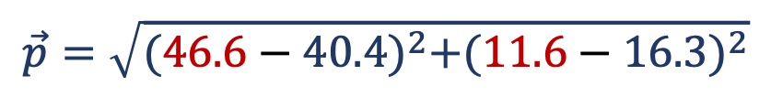
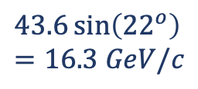
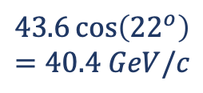
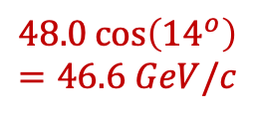
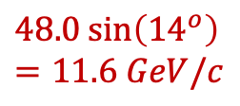
Measuring the Mass of the Z Boson
Energy is a scalar
Momentum is a vector
m_{o}² = E² - p²
To calculate the total momentum of the two particles, we must do a vector sum of their momentum
$$43.6\cos\left({22}^{o}\right)=40.4 GeV/c$$
48.0 GeV
$$48.0\sin\left({14}^{o}\right)=11.6 GeV/c$$
14º
$$43.6\sin\left({22}^{o}\right)=16.3 GeV/c$$
22º
$$48.0\cos\left({14}^{o}\right)=46.6 GeV/c$$
43.6 GeV
$$\vec{p}=\sqrt{{(46.6−40.4)}^{2}+{(11.6−16.3)}^{2}}$$
Total Momentum = 7.78 GeV/c (Vector sum)
Notes:
Students need to estimate the INITIAL angle of the muons

Slide 8
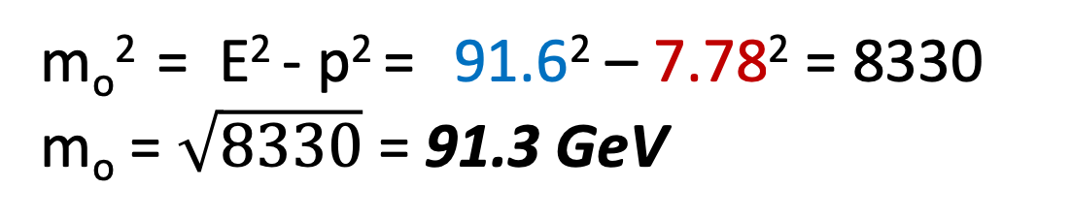

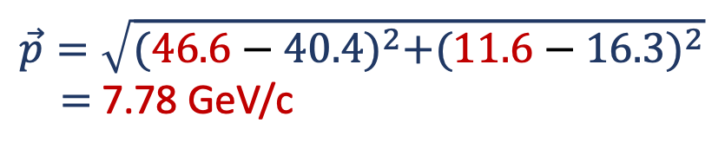



Measuring the Mass of the Z Boson
Energy is a scalar = 91.6 GeV (Scalar sum)
Momentum is a vector = 7.78 GeV/c (Vector sum)
m_{o}² = E² - p² = 91.6² – 7.78² = 8330
m_{o} = $\sqrt{8330}$ = 91.3 GeV
E = 43.6 GeV + 48.0 GeV = 91.6 GeV
48.0 GeV
$$40.4 GeV/c$$
$$11.6 GeV/c$$
14º
22º
$$46.6 GeV/c$$
$$16.3 GeV/c$$
43.6 GeV
$$\vec{p}=\sqrt{{(46.6−40.4)}^{2}+{(11.6−16.3)}^{2}}$$
$=$ 7.78 GeV/c

