Slide 1
Types of Colliders
electron-positron: either linear or circular
proton-proton,
proton-antiproton: circular
electron-proton: linear e, circular p
muon-muon: circular
I’ll talk about each of these, then the past/current colliders, then the future proposals, and finally the decision
made two weeks ago.

Slide 2
Electron-positron: can measure collision energy precisely (ppm), unlike
protons (due to quark/gluon motion inside protons).
Circular colliders have a problem because electrons that accelerate emit
radiation – need huge sizes to get high energies. Highest energy
proposed circular collider (com energy) is 350 GeV (the LHC is 14 TeV).
Linear colliders don’t have as much radiation loss, and they can also be
”easily” extended just by adding to each end. But there is only one
interaction region, and one can’t store beams, so intensity is smaller.

Slide 3
There was a linear collider at SLAC in the 80s, but the most crucial was
a circular collider at CERN, LEP, with a com energy of 200 GeV. Ran from
1989 to 2000.
Started at 91 GeV, to sit on the Z-boson resonance:
e⁺ e⁻ → Z → stuff Very high precision studies of Z properties
Then went to 162 GeV to produce W⁺W⁻ pairs. Increased to 206 GeV,
gradually, searching for the Higgs e⁺ e⁻ → Z* → Z + Higgs. If the mass
of the Higgs had been 115 GeV or less, they would have discovered it and
been able to study it. Alas, it is 125 GeV.

Slide 4
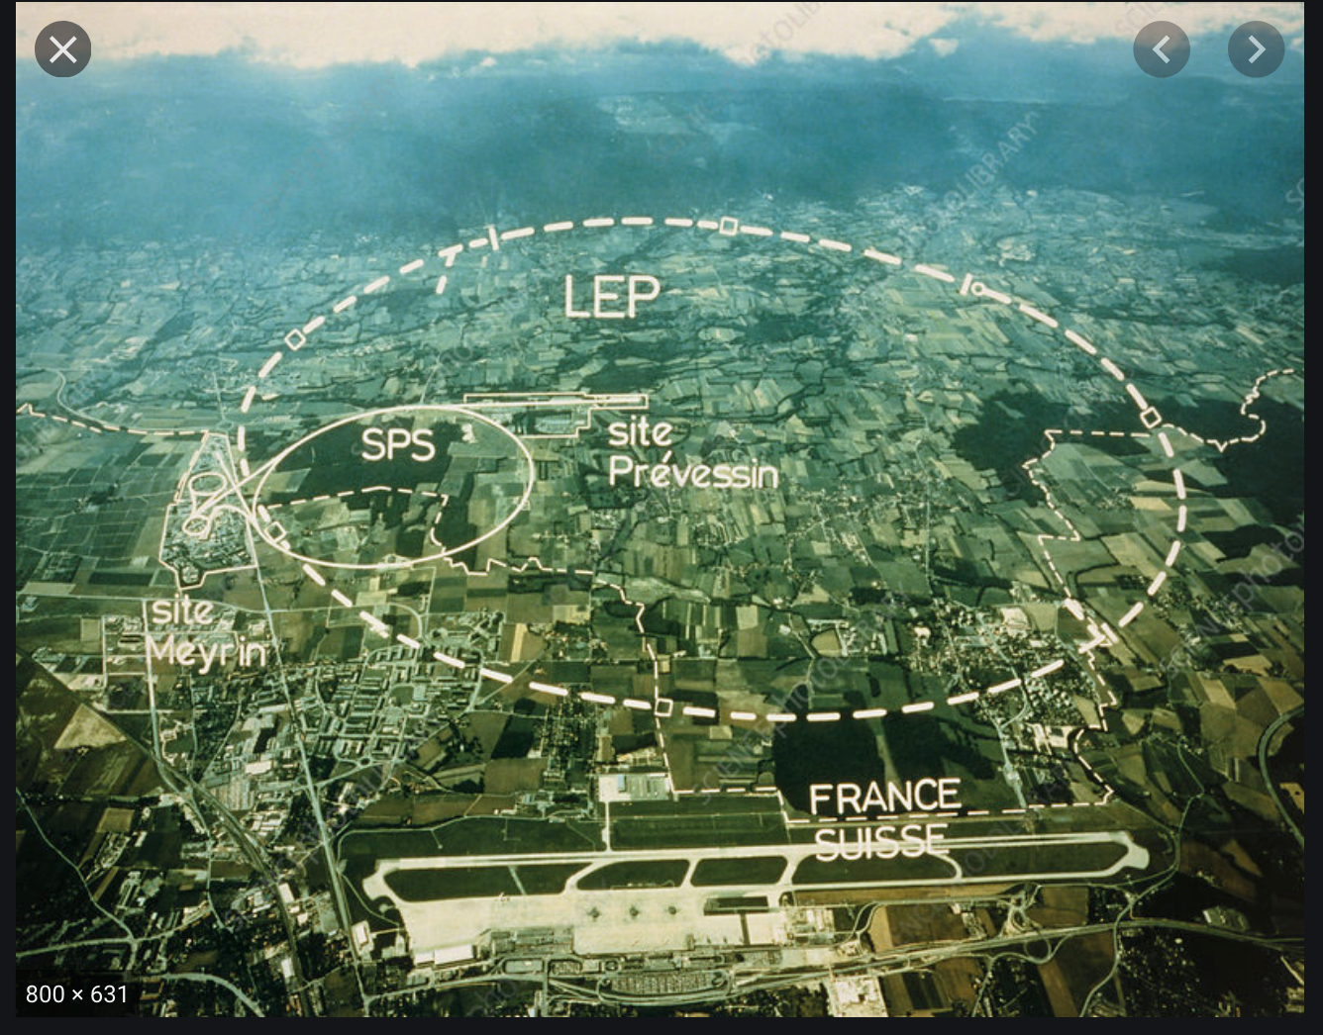

Slide 5
One might think that proton-antiproton collisions are better
because they go into “pure energy”. But protons have a
substantial component of antiquarks and gluons, so proton -
proton also have quark-antiquark annihilations or gluon-gluon
annihilations. Much easier to make protons than antiprotons.
But, need two rings for proton-proton, and one ring for proton-
antiproton.
Fermilab built the Tevatron, with 1 TeV proton-antiproton beams.
It ran from 1985 to 2011.

Slide 6
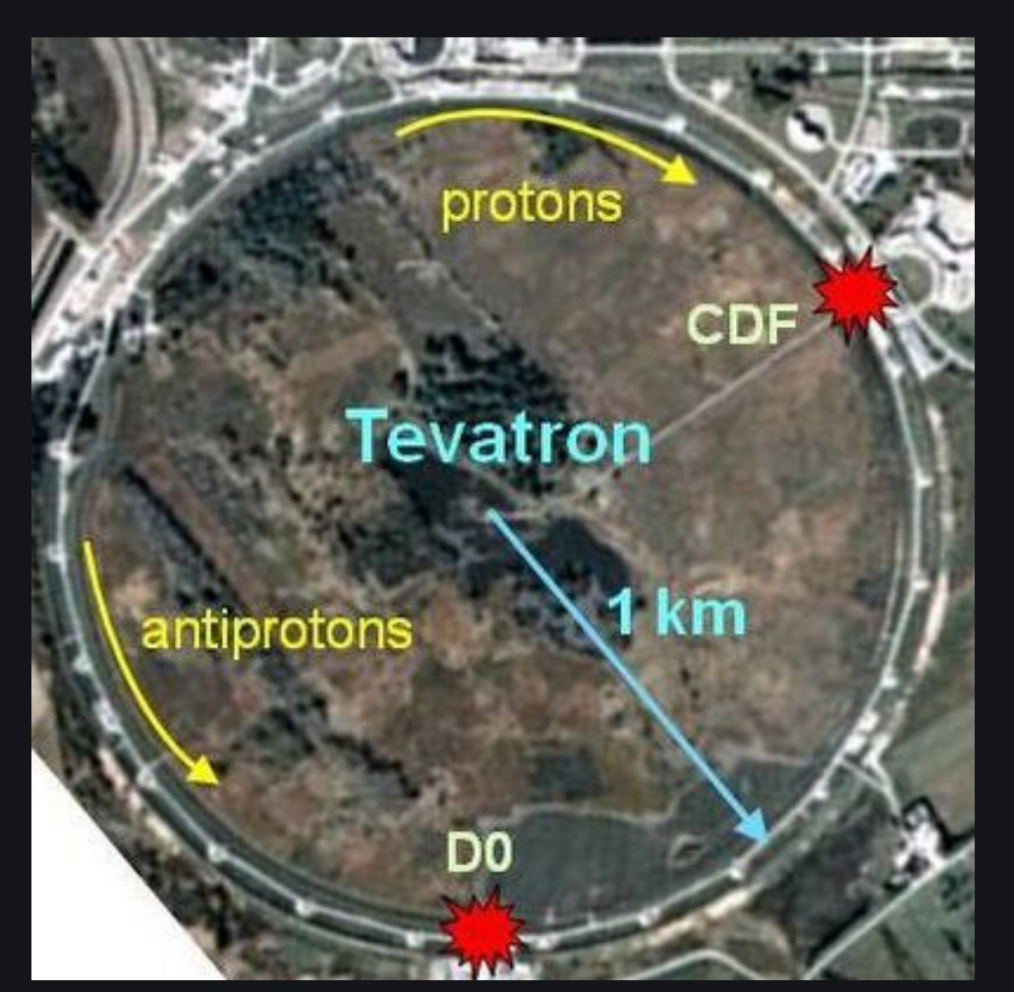
Major discovery was the top quark in
The top was studied extensively
over the next 15 years. They also
looked for the Higgs – could barely
reach the LEP bound of 115 GeV (which
was set in 2000), but would have
discovered the Higgs if it were between
150 and 190 GeV.

Slide 7
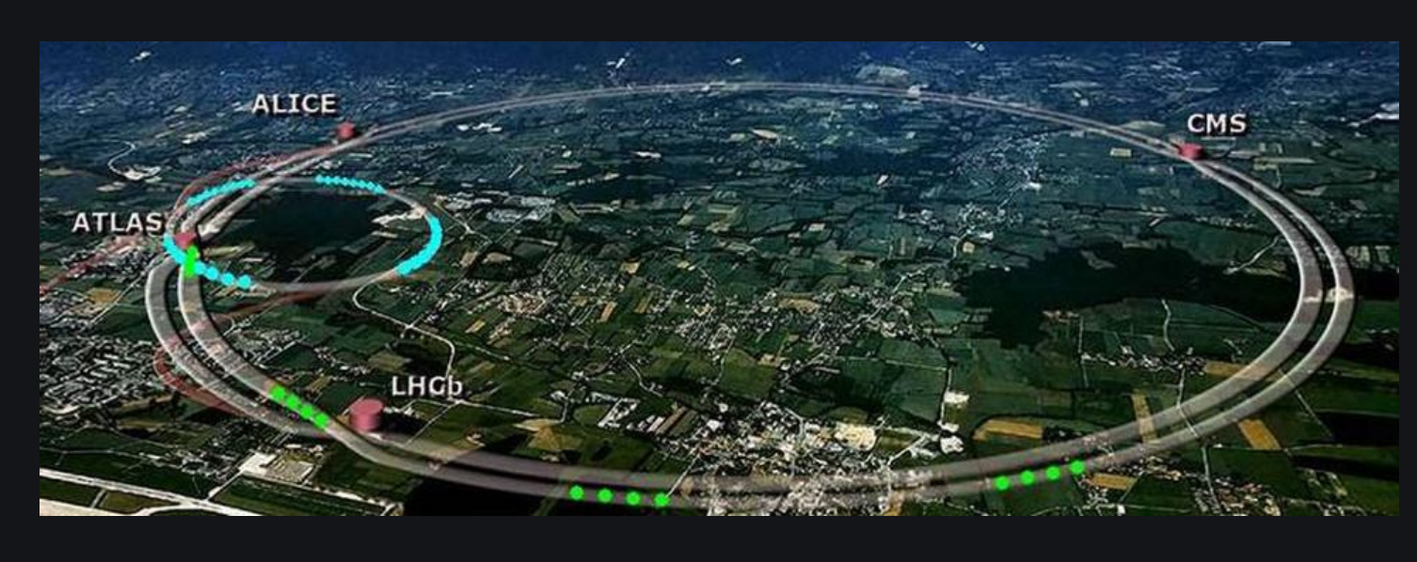
The LHC -- started in 2010, proton-proton started at 7-8 TeV and
is now 13 TeV. Shut down two years ago after a long run, starts again
next year.
Discovered the Higgs boson in 2012 and has studied it intensively
ever since. Many searches for new physics – no luck yet

Slide 8
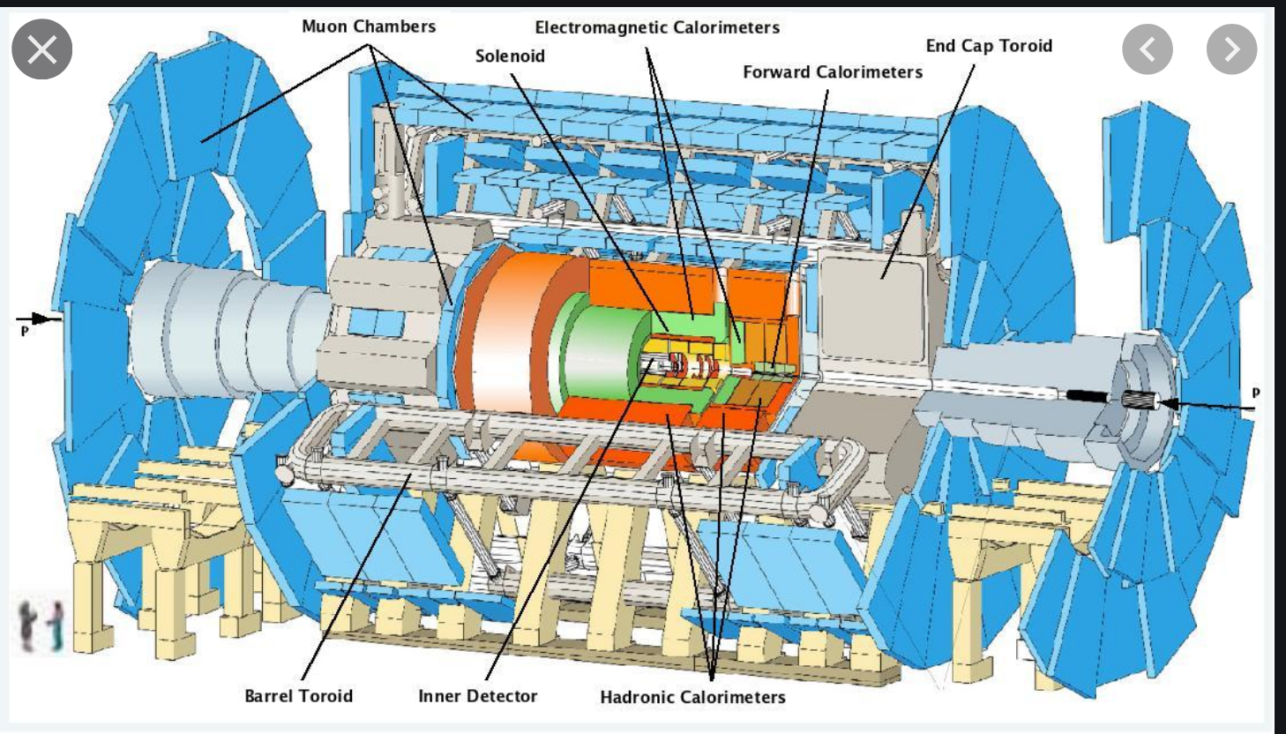

Slide 9
Units: The Luminosity is the number of particles crossing a square
centimeter per second. Typical is 10³⁴/cm²-sec. Cross-sections
(related to interaction probabilities) are 10⁻³⁶ cm² for electroweak interactions,
10⁻⁴⁰ cm² for neutrino interactions, 10⁻⁴⁷ cm² at most for dark matter, etc.
Multiply luminosity times number of seconds times cross section gives the
number of events.
We use femtobarns, or 10⁻³⁹ cm² for cross sections, and the luminosity
times the number of seconds (integrated luminosity) in inverse femtobarns.
LHC discovered the Higgs after 10 fb⁻¹. They now have collected 140 fb⁻¹
The plan is to run from 2021 – 2024 and collect an additional 300 fb⁻¹, then
shut down until 2028, upgrade the LHC to higher luminosity, and then by
2038 collect 3000 fb⁻¹ (or 3 inverse attobarns)

Slide 10
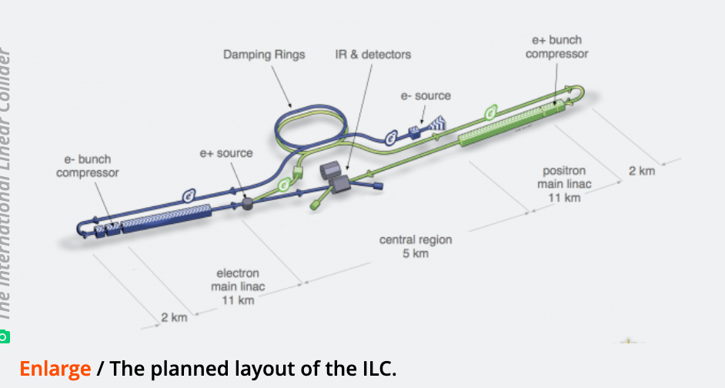
Future machines - Japan is consider the ILC
Start at 250 GeV, then upgrade to 500 GeV (com), produce
top-antitop-Higgs and many more Higgs than before.
Upgradeable to 1000 GeV.

Slide 11
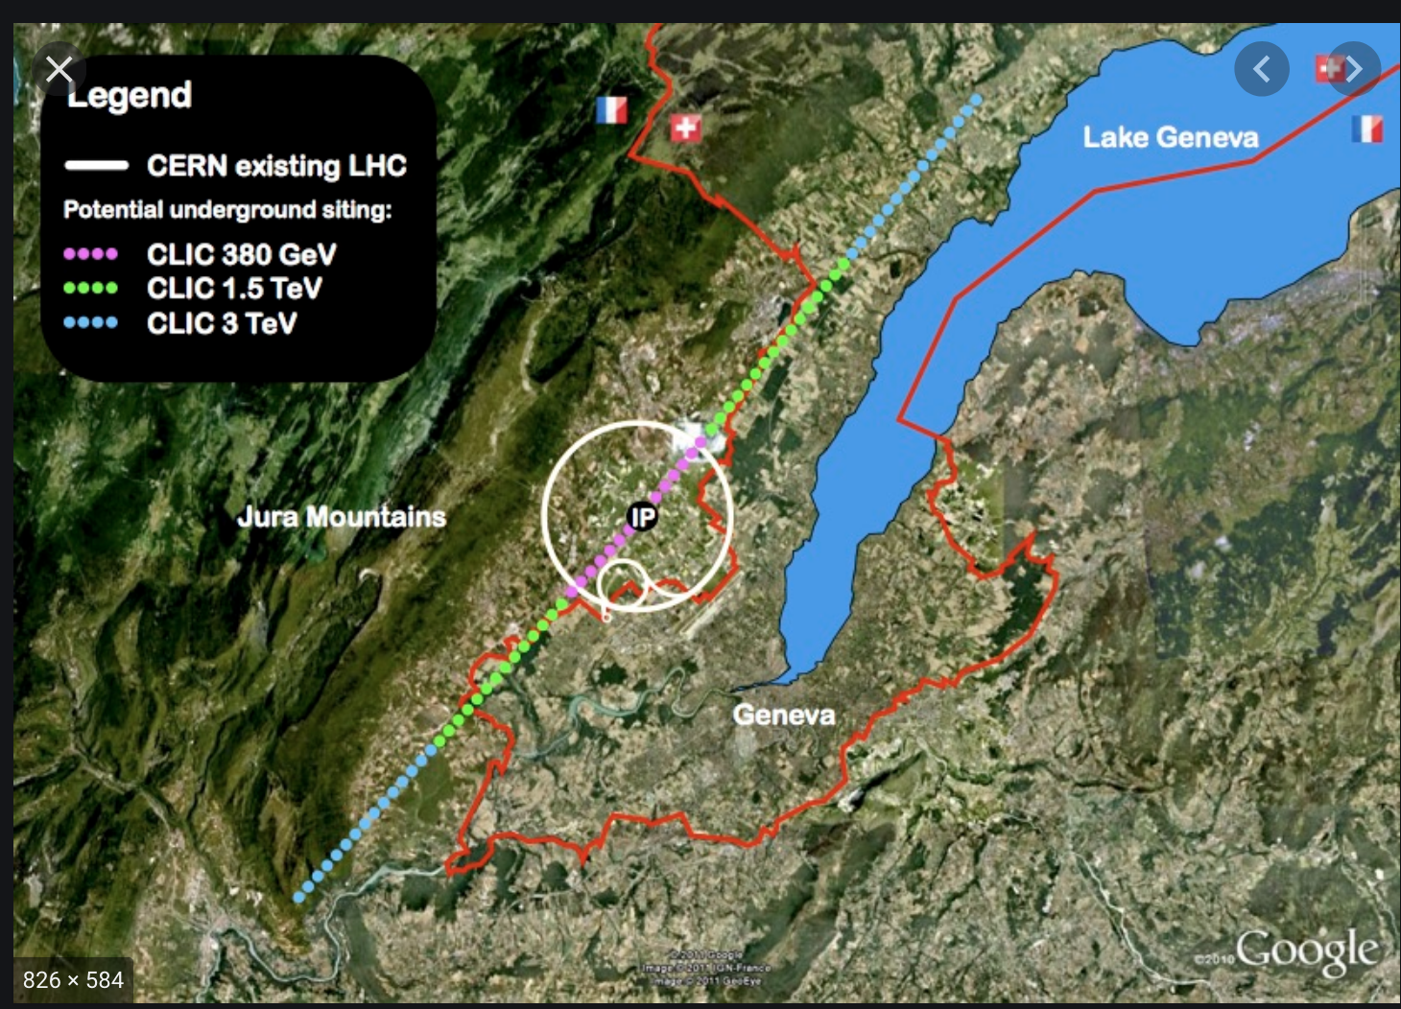
CERN is considering CLIC, which can go up to 3 TeV. If there
is any new physics below 3 TeV, they will be able to study it in
detail.

Slide 12
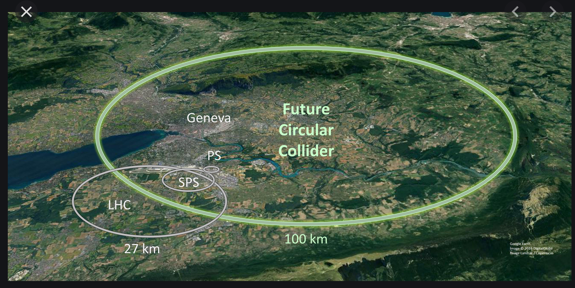
CERN is also thinking of the FCC. Much bigger. Could be
e⁺e⁻ at 350 GeV (FCC-ee), or e p (e beam at 50 GeV,
p beam at 60 TeV)(FCC-eh) or p p (100 TeV)(FCC-hh)

Slide 13
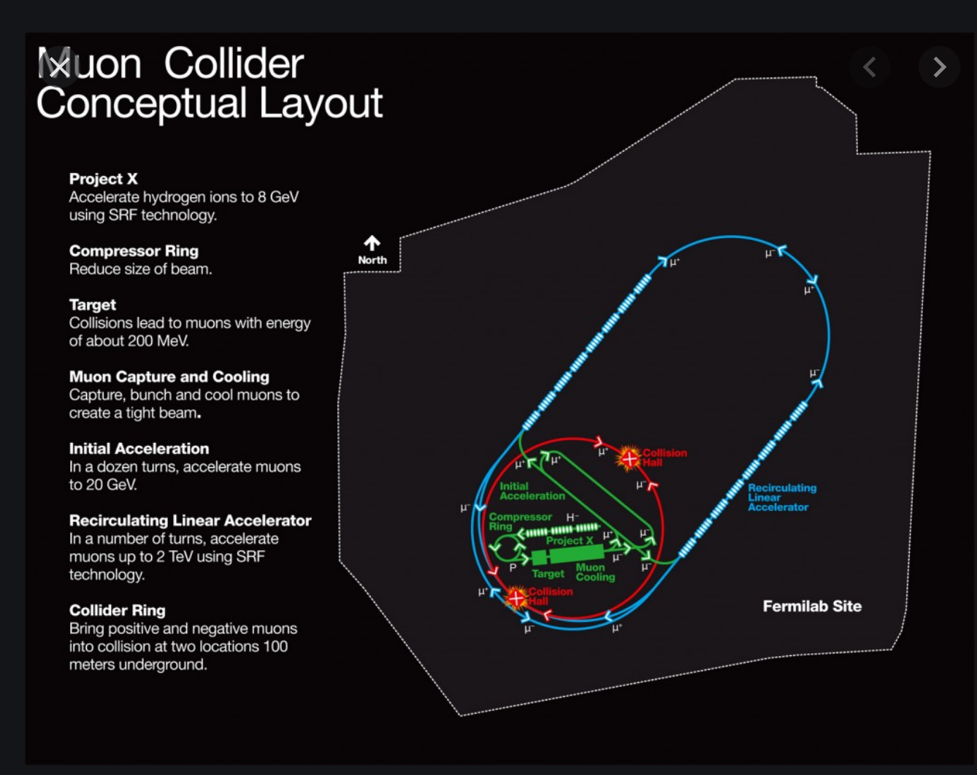
Muon collider. Muons radiate much
less than electrons, so the size can be
much smaller. Also, the energy can be
measured precisely. Muons have a
lifetime of 2 microseconds, but that is
time-dilated by a factor of 10,000-100,000.
Only machine that can produce a Higgs
boson directly – could sit on the resonance.
Possible issue with the Disk of Death.

Slide 14
