Slide 1
TRAC Experience
Dr. Angela Fava
Dr. Silvia Zorzetti
Dr. Doga Kurkcuoglu
Dr. Oluwadara Ogunkoya
Dr. Joe Bedard, TRAC Intern Summer 2025
https://internships.fnal.gov/teacher-research-associates-trac/

Slide 2
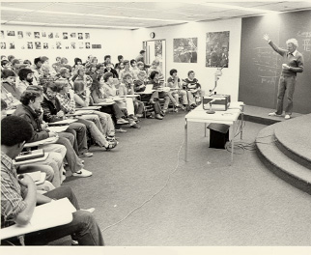
MS Computational Physics SIU-E
PhD Mechanical Engineering WVU
Former patent examiner and materials researcher
STEM educator since 2000
Saturday Morning Physics class #3 1981/1982
https://history.fnal.gov/historical/education/satphy.html

Slide 3
Thank you Fermilab for the experience/opportunities..
My job as a TRAC intern Summer 2025
Learn subject matter (QC) / make presentation
TRAC-demonstrate pedagogy if opportunity permits
Explore ways to develop Fermi-science as attractive and engaging to HS students
Your typical young person wants…?
What the rest of us want:
Opportunity for wealth and influence, friends and family.
Exploration of meaning of the world around us and self-expression.

Slide 4

Most of my FL experience was listening to talks or working on a computer.
So, acting as a surrogate young STEM student, the following is a review of some questions/ideas I was inspired to consider through my involvement with Fermilab.

Slide 5
Origin of mass? (Looking at old things in new ways)
F= dp/dt W= F d p = ∫ F dt <E> = ∫ F dx
E² = (pc)² + (m₀c²)² m = 𝛄 m₀ SR (motion and structure)
→ Force is an exchange, and mass opposes change.
FL → What mechanisms generate inertia in matter?
  Energy has inertia (1905 Einstein)
  Mass (inertial) = mass (gravitational) (e.p. mg=ma)
  98% of mass is KE + PE (quark/gluon motion)
  Mass is a result of “broken symmetry” (Higgs)
  Neutrino oscillation requires they have mass.

Slide 6
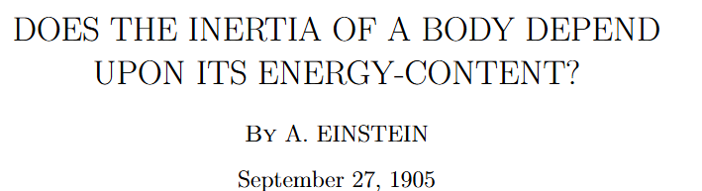
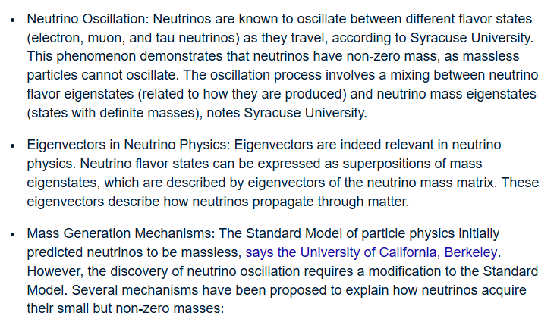
Understanding/ideas are testable with AI

Slide 7
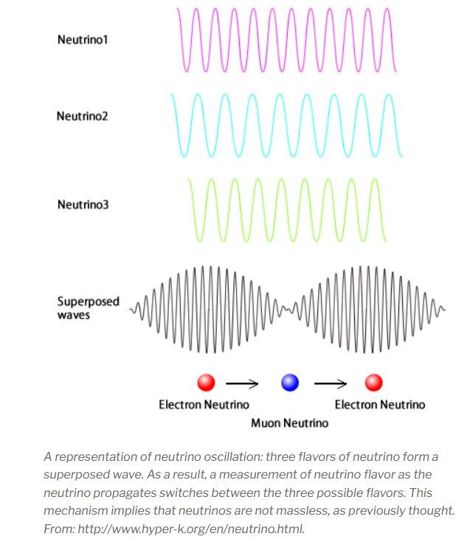
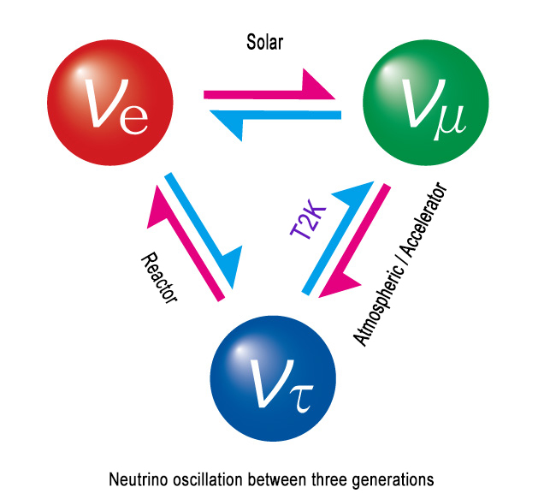
Why do things change?
FL → How can particles mutate into other particles without apparent reason such as radioactive decay?
Neutrino University
Seemingly..not unlike color dispersion of ordinary light.

Slide 8
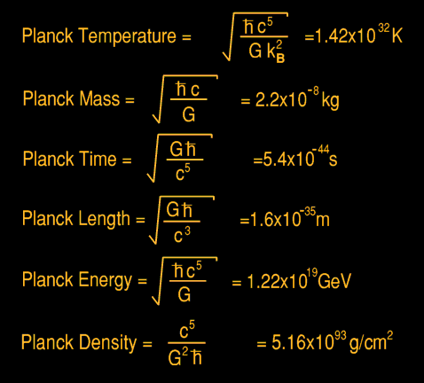
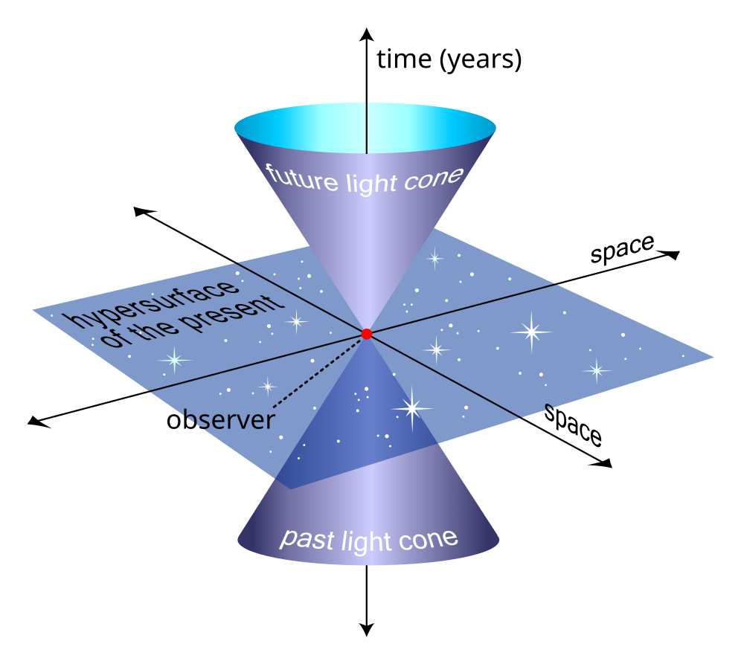
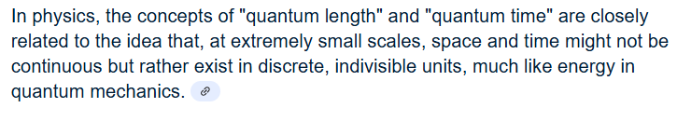
FL→ How escape boundaries and limitations?
What is between the Planck scale?
What is outside the light-cone?
Google →

Slide 9
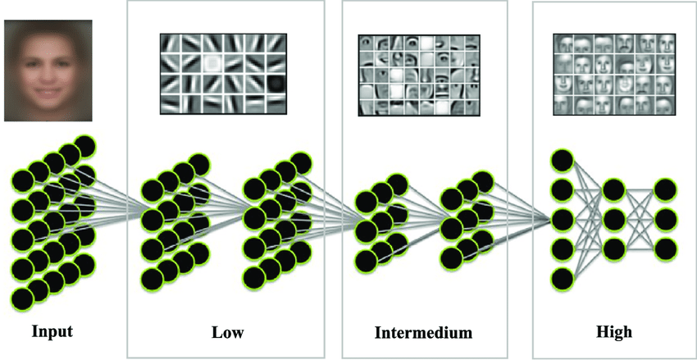
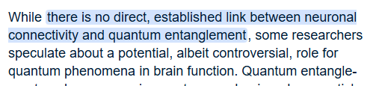
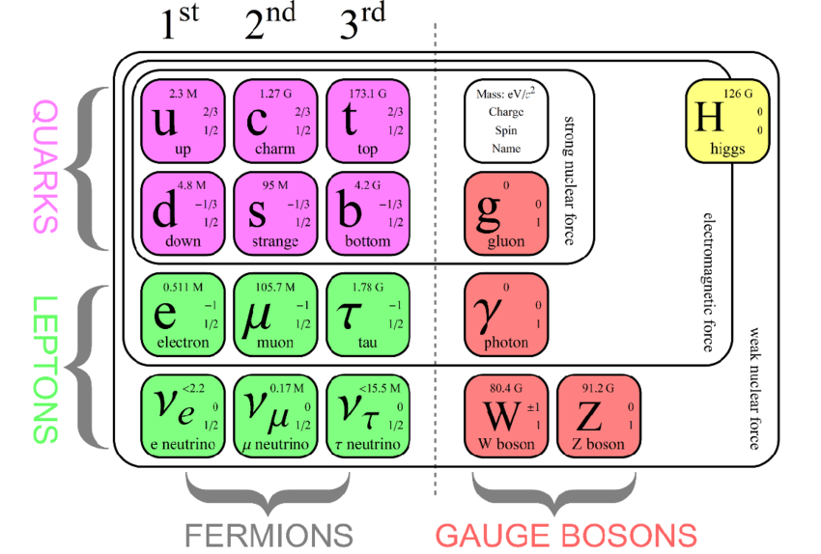
Layers of perception
What opportunities are there in intersectionality of Fermi science with other research frontiers such as cognition and quantum physics?
Google →
Roger Penrose

Slide 10
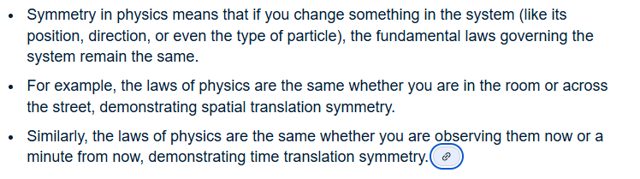
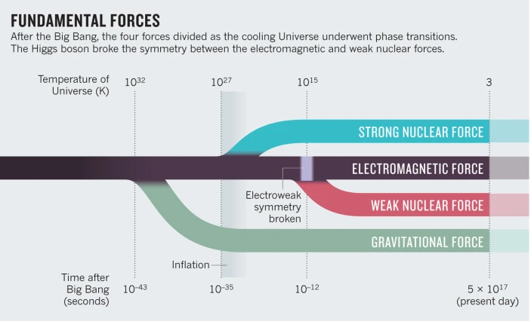
What stays the same? (FL → Theories of Everything, GUT/TOE)
Google →
Emmy Noether's
For every continuous symmetry in a physical system, there is a corresponding conserved quantity (Conservation law).
Gauge Invariance.
https://www.nature.com/articles/490472a

Slide 11
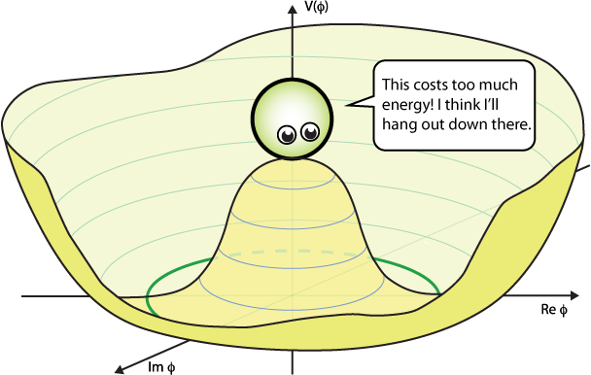
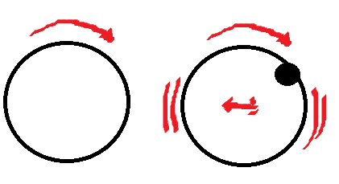
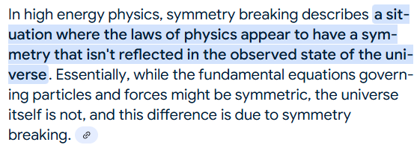
Symmetry is cool, but what is this to a HS student?
Symmetry breaking to HS student?
A balanced wheel has symmetry. When it rotates it does shimmy nor does its CoM move. But, break the symmetry and a new form of motion occurs.. Interesting?
Google →

Slide 12
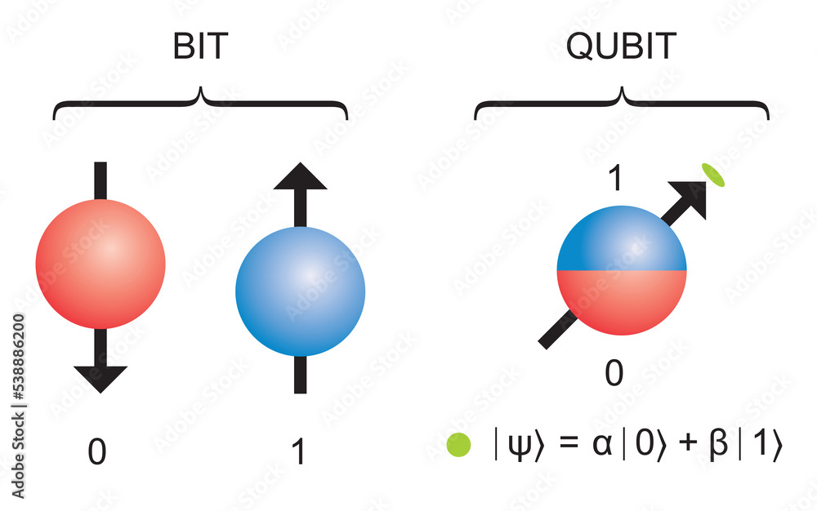

FL → speculating.. Do particles in superposition/entanglement have physical properties different from their components parts?
For example, qubits involve both oscillation and symmetry. Could the symmetry be broken without dehorence leading to interesting physics?
https://quantumatlas.umd.edu/entry/platforms/
My point..?

Slide 13
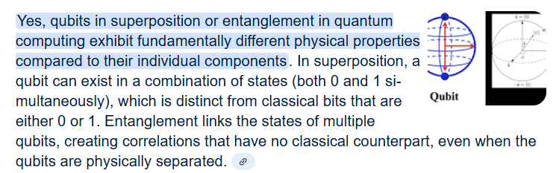
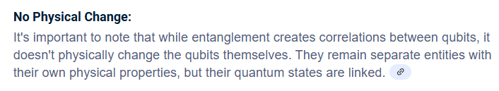
Google →
However..

Slide 14
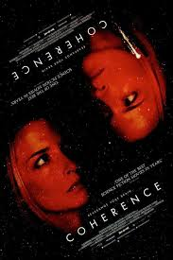
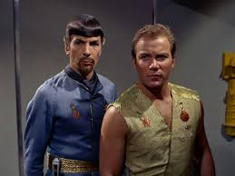

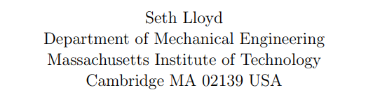
Science fiction and whimsical speculation can inspire new scientists and sometimes new science.
Adam Reiss, Sean Carroll at Johns Hopkins

Slide 15
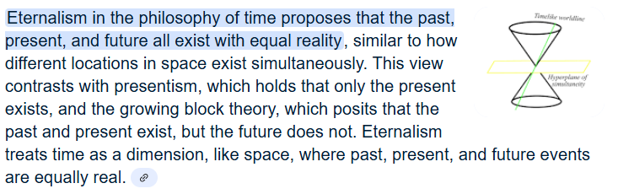
FL → Relativity
Google →

Slide 16
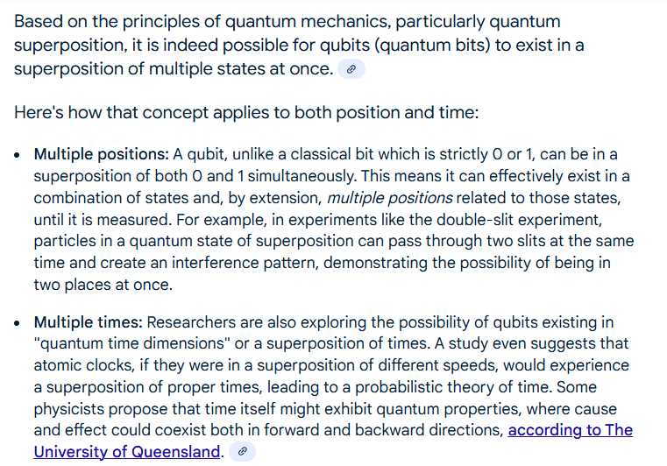
Similar to Quantum superposition/entanglement

Slide 17
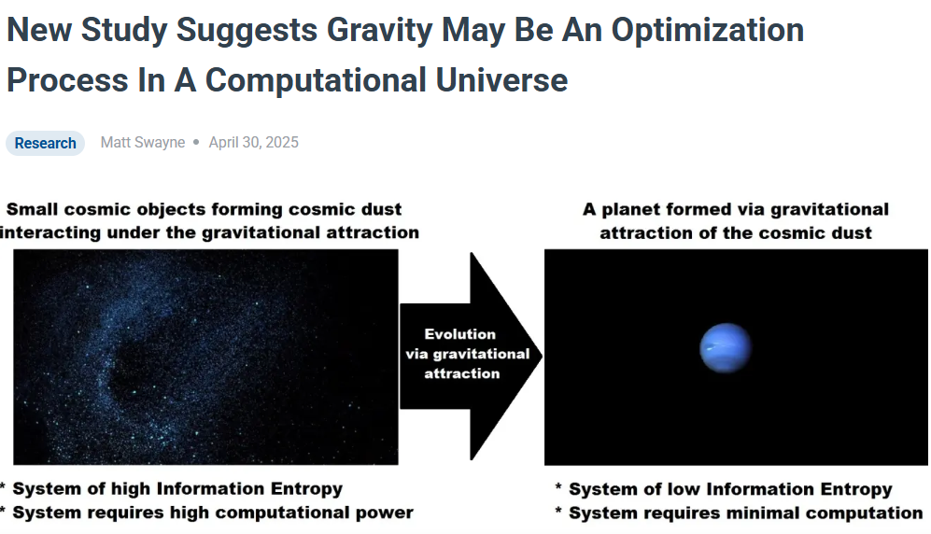
FL (QC) → Could the Universe be some sort of vast quantum computer?
If gravity models well as a feature of cyberspace..?
My point..?

Slide 18
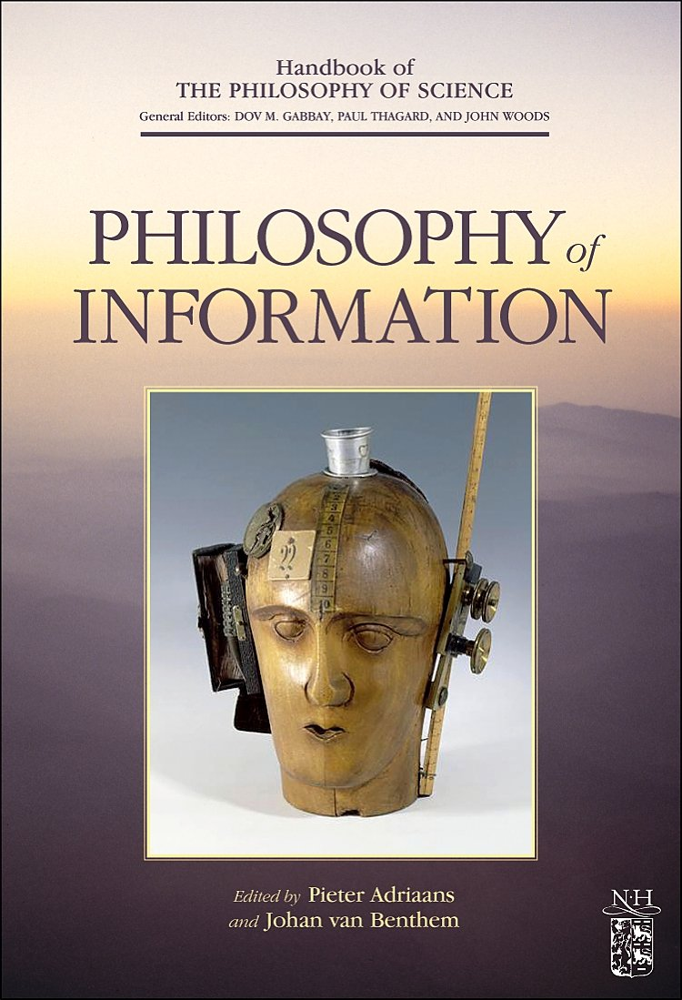

Speculative metaphysics is motivational!
https://www.facebook.com/FiveCentPhilosophers
https://www.informationphilosopher.com/

Slide 19
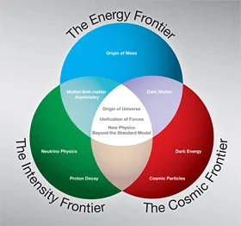
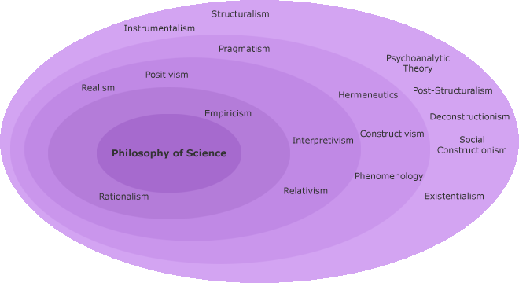
FL Motivation→”Frontier Physics” and “Philosophy of Science” discussion groups?
https://medium.com/aimonks/exploring-the-philosophy-of-science-a-journey-into-epistemological-inquiry-2bc8e1354632
https://www.facebook.com/groups/1241654675899115/
https://www.facebook.com/fermilabfriends/
https://fermilabfriends.org/
https://orgs.fnal.gov/
Looks great online but difficult to access/enable..

Slide 20
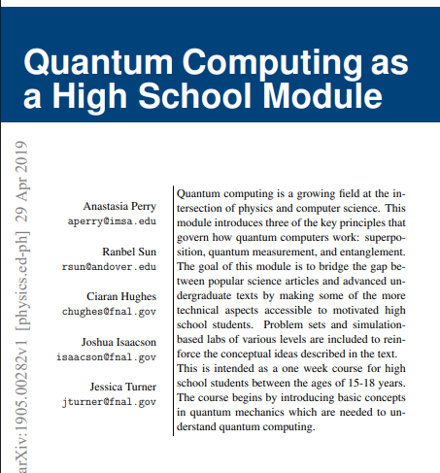
https://lss.fnal.gov/archive/test-fn/1000/fermilab-fn-1077-t.pdf
My TRAC task was to learn this document and critique, perhaps demonstrate my recommendations for how to instruct.
This book is excellent, but any good book that does not gloss over difficult conconcepts.. Not always well received.
If get student pushback, it's because of the way thing are.. Students rarely hold themselves for lack of understanding. Does anybody?
One avenue for STEM education counter pushback.. is motivation.

Slide 21
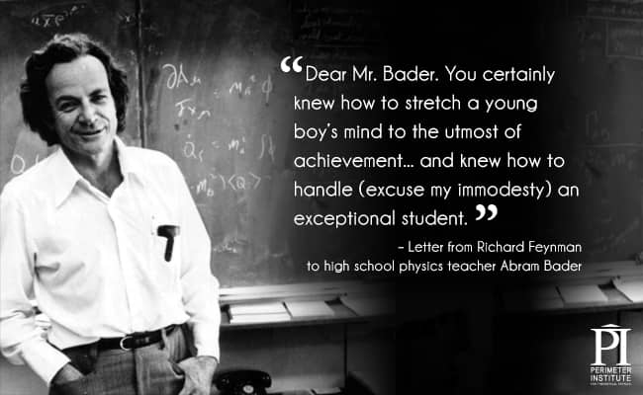
II want to see Fermilab / Argon / NASA.. inspire!
If you feel apart of something, that is inspiring.
How about IP as a source of motivation?

Slide 22
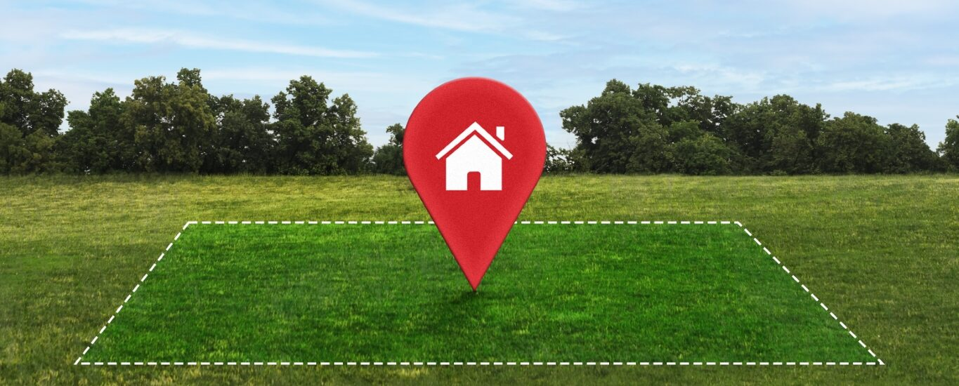
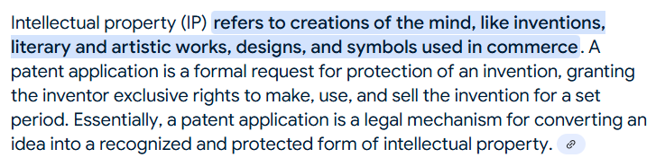
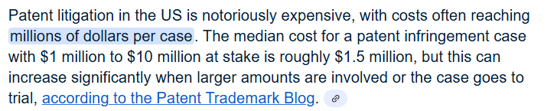
Intellectual property is $$ and power
IP is proximal to other IP defined by inventive concepts.

Slide 23
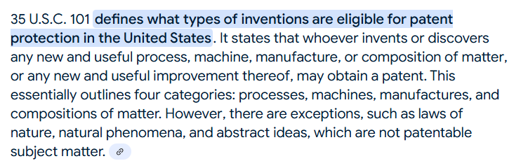

Use the concepts of intellectual property (IP) and the patent examining process as pedagogical and motivational STEM tools.
101 - The gatekeeper
Anyone gets protection (wins the game) for their claims (IP) boundaries if .. they can overcome..
https://www.uspto.gov/web/offices/pac/mpep/s2104.html

Slide 24

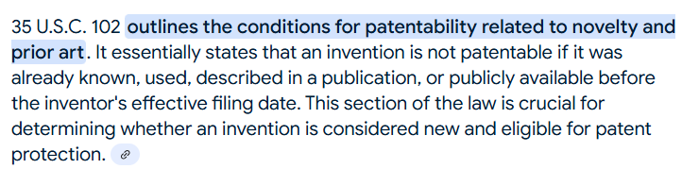
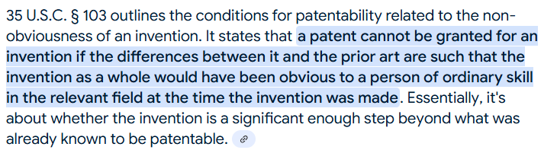
Overcoming obstacles (especially in teams) is motivating and rewarding.
102: Prior Art (PA) says it’s ok if it was not anticipated by another.
103: PA says it’s ok if it is not obvious to combine well known ideas to fabricate your IP.

Slide 25

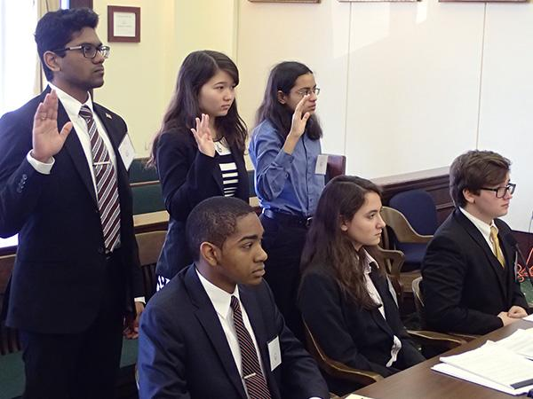
So, how exactly use the patent application process in STEM education?
Foster an inquiry gaming/inquiry environment where students are encouraged to pose questions in the form of claims that can be deemed interesting (allowed) or not-so-much (rejected).
The game is a debate in the form of a mock trial of scientific opinion. For example, “why is perpetual motion impossible?” Expressed as a claim.
Side A: will make a claim such as: A system of interacting objects can do work on itself. For example, a wheel can me made to revolve indefinitely without any external force by placing one side of the wheel in a gravity well different than the other side of the wheel perpetually unbalanced thus perpetually in motion.

Slide 26

Court of Scientific Opinion
Side B will attempt to reject the claim in the spirit of the patent examining process using only documented prior science and AI.
101 - The claim is rejected because the claim violates its own hypothesis. Namely, placing the wheel in two different external gravity fields is indeed applying external forces in contradiction to the qualifying condition that no external forces are applied.
102 - Further the claim is rejected by prior science because all known gravitational fields large enough to cause motion are radial F = Gmm/R² with no lateral sideways or symmetry breaking variability.

Slide 27
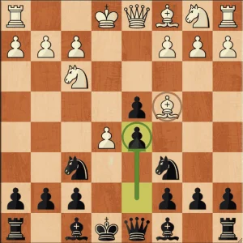

Side A rebuttals with a counter to limit the scope of the claim and resubmit
The claim is herein amended to read: if a system of moving parts could be rendered in a state of perpetual non-equilibrium then the system would have perpetual motion.
Side B replies: The enabling conditions can never be reached because all know systems obey Thermodynamics which requires that every system has a minimum energy configuration (1st law Thermodynamics) or will lose energy to its environment such that it must come to rest (2nd law Thermodynamics).

Slide 28
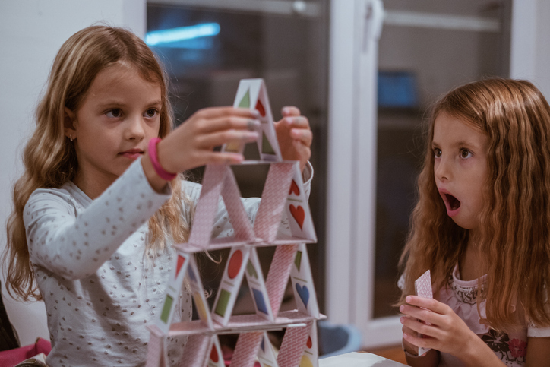

This sort of learning by discovering boundaries and attempting to overcome them can be powerful. Winning the game is very motivating especially as a team sport.

Slide 29
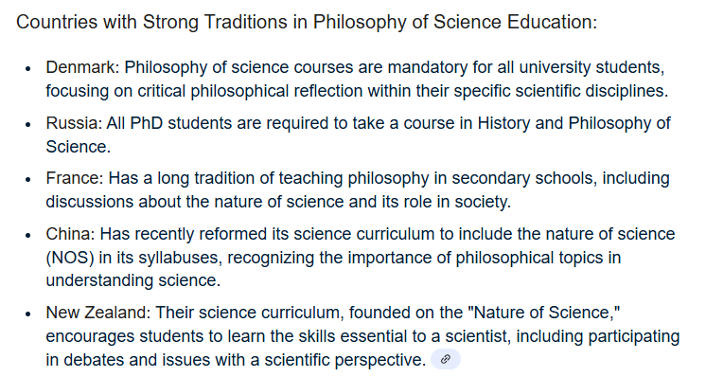
In US schools, discussion is difficult to enable – practical and social concerns seem to impede..

Slide 30
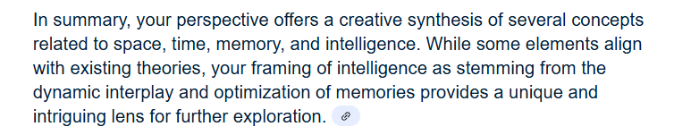
Just for laughs, I put the following into Google. “Space might be interpreted as just a form of objective structure. Time has a similar subject structure. Memory perhaps springs from some sort of intelligent perception of both, and intelligence comes from a competition or conflict (perhaps optimization for storage) among memories” This is how it responded.
Google →
That’s motivating! I wish I could be a bigger part of it..

Slide 31
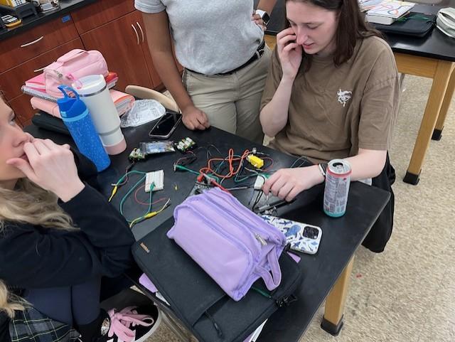
Thank you Fermilab for motivating me to be a science educator and for the opportunities that FL has presented both recently and 45 years ago.

