Slide 1
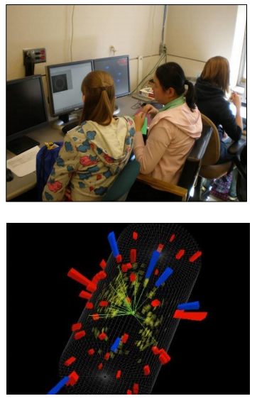
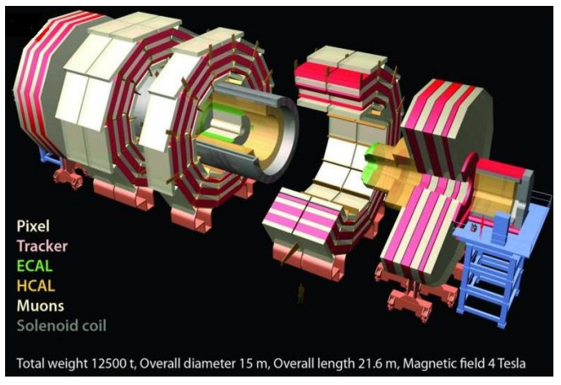



CMS WZH Masterclass

Slide 2
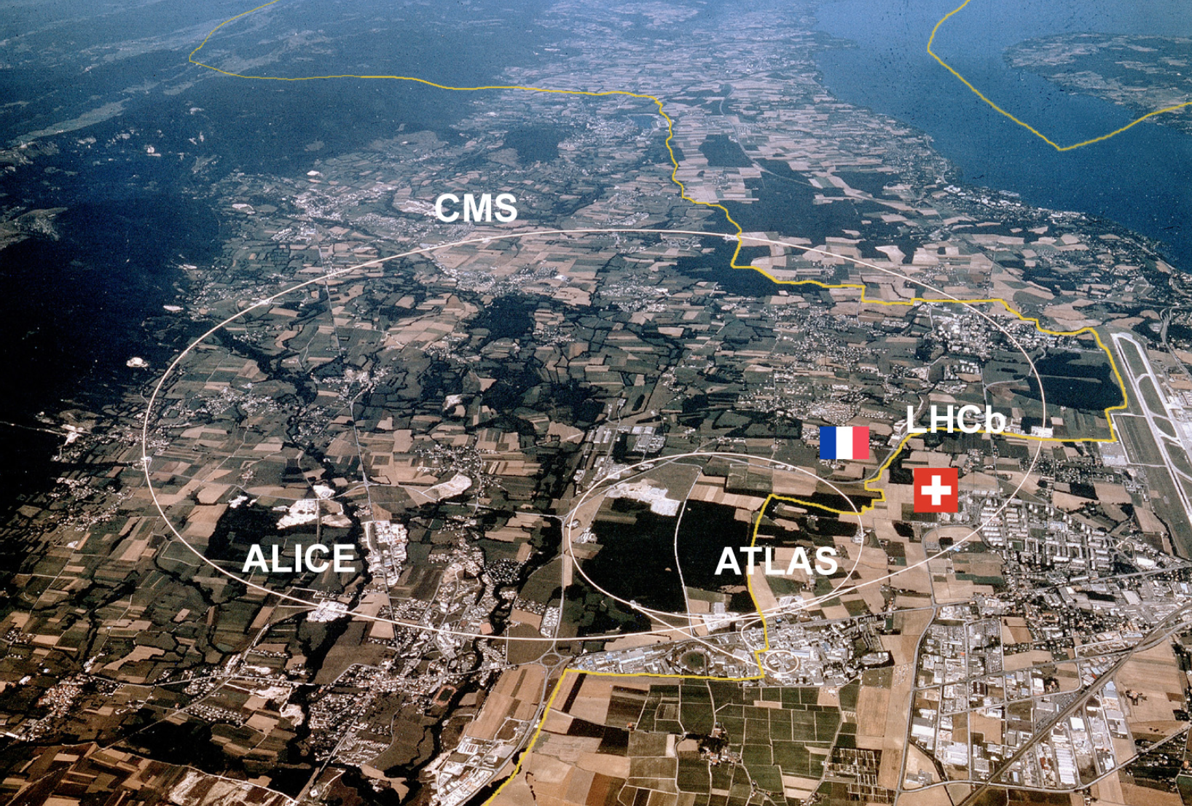
LHC@CERN
~27 km circumference
~100 m underground
Protons circulate in opposite directions
Up to 14 TeV collision energy

Slide 3
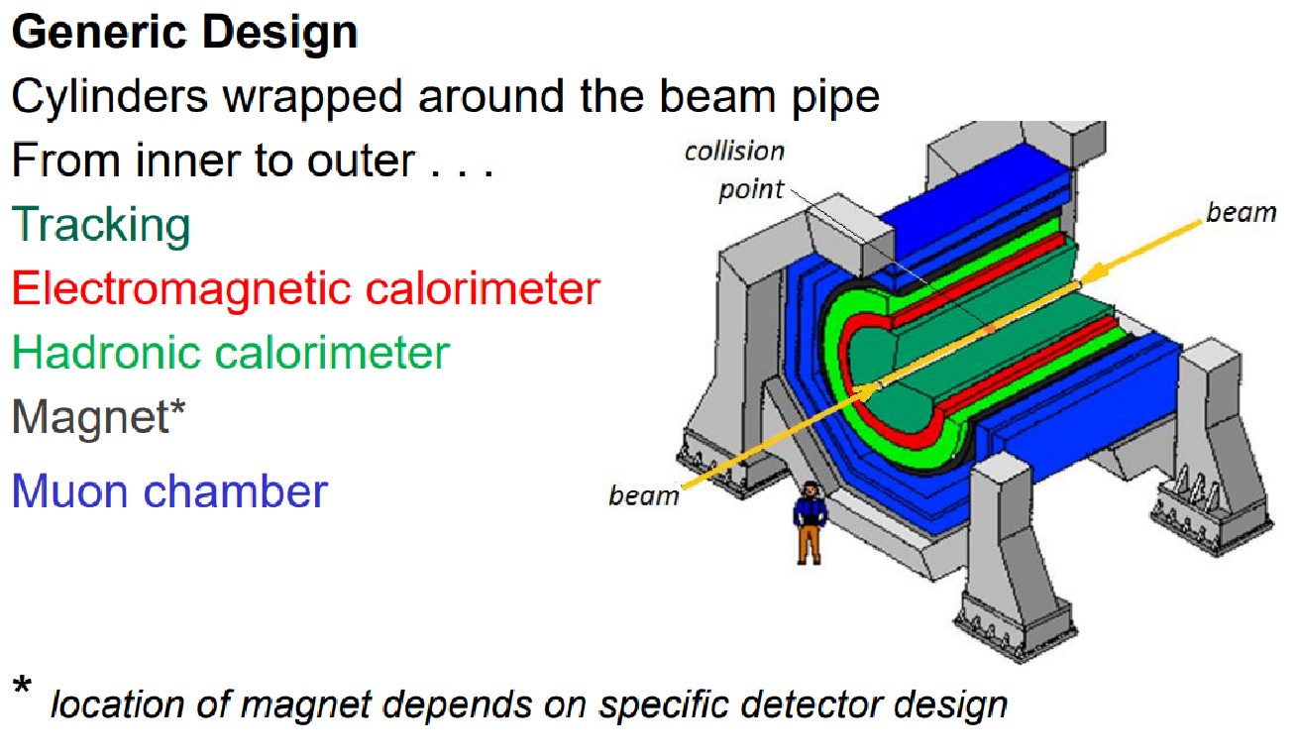
The LHC and the new physics

Slide 4
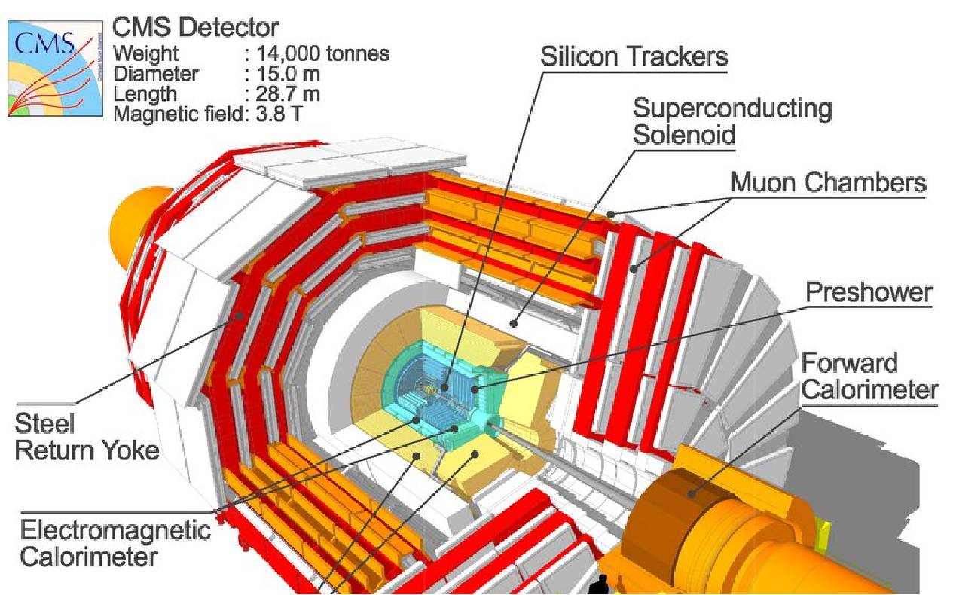
The Compact Muon Solenoid (CMS)

Slide 5
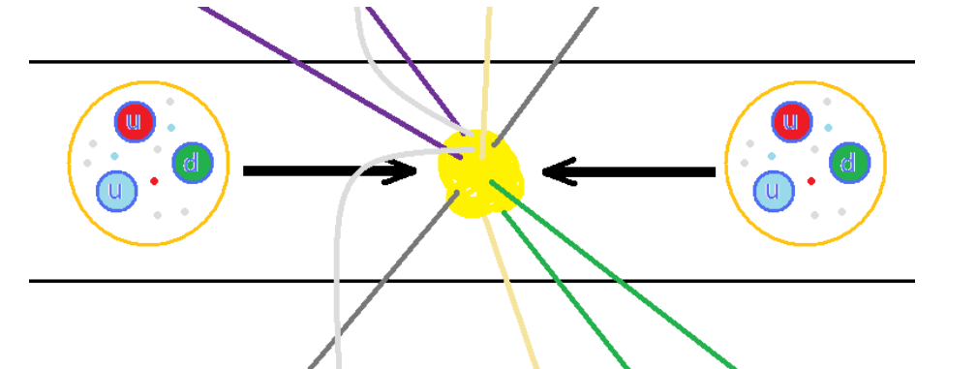
Protons collide inside CMS
The LHC accelerates protons to almost 7500 times the energy equivalent of their mass. The protons circulate in opposite directions and collide in the center of CMS.
But protons are not just particles: they are more like bags of quarks and gluons. When protons collide, all sorts of very short-lived particles can be made from all that energy.

Slide 6
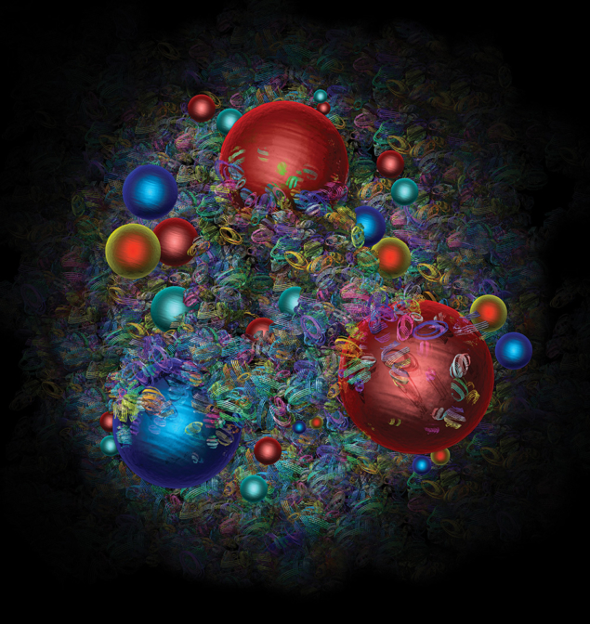
What do the protons tell us?
We learn from what proton collisions produce:
W bosons give us clues to the proton structure…and they also present a mystery.
Z bosons decay (sort of) like lighter particles but are also needed to sort out Higgs data.
Higgs bosons, well, are Higgs bosons, the new kid on the block!
Artist’s image of a proton from CERN Courier. Learn more here and even more here.

Slide 7
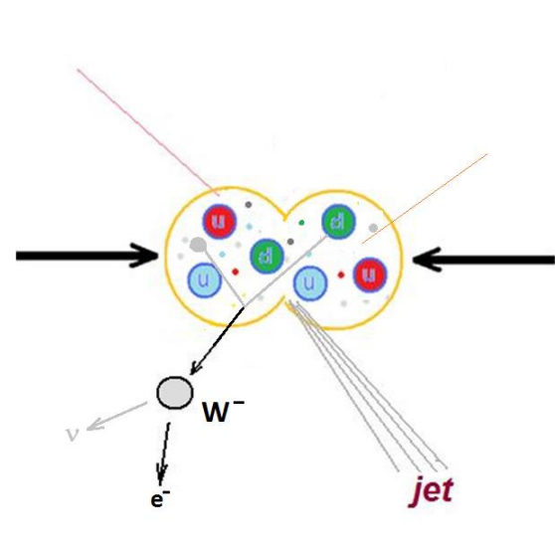




One-lepton events
The + or – charged W boson enables radioactive decay by transforming neutrons into protons.
It decays into a neutrino and another lepton. Since CMS cannot detect the neutrino directly, we can call this a one-lepton event.

Slide 8
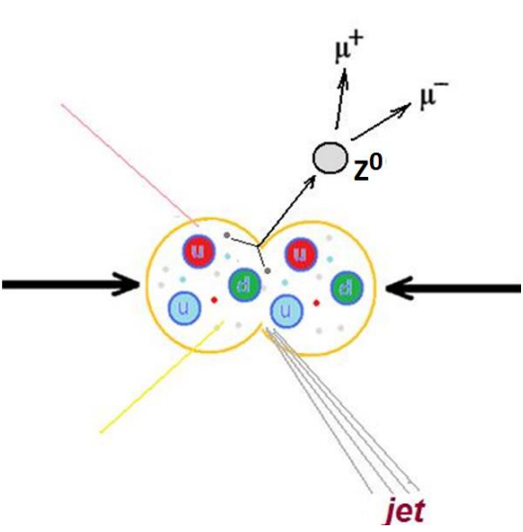


Two-lepton events
The Z boson is a neutral cousin of the W. It enables the “weak neutral current”.
It decays into two leptons of the same type but opposite charge – electron and positron or muon and antimuon. It has other decay paths but we are not looking for these.

Slide 9
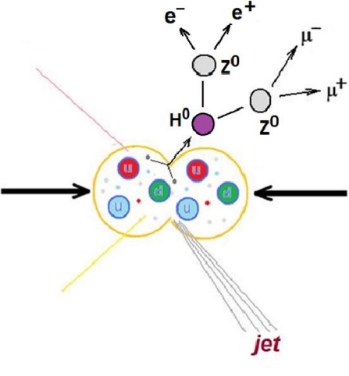
Four-lepton events
The Higgs boson is an expression of the field that gives other particles mass.
One decay mode of the Higgs is into two Z bosons, which themselves promptly decay. Thus we can get 2 muons and 2 electrons or 4 muons or 4 electrons.

Slide 10
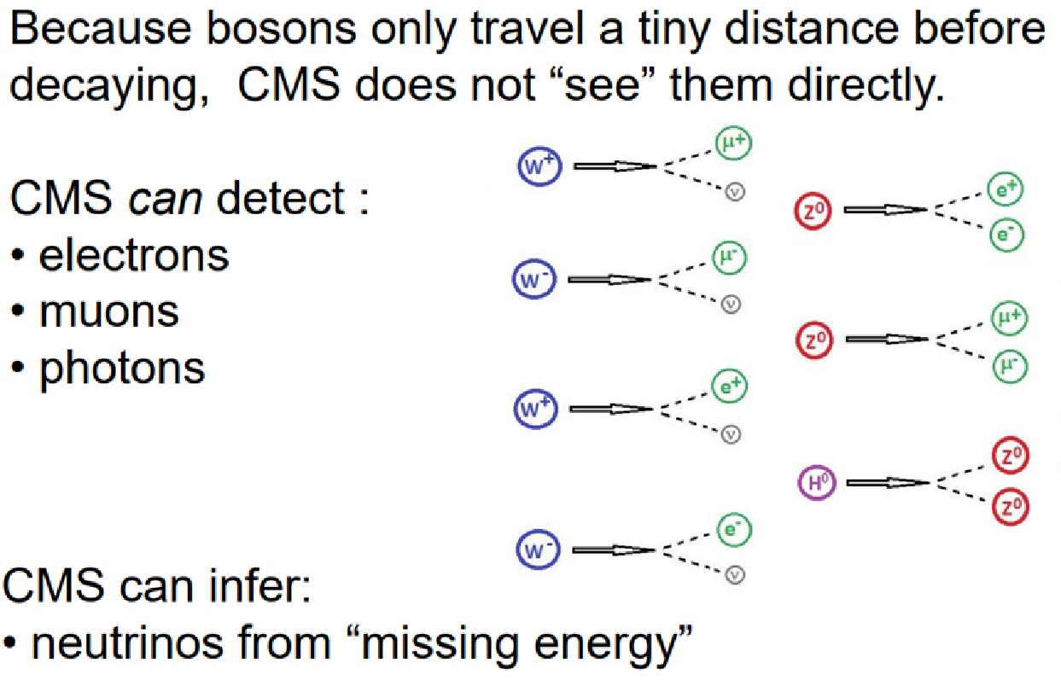
Decay summary

Slide 11
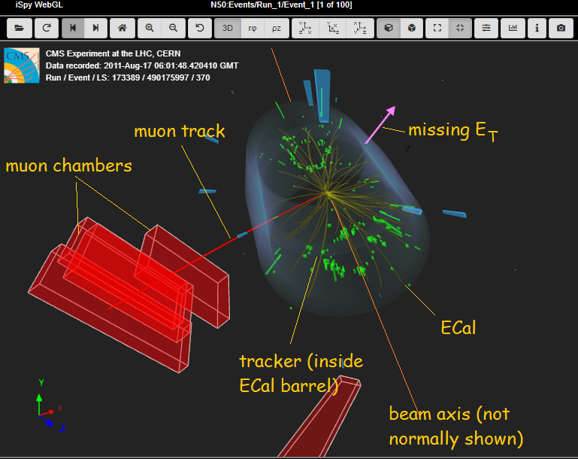
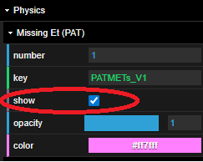
iSpy event display for CMS
We only see missing Et if we find it in the right-side menu under Physics and choose the “show” checkbox.

Slide 12
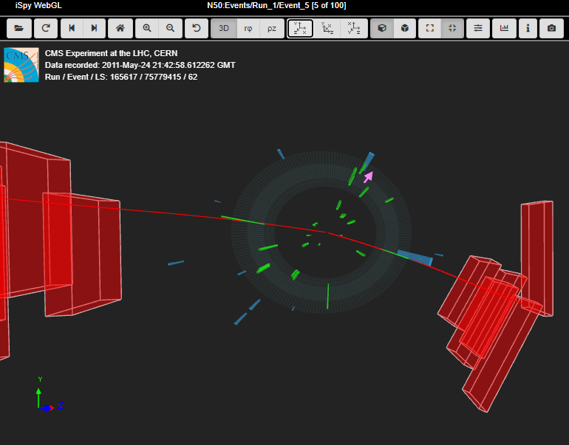
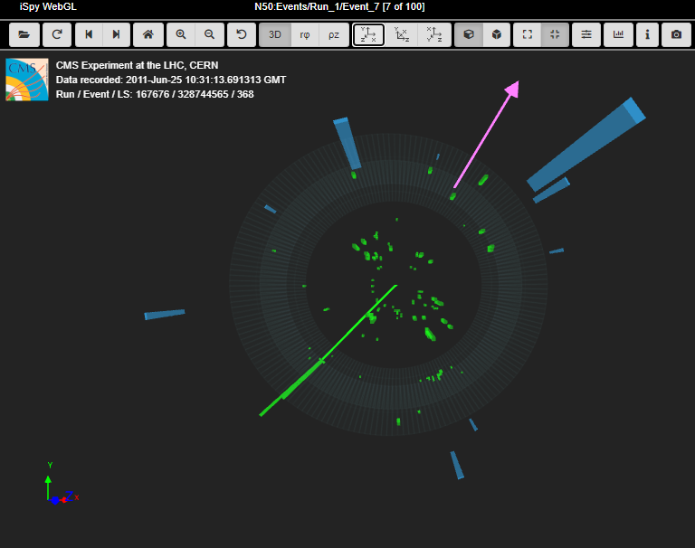
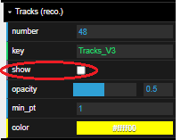
1, 2, or 4 leptons?
Which of these events has 1, 2, or 4 charged leptons? Which flavors of leptons? What else do you see?
Note Tracks (reco) turned OFF.

Slide 13
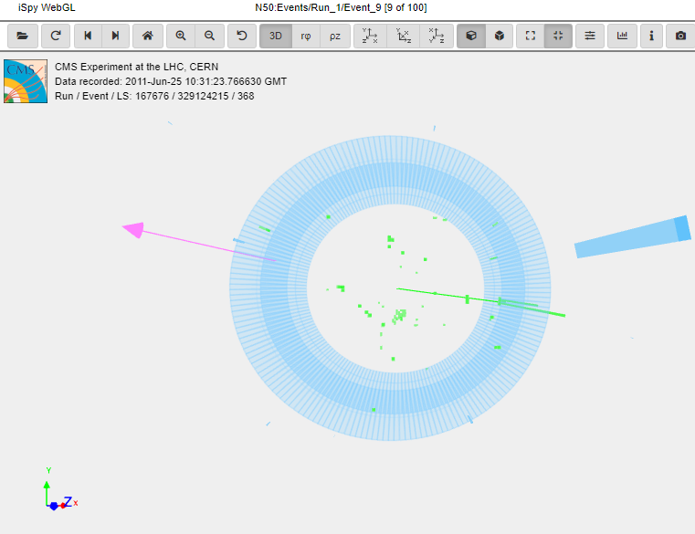
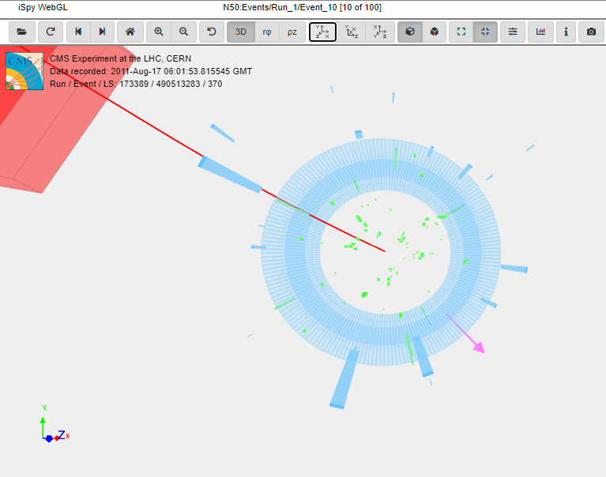
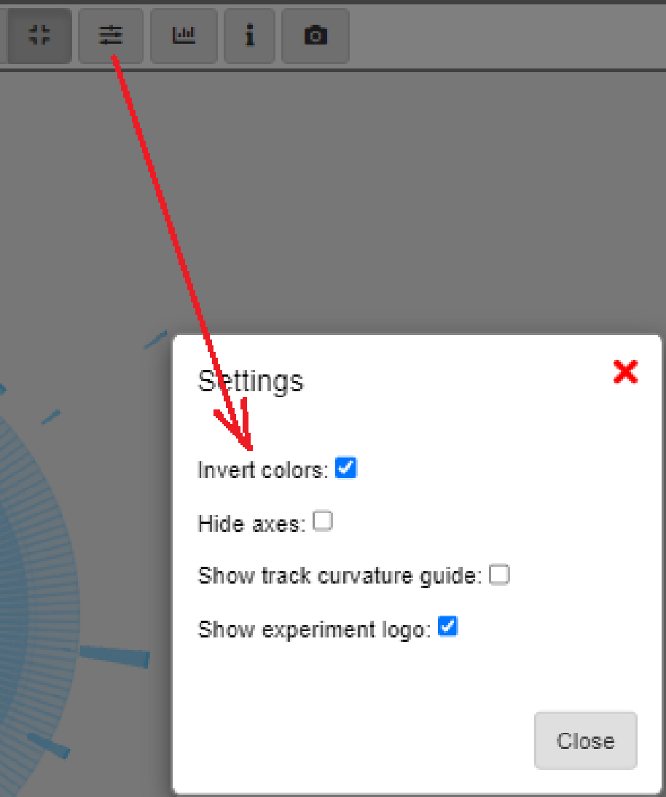
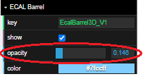
1, 2, or 4 leptons?
Which of these events has 1, 2, or 4 charged leptons? Which flavors of leptons? What else do you see?
Note Inverted Colors and increased ECal Barrel opacity.

Slide 14
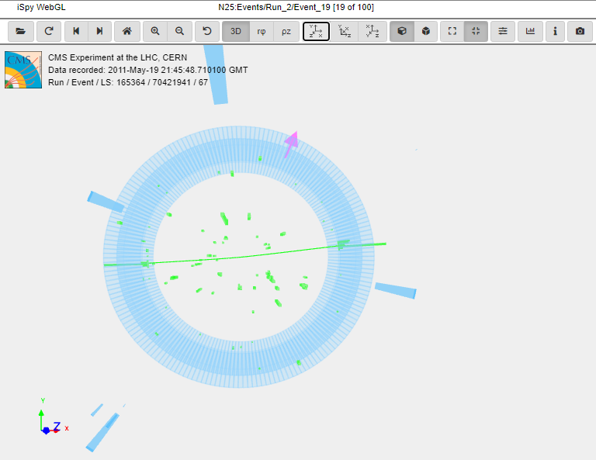
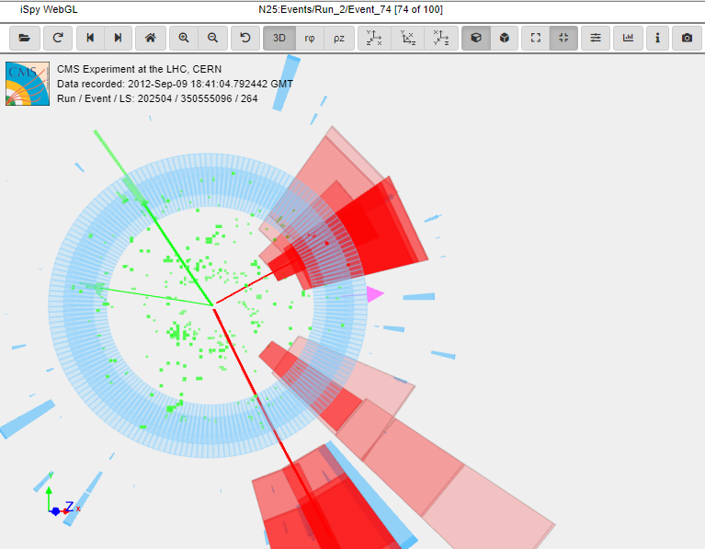
1, 2, or 4 leptons?
Which of these events has 1, 2, or 4 charged leptons? Which flavors of leptons? What else do you see?

Slide 15
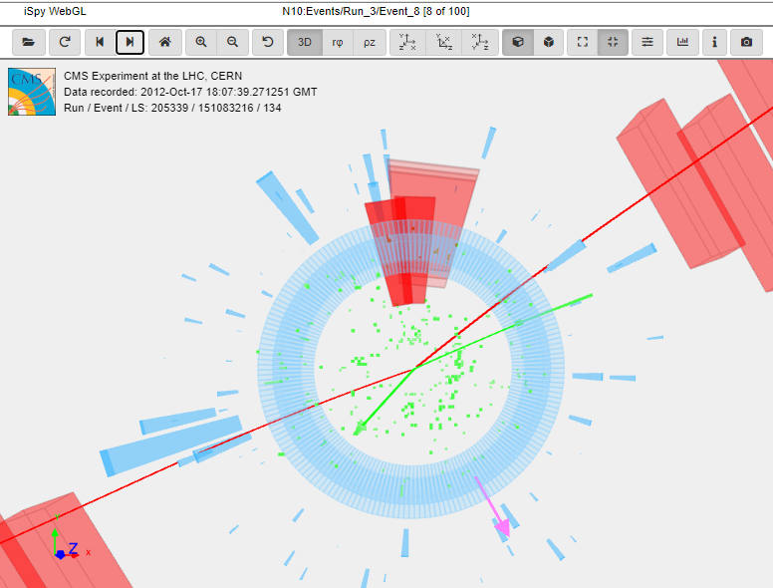
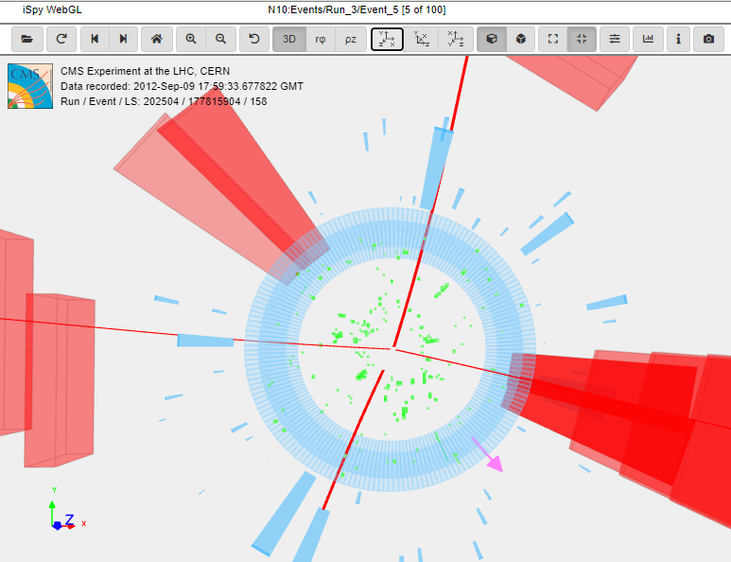
1, 2, or 4 leptons?
Which of these events has 1, 2, or 4 charged leptons? Which flavors of leptons? What else do you see?

Slide 16
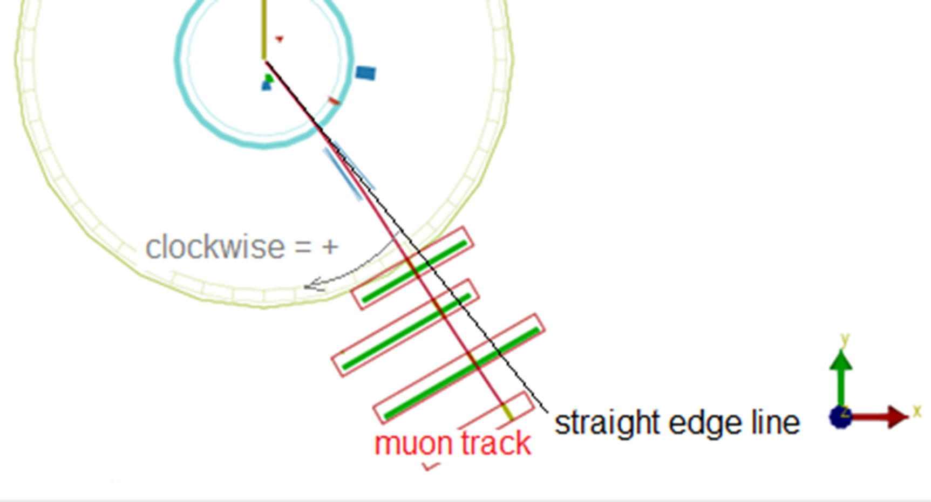
W+ or W-?
Can you distinguish W+ from W- using track curvature in the CMS solenoid magnetic field?

Slide 17
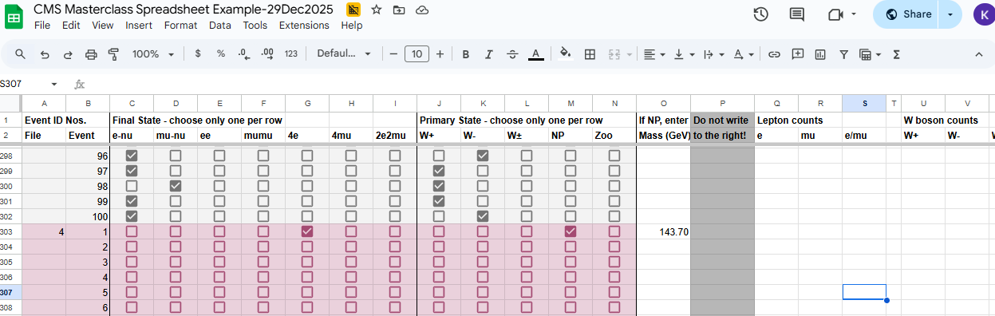
CMS Masterclass Spreadsheet
Enter data on each event in the Google Sheet:

Slide 18
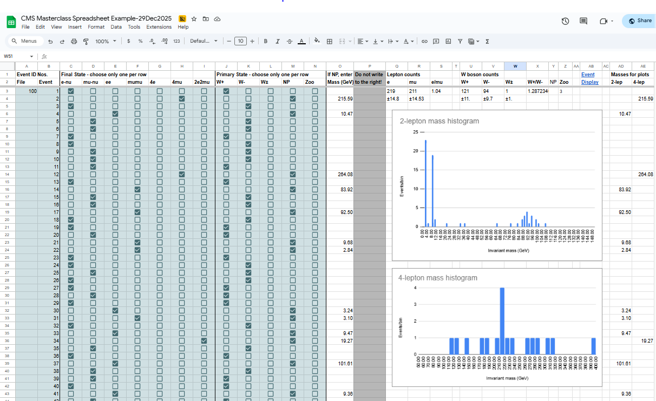
CMS Masterclass Spreadsheet
Your spreadsheet makes mass histograms automatically:

Slide 19

CMS Masterclass Spreadsheet
It also tabulates data for key ratios:

Slide 20
Follow the flow
Your data file
CMS masterclass has 100 data files
Each file has 100 events
Two students analyze one assigned data file
Event display
Go to file folder
Events frm web
File names “masterclass_xx.ig” → “xx” replaced by your file number
Choose your file then scroll up to first event (top, right in window)
Choose that and then Load
You are now in file xx, event 1
Right arrow advances to the next events, up to event 100
Google Sheet
Scroll down until you find your data file in column A
Event numbers are in column B
Enter results in columns C-N
Final State C-D → Primary State J-K only
Final State E-I → Primary State L, N only
Can’t answer? Column M (use rarely)
Screencast: cern.ch/cms-cast2026

Slide 21
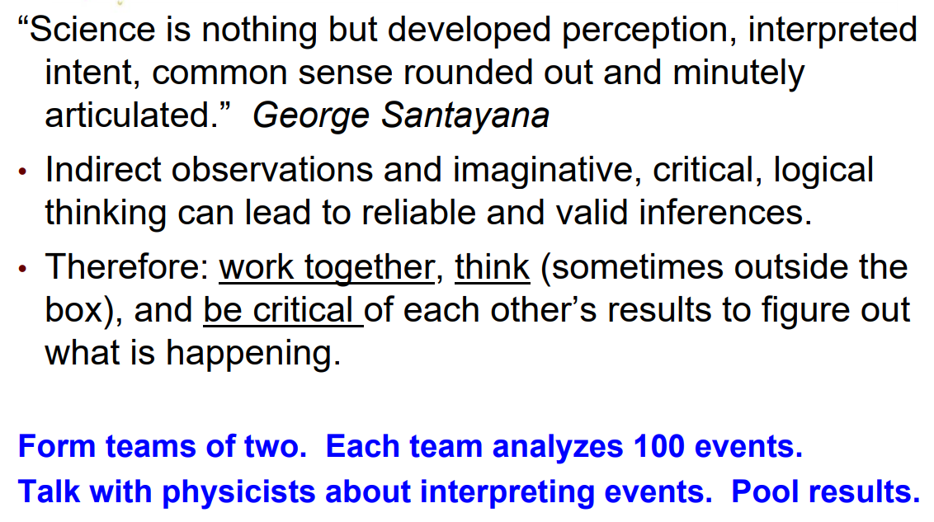
Parting words…

