Slide 1



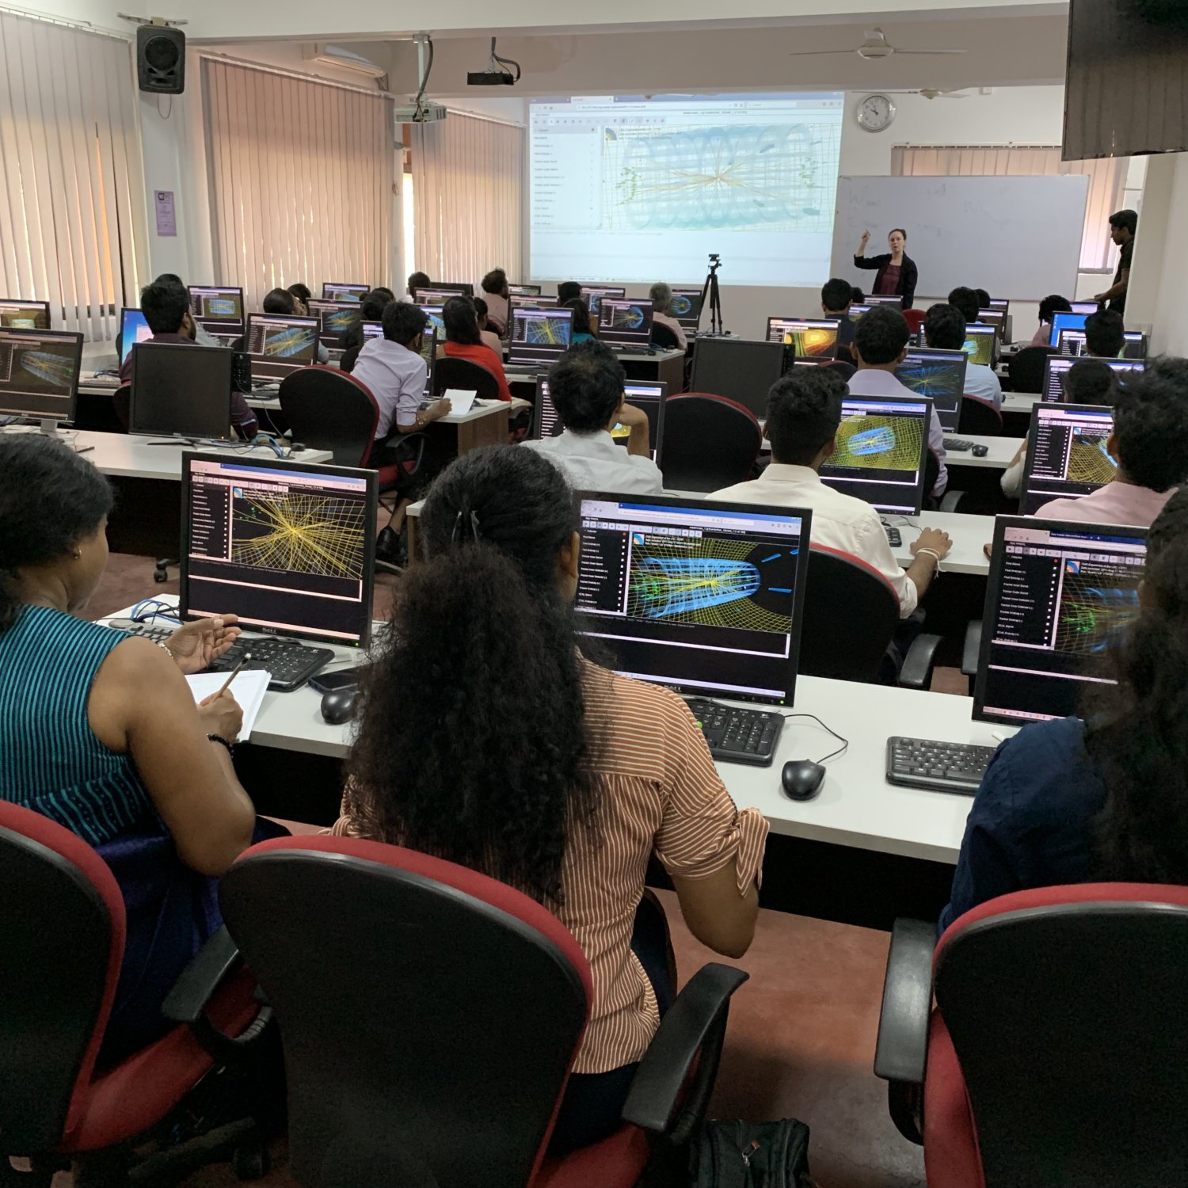
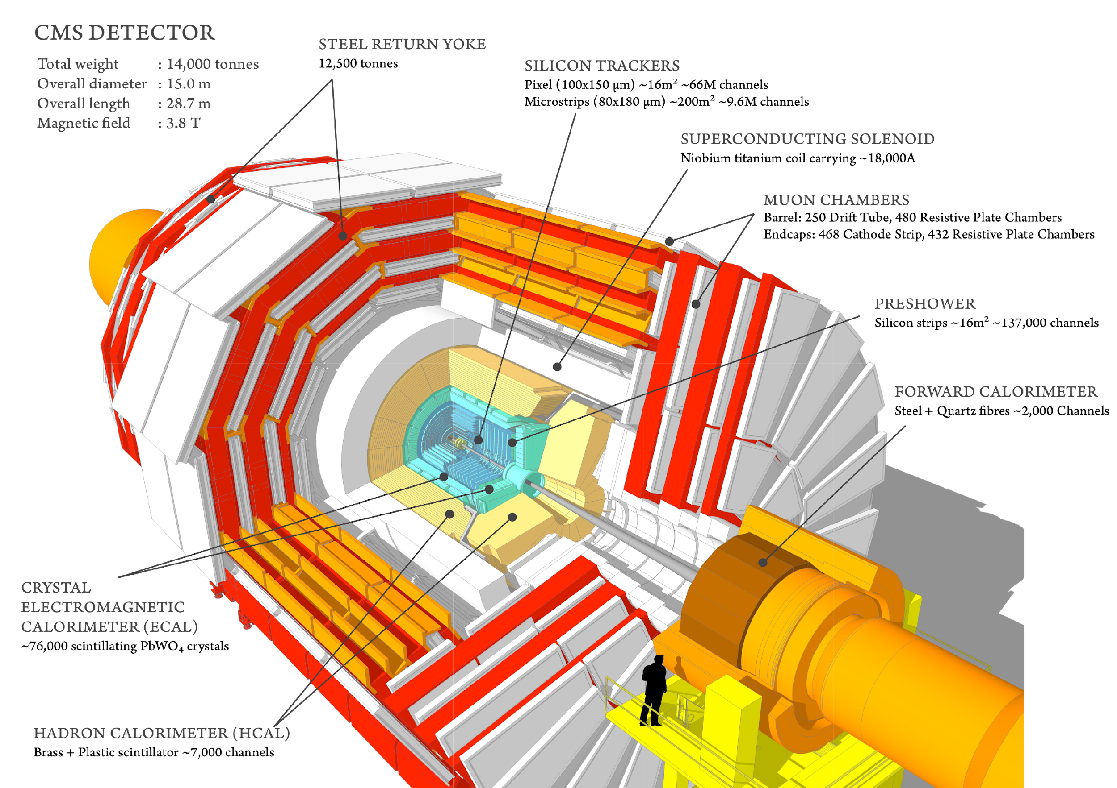
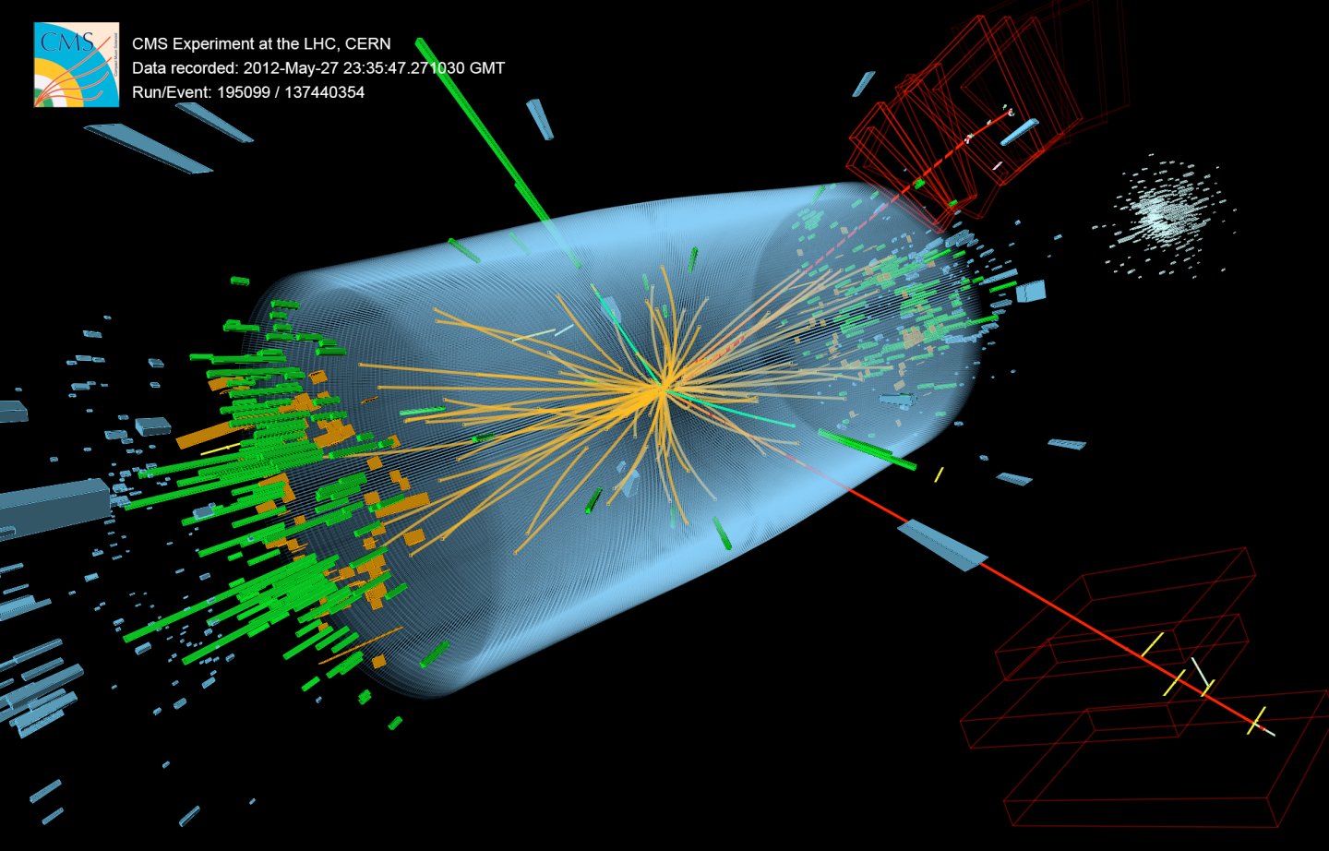


CMS Masterclass 2026
for Moderators

Slide 2

CMS masterclass features
10K events (divided into 100 datasets):
  1-lepton (plus missing E_{T}): W
  2-lepton: Z, J/Psi, Upsilon
  4-lepton: H, ZZ
Event display: iSpy-WebGL
CIMA → special Google Sheets
Documentation at https://quarknet.org/cmsdoc2026.
Students find e:mu and W+:W-.
Students create 2-lepton and 4-lepton mass plots.

Slide 3
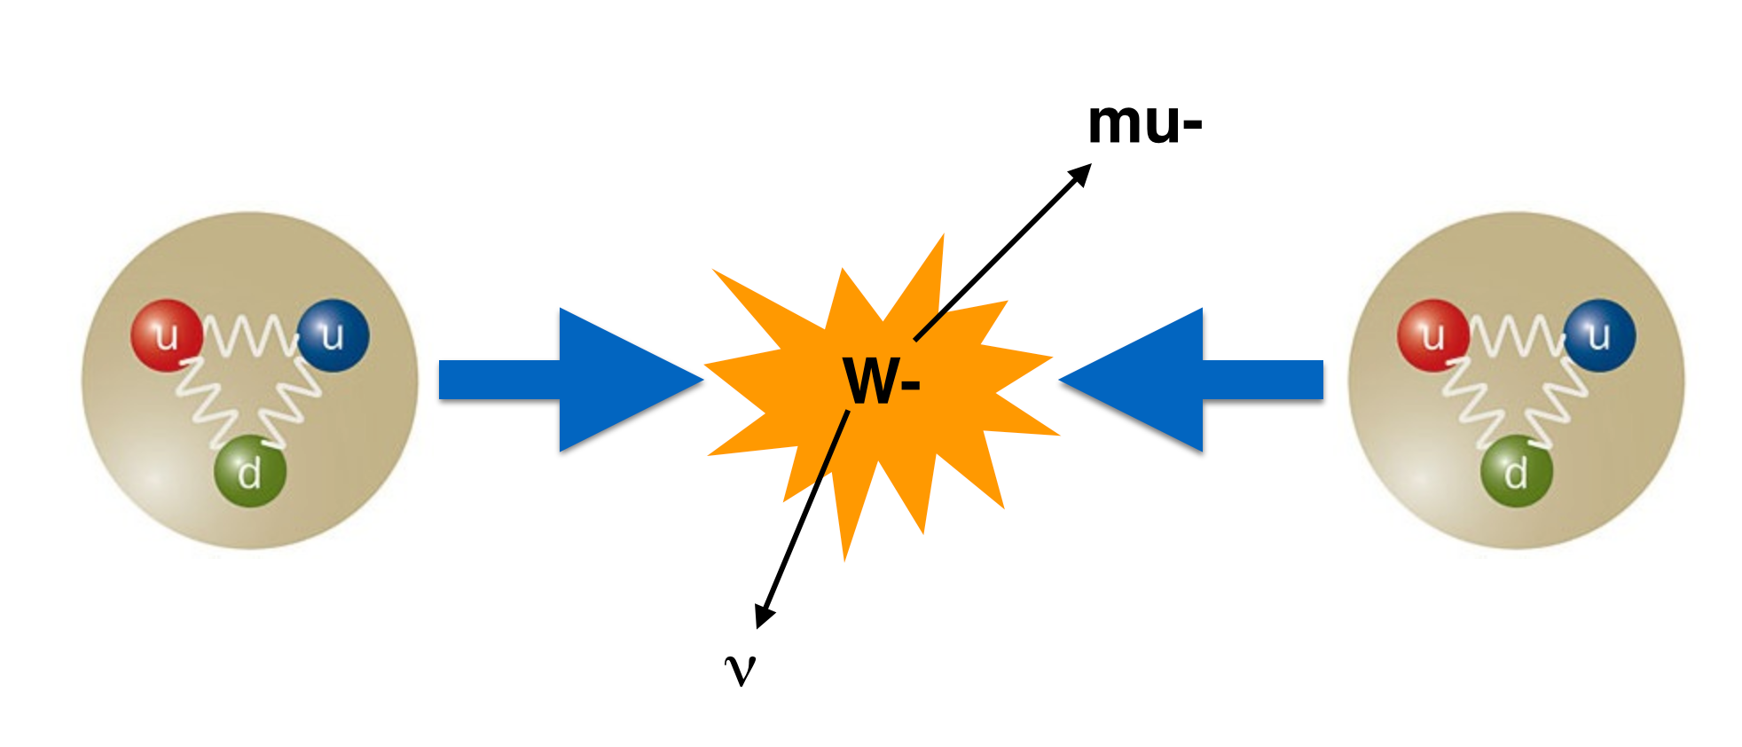
About collisions
Protons as “bags of partons”
Parton-parton collisions
Each parton shares only a portion of proton momentum
W+:W- as probe of proton structure

Slide 4
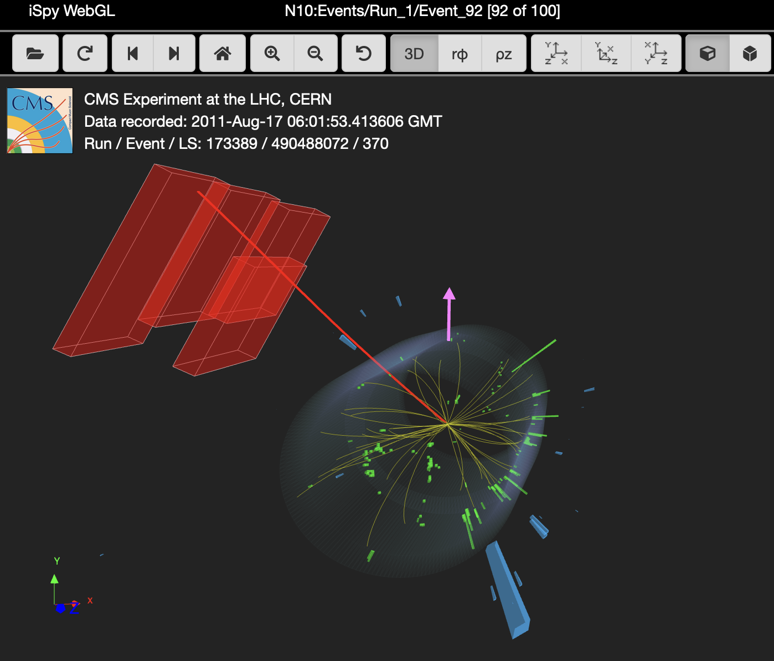
iSpy-WebGL
Matching muon chambers
Muon
MET
ECAL barrel

Slide 5
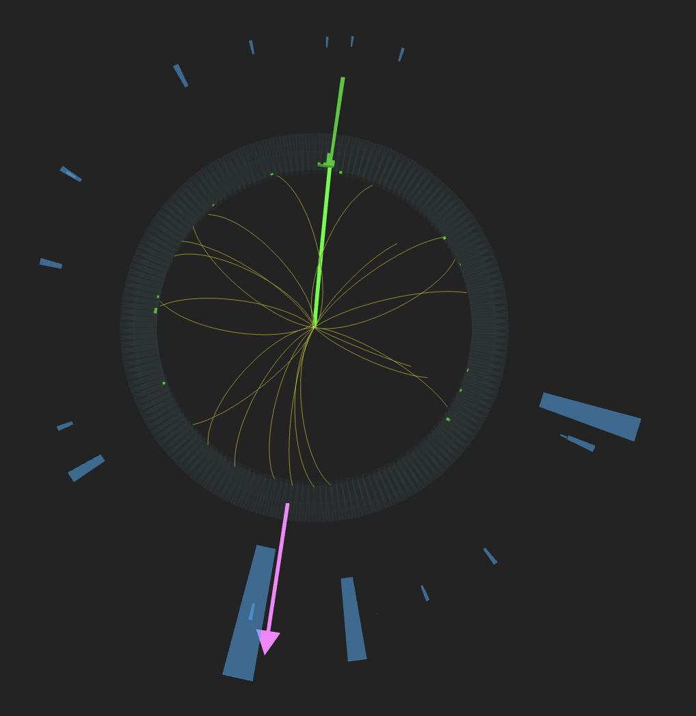
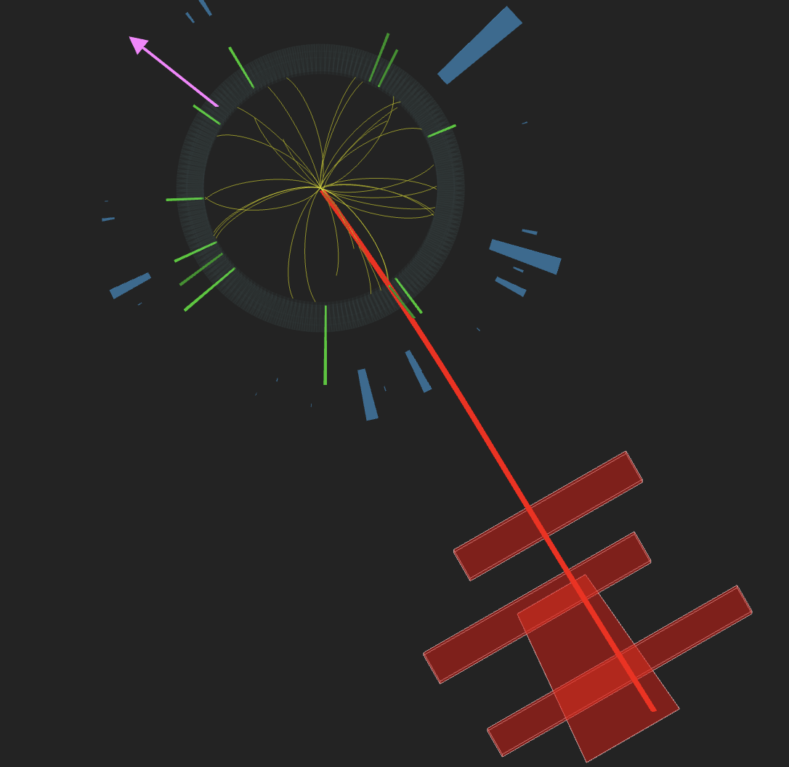
Student tasks
Students distinguish electron tracks from muon tracks.
Electron
Muon

Slide 6
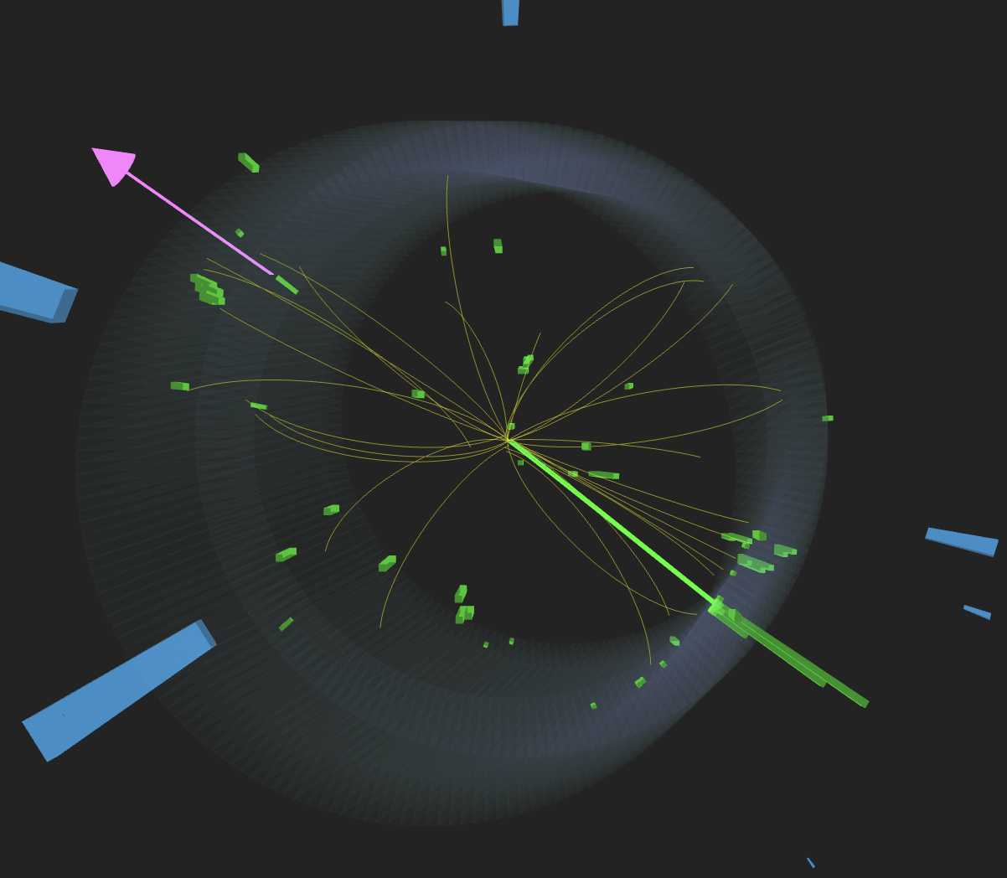
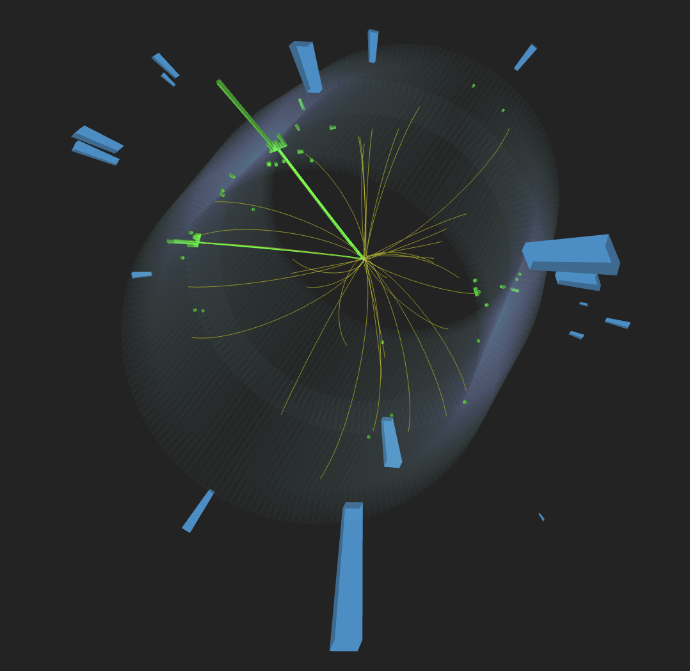
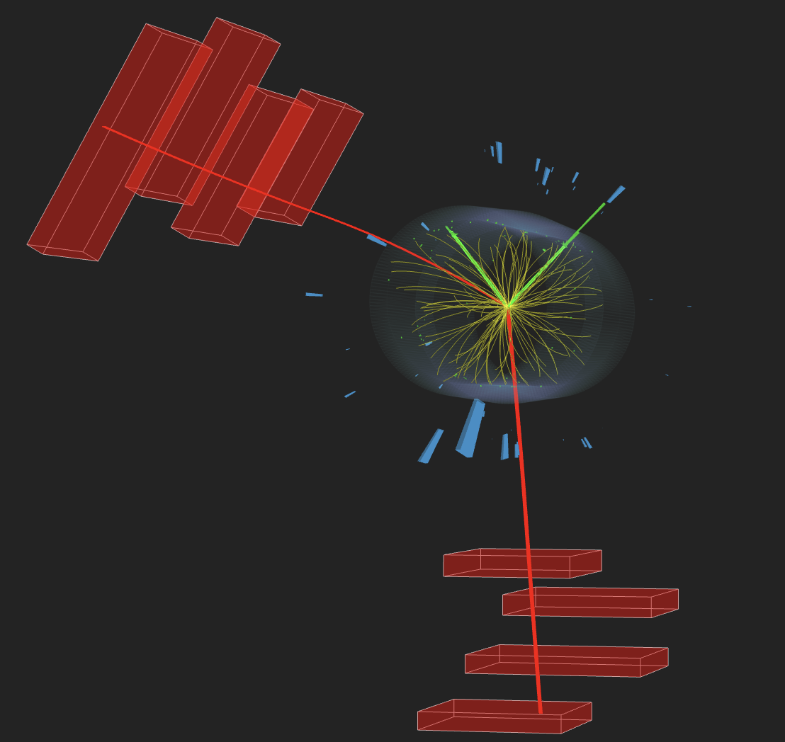
Student tasks
Students must distinguish 1-lepton plus missing E_{T}, 2-lepton, and 4 lepton events.
Typical questions are about extra lepton tracks or missing E_{T} together with 2- or 4-lepton events.

Slide 7
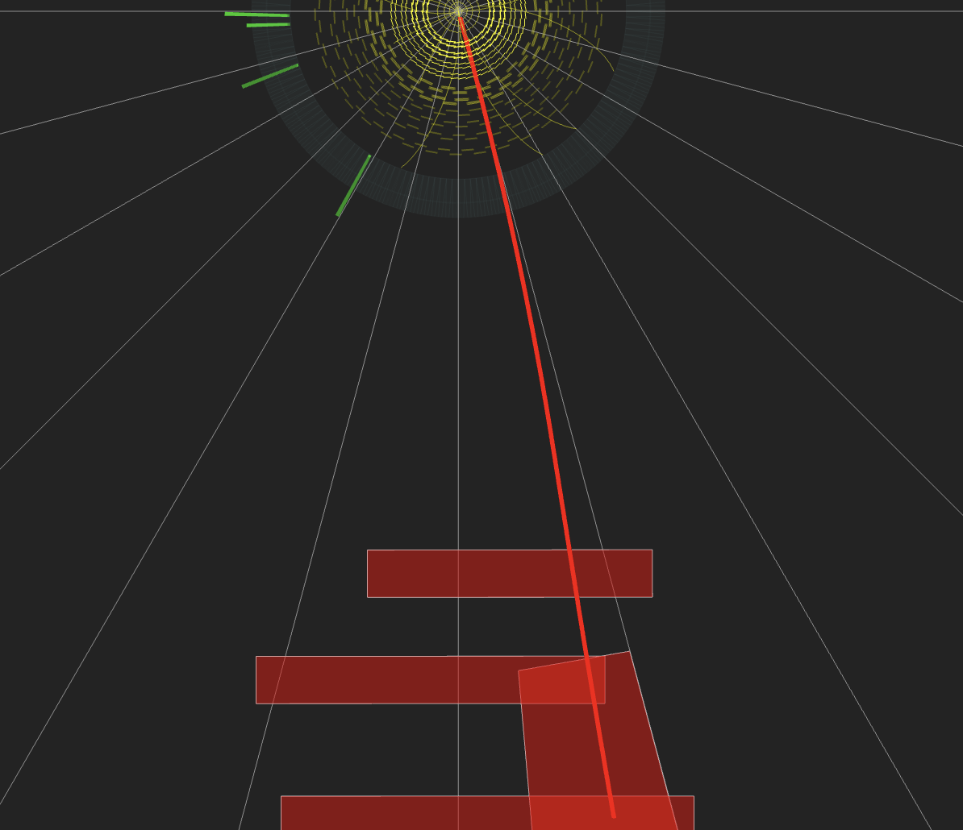
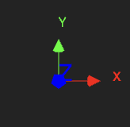
Student Tasks
Students distinguish W+ from W- using track curvature.
Clockwise +

Slide 8
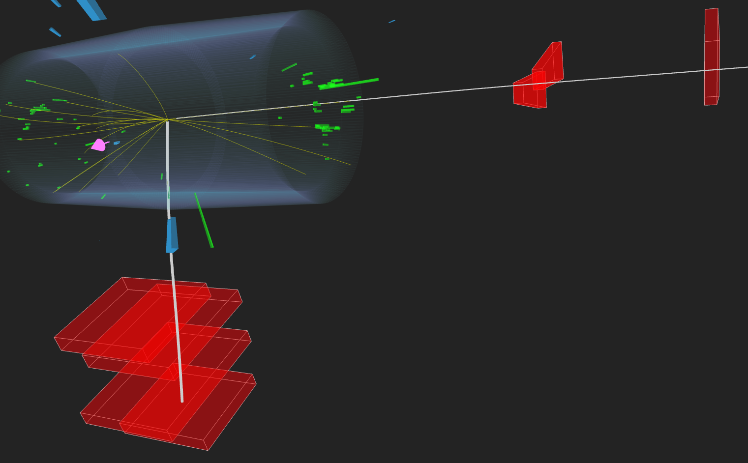
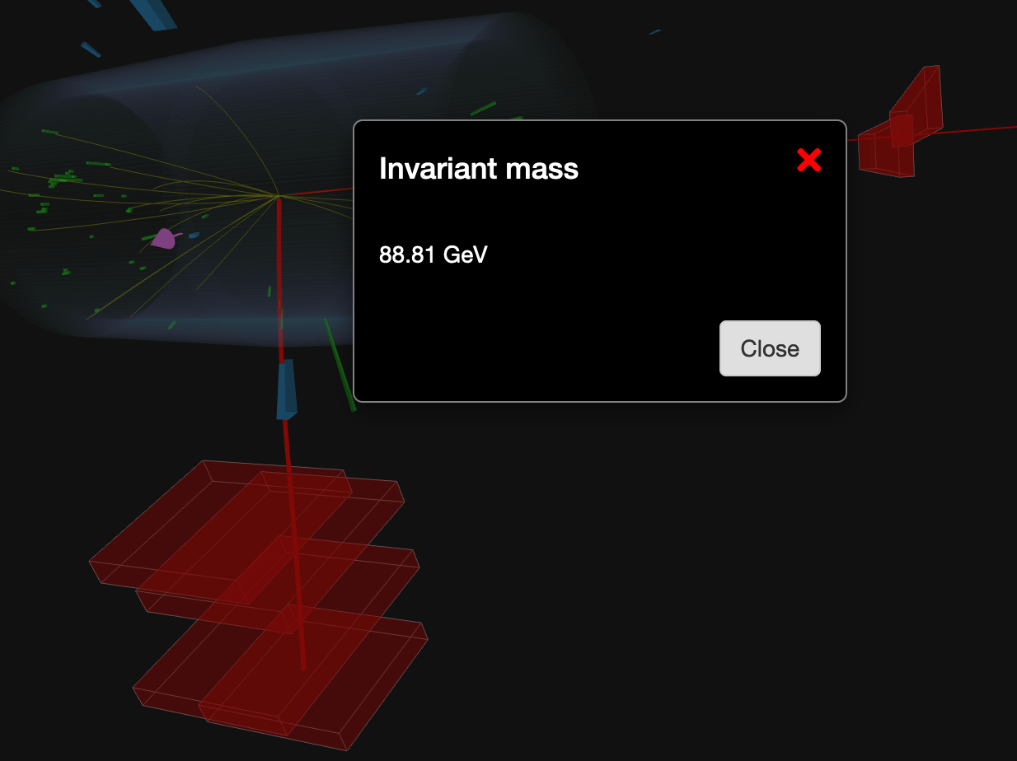
Student Tasks
Students determine invariant mass.
Press “M” to reveal invariant mass
Click on electron or muon tracks to highlight

Slide 9
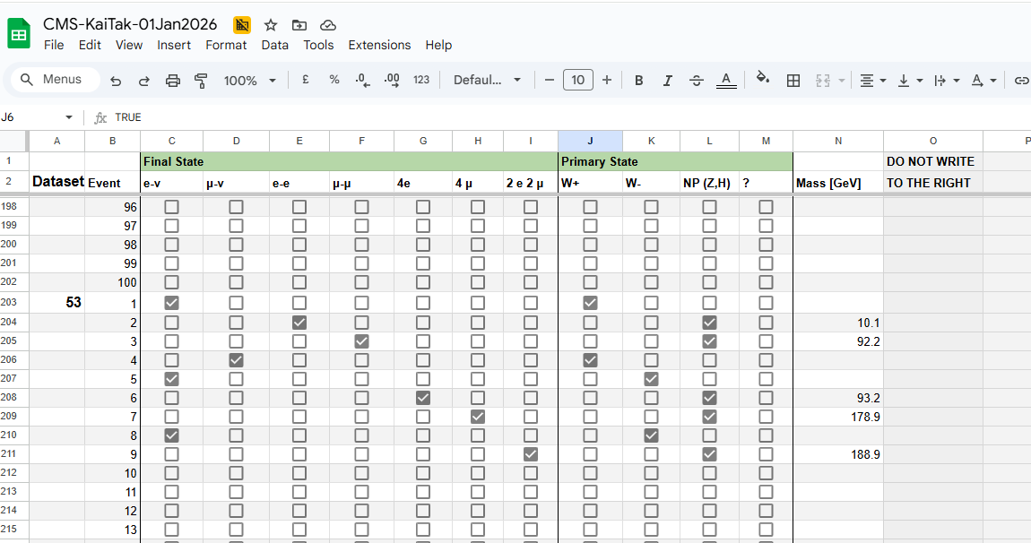
Students record in Sheets
Students find their datasets (left column) by scrolling.
They record parent particles and decay modes.

Slide 10
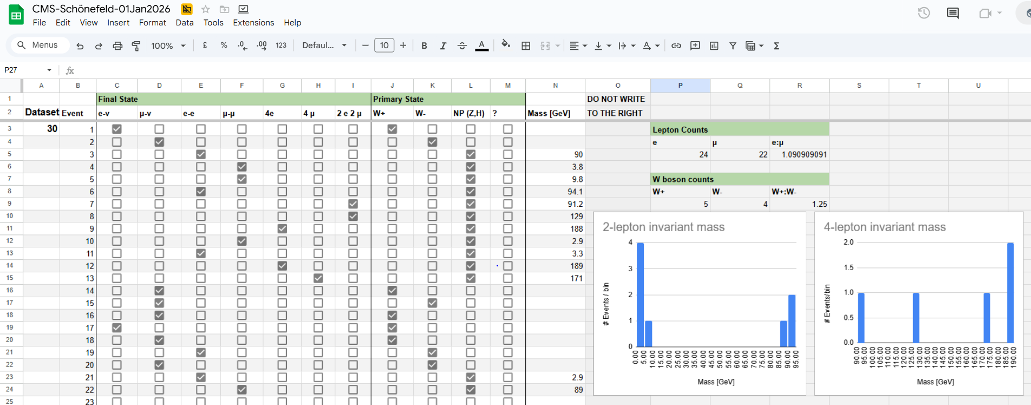
What students see
The spreadsheet produces e:mu and W+:W- ratios as well as 2-lepton and 4-lepton mass plots for the local masterclass.

Slide 11
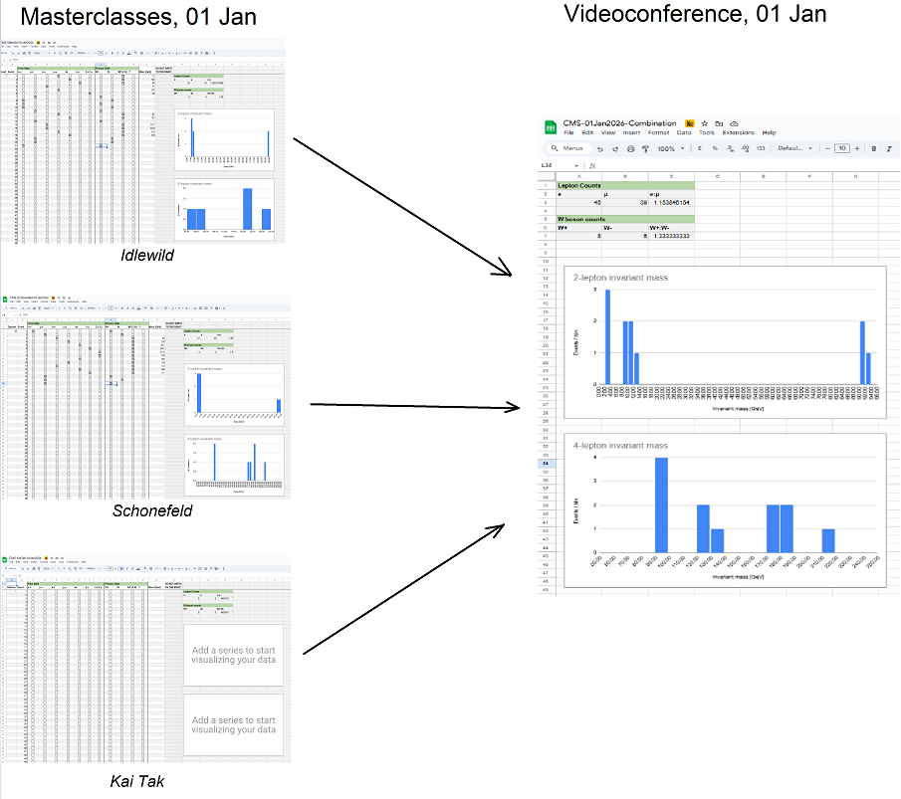
Combining results

Slide 12
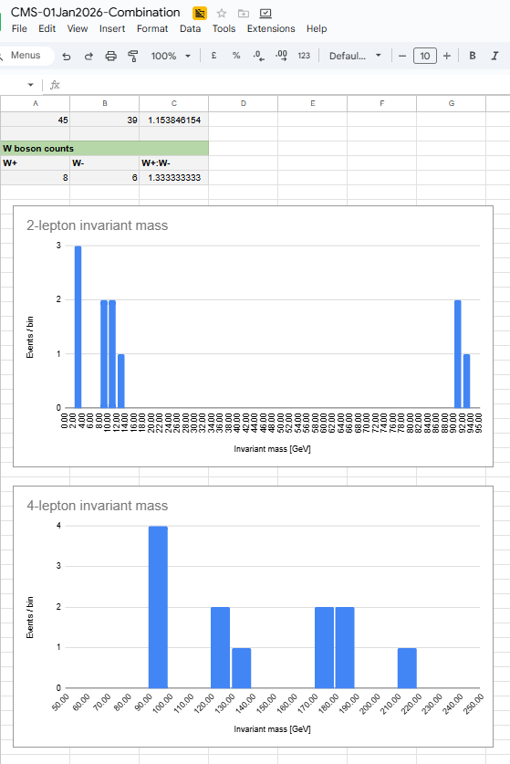
What you see
Combined ratios for all CMS masterclasses in videocon
Combined mass plots.
You can:
Change size
Adjust axes
Adjust bin widths
All Google Sheets edit features.
(But remember time and need for simplicity.)

Slide 13
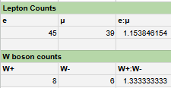
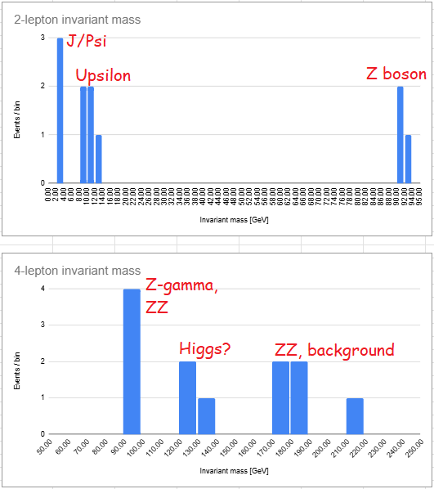
What to help students find
e:mu ~ 1.0
W+:W- ~ 1.4
Results will vary, depending on statistics.
Twiki

Slide 14
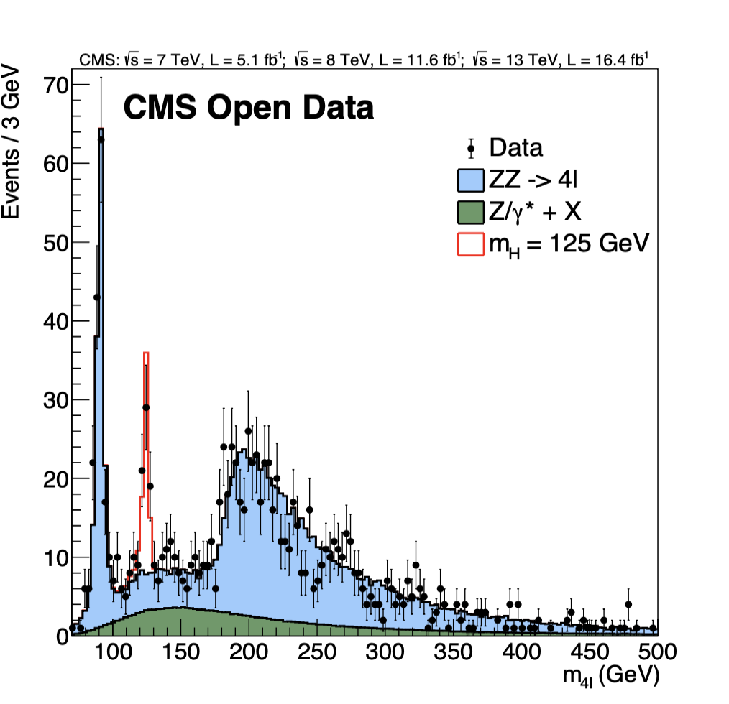
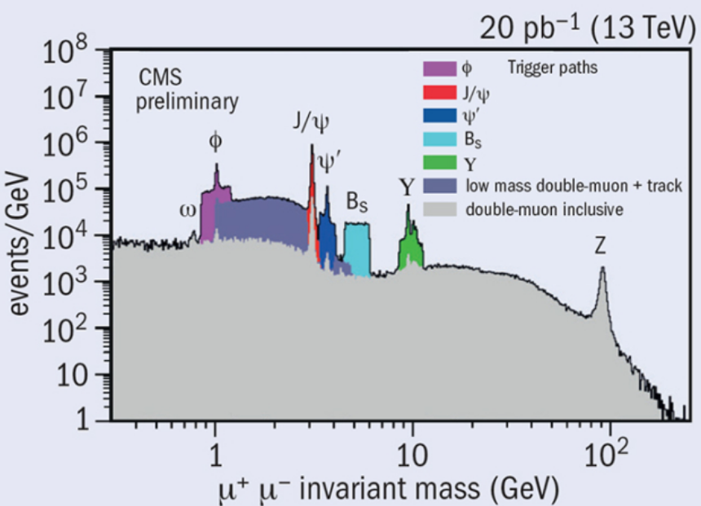
2,4-lepton events

Slide 15
Brief discussion of plots
Ask students how many peaks they see. (Show of hands for 0, 1, 2, … peaks.)
Where is Z boson in the dilepton plot? Is there a similar peak in the 4-lepton plot?
The Higgs should be at ~125 GeV. Do we see that? Can we claim discovery?
If a peak is uncertain, what do we expect at that mass? It might be useful to have CMS invariant mass plots handy.
Do not ask leading or open-ended questions as this is often too time-consuming.

