Slide 1

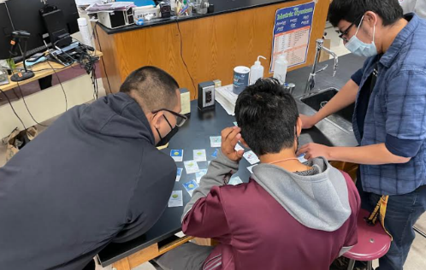
Diversity & Broader Impacts
Outreach Activities
Pre-AAPT Winter Meeting workshops - partnering with AAPT - 3 so far including Portland, OR in 2023
Future “Needs Assessment” workshops
STEP UP connections

Slide 2
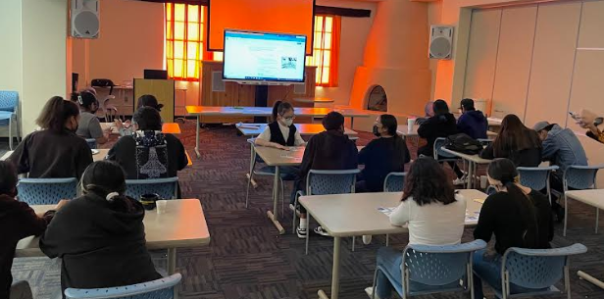
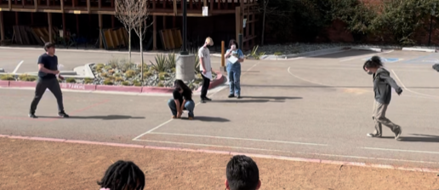
Diversity & Broader Impacts
Virtual Space Messengers Workshop (Early 2022)
In-person Space Messengers Follow-up (April 2022)
Outreach activities already happening at centers
Notes:
Examples: Notre Dame @ Science Alive; Black Hills: Schools on reservations

Slide 3
Diversity & Broader Impacts
International Outreach
International Masterclasses
  Central Coordination (Ken, with Uta Bilow, TU Dresden)
  CMS masterclass
  Fermilab videoconferences
  “off-shell”
Global Cosmics
  Service to detectors and e-Lab worldwide
  Participation with other CR initiatives
IPPOG
  U.S. Representative (Spencer)
Notes:
Example: Notre Dame @ Science Alive

Slide 4
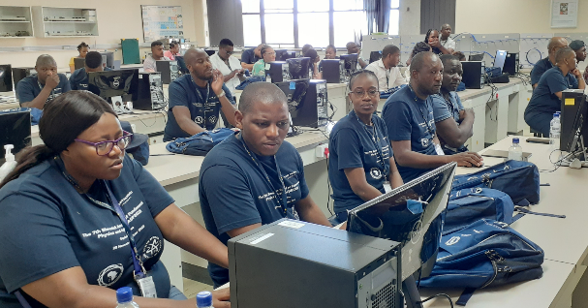
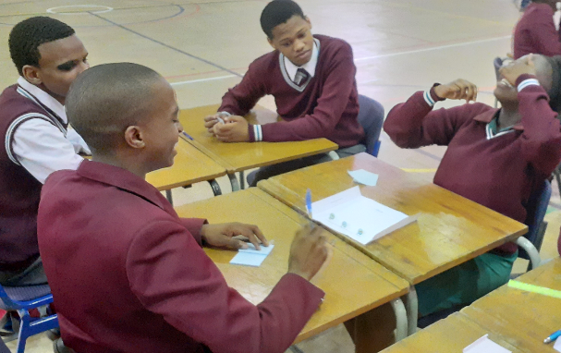
Diversity & Broader Impacts
International Outreach
African School of Fundamental Physics and Applications (ASP)
Nov 28-Dec 9, South Africa
Teacher Program, 60 participants
Learner Program, ~400 participants
Cosmic Ray and Masterclass sessions for university students
Notes:
Example: Notre Dame @ Science Alive

