Slide 1
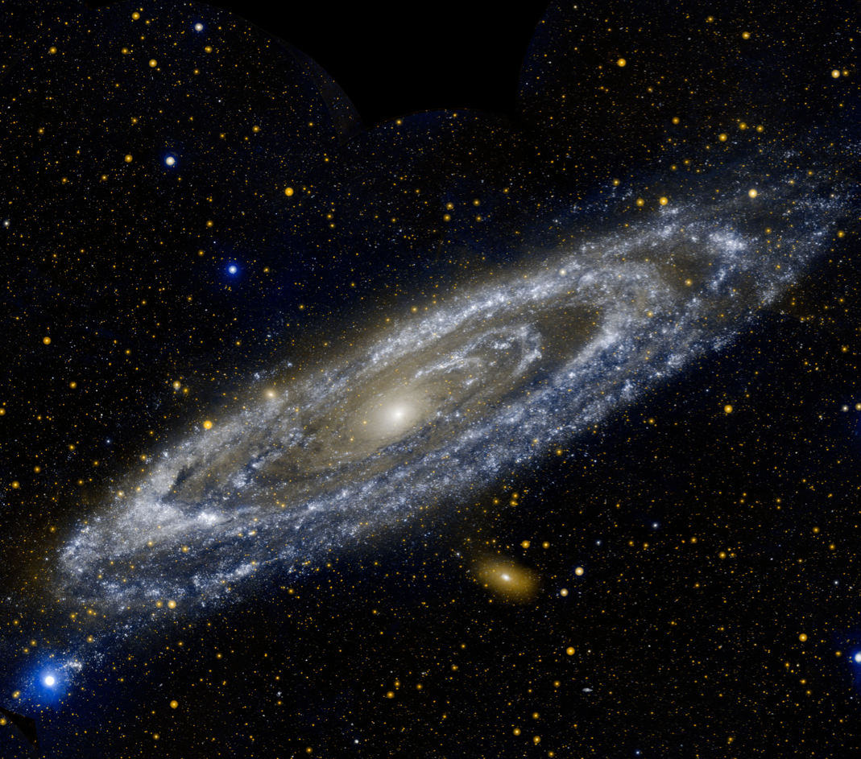

Slide 2
Weigh the Galaxy

Slide 3
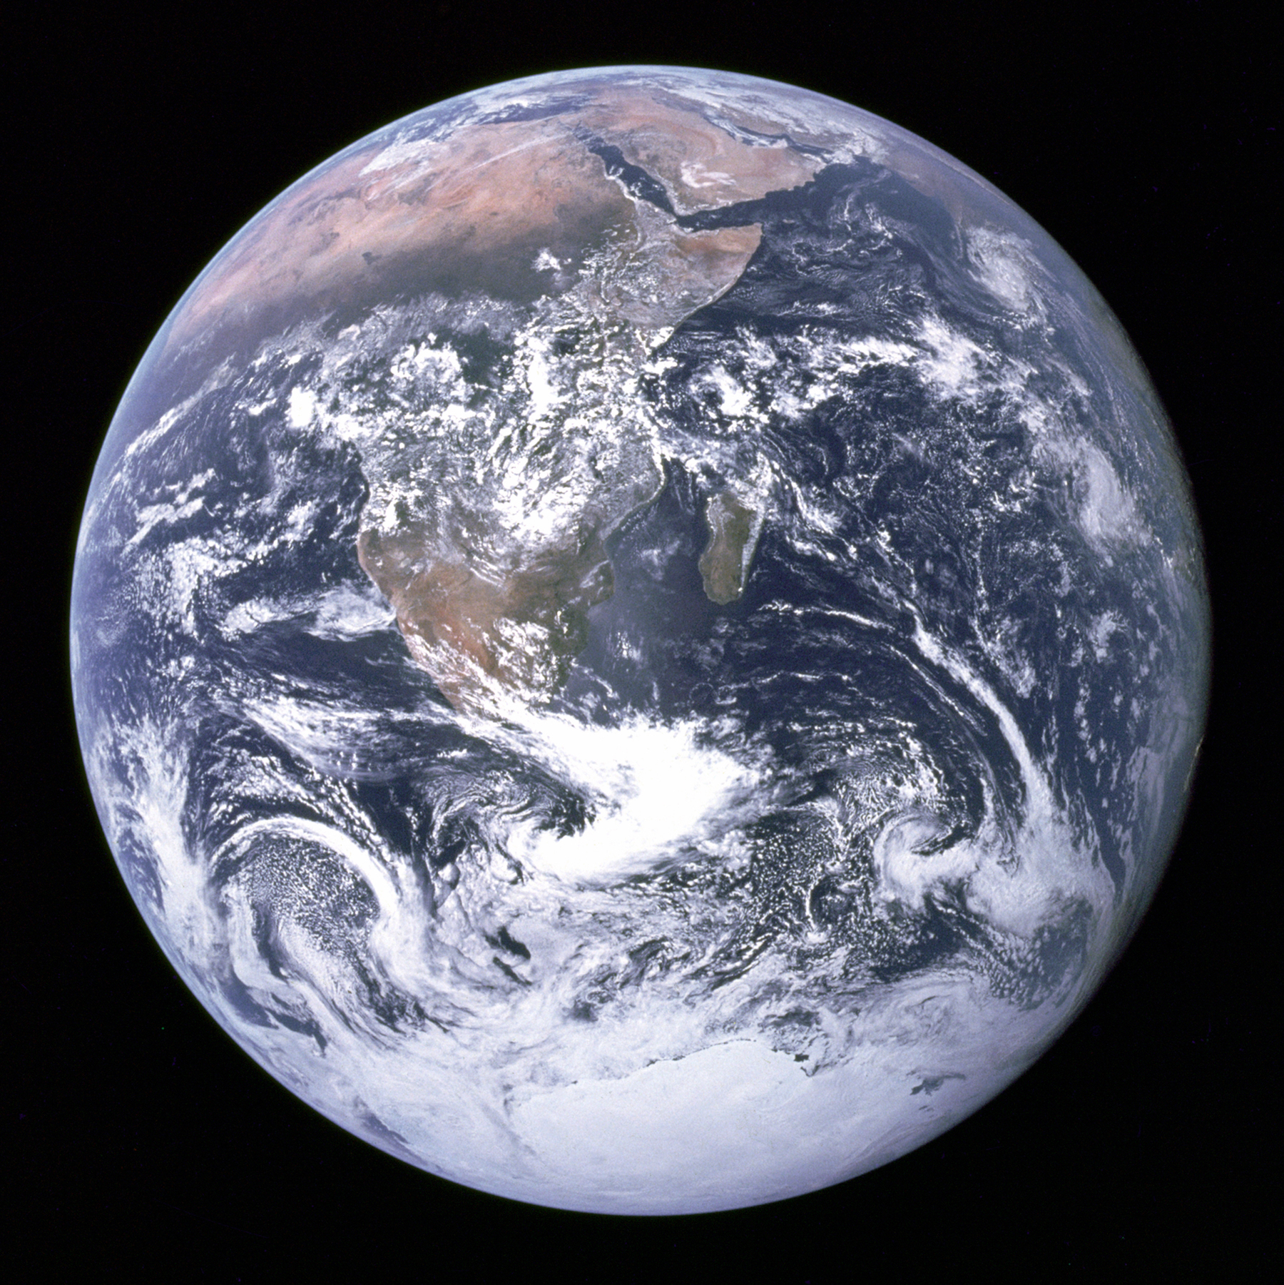

Slide 9


Slide 10


Slide 11


Slide 23


Slide 24


Slide 27
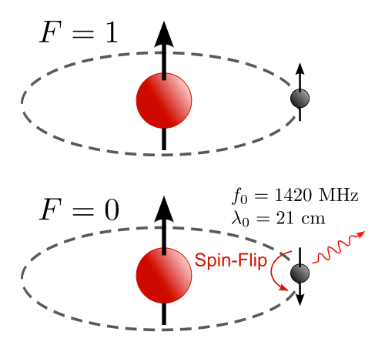

Slide 30
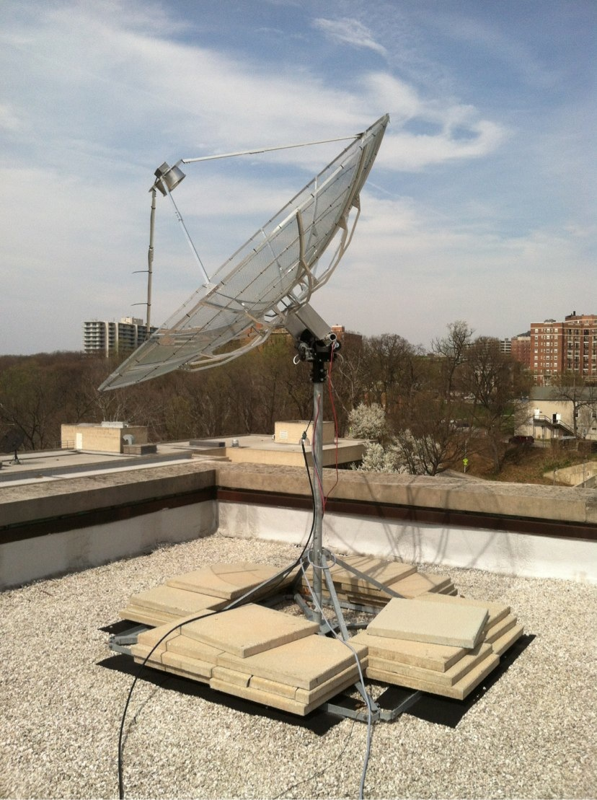

Slide 32
Line of
Sight
GC

Slide 33
Line of
Sight
GC

Slide 34
Line of
Sight
GC

Slide 35
Line of
Sight

Slide 36
Line of
Sight

Slide 37

Line of
Sight

Slide 38

Line of
Sight

Slide 40
Line of
Sight

Slide 41

Line of
Sight

Slide 42

Line of
Sight

Slide 47


Slide 48


Slide 49

Evidence for Dark Matter!

Slide 50
Concepts
Doppler Shift:
How fast is the sun moving?
What is a “Galactic Year”?
Centripetal Acceleration:
How massive is the galaxy?
Dark Matter!
Extensions
Multiple Galactic longitudes:
Provide evidence for V(R)=Constant
(“flat rotation curve”)
Also evidence for Dark Matter
Many more physics concepts.

