Slide 1
The Photoelectric Effect: an activity
M. Swartz
Johns Hopkins University

Slide 2
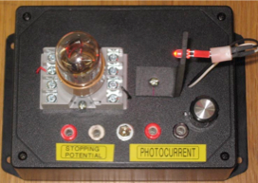
Introduction
The photoelectric effect was first observed in the late 19th century. Understanding it began the quantum revolution in physics. This week, we will build a simple apparatus that demonstrates quantum ideas in the classroom!

Slide 3
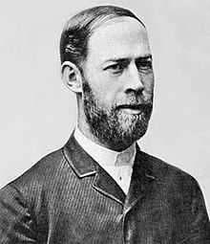
Experimental History
The discovery of the photoelectric effect and the early attempts to understand it were closely connected to research on electromagnetic waves
First evidence observed by Heinrich Hertz in 1887
he observed that the sparks in his spark gap detector were shorter in the dark
phenomenon was related to presence of uv light

Slide 4
There were many related results in the next few years. The most important ones were:
In 1888, Wilhelm Hallwachs observed that metal plates exposed to UV light became positively charged
Also in 1888, similar work by Aleksandr Stoletov demonstrated that the rate of charging was proportional to the intensity of the light
Stoletov’s Law (first law of photoelectric effect)

Slide 5
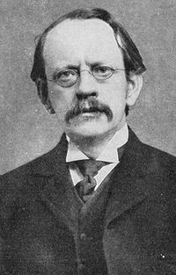
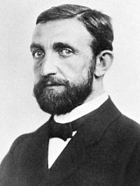
In 1899, J.J. Thomson showed that metals exposed to UV light emitted particles identical to cathode rays (electrons)
In 1902, Philipp Lenard studied the intensity and wavelength dependence of the energies of the emitted electrons
energies are independent of the intensity [surprising since there are bigger E-fields in higher intensity light]
energies decrease with increasing wavelength to 0 at a maximum wavelength
hypothesized that the light “triggers” energetic electrons already present?

Slide 6
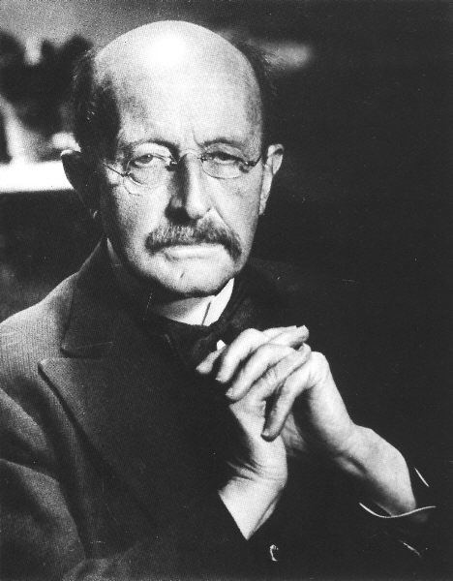

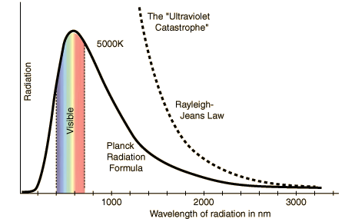
Theoretical History
In 1900, Max Planck successfully described the spectrum of a “black body” by assuming that radiation in a cavity is in thermal equilibrium with harmonic oscillators in walls
energies of oscillators are E=hn [n = freq.]
h = Planck’s constant = 6.626x10⁻³⁴ J-s
he hated statistical mechanics, but used it
it worked!

Slide 7
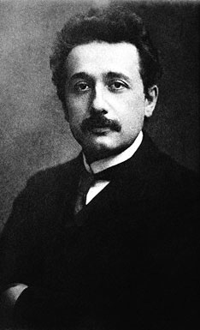
In 1905, Albert Einstein had a very good year
invents Special Relativity
successfully describes Brownian Motion
successfully describes Photoelectric Effect by building on Planck’s blackbody work:
assumes that light is “corpuscular” and that the energy of each corpuscle [photon] is E=hn [first explicit quantum]
light intensity is proportional to the number of photons
maximum kinetic energy of ejected electrons is the photon energy less the work function Tmax=hn - W [W is binding energy to the surface]
Nobel Prize 1921:
“The Law of the Photoelectric Effect”

Slide 8
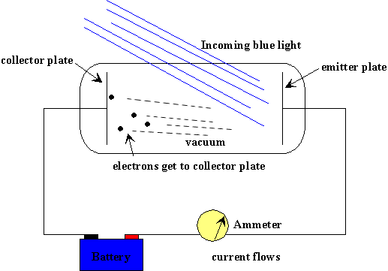
The classical Photoelectric Effect experiment is conceptually quite simple,
Uses monochromatic light of frequency n=c/l, l is the wavelength
  A bias voltage V is applied to decelerate the ejected e-
current stops flowing when eVs = hn - W = hc/l - W

Slide 9
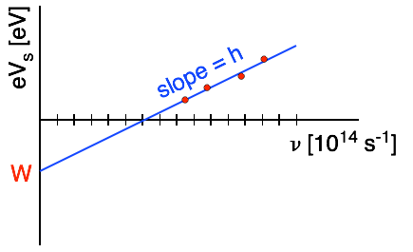
Taking data at several frequencies should show a linear relationship with stopping potential,
the slope gives a measurement of Planck’s constant h
  the x-intercept gives the minimum frequency [maximum wavelength] for the PE
  the y-intercept gives the work function W of the surface
  the photocurrent for V<Vs should be linear in the light intensity

Slide 10
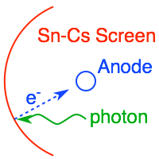
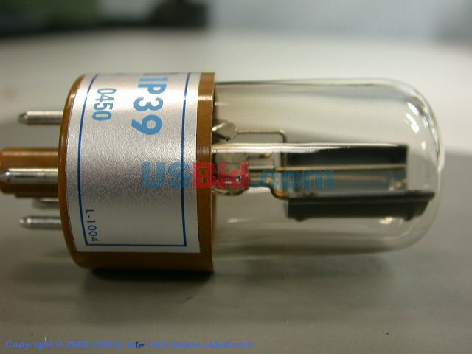
The Real Experiment
The key elements of the real experiment are a unit-gain phototube [1P39 or 939] and several led light sources. Both elements have “characteristics” that can complicate the interpretation of data.
  Phototube: our’s is a very simple device with 2 parts
  photosensitive Sn-Cs semicircular screen: Cs lowers work functions of everything to make quantum efficiency large
  tubular anode to collect the emitted electrons

Slide 11
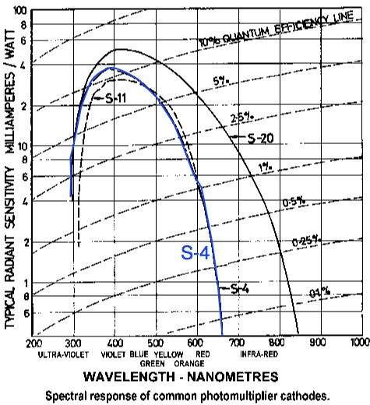
The Sb-Cs photocathode [S-4] has a very non-uniform response vs wavelength (frequency).
  If the light source has a narrow wavelength [frequency] distribution, this wouldn’t matter
  led’s have “broad” spectra
  need response corrections?
  The red light points will have small signals
    need bright red leds

Slide 12
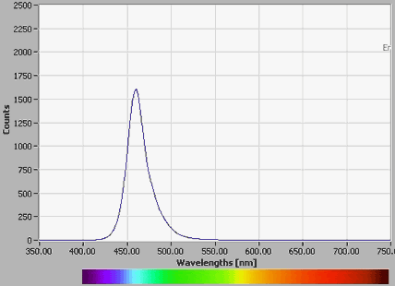
  Light Emitting Diodes [LEDs]: semiconductor pn junctions
  shorter wavelength, higher frequencies only developed during last 20 years
  makes this experiment relatively inexpensive
  unfortunately, they are not really monochromatic,

Slide 13
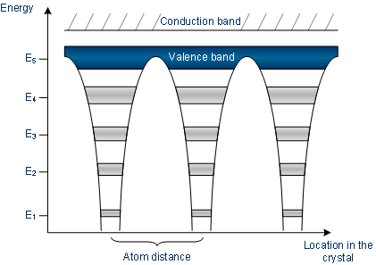
pn-Junction Diodes
Our Light-Emitting-Diodes [LEDs] are pn junctions. Since pn junctions are also at the heart of tracking in particle physics and imaging in astronomy, maybe we should spend a few slides reviewing what they are?
When many atoms are assembled in a lattice, their quantum states become grouped into several bands of closely spaced states. The higher energy bands can be “delocalized”: electrons can move from one atom to another,
  Electrons in the valence band are bound to their atoms
    missing electrons [holes] in the valence band can move from one site to the next
  Conduction band e- can move as almost free particles through crystal
  Valence band holes can also move as almost free particles through crystal
  There can be an energy gap between valence + conduction

Slide 14
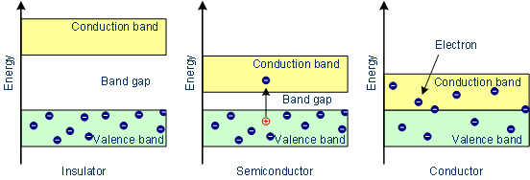
In simplest approximation, there the size of the band gap determines the properties of the crystal,
  If the gap is much larger than kT [typical thermal energy], all of the electrons remain in the valence band, bound to atoms
    material is an insulator
  If the gap is small or if there are unfilled states at the top of the valence band, a large fraction of the electrons are delocalized
    material is a conductor
  If the gap is only ~50 times larger than kT, then some of the electrons become delocalized and leave behind delocalized holes
    material is a semiconductor

Slide 15
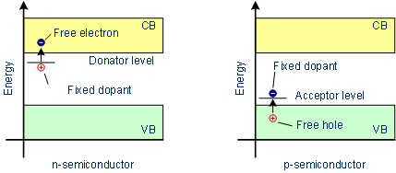
The density of e+h [carriers] in a pure semiconductor is much smaller than the density of electrons [in Si, 2x10⁻¹⁴ times smaller]. What this means is that the properties are very sensitive to impurities: deliberately introduced [dopants] or not. There are two kinds of dopants,
A donor state has an energy near the conduction band and donates an electron to the CB leaving a positively charged ion
    n-type material
  An acceptor state has an energy near the valence band and captures an electron producing a free hole and leaving a negative ion
    p-type material
Both types of material are electrically neutral until they are combined

Slide 16

The pn junction contains both types of material in contact
With no applied potential get a “depleted” zone with non-zero E-field
  With reverse bias [+ to n, - to p], depleted zone grows, no current flow
    perfect for tracking detectors and photo-sensitive devices
  With forward bias [- to n, + to p], current flows with low resistance
    perfect for light-emitting diodes [lots of e-hole recombination]

Slide 17
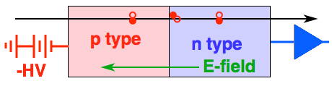
Much particle physics detector technology is based upon the reverse-biased diode:
Large depleted thickness is traversed by charged particles
ionization produces large signals: 22,000 eh pairs in 300 mm
Supports a large internal field to sweep the carriers to electrodes
Small leakage currents for electronics to cope with
    good signal to noise
High precision tracking (approaching few mm) possible
Affordable: sort of ....
Can be made quite radiation hard compared with older tracking technologies (still not enough)

Slide 18
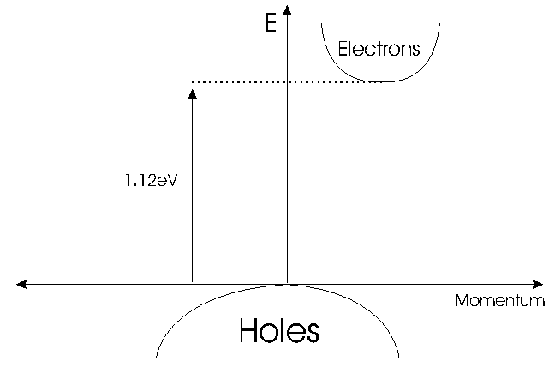
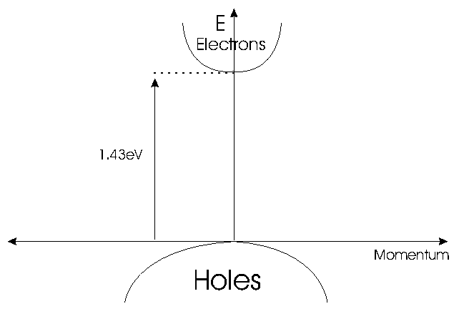
Silicon used for tracking detectors is an “indirect” semiconductor, the materials used for LEDs must be “direct” semiconductors to have a good efficiency,
Silicon
GaAs
  For efficient e-h recombination, need equal e-h momenta
  direct semiconductors have “aligned” momentum vs energy
  indirect semiconductors have an offset, need “phonons” to interact and balance momenta

Slide 19
  LEDs are made from forward-biased direct semiconductors
  wavelength of an LED is determined by the bandgap of the material
  brightness/width is determined by the density of available states
  Some [white/purple] are not monochromatic!
 | Color | Wavelength [nm] | Voltage drop [ΔV] | Semiconductor material
 | Infrared | λ > 760 | ΔV < 1.63 | Gallium arsenide (GaAs) Aluminium gallium arsenide (AlGaAs)
 | Red | 610 < λ < 760 | 1.63 < ΔV < 2.03 | Aluminium gallium arsenide (AlGaAs) Gallium arsenide phosphide (GaAsP) Aluminium gallium indium phosphide (AlGaInP) Gallium(III) phosphide (GaP)
 | Orange | 590 < λ < 610 | 2.03 < ΔV < 2.10 | Gallium arsenide phosphide (GaAsP) Aluminium gallium indium phosphide (AlGaInP) Gallium(III) phosphide (GaP)
 | Yellow | 570 < λ < 590 | 2.10 < ΔV < 2.18 | Gallium arsenide phosphide (GaAsP) Aluminium gallium indium phosphide (AlGaInP) Gallium(III) phosphide (GaP)
 | Green | 500 < λ < 570 | 1.9[66] < ΔV < 4.0 | Traditional green: Gallium(III) phosphide (GaP) Aluminium gallium indium phosphide (AlGaInP) Aluminium gallium phosphide (AlGaP) Pure green: Indium gallium nitride (InGaN) / Gallium(III) nitride (GaN)
 | Blue | 450 < λ < 500 | 2.48 < ΔV < 3.7 | Zinc selenide (ZnSe) Indium gallium nitride (InGaN) Silicon carbide (SiC) as substrate Silicon (Si) as substrate—under development
 | Violet | 400 < λ < 450 | 2.76 < ΔV < 4.0 | Indium gallium nitride (InGaN)
 | Purple | multiple types | 2.48 < ΔV < 3.7 | Dual blue/red LEDs, blue with red phosphor, or white with purple plastic
 | Ultraviolet | λ < 400 | 3.1 < ΔV < 4.4 | Diamond (235 nm)[67] Boron nitride (215 nm)[68][69] Aluminium nitride (AlN) (210 nm)[70] Aluminium gallium nitride (AlGaN) Aluminium gallium indium nitride (AlGaInN)—down to 210 nm[71]
 | Pink | multiple types | ΔV ~ 3.3[72] | Blue with one or two phosphor layers: yellow with red, orange or pink phosphor added afterwards, or white phosphors with pink pigment or dye over top.[73]
 | White | Broad spectrum | ΔV = 3.5 | Blue/UV diode with yellow phosphor

Slide 20
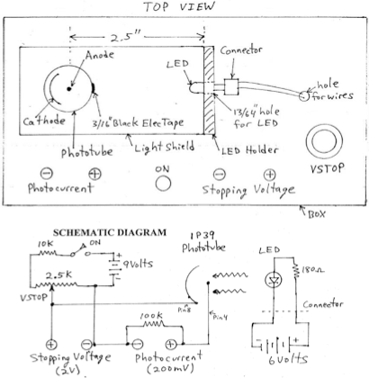
Our Experiment
The apparatus/circuit that we are building this week is VERY simple.
A 9V battery and variable resistor are used to generate the stopping potential
    measured across 2 terminals
  The photocurrent flows through a 100kV resistor: 10nA = 1mV
    measured across 2 terminals
  The LEDs are powered by a 6V battery pack and 180V series resistor
    Adding a rotary switch to select one of several permanently wired diodes
    Adding variable resistor to vary LED intensity
  Adding a light shield over the tube
    mask anode with tape?

Slide 21
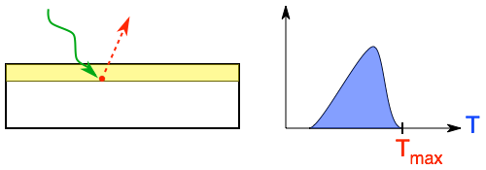
Procedure
The classical procedure has always been to increase the stopping potential until the photocurrent goes to zero. This is because the photons are absorbed in a layer near the surface of the photocathode. The more deeply penetrating ones produce electrons that scatter and lose energy before emerging from the surface,
Electrons produced at the surface don’t scatter and can carry the maximum energy Tmax=hn - W
    Tmax is the endpoint of the electron energy spectrum
  Our photons have a spectrum of energies, this means a spectrum of Tmax
    is zeroing the photocurrent the right thing to do?
    do we plot the data at the average photon frequency?

Slide 22
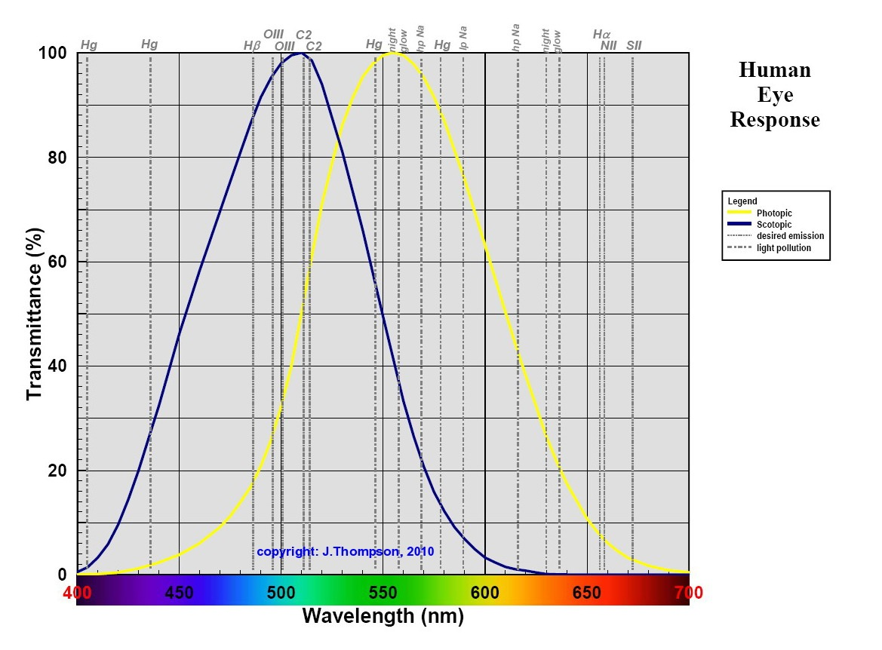
A second question is how does the phototube response modify the distribution of photon energies detected by the photoube? The response is quite non-uniform,
rods
cones
Phototube response peaks at 400nm and drops to zero around 660nm
Bright light [phototropic] response of the human eye also stops around 660 nm
    What does than LED manufacturer actually specify?

Slide 23
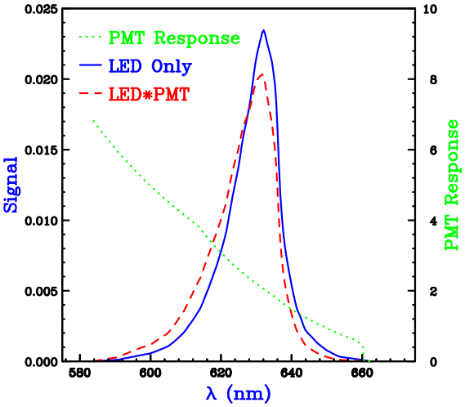
Let’s digitize the response function for the 624nm LED [blue curve]. We can also fold it with the phototube response function [green dots],
LED peaks at 631.7nm
LED*PT peaks at 631.7nm
LED*PT average at 625.5nm
    This is close to the quoted value
    Does the spec include human eye response?
What number do we use?
    the average?
    some fraction of the area under the red dashed curve evaluated from the small l side?

Slide 24
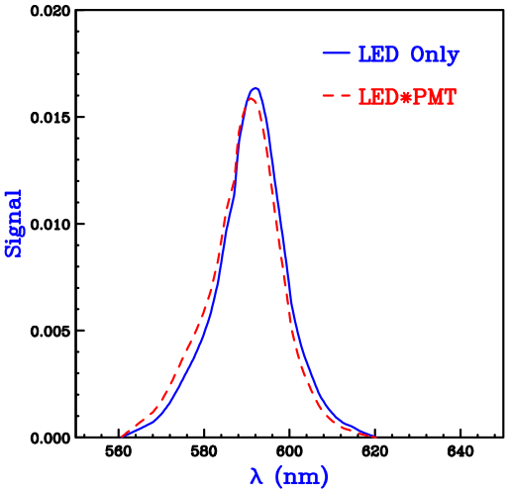
The PT effect is smaller at smaller wavelengths because the response is less steep. For the yellow diode at 590nm, it looks like this
LED peaks at 591.8nm
LED*PT peaks at 590.9nm
LED*PT average at 589.3nm
What number do we use?
    the average?
    some fraction of the area under the red dashed curve evaluated from the small l side?
increase Vs

Slide 25
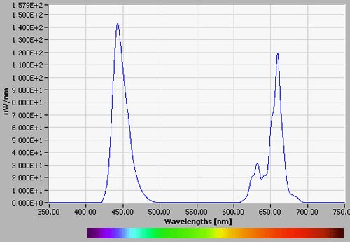
Note that there is a blue diode at 470nm and a violet diode at 460nm?
Blue 470nm
Violet 460nm
increase Vs
The violet diode has peaks around 440nm and 660nm.
The quoted value is obviously an a weighted average [human eye]?
Our stopping potential would entirely remove the right hand peak from the photocurrent [poor PT response there also].
We should NOT use 460nm for that diode!!

Slide 26
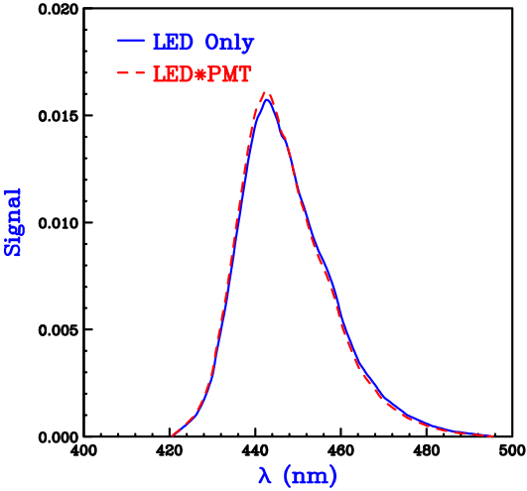
Digitizing the left-hand peak of the 460nm diode,
LED peaks at 442.5nm
LED*PT peaks at 442.5nm
LED*PT average at 445.5nm
What number do we use?
    the average?
    some fraction of the area under the red dashed curve evaluated from the small l side?

Slide 27
Things to investigate
Is it important to mask the anode?
How do we handle the finite widths of the LED signals?
  try a more monochromatic source of the same l?
  try a diode laser?
  concern about damage to the photocathode?
Superbright LEDs does not have spectra for the UV [or IR] diodes
  maybe we should try using only the ones that we can calibrate?
Is result stable under intensity variations?
More items??
Let’s have fun this week!!

Slide 28
Extra Slides

Slide 29
An Introduction to Silicon Detectors
M. Swartz

Slide 30
Much particle physics detector technology is based upon the reverse-biased diode:
Why do we use them?
Large signals: 22,000 e-h pairs produced in 300 mm thickness
Supports a large internal field to sweep the carriers to electrodes
Small leakage currents for electronics to cope with
High precision tracking (approaching few mm) possible
Affordable: sort of ....
Can be made quite radiation hard compared with older tracking technologies (still not enough)

Slide 31

In pure silicon, the carrier densities are quite small:
ni = 1.45x10¹⁰ cm⁻³ at room temperature
  compare with atomic number density = 3.51x10²² cm⁻³
  < 1 carrier/10¹² atoms
  properties of Si are totally dominated by impurities!!
After the addition of donor or acceptor impurities, the same relationship holds
  n-type silicon, n~ND~1x10¹² cm⁻³(low doping, high resistivity) or n~ND~1x10¹⁸ cm⁻³ (high doping, low resistivity ... n+ )
  p-type silicon, p~NA~1x10¹² cm⁻³(low doping, high resistivity) or p~NA~1x10¹⁸ cm⁻³ (high doping, low resistivity ... p+ )

Slide 32
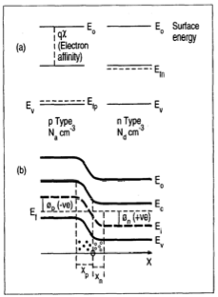
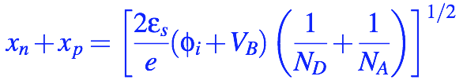
What actually happens at a pn junction?
Electrons diffuse into the hole-rich p-region and holes into the electron-rich n-region:
Generates non-zero field near junction
  depletes majority carriers
  xpNA = xnND - thicker depletion layer for smaller doping density
reverse biasing the junction increases the thickness of the depletion zone
  fi is the intrinsic potential (few V)
  dominated by smaller doping

Slide 33
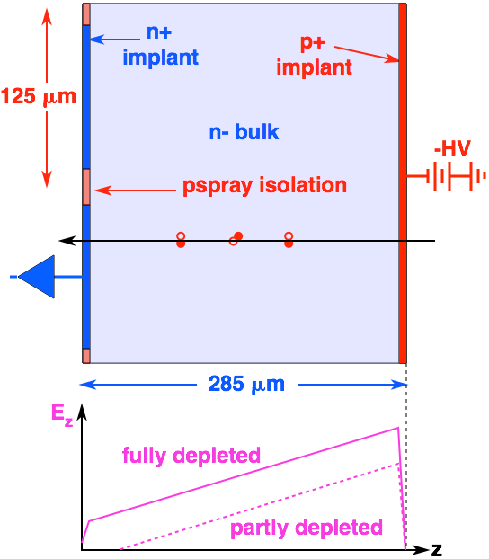
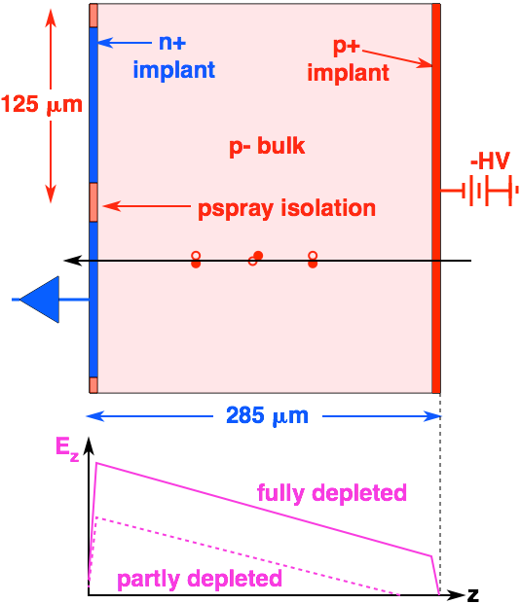
Type-Inversion
n- bulk detectors are widely believed to “type invert” after irradiation:
pn junction moves from p+ side to n+ side
fields vary linearly in z before and after irradiation
  consequence of Poisson Eq: dEz/dz = rconst = Neff
Why do we believe this?

Slide 34

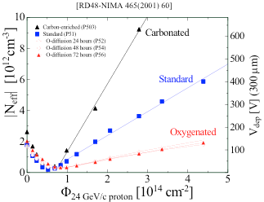
The depletion voltage and resistivity are related to the net (uniform) density of ionized impurities Neff
description works well for unirradiated detectors
Standard picture suggests that irradiation induces acceptor defects which “invert” the n- substrate,
Vmax-Q~Vmin-C~Vdep has a minimum at a modest fluence
interpreted to mean that substrate is now p-doped
starting with n-substrate increases detector lifetime
type
inversion
n-type
“p”-type
Nice, simple picture ... is this really what happens?
5

Slide 35
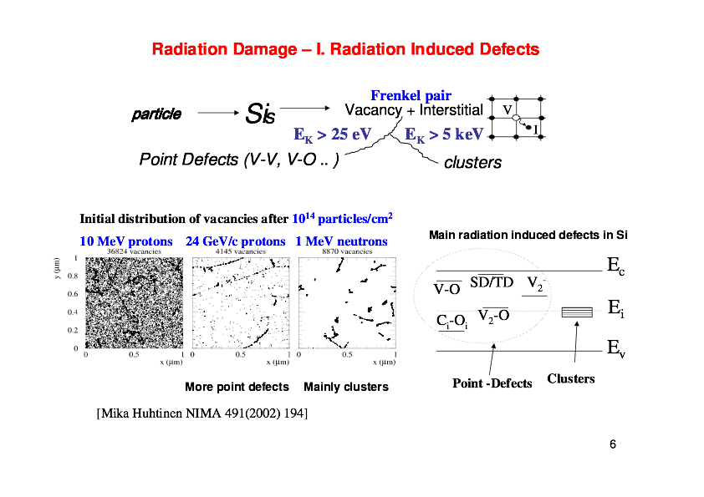
M. Bruzzi

Slide 36
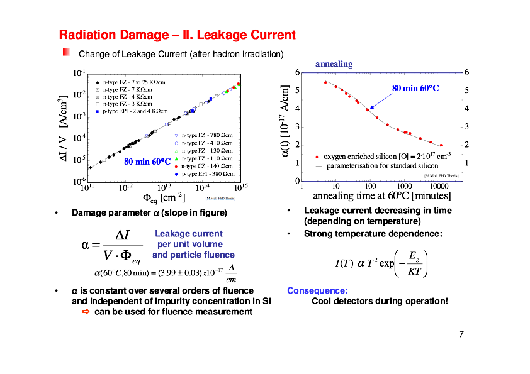
M. Bruzzi

Slide 37
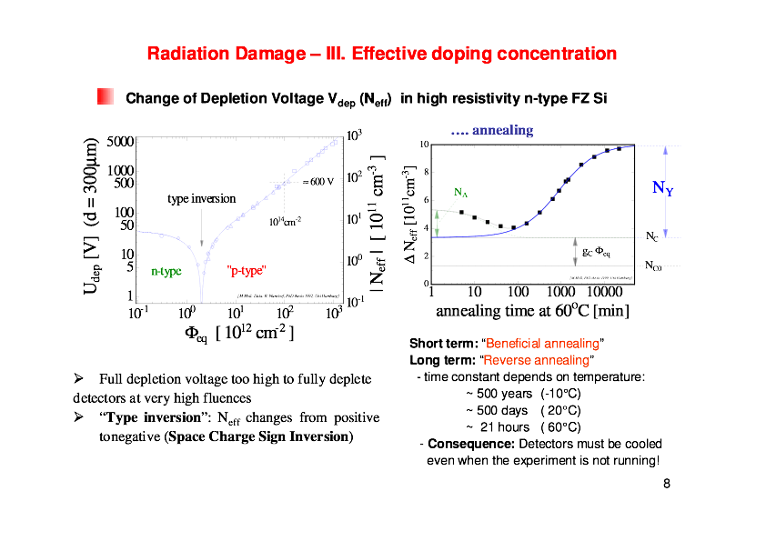
M. Bruzzi

Slide 38
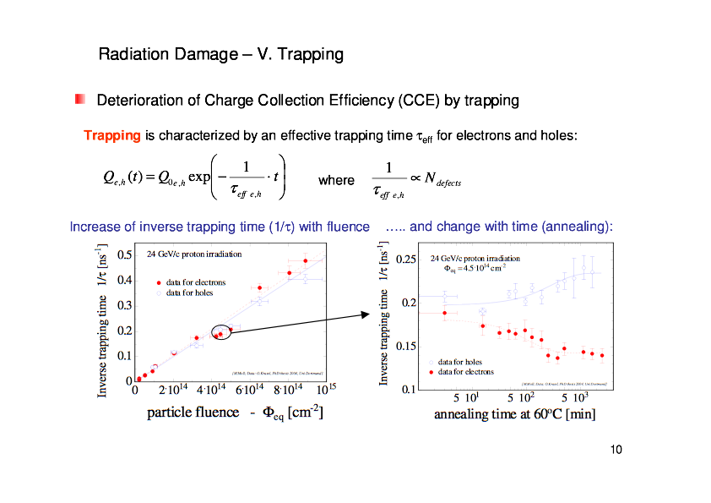
M. Bruzzi

