Slide 1
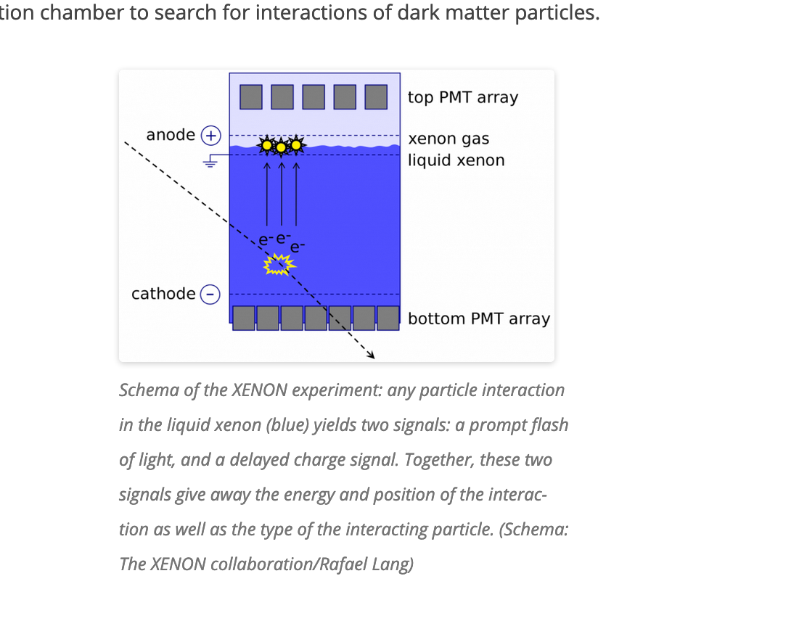
Searching for weakly interacting massive particles (WIMPs) as dark matter candidates.
XENON1T experiment uses a ton
of liquid xenon with gaseous xenon
on top.
Looks for prompt flash of light and
then a delayed signal from the
electrons
Located in the Gran Sasso mine,
underneath Mont Blanc between
France and Italy.
Currently off, supposed to restart
within a year with roughly 10 times
the size. Not sure about delays…

Slide 2
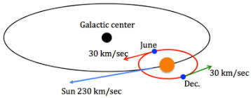
Signal has more energy release in June (early) than in December. Modulation would help
clinch the case for dark matter.
No accepted positive signals for WIMPs yet.

Slide 3
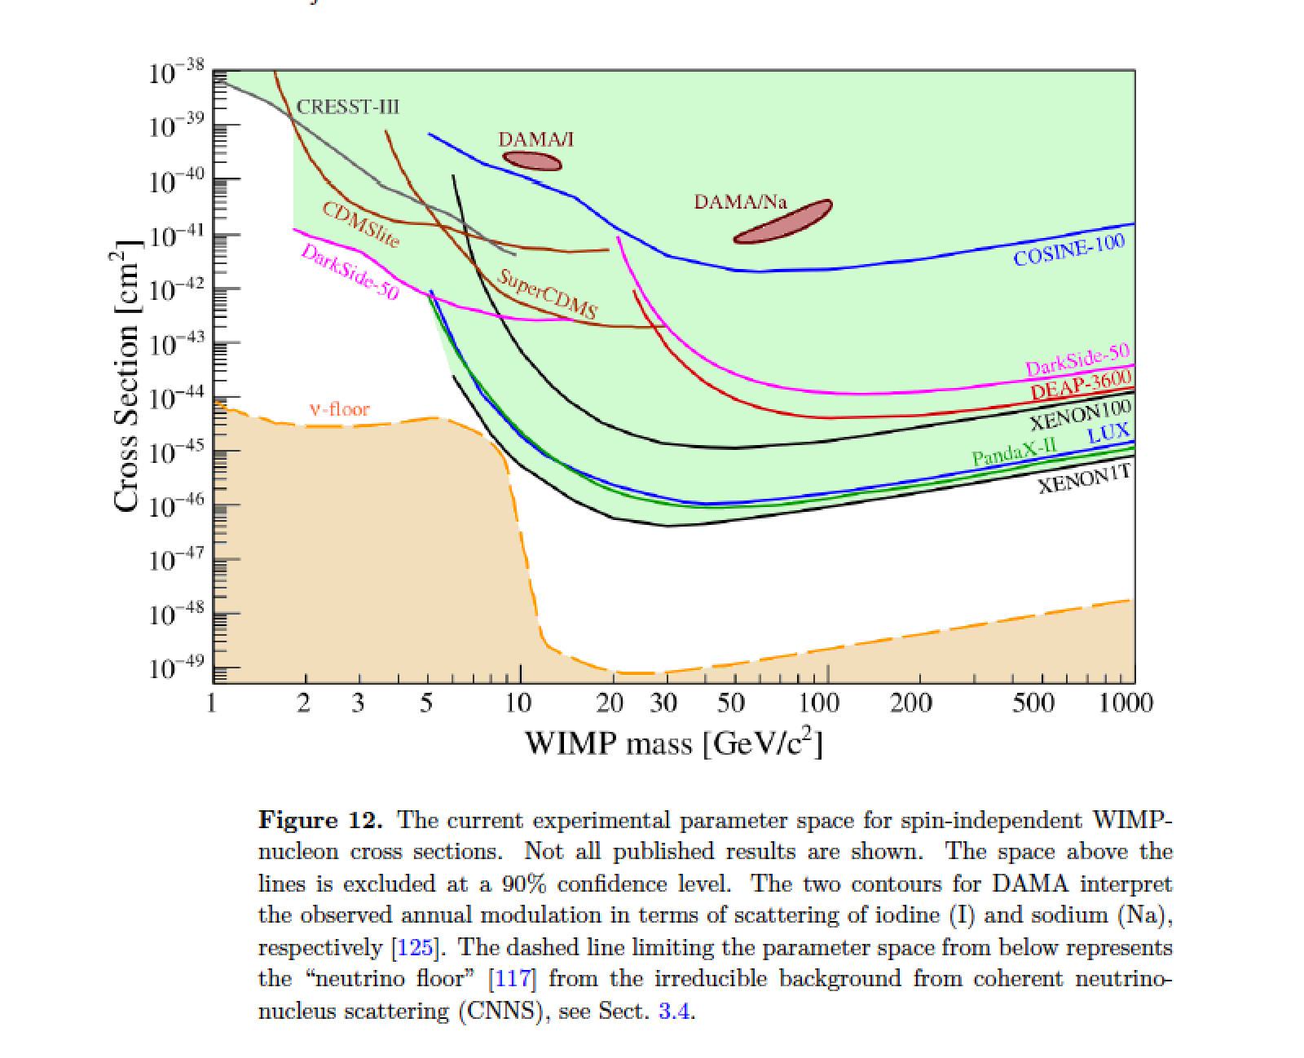

Slide 4
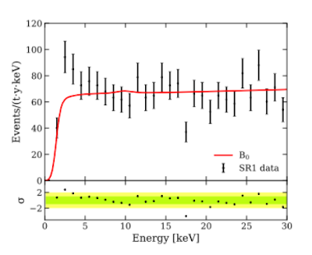
So, with no luck finding WIMPs, XENON1T decided to look for much lighter particles interacting with the
electrons in the xenon. Without the high energy photon emission, backgrounds are harder to eliminate.
Results were:
Possible peak – 3.5 standard deviations, at 2-3 keV.
These energies are almost the same as the average
temperature in the solar interior.
Could something be coming from the Sun? (They don’t
have directional information yet). Well, the Sun does
emit light particles – neutrinos. It also might emit
particles called axions.

Slide 5
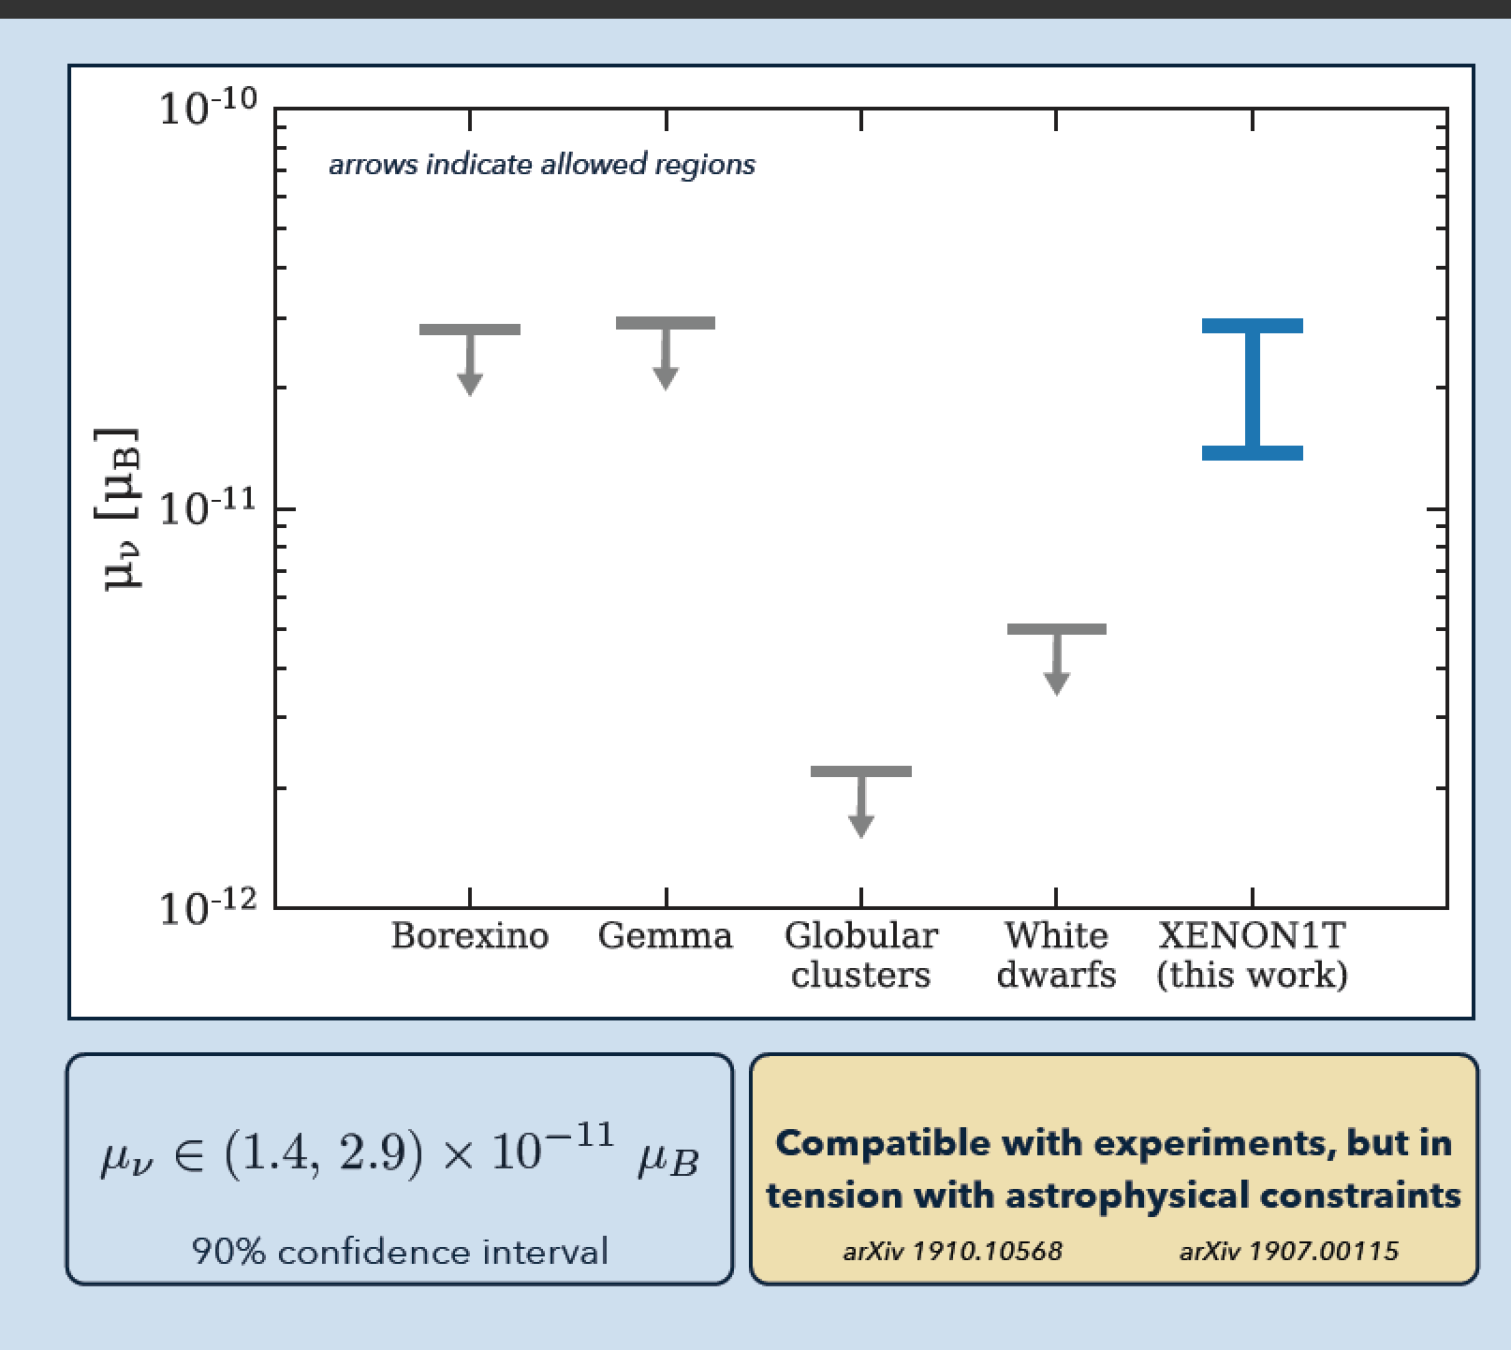
Could it be neutrinos? The Sun emits 10³⁸ per second. Alas, they interact too weakly with electrons.
However, if a neutrino had a magnetic moment (not in the Standard Model), then it would interact
electromagnetically (bounds are severe for electron neutrinos, but not muon or tau neutrinos).
Some tension with Borexino (a neutrino detector that
has studied solar neutrinos) and Gemma (which is
near a nuclear reactor and has looked explicitly for a
neutrino magnetic moment).
But there is no model that predicts a magnetic moment
in this range, and it only improves the fit a little bit.

Slide 6
Axions:
The QCD Lagrangian can contain a term proportional to
where
For those who haven’t seen this, the usual Lagrangian has terms proportional to E² and B², but this extra term
is proportional to E dot B. This is CP violating (C – matter-antimatter, P – mirror symmetry). This will lead to
a nonzero electric dipole moment for the neutron which is MUCH bigger than observed. The Lattice group at
W&M has shown that one much have θ < 10⁻⁹. The strong CP problem is “why is the value of this parameter, that
one expects to be O(1) so small”.
Peccei and Quinn showed that a simple global symmetry applied to an extension of the Standard Model changes
into a dynamical variable – it has a potential with a minimum at zero.
However, it was shortly thereafter shown that the solution automatically has a new spin-zero particle, very light,
called the axion. It interacts with two photons, and also with two electrons, but the interactions are very weak.

Slide 7
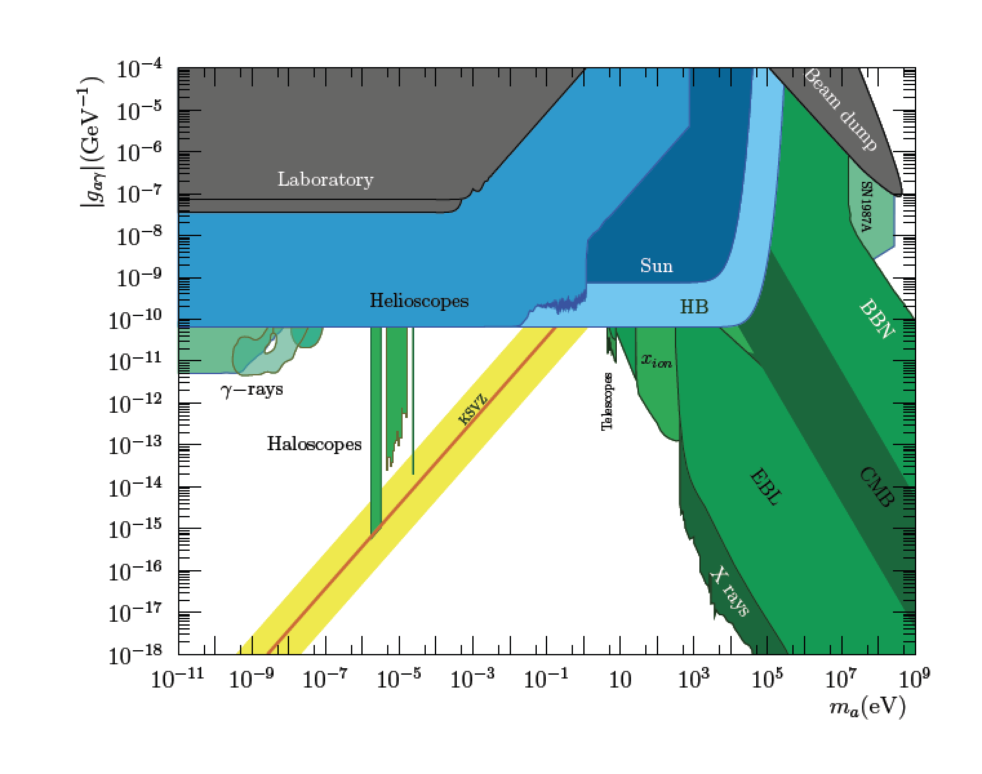
The yellow bound covers
all of the various axion models,
with the “preferred” model
being the red line
This interaction is measured
by looking for an axion to convert
to a photon in a very high B-field
If axions are the dark matter, its mass will be 10⁻⁶ – 10⁻⁵ eV
If it is heavier than 0.1 eV, it would have been emitted by the Sun and would have been
detected.

Slide 8
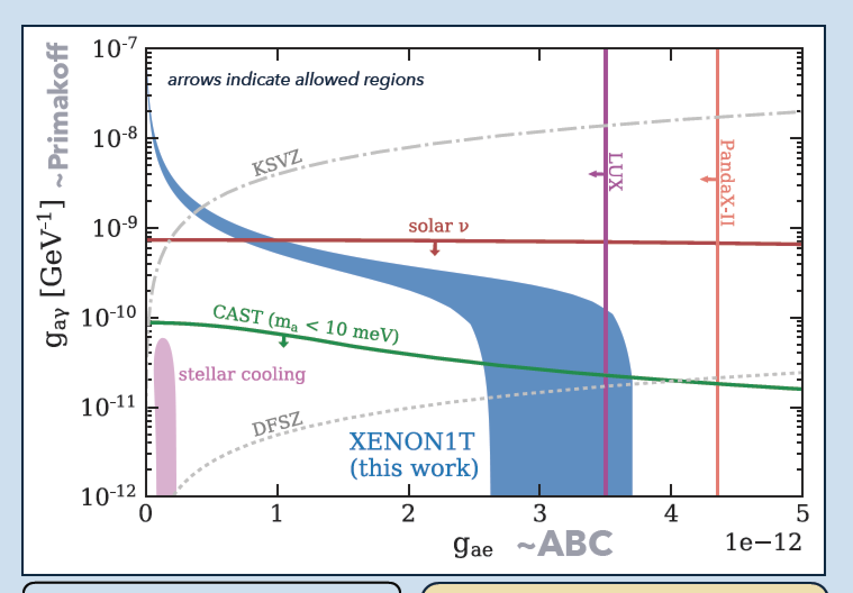
This isn’t relevant for Xenon1T, which only looks at the axion – electron interaction
They require an axion-electron coupling constant of 2.7 – 3.7 x 10⁻¹² . This would explain the data.

Slide 9
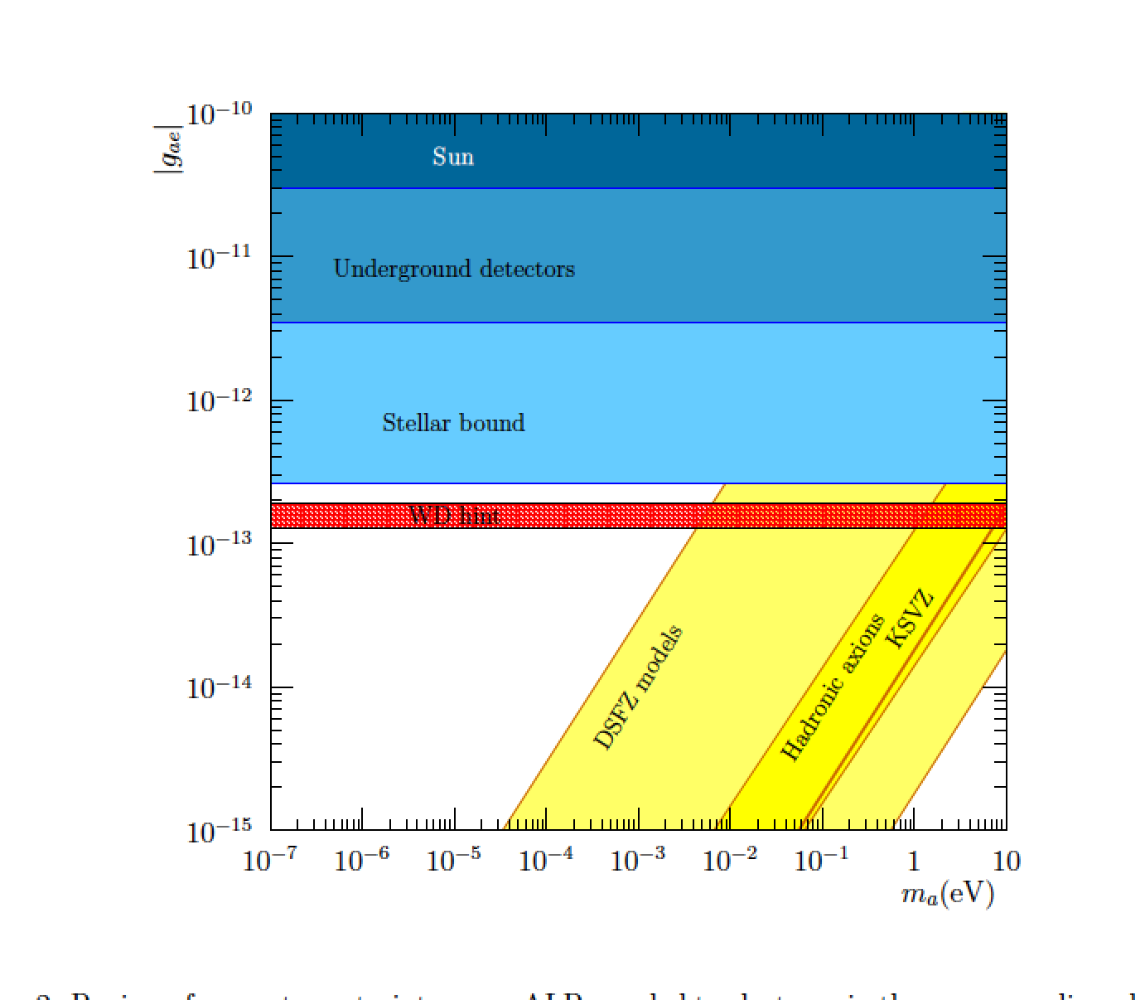

Slide 10
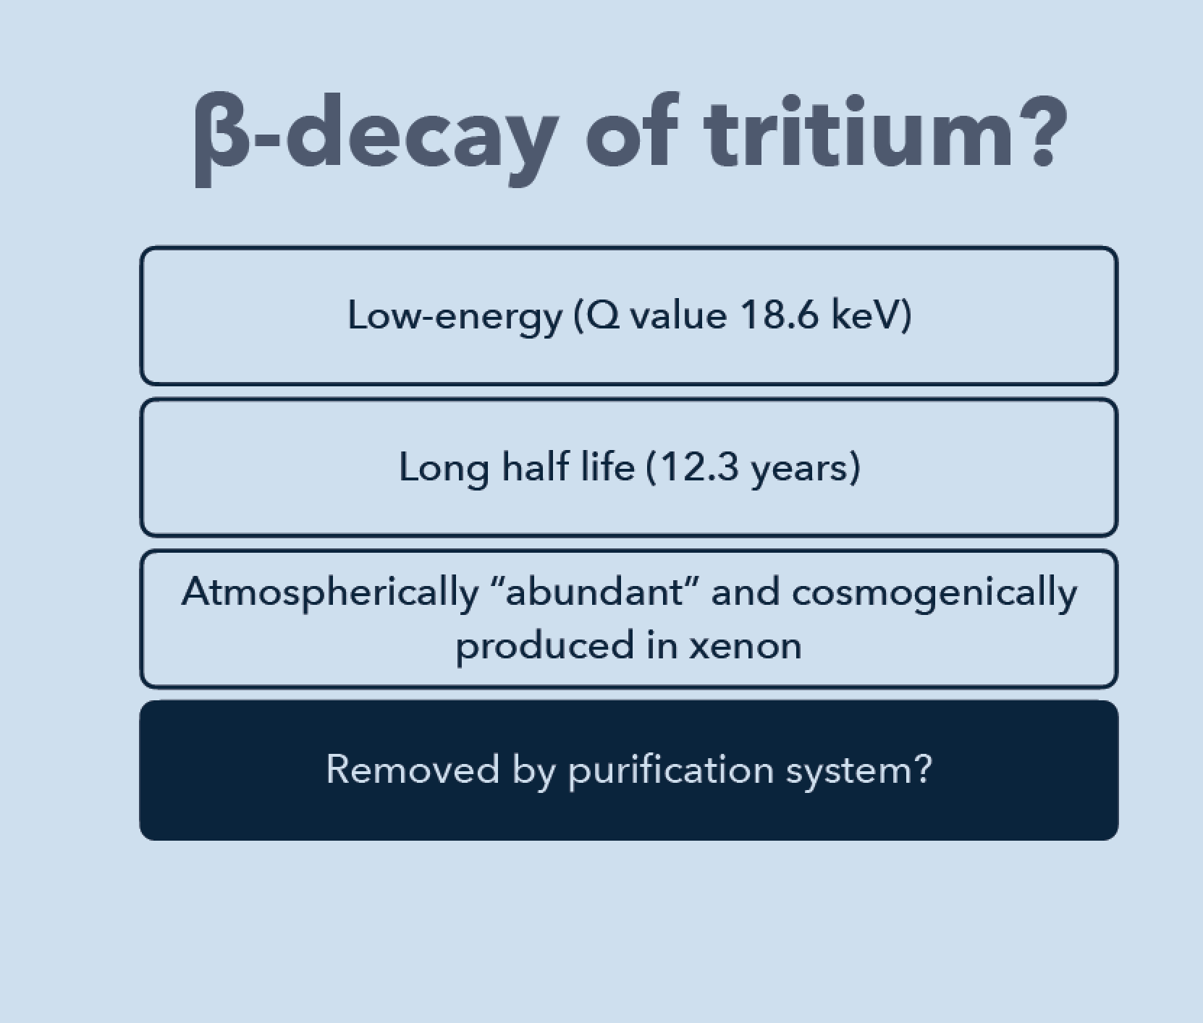

Slide 11
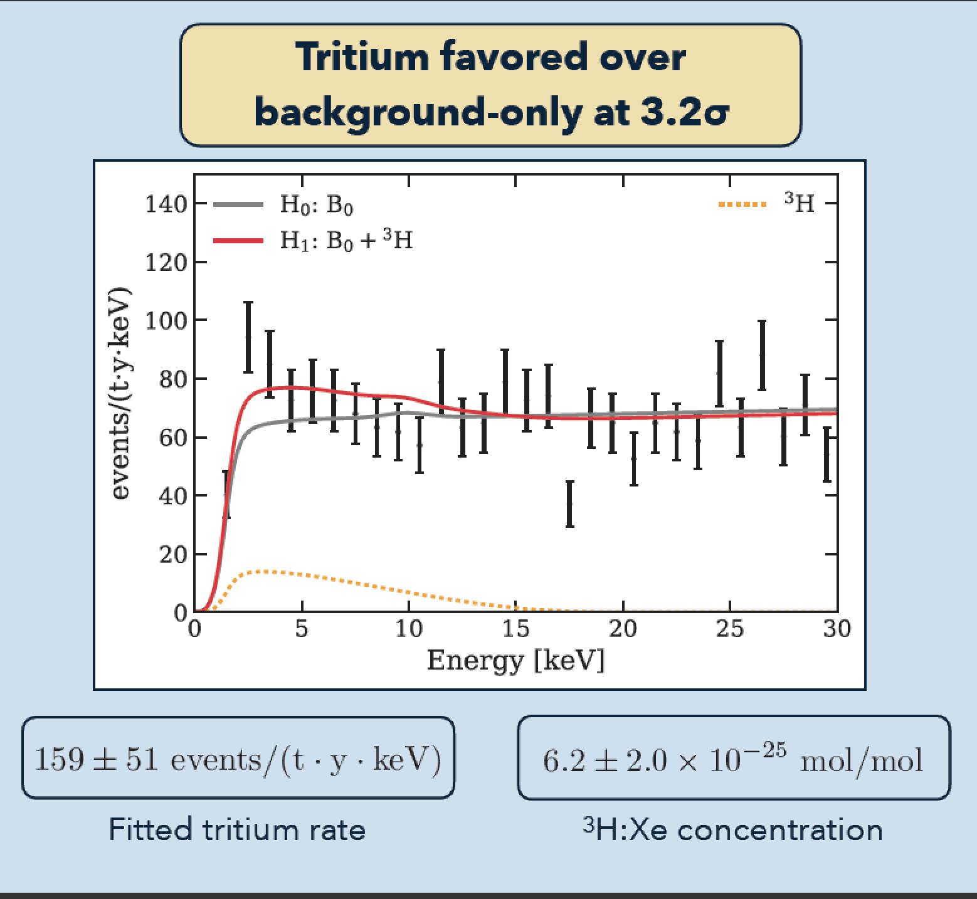

Slide 12
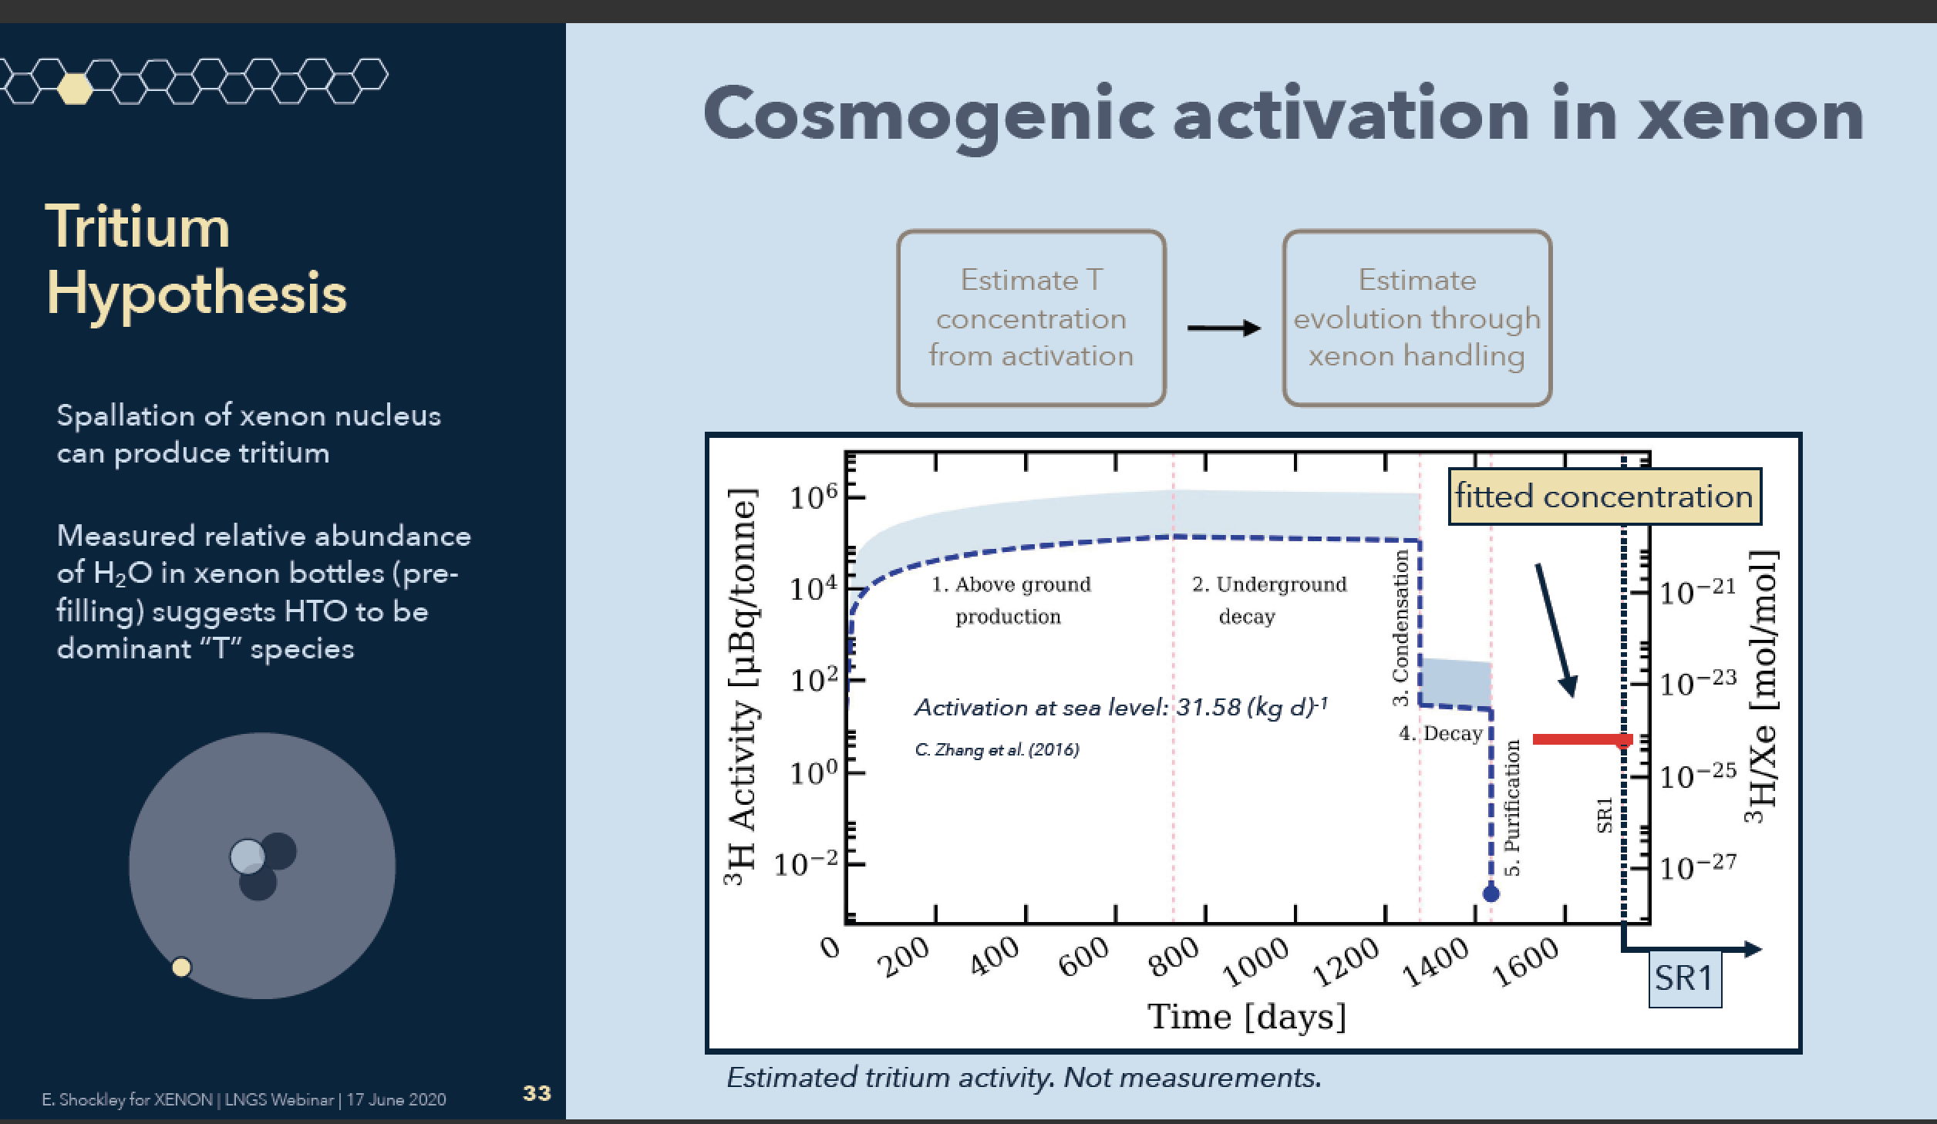

Slide 13
Best estimates are a concentration of tritium of roughly an atom per 30 kg. But there are big uncertainties.
So those are the most likely options (IMO in increasing order of likelihood):
neutrino magnetic moment
Axions from the Sun
Tritium contamination
Roughly 10 papers submitted per day giving other explanations, ranging from Dark Photons to light dark matter from
a new meson decay, other neutrino interactions with another mediator, and various esoteric models of dark matter.
In its next run, with roughly 5 times the exposure, they should be able to see if there is an annual modulation….but even
that won’t be definitive (unless the signal goes away).

